Slide 1
PPD Status
Jonathan Lewis
AEM
23 April 2018

Slide 2
CMS
First collisions with stable beams recorded last week

Slide 3
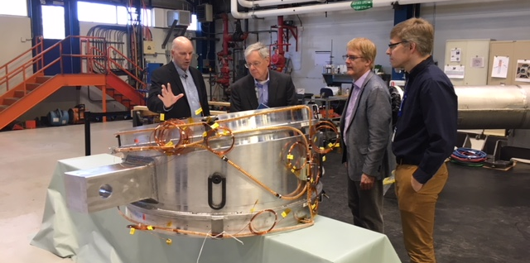
Mu2e
Solenoids
TS first article warm tests (field studies and cooling pipe pressure tests) were completed last week. The unit was moved across to HAB just in time for the visit from Steve Binkley.

Slide 4
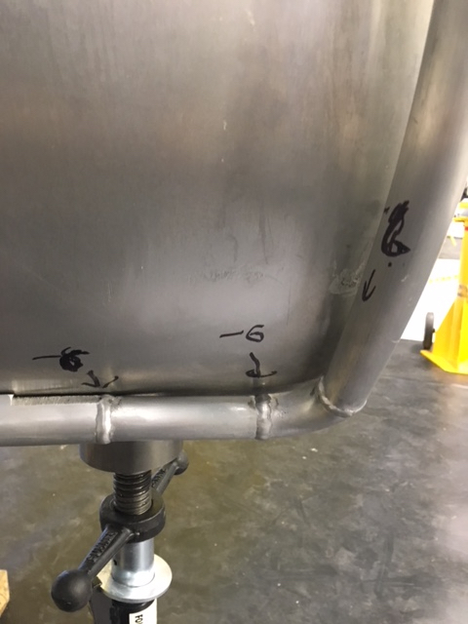
Mu2e
Solenoids, cont.
TS Thermal shield leaks in several areas along the cooling pipes, most often near the welds between pipe pieces
Discovered during the pressure tests conducted at Fermilab, even though this was apparently tested at the company prior to shipping.
The company has asked us to ship the shield back for repairs.

Slide 5
Mu2e
CRV
25,800 m total extruded – about 98% of detector scintillator needed to meet T1 milestone on May 31, 2018.
Upcoming reviews
The DOE mini-IPR will be held on June 12th. The subsystems being reviewed are the Solenoids and the Tracker.
Accelerator - A mini-review will be held on April 24th for the Commissioning Target.
CRV - a CRR for the CRV modules, electronics and installation will be held on May 21st.

Slide 6
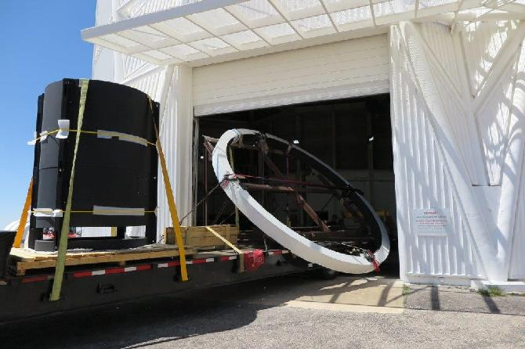
Astro
DESI
Top “ring” and new prime focus cagefor DESI arrived at Mayall Telescope

Slide 7
Test Beam
Mtest
ATLAS Pixels (T1224) continues to take beam. They are doing extremely well.
T992 (Dave Christian’s version) is also taking data parasitically, and opportunistically working on the telescope
T1044 will return this week (Wednesday) and take data in the overnight hours. They will minimize disruption to T1224.
Mcenter
Installing vacuum pipe for Nova Test beam.
Layout secondary and tertiary beam lines for component placement.

Slide 8
Electrical Engineering
Jim Hoff had his patent released US 9,928,202 B2 “Time Division Multiplexing Data Bus”
Terri Shaw spent last week at CERN reviewing the state of ProtoDUNE-SP and meeting with subsystem experts on current state of implementation and reviewed grounding/shielding connections.

Slide 9
Custom Detector Technologies
Optical fibers
CMS – prepared for quartz fiber polishing work requested.
Thin films:
ProtoDune – R&D – ARAPUCA coatings
Coating thickness QC equipment – Vendor demonstration (Keyence) of 3D laser scanning confocal microscope (VK-X260K) at Fermilab and testing of dopant coatings on filters.

