Slide 1
Dual Phase Electronics Consortium Meeting Introduction
Dario Autiero (IPNL Lyon) and Takuya Hasegawa (KEK)
April 19, 2018

Slide 3
Last Consortium Meeting at the time of the LBNC meeting on 22/2:
https://indico.fnal.gov/event/16512/
Last TB meetings:
https://indico.fnal.gov/event/16522/ 22/2
https://indico.fnal.gov/event/16686/ 15/3
https://indico.fnal.gov/event/16846/ 5/4
New TB foreseen today:
https://indico.fnal.gov/event/16925/ 19/4
Main activities:
Focusing on completing TP editing, exchanges with referees → see presentation
First draft scheme of construction schedule, work in integration issues → see presentation
Costing delivery was postponed by TB
Appointed Technical Coordination engineering team (working on integration):
• Jack Fowler LBNF/DUNE Systems Engineer
• Farshid Feyzi Lead DUNE Mechanical Integration Engineer
• Terri Shaw Lead DUNE Electrical Integration Engineer
Reporting on consortia international schedule 2018-2019 (see attached document) in our case it is mainly the TP and ProtoDUNE-DP

Slide 4
DP Electronic consortium LBNC presentation (well received by Committee):
All documents requested by the LBNC were completed, all documents accessible from Project Offfice page:
https://web.fnal.gov/collaboration/DUNE/DUNE%20Project/SitePages/DUNE%20Project%20Office.aspx
DAQ interface document: DocDB 6778
CRP interface document: DocDB 6751
PD interface document: DocDB 6772
Slow control interface document: DocDB 6784
Detector and Facilities (LBNF) interface document: DocDB 6982
Underground Installation Team interface document: DocDB 7009
Integration Facility interface document + questionnaire: DocDB 7036
Calibration Task Force interface document: DocDB 7063
Physics interface document: DocDB 7090
Software interface document: DocDB 7117
Risks document (following discussion at last TB meeting): DocDB 7171
Requirements document: DocDB 6428
Strategy document: DocDB 7207
Milestones: DocDB 6407

Slide 5
LBNC report made available on 6/4, next LBNC in May is off-time wrt TP schedule
https://indico.fnal.gov/event/16358/material/1/0.pdf

Slide 6
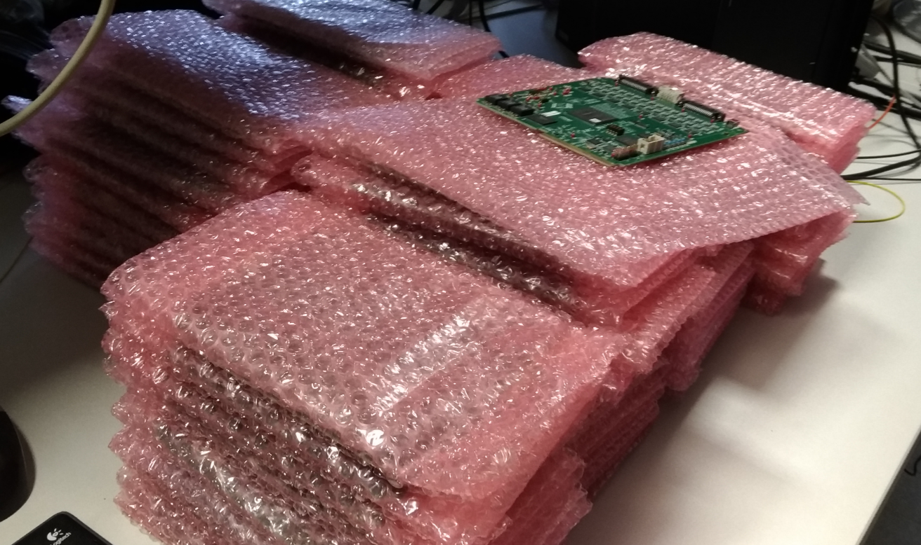
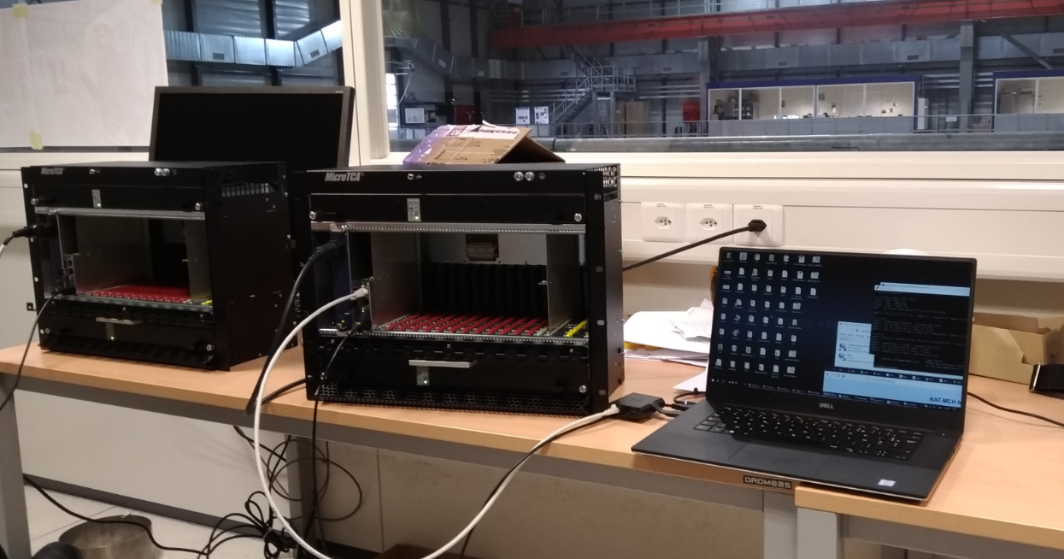
Developing QA/QC and logistics aspects from the treatment of the production for PD-DP
Productions management
Transportation logistics and packaging
Time to set up/install crates/cards etc …
QA/QC tests
Hardware data-base and components traceability
(hear more in the next meetings)
New group interested in chimneys, organized discussions with Franco and them
Installation/Integration workshop foreseen before the May Collaboration meeting
https://indico.fnal.gov/event/16892/

Slide 7
What next ?
Completion of TP (DP Electronics well advanced) with also global consistency with other parts (Introduction, DAQ, Slow Control ..). Some discussions involving Dario and Takuya with the Slow Control Consortium leaders …
Progress on schedule and integration aspects
PD-DP installation and commissioning progress

