Slide 1
Post-Moore introduction
Jim Kowalkowski
µRetreat
19 April 2018

Slide 2
Post-Moore (After Moore’s Law falls apart)
When is this (or are we in it)?
  Doomsday has been predicted for a long time
    2017 was one of the predictions.
  Most realistic: Hits in 2020, but start seeing real affects around 2022-2023
    Based on 4-5nm technology/fabrication limits
    Will manufacturers even want to go to this level?
How do we know about this?
  Workshops like https://sites.google.com/view/pmes17/program
  DOE Office of Science documents like this https://science.energy.gov/~/media/ascr/ascac/pdf/meetings/201612/ASCAC_BMoore_Susut.pdf
If you forgot Moore’s Law: “Moore's law is the observation that the number of transistors in a dense integrated circuit doubles about every two years… Moore's law is an observation and projection of an historical trend and not a physical or natural law.” - Wikipedia

Slide 3
Post-Moore (2)
What does it mean? (not mutually exclusive categories)
  Energy efficient computing
  Exotic technology
  Extreme heterogeneous computing
  Processing in close proximity to peripheral systems
  FPGAs everywhere
Already see evidence of this depending on definition you like best
Well-known contenders in the exotic technology realm
  Quantum computers (the latest craze, includes D-Wave)
  Neuromorphic Computing (C. Shuman gave a few talks here on the subject)
  Micron’s automata processors (Practically dead)
  Shared property: Very much unconventional programming here

Slide 4
What is driving changes in computing architecture?
DOE’s ASCR program looks to be driving a good amount of future technology
This recent slide provides a good summary of computing drivers
Helland - ASCAC Presentation 9/26/2017

Slide 5

Post-Moore directions
Not that
post-Moore …
Nowell – SSDBM, June 29, 2017

Slide 6
Memory – is it really changing?
New Devices and Architectures for Energy Efficient Computing
Thomas N. Theis

Slide 7
Other things to watch
Architectures for the Post-Moore Era
  https://ieeexplore.ieee.org/xpl/tocresult.jsp?isnumber=8013454
  Near-memory acceleration
  Processing-in-storage (Resistive CAM – Content Addressable Storage)
  Intelligent memory

Slide 8
Software R&D Context
Now
Exascale era begins
HL-LHC / DUNE era begins
Timeline
2021-2022
2025-2026
Goals here
Vision here
What now?
Software R&D
Specific technologies
Addressing change
Concepts that survive
Meeting needs
Post-Moore: after 2022 and definitely after 2026

Slide 9






SciDAC-4: HEP Data Analytics on HPC
Enable HPC facilities to meet the future HEP data analysis demands, allowing computationally expensive physics studies to be completed on time scales that are not currently feasible.
Scientists from HEP and ASCR
  LHC and Neutrino Science: Norman Buchanan (CSU, NOvA/DUNE), Paolo Calafiura (LBNL, LHC-ATLAS), Zachary Marshall (LBNL, LHC-ATLAS), Stephen Mrenna (FNAL, LHC-CMS), Andrew Norman (FNAL, NOvA/DUNE), Alex Sousa (UC, NOvA/DUNE)
  Optimization: Sven Leyffer (ANL), Juliane Mueller (LBNL)
  Storage and Data Modeling: Rob Ross (ANL), Marc Paterno (FNAL), Saba Sehrish (FNAL)
  Workflow: Marc Paterno (FNAL), Saba Sehrish (FNAL), Thomas Peterka (ANL)
DOE SciDAC program manager support
  Lali Chatterjee (Computational HEP, Office of High Energy Physics)
  Randall Laviolette (SciDAC Application Partnerships, ASCR)
Official web site is http://computing.fnal.gov/hep-on-hpc/

Slide 10
Neutrino physics
Linking neutrino oscillation measurements back to the underlying neutrino oscillation and nuclear interaction (cross section) parameters
Requires multi-dimensional parameter spaces and fitting the observed data to the underlying physics models
Advancements using HPC leadership facilities
  Analysis using full dataset across all layers, managed using tools and techniques developed by ASCR’s RAPIDS institute
  Expand fitting into 4D, 5D, including anti-neutrino data, utilizing multi-dimensional fitting procedures from ASCR’s FastMATH institute
  Include all layers in the analysis
Notes:
Need plot from proposal here

Slide 11
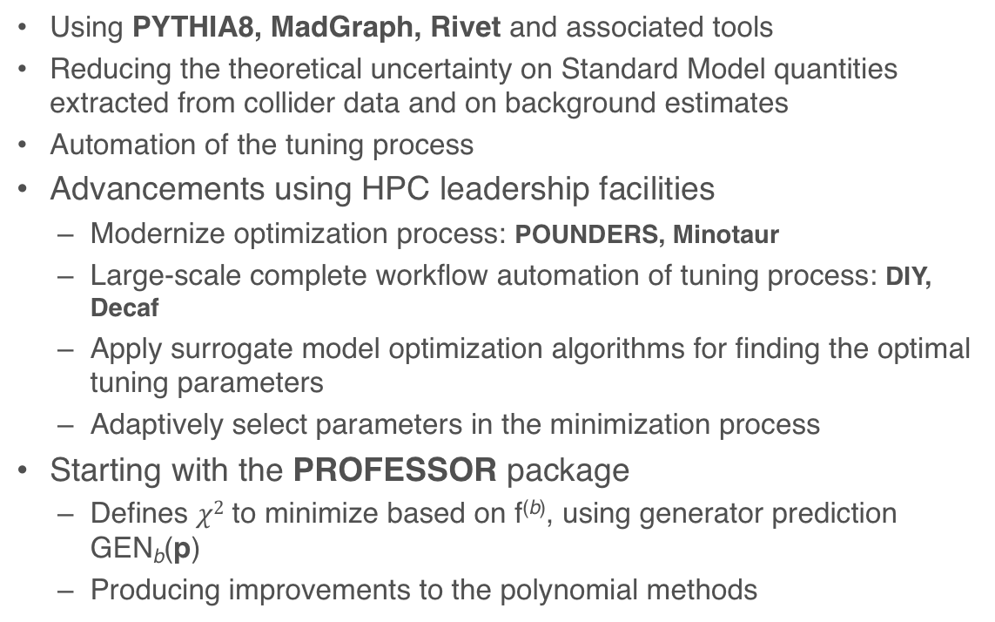
Generator tuning
Using PYTHIA8, MadGraph, Rivet and associated tools
Reducing the theoretical uncertainty on Standard Model quantities extracted from collider data and on background estimates
Automation of the tuning process
Advancements using HPC leadership facilities
  Modernize optimization process: POUNDERS, Minotaur
  Large-scale complete workflow automation of tuning process: DIY, Decaf
  Apply surrogate model optimization algorithms for finding the optimal tuning parameters
  Adaptively select parameters in the minimization process
Starting with the PROFESSOR package
  Defines $χ2$ to minimize based on f^{(b)}, using generator prediction GEN_{b}(p)
  Producing improvements to the polynomial methods
Notes:
Need plot from proposal here

Slide 12
Crude timeline
CMS/ATLAS
Generator Tuning
Current generation analysis – new tools
Next generation techniques with automation
NOvA/DUNE
Oscillation/Cross-section
analysis
Use existing code and tools
Oscillation analysis Next Generation
Cross-section analysis
Focus on whole-dataset analysis, utilizing whole machine
  Introduce optimization and workflow tools from HPC community
  Incorporate simulation, reconstruction, and selection layers into analysis procedures
Generator analysis and tuning will lead in development and utilization of new tools and techniques
Experiment analysis will start with existing codes and application to establish baselines, next generation systems will adapt and utilize techniques from generator groups

