Slide 1
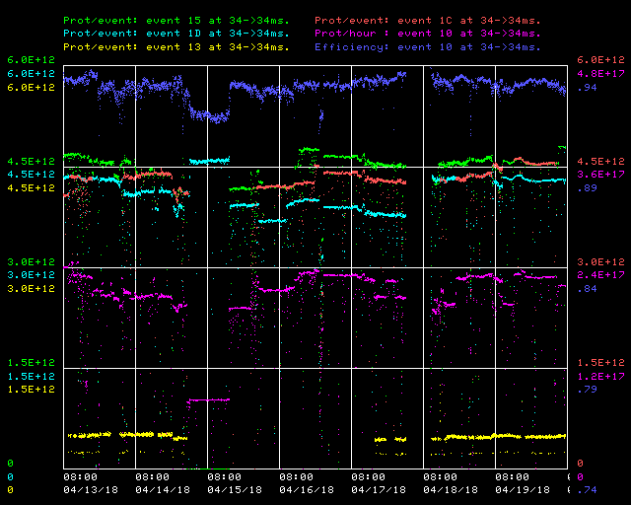
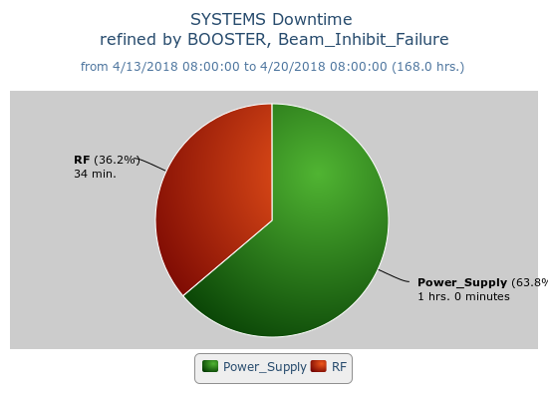
Booster Operations 04/13/18 – 04/20/18
F
Sa
Su
M
Tu
W
Th
F
Capture/Transition Issues
Access to replace BRF16 Cavity
BRF8 Cable Fault
Downtime:
1 hour 34 minutes for the week
1hour for GMPS ground fault meter trips/replacement
34 minutes of various minor RF trips (some due to roof water leak onto BRF17)
DOGL3 Flow Switch
MKS06 Cable Termi
Collimator Studies
Access, BRF21 installed
Currently:
Beam to NuMI $15 ~4.8E12 92-93%
Beam to BnB $1D ~4.3E12 93-94%, ~7.44E16 P/hr
Over night, Beam to Muon $1C ~4.5E12 93-94%
Beam to SY $13 ~5.0E11
Lots of tuning through the week, worked to keep efficiency up
Request opportunity for an hour or so this morning for Laser Notcher diagnostics and adjustments. Will require reducing intensity a bit for the duration of this effort
Thanks to Ops for their efforts and diligence in tuning!

