Slide 1
Switchyard Weekly Summary
Adam Watts
AD Friday 0900 Meeting
20 April 2018

Slide 2
Summary
Instrumentation
Making progress on improving reliability of resonant BPMs (Thanks Troy, John, Elliot). Working toward auto-tune in Switchyard.
Testing ion chamber with Helium gas and new digitizer to increase upper dynamic range (Thanks Dan, Rick, Gianni)
Some more studies needed, but making good progress
HP3DS (see next slide for pictures)
Sunday 4/15 afternoon, HP3DS flash-over in 13.8 kV bus cabinet connecting switchgear to primary side of transformer.
Transformer not damaged, but bus cabinet and some switchgear bus had to be replaced.
EE support got us back up before end-of-shift on Tuesday (Thanks Chris, Bob, Terry, Dave, et. al.)
<number>
4/20/18
Adam Watts | Friday 0900 Report

Slide 3
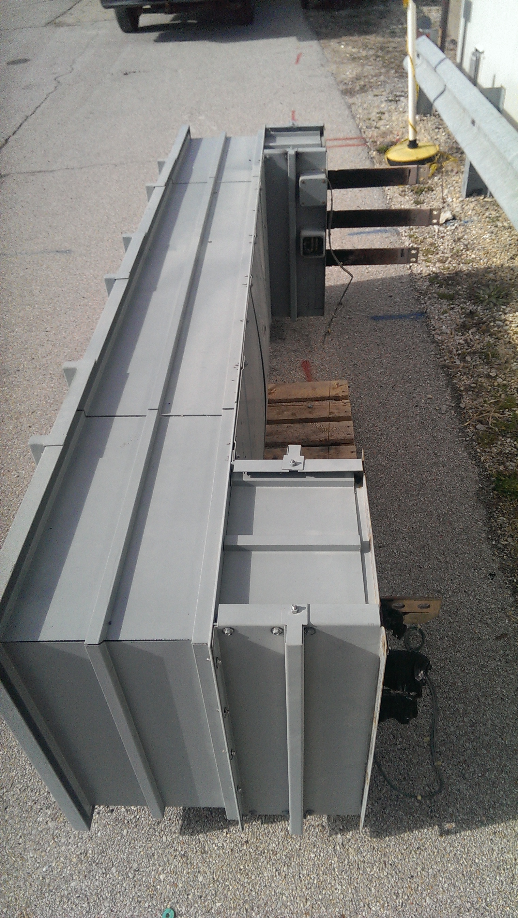
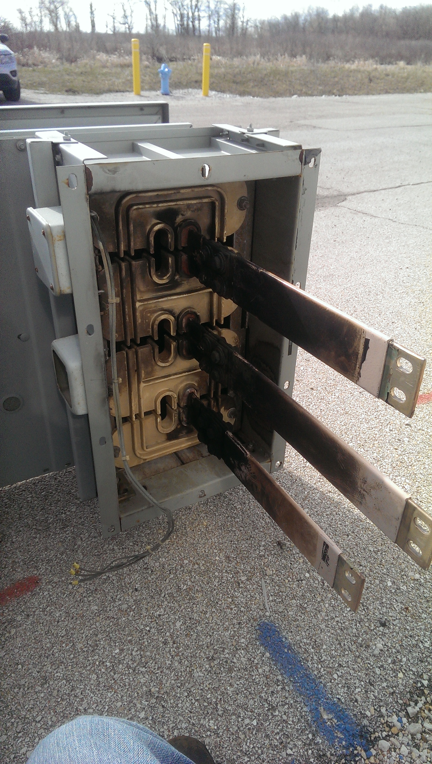
<number>
4/20/18
Adam Watts | Friday 0900 Report

Slide 4
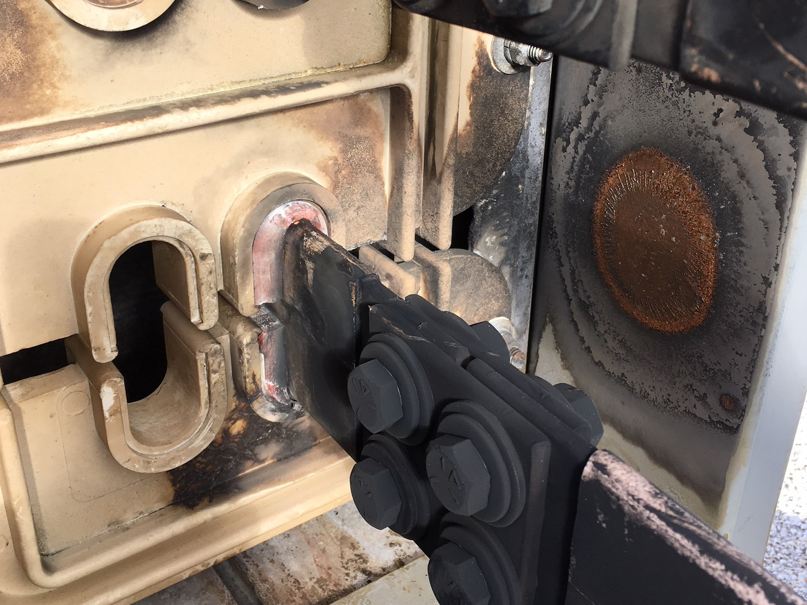
<number>
4/20/18
Adam Watts | Friday 0900 Report

Slide 5
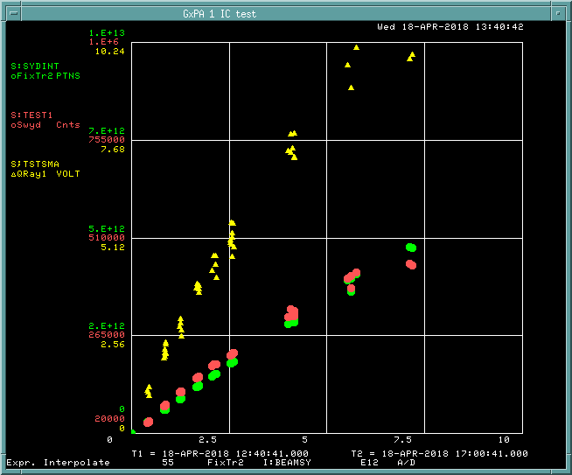
Studies requests
SY dump ion chamber high intensity
Extended study (~6 hours) to tune-up Main Injector and SY beamline to send high-intensity (~1E13) beam to the SY absorber. Will help us finish characterizing ion chamber and new digitizer at maximum intensity.
Will coordinate with FTBF experimental schedule and MI group to find a good time for this.
<number>
4/20/18
Adam Watts | Friday 0900 Report

