Slide 1
Muon Campus Status
Brian Drendel
Weekly Status
April 20, 2018

Slide 2
Beam to g-2 this week
Up from 15 o 17 turns to get to design POT.
G-2 kicker, inflector, trim work => big gains, but lots of quad trips
Accelerator tuned up bunch length and beam to experiment.
A0 compressors offline twice => g-2 magnet off.
DR momentum collimation studies
D:Q404 SCR circuit fixed
TLM trip during M1 optics work Thursday PM

Slide 3
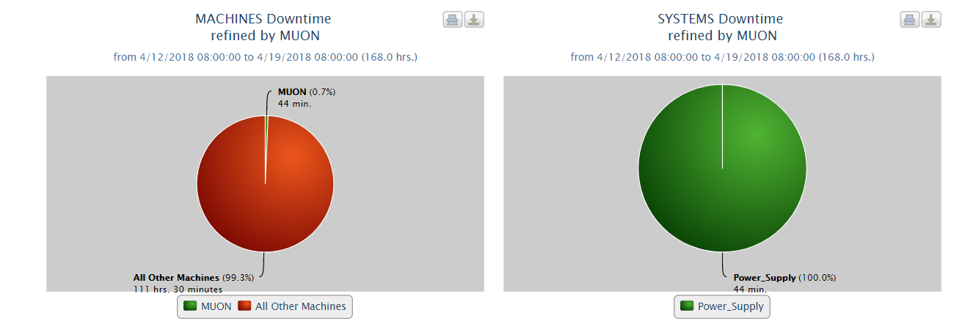
Downtime
No Data Found
A0 compressor trip
MI bus ground fault
S:HP3DS transient -> A0 compressors trip #2
LRF3

Slide 4
Work Requests
  G-2 has a planned magnet off day Wednesday, April 25th.
  We will likely access Delivery Ring driven by D30 vacuum issues.
  List possible work:
    Chipmunk Swap: MC1 Hall above quad - needs scissors lift (White).
    D30 vacuum work (Vrbos)
    Check PWC014 signal connectors - Extraction enclosure (Drendel)
    Mid-transport beamline inspection (Muon Dept.) - only if upstream accelerators are down.

Slide 5
Upcoming Studies
  Tune-up (Morgan) – Up to four hours of optimizing beam to the experiment. This evening.
  Ap0 chipmunk measurements (Drendel): Transparent to operatiosn
    Data is being be collected with a set of temporary chipmunks in various configurations. At this time, this work is completely transparent to operations.
  Delivery Ring Tune Measurement work (Scarpine). Requires 8 GeV operations.
  Dispersion in RR-Target (Nagaslaev, Adamson). Destructive study. 2-4 hours
    Primary 8GeV transport beam line RR-Target. We need to establish a procedure for the dispersion measurement in this line. We will have to do transfers in a slow manner, kind of 20 sec between transfers and run the waterfall display in the RR for each transfer. We will also modify the RF frequency in RR so that the beam will be slightly off momentum. This change doesn't necessarily impact the yield on the target, but may result in increased beam losses, while tuning. This study is opportunistic. Time estimate is 2-4 hours. Will impact the beam delivery to g-2, so needs to be aligned with their planning.

