Slide 1
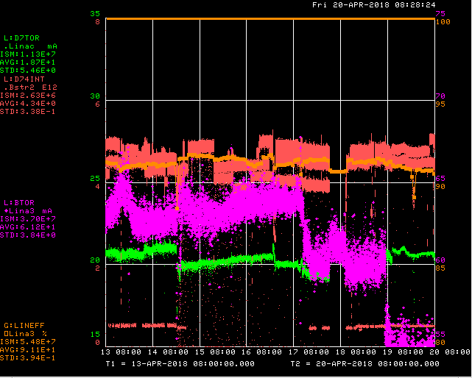
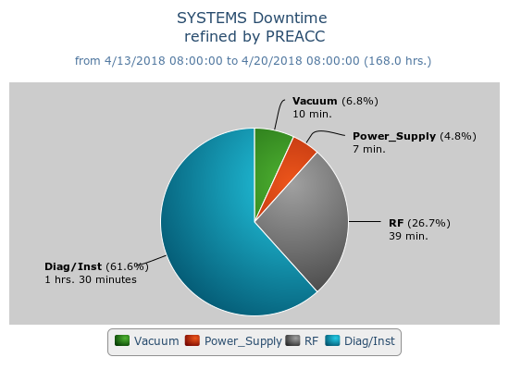
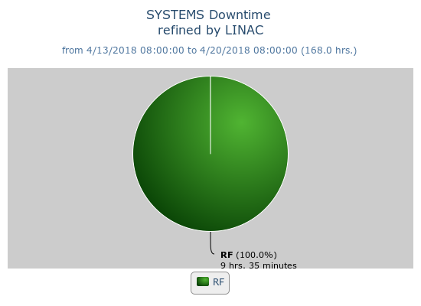
Preacc/Linac Weekly Performance
Weekend – Source vacuum issues due to sparking
Monday – Laser notcher amplifier to zero;
ACNET issues
Wed – LRF3 driver failure

Slide 2
Current Conditions
Source B – 55 mA
Linac input – 22 mA
Linac output – 20 mA, ~4.4E12 p/pulse
Request ~1 hr. for laser notcher studies.

