Slide 1
Machine status
Ming-Jen Yang
Friday 9:00am Meeting,
April 20, 2018

Slide 2
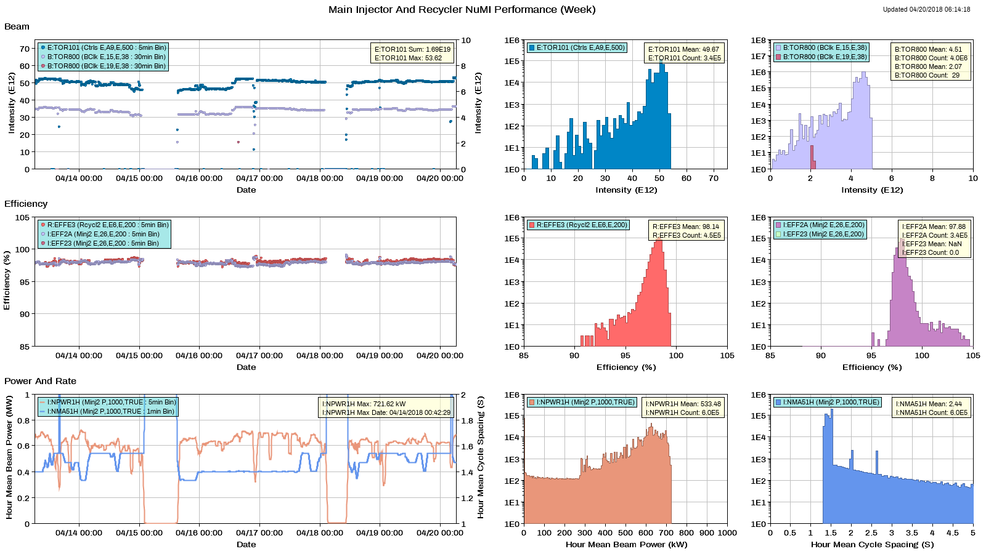
NuMI

Slide 3
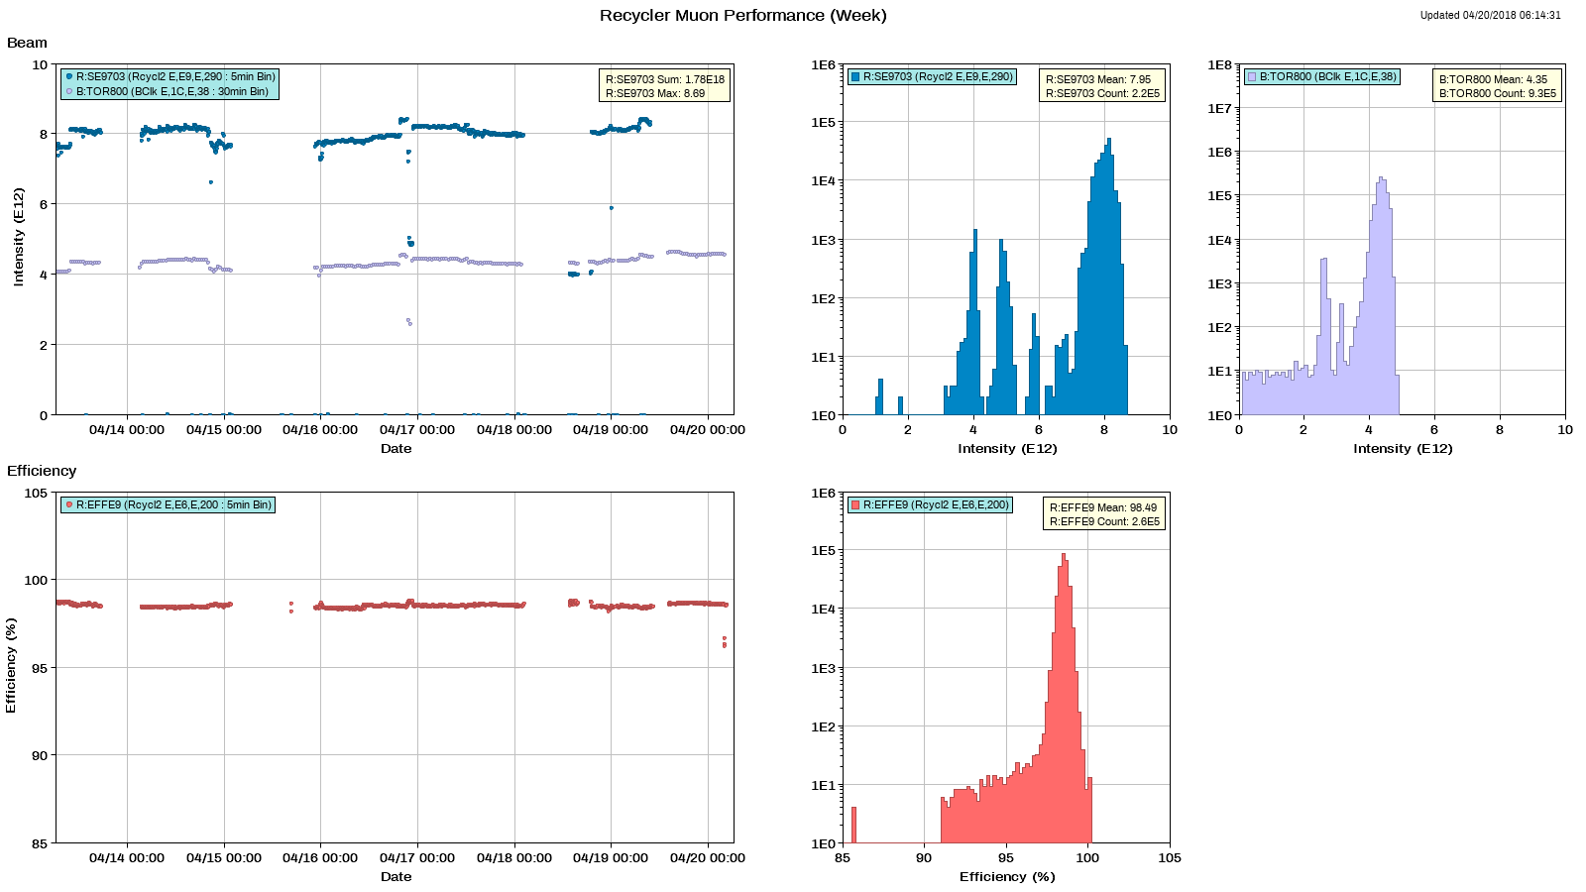
Muon

Slide 4
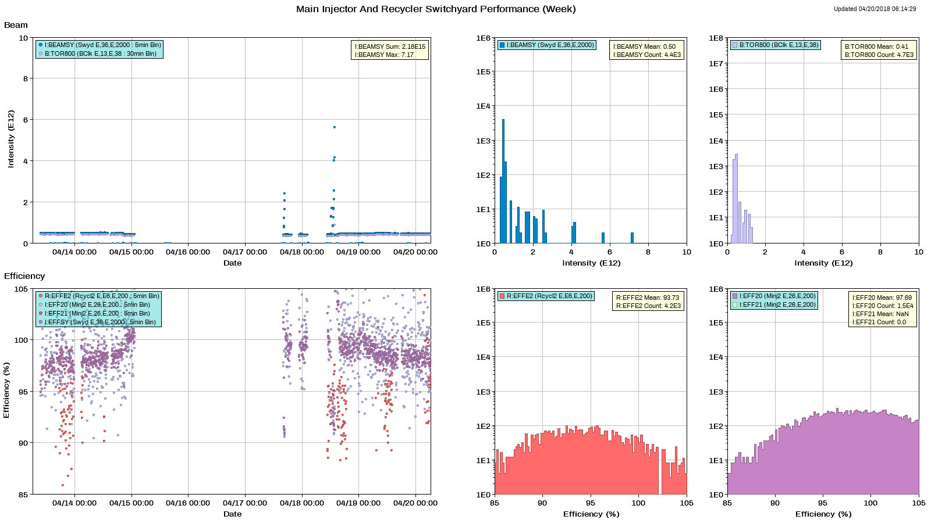
SY

Slide 5
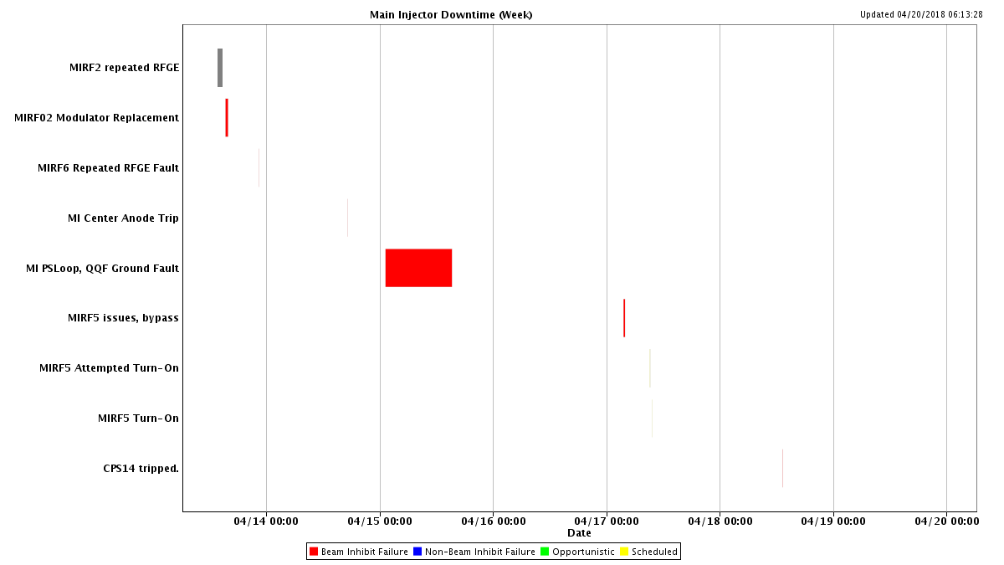
MI downtime

Slide 6
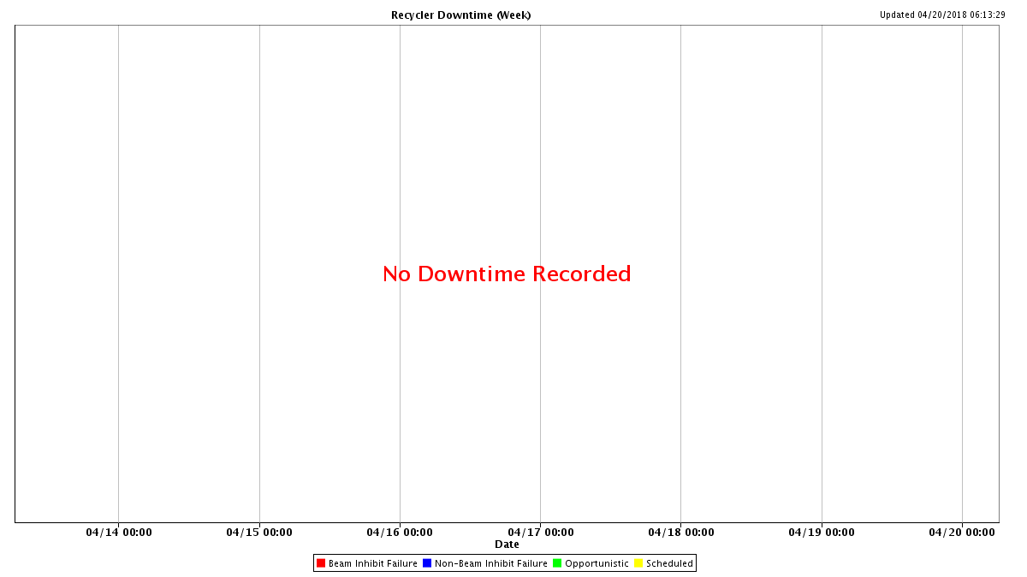
RR Downtime

Slide 7
Issues
MIQF ground fault at MI60, Sunday 04/15/18
Water seepage in MI60 north bus penetration was suspected.
The soft ground fault improved after 12 hours.
Looking for opportunistic downtime
8 hours access to MI tunnel.
Investigate bus penetration at MI60 north.
Repair ion pump cable at MI30.

Slide 8
Study requests
1.2 second fast ramp.
MI8 line autotune
Parasitic.
MI TBT lattice measurement
RR TBT lattice measurement

