Slide 1
Slip-stacking simulations
Rob Ainsworth
16th April 2018

Slide 2
Outline
Synergia
Simulations
  inputs
  Space charge effects
  Resonance compensation
  Frequency separation scan

Slide 3
Synergia
Self-consistent 3D Particle-in-cell accelerator simulation C++ code
Specifically to simulate collective effects in accelerators
Designed from the beginning to run on large parallel computing systems (but it doesn't have to)
Library of Objects which are combined to create a simulation
Lattice, Bunch(es), Diagnostics (bunch measurements), Collectives, Propagation scheme, all under programmatic control
One or two co-propagating single bunch or multi-bunch beams
Simulations are python scripts (not another special purpose language)
Collective effects included with split-operator formalism:
Space Charge (validated with GSI space charge benchmark, multiple models)
Impedance (per-element) within bunch and bunch-to-bunch, γ < ∞ for boosters
Single Particle Optics (full tracking or polynomial approximation)
Magnets, RF cavities, Drifts, Apertures, Septa
Simulation parameters may be dynamically controlled throughout execution by altering the state of the simulation objects (ramping of accelerator elements)
Combine most suitable algorithms in each area for a complete simulation.

Slide 4
Synergia
Synergia contains an internal test suite that verifies the correct operation of most modules. Particle tracking is verified with MAD-X/PTC and analytic calculations. Space charge kicks are verified with analytic calculations. Particles are labeled.
Synergia is actively used to model all of our circular machines:
Recycler, Main Injector, Booster, IOTA, Debuncher
Synergia is developed by the Acceleration Simulations Group within Fermilab’s Scientific Computing Division and is publicly available.
J. Amundson, P. Lebrun, Q. Lu, A. Macridin, L. Michelotti, C. S. Park, E. Stern, T. Zolkin.
https://web.fnal.gov/sites/synergia

Slide 5
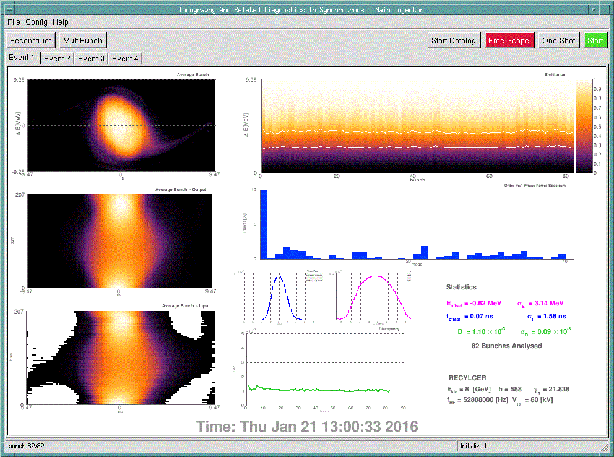
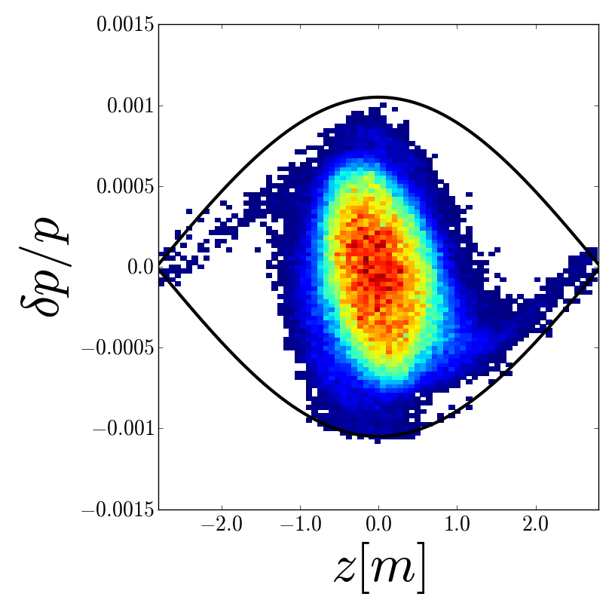
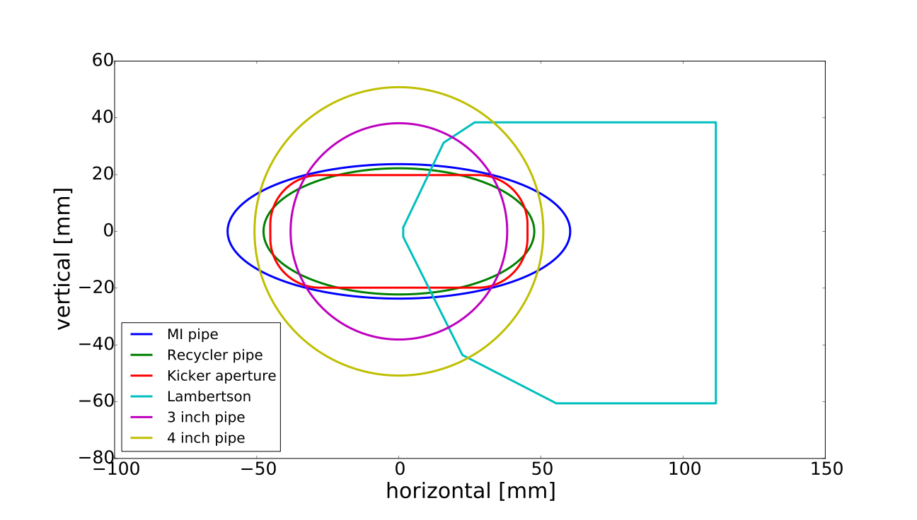
Recycler simulations - inputs
Realistic longitudinal distribution from tomography
Transverse distribution matched but using measured beam sizes
MAD8 input file
Using apertures, orbit bumps,

Slide 6
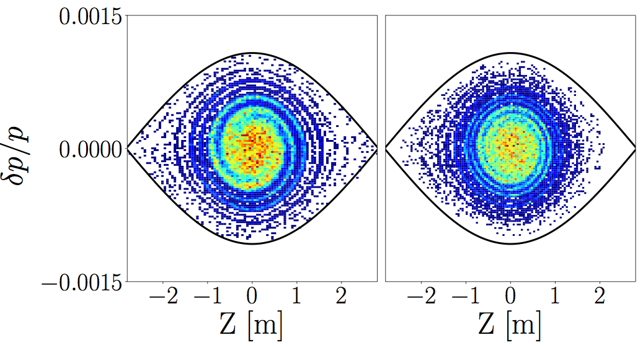
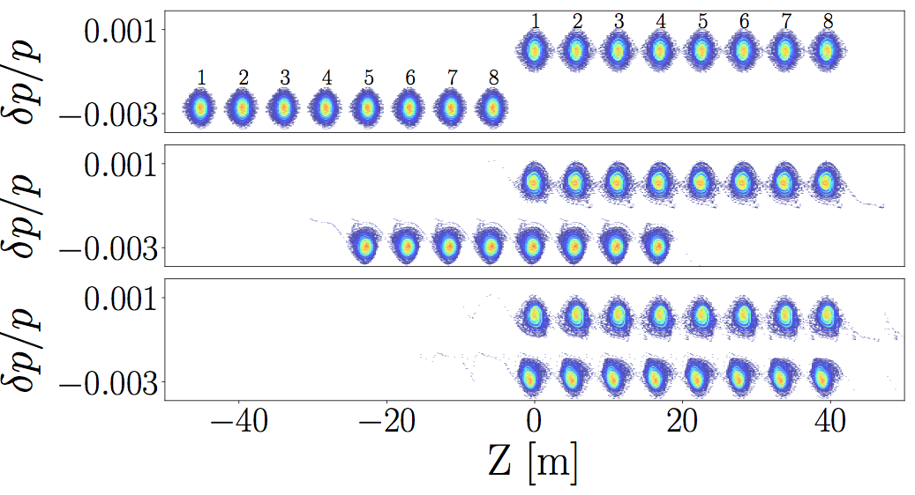
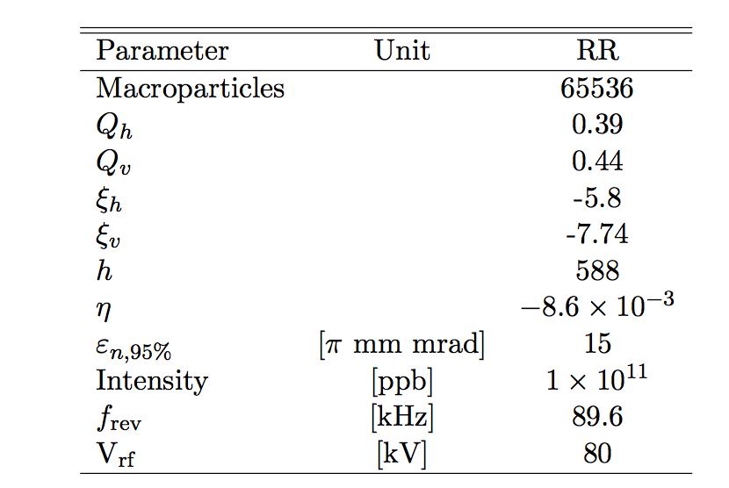
Recycler simulations
Filament
50ms
Decelerate
1260Hz
50ms

Slide 7
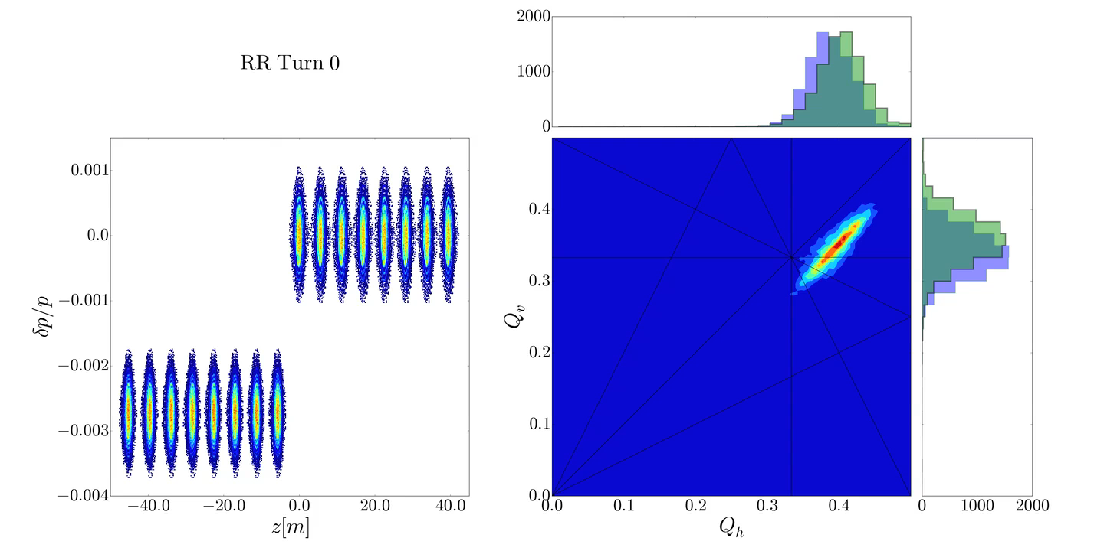
Space charge footprint

Slide 8
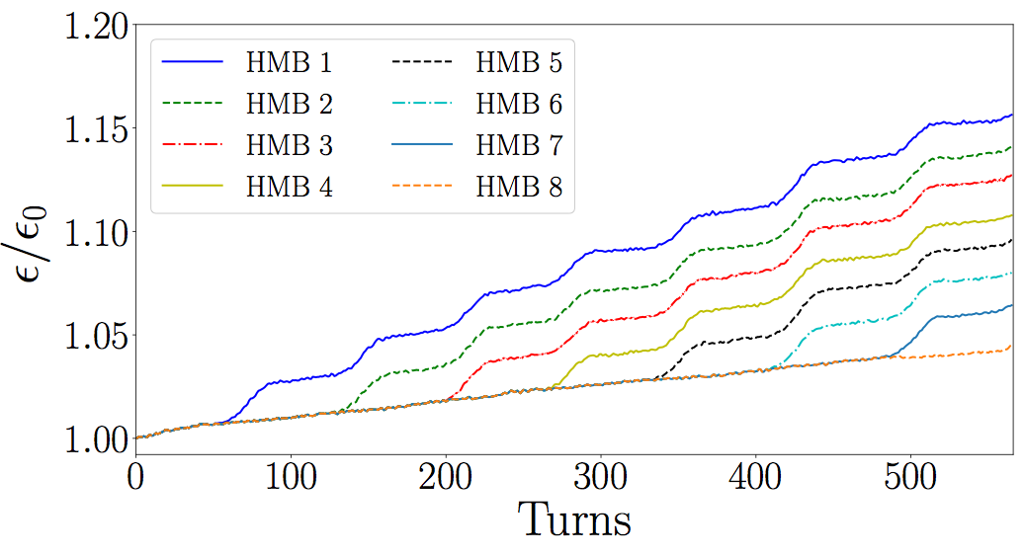
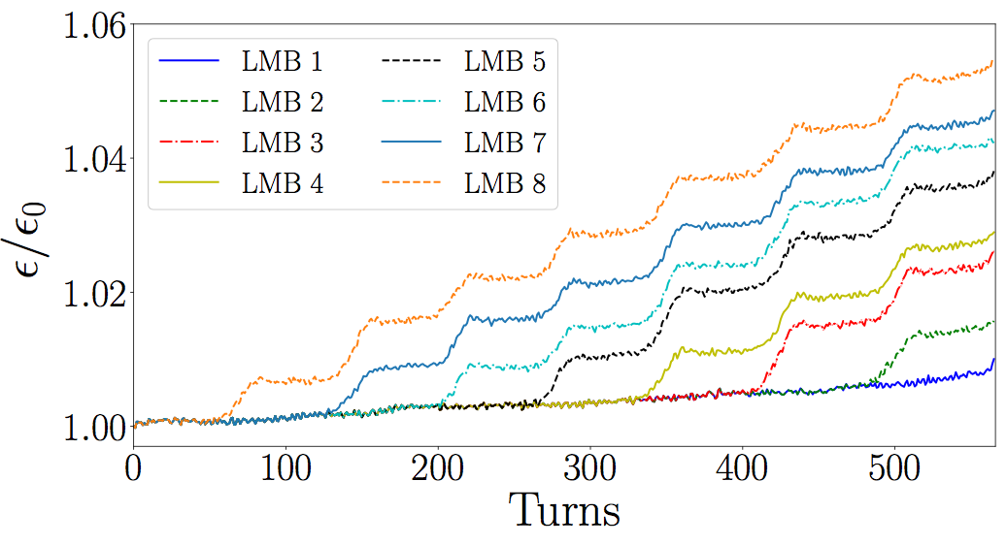
Effect on emittance

Slide 9
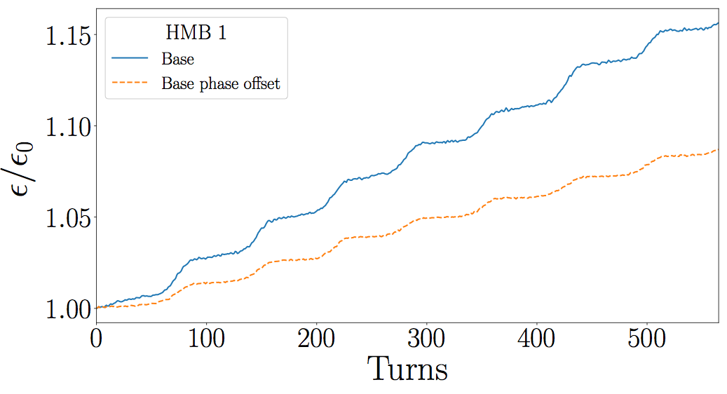
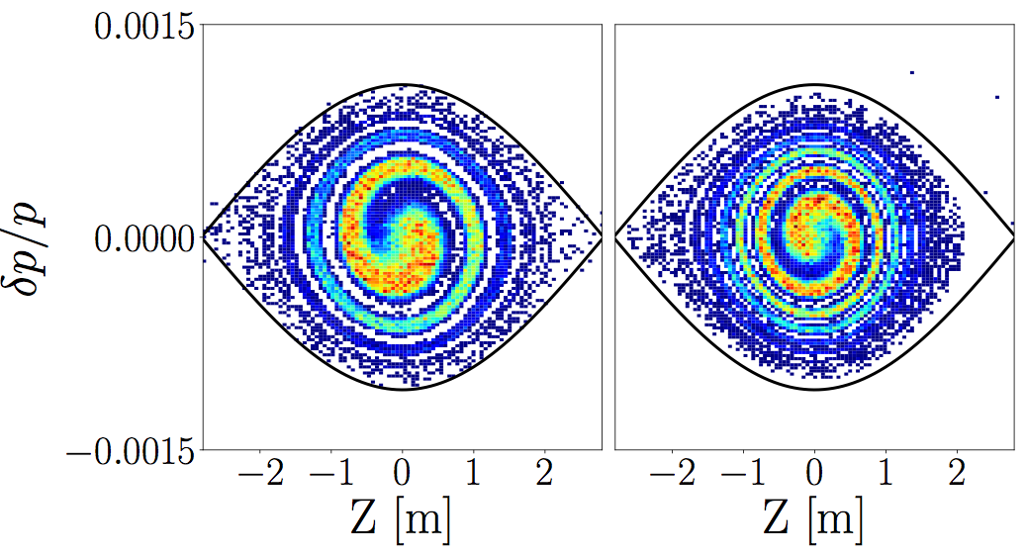
Phase-offset
Base case
with
1.5ns
injection
offset

Slide 10
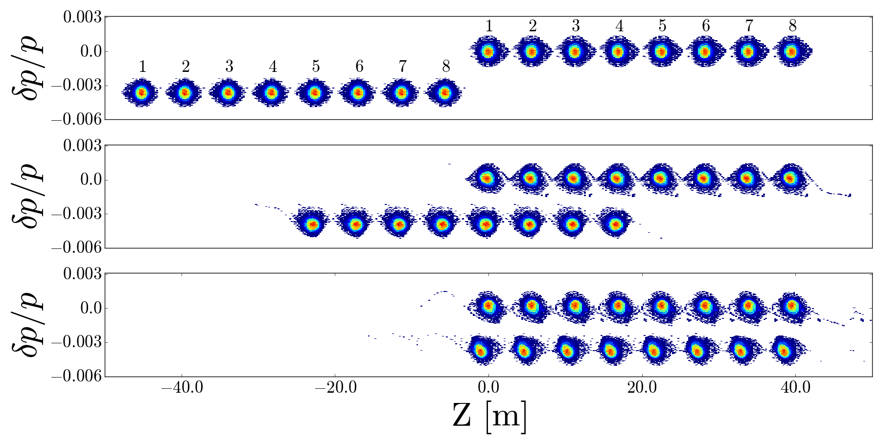
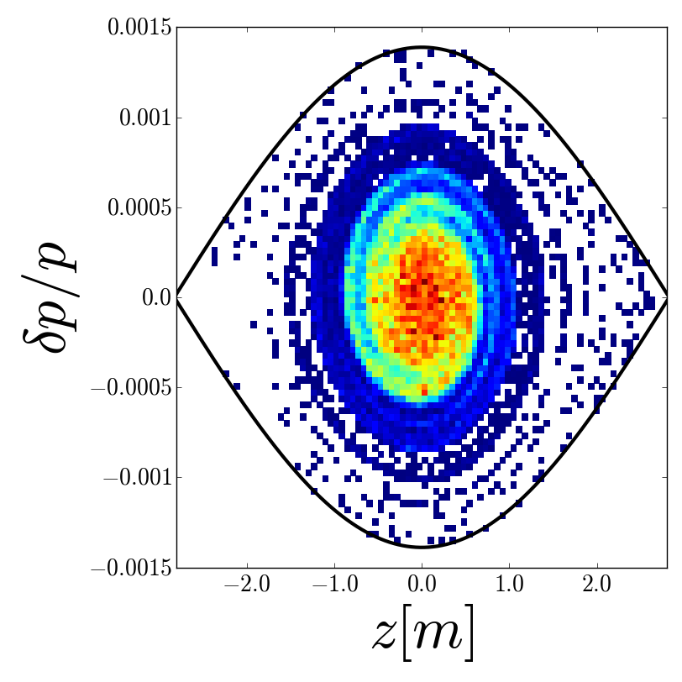
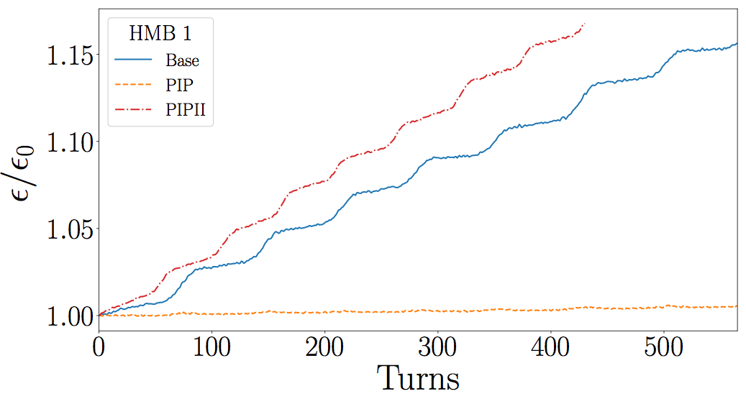
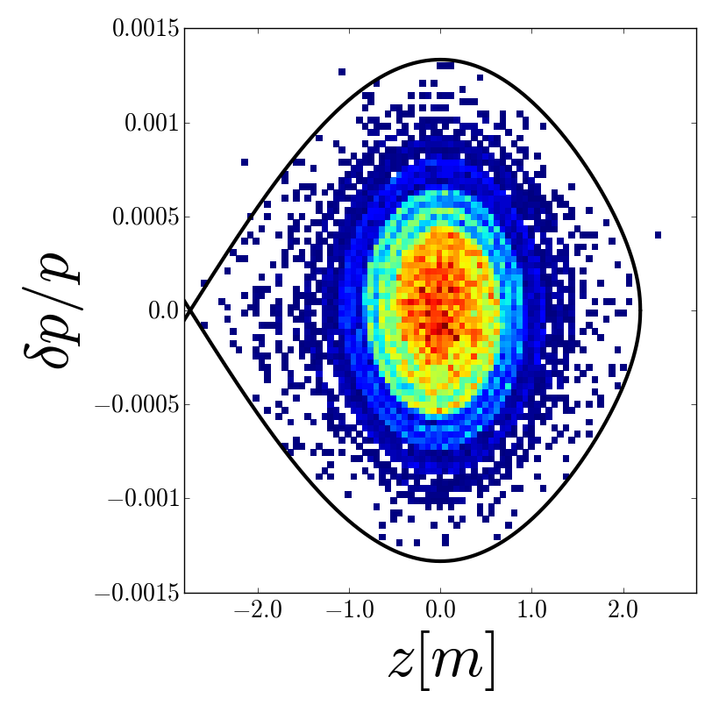
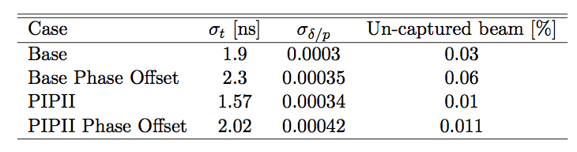
PIPII
Separation
increased
from 1260
to 1680 Hz
80 to 140 kV
15 Hz to 20 Hz

Slide 11
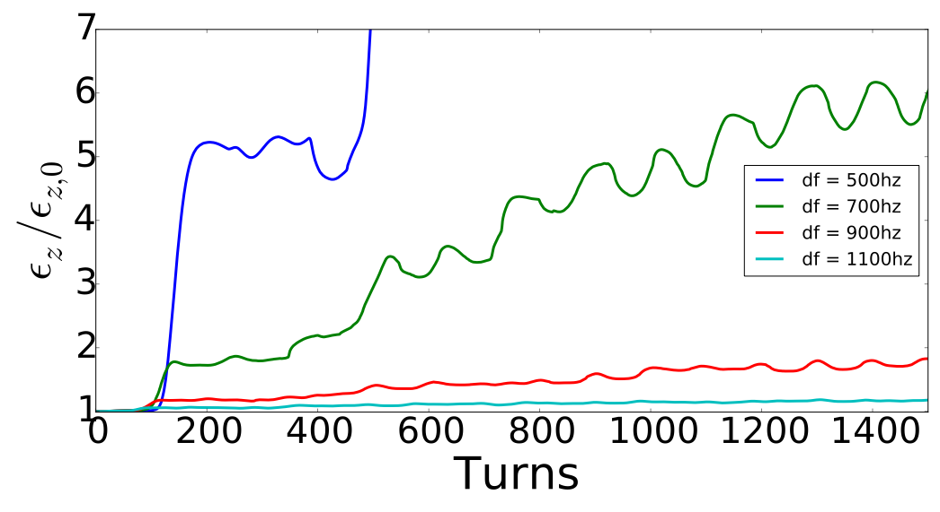
Frequency separation
80 kV buckets
alpha = 1.95, 2.73, 3.52, 4.3

Slide 12
Back-up

Slide 13
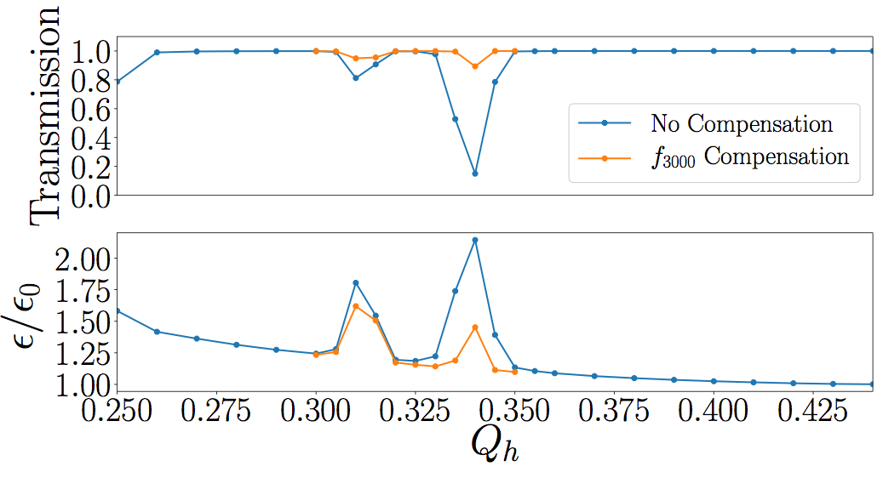
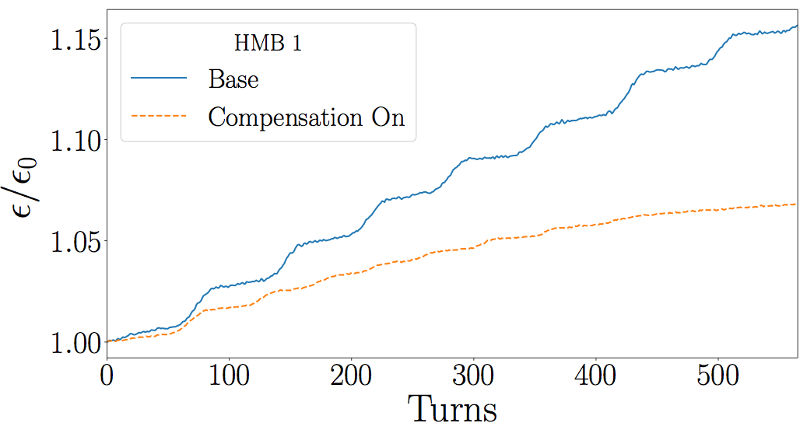
Resonance Compensation
Transmission is improved!
Not 100%, higher order terms
are not compensated
Slip-stacking case shows
saturation with 8 overlaps

