Slide 1
Fermilab LLRF Systems Architecture and Overview
B. Chase/P. Varghese
Fermilab LLRF Systems
17 April 2017

Slide 2
LLRF System Architecture
EPICS
AcNET Interface – requestor
Front-end software - director
User interface
Scenario execution
Shared Libraries – workers
Software – logger, event, cog,…
Hardware – link, VXI-UCD, VXI
DSP Software – serfs
Patterns
VXI Module Hardware
40 MHz AD-SHARC™ DSP
ADCs, DACs, NCOs, Link ports
CA Client
CA Server
IOC
Drivers

Slide 3
Front-End Software
The “application program” or *.exe file (VxWorks)
Provides set of services or tools to end-user.
Coordinator of tasks within front-end by combining services provided by different modules.
Responds to IRQs, TRIGs or external requests for data.
Error detection, logging and recovery.
Basic Control System Interface – devices (PV)
Advanced Control Interface – I6/R6
Scenarios - UseManager, Multi-timer

Slide 4
VXI Module Software
DSP Software Patterns
Vector Interrupts
Link Port Communication
Scheduler
Fast Time Plot Variables (PV)
Object Based Methodology
Construction
Configuration
Information
Shared Library
Slot 0 level
DSP Software
FPGA
Hardware DACs, ADCs, etc.
Actuators / Detectors
beam

Slide 5
Software Modules
AN (Channel Access Server)
Acnet interface, callback mechanism
Event
Observer pattern or Publish-Subscribe model
Logger
Message queue used to log error messages
Different message levels, information content
Cog
manages cogging beam to specific RF buckets
Details of cogging hidden, interface clear

Slide 6
DSP Software
Multiple processing rates
100 kHz, 16.6 kHz, 720 Hz
Common software patterns
Scheduler – schedules work tasks
Vector Interrupts – slot 0 to DSP interface
FTP Variables – accelerator data variables
Link port communication - high speed data transfer between multiple modules.

Slide 7
MILLRF Front End Software
Construction and Configuration
I6 PA Interface
Use case scenarios
Multi-timer and UseManager
Middleware
Gather resources to accomplish tasks, i.e. feedback state changes, machine transfers
Use interface of lower level libraries
Parameter Page Devices
Readings/Settings
FTP Variables

Slide 8
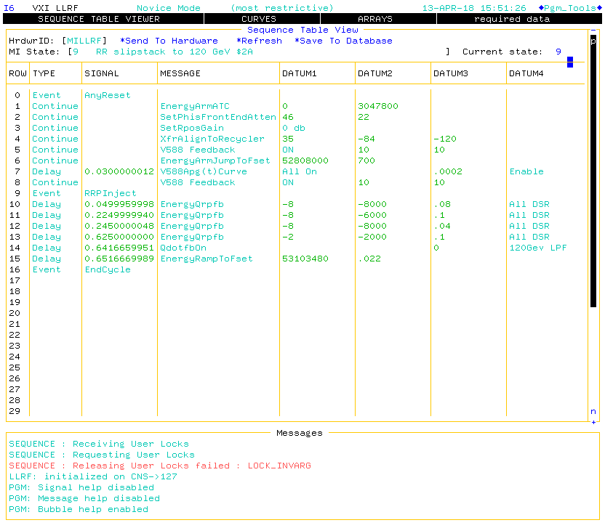
I6 Primary Application

Slide 9
MILLRF LLRF VXI Crate

Slide 10
Booster, Recycler and Main Injector

Slide 11
Recycler/Main Injector LLRF Systems

Slide 12
Recycler/Main Injector LLRF Systems

Slide 13
Main Injector Feedback Loops

Slide 14
LEL LLRF System

Slide 15
LEL LLRF Station

Slide 16
MFC FPGA/DSP Board

Slide 17
FAST LLRF System

Slide 18
FAST LLRF Station

Slide 19
PIP-II IT LLRF System

Slide 20
PIP-II IT LLRF Racks

Slide 21
SOC MFC Overview

Slide 22
ARRIA10 SOC MFC Overview

