Slide 1
First slip-stacking simulations with BLonD for SPS ion beams
D. Quartullo (Presented by T. Argyropoulos)
Acknowledgements: T. Argyropoulos, A. Lasheen,
E. Shaposhnikova, the BLonD team

Slide 2
Contents
Introduction
Slip-stacking principle
Slip-stacking simulations in SPS, setting up
Slip-stacking simulations in SPS, first results
Conclusions and next steps

Slide 3
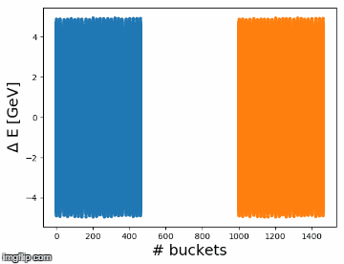
Introduction (1/2)
HL-LHC requirement: to double peak luminosity after LS2
Increase the number of bunches in the LHC
LIU baseline to achieve that is to decrease bunch spacing from 100 ns to 50 ns in SPS through slip-stacking
Basic idea: let two batches move in longitudinal phase space and interleave -> bunch spacing divided by two!
Slip-stacking already used in operation at Fermilab to double beam intensity

Slide 4
Introduction (2/2)
Potential slip-stacking feasibility based on large bandwidth of the 200 MHz RF system
Slip-stacking can be tested only after LS2
LLRF of 200 MHz RF system has to be upgraded
Simulations are the only means to check slip-stacking feasibility
In case of bad outcome alternative scenarios have to be found [1]
Some preliminary simulations done by T. Argyropoulos in 2014 [2]
Results were promising but simulations were without intensity effects
The goal of the present study is
Confirm previous results
Make simulations more realistic (e.g. including intensity effects and using measured beam parameters)
The CERN BLonD code has been used for the first time for slip-stacking
No intensity effects included in this presentation
Many parameters have to be decided and a general understanding of the process is needed (intensities effects heavily slow down the simulations)
[1] A. Saa Hernandez ‘Results from ion studies in PS & SPS from 2016/2017 and planning for 2018’, Injector MD day, 2018
[2] T. Argyropoulos et al ‘Slip stacking in the SPS’, LIU Day, 2014

Slide 5
Contents
Introduction
Slip-stacking principle
Slip-stacking simulations in SPS, setting up
Slip-stacking simulations in SPS, first results
Conclusions and next steps

Slide 6
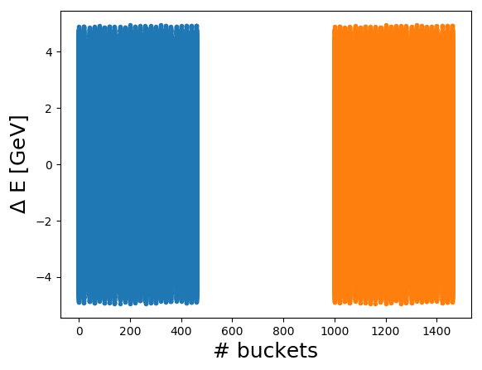
Conventions
d -> design (e.g. $p_{d}$ = design momentum)
$d_{bu}$ -> distance between two bunches in the same batch
$l_{ba}$ -> batch length
$d_{ba}$ -> distance between first bunches of two batches
$T_{ba}$-> distance between tail and head of two batches
${Δf}_{rf}^{ba}$-> difference in RF frequency between two batches
$f_{s0}$ -> small amplitude synchrotron frequency of one bunch
$H_{b}$ -> bucket half height in energy in single RF
$$d_{ba}$$
Batch 2
$$T_{ba}$$
$$l_{ba}$$
Batch 1

Slide 7
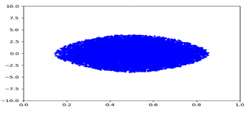
BLonD equations of motion: synchronicity
Assumptions: single RF, no intensity effects and constant design magnetic field
Longitudinal equations of motion:
$$B_{d}ρ=\frac{p_{d}}{q}$$
$${ΔE}^{(n+1)}={ΔE}^{(n)}+qV\sin\left(ω_{rf}^{(n)}{∆t}^{(n)}+φ_{rf}^{(n)}\right)−β_{d}^{\left(n+1\right)}c \left(p_{d}^{\left(n+1\right)}−p_{d}^{\left(n\right)}\right)$$
$${∆t}^{(n+1)}={∆t}^{(n)}+t_{rev,d}^{(n+1)}η_{d}^{(n+1)}δ^{(n+1)}$$
$${∆t}^{(n)}≐t^{(n)}−\sum_{k=1}^{n}{t_{rev,d}^{(n)}}$$
$$δ≐\frac{Δp}{p_{d}}=\frac{ΔE}{{β_{d}^{2}E}_{d}}$$
$$η_{d}^{(n)}≐\frac{1}{γ_{tr}^{2}}−\frac{1}{γ_{d}^{2}}$$
$${∆E}^{(n)}≐E^{(n)}−E_{d}^{(n)}$$
Phase space at turn n
$${ΔE}^{(n)}$$
$$0$$
$${∆t}^{(n)}$$
$$t_{rev,d}^{(n+1)}$$
If $ω_{rf}^{(n)}=h ω_{rev,d}^{(n)}$ then the synchronous particle remains on the design orbit turn after turn with all the other particles performing synchrotron oscillations around it

Slide 8
BLonD equations of motion: asynchronicity
If $ω_{rf}^{(n)}≠hω_{rev,d}^{(n)}$ then from the differential relation
$$\frac{dB}{B_{d}}=γ_{tr}^{2}\frac{{df}_{rev}}{f_{rev,d}}+\left[1−{\left(\frac{γ_{tr}}{γ_{d}}\right)}^{2}\right]\frac{dp}{p_{d}}$$
$$\frac{{df}_{rf}}{f_{rf,d}}=−η_{d}\frac{dp}{p_{d}}$$
we have $dp≠$0, this means that the bunch will accelerate or decelerate relative to the design $p_{d}$. In transverse plane that implies a change of the trajectory radius:
$$\frac{dp}{p_{d}}=γ_{tr}^{2}\frac{dR}{R_{d}}+\frac{dB}{B_{d}}$$
If ${dω}_{rf}≠0$ then a shift ${dφ}_{rf}=\frac{2 π h{ dω}_{rf}}{ω_{rf,d}}$ should be added to $φ_{rf}$ in
$${ΔE}^{(n+1)}={ΔE}^{(n)}+qV\sin\left(ω_{rf}^{(n)}{∆t}^{(n)}+φ_{rf}^{(n)}\right)$$
to make the sine wave continuous from turn n to turn n+1 in the frame [0, $t_{rev,d}$], where $t_{rev,d}$ is constant. Accumulation from turn to turn gives
$$φ_{rf}^{(n)}=\sum_{i=1}^{n}{{dφ}_{rf}^{(i)}}+{dφ}_{ext}^{(n)}={dφ}_{rf,tot}^{(n)}+{dφ}_{ext}^{(n)}$$
other contributions (phase noise, feedbacks etc.)

Slide 9
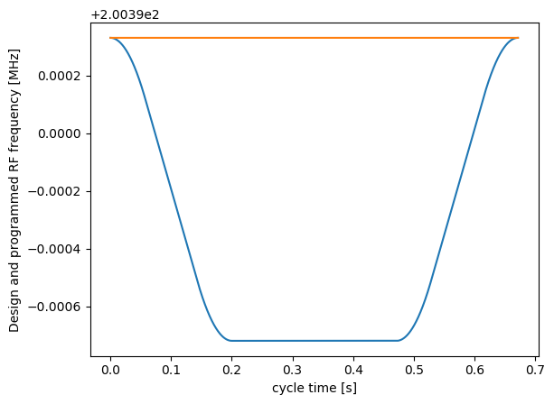
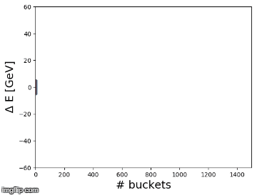
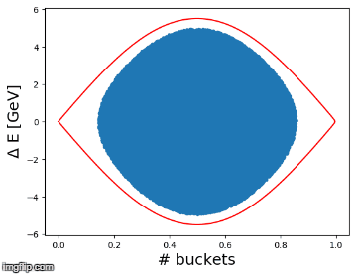
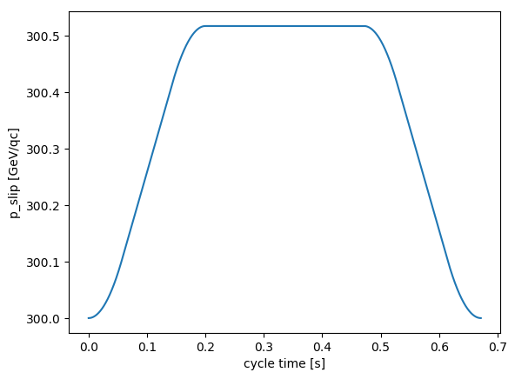
Example 1: single bunch asynchronicity
Example above transition (SPS ions at 300 GeV/qc, h=4620) with $ω_{rf}^{(n)}<hω_{rev,d}^{(n)}$ for each n:
$${df}_{rf}<0$$
$$dp>0$$
$$dR>0$$
$${dφ}_{rf}<0$$
the bunch average momentum increases relative to $p_{d}$
the bunch moves up in phase space and shifts to the right
the bunch displaces outwards relative to $R_{d}$
$$f_{rf,d}$$
$$f_{rf}$$
$p(f_{rf}$)
acceleration
slipping bucket frame =
$$\left[−\frac{{dφ}_{rf}^{tot}}{2π}, \frac{2π−{dφ}_{rf}^{tot}}{2π}\right]$$
deceleration
reference frame = [0, 1500]
$$p_{d}$$

Slide 10
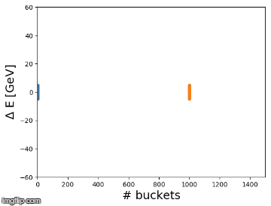
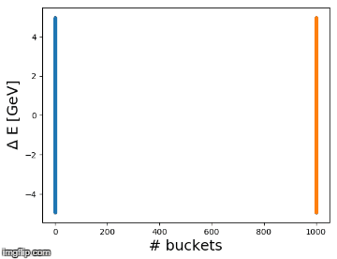
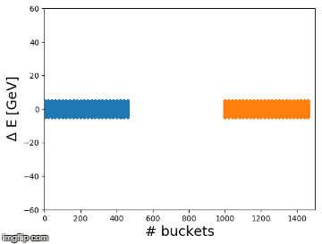
Example 2: slip-stacking
Same example with two bunches and two RF systems where
Each bunch is accelerated by a different RF system
$ω_{rf}^{1}=−ω_{rf}^{2}{,V}_{rf}^{1}=V_{rf}^{2}$,
Assumption: each bunch does not feel the perturbation from the other RF system
At the end of the procedure $ω_{rf}^{1}=ω_{rf}^{2}=hω_{rev,d}^{}$
Reference frame
Zoom on the 2 bunches
$$d_{bu}:$$
1000->10
buckets
Same example with two batches with 24 bunches each
Reference frame
Zoom on the 48 bunches
$$d_{bu}:$$
20->10
buckets

Slide 11
RF perturbation
Unfortunately the assumption of no perturbation from the other RF system is valid only
when $T_{ba}$ is greater than a certain threshold $T_{ba}^{th}$, which represents the time needed to switch alternatively the two RF systems on and off depending on which batch passes by. ($T_{ba}^{th}$= 1.3 $μs$ in SPS by T. Bohl)
when ${Δf}_{rf}^{ba}$ is large enough: in this case the perturbation averages within a synchrotron oscillation period and the batches are practically independent
It has been proven (F. E. Mills) that a lower limit for stable motion is defined by
$α$is called slip-stacking parameters and two different case studies with the same alpha show qualitatively the same beam dynamics
$α$ >> 4 -> small perturbation effect but large emittance after filamentation and large needed recapture voltage
$α$ $≈$ 4 -> small emittance growth after recapture (and smaller recapture voltage needed) but the perturbation has more effect
$$α≐\frac{{Δf}_{rf}^{ba}}{f_{s0}}=2\frac{{ΔE}^{ba}}{H_{b}}=4$$
separatrices of the buckets of the two batches are tangent
$${ΔE}^{ba}=2H_{b}$$

Slide 12
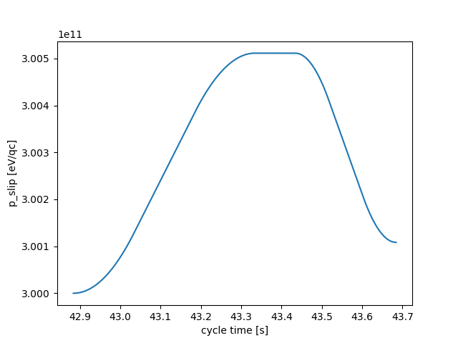
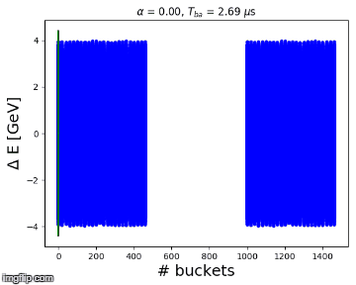
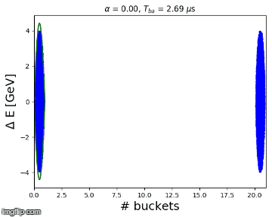
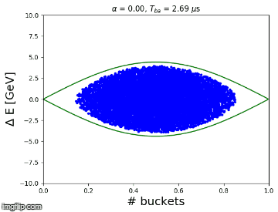
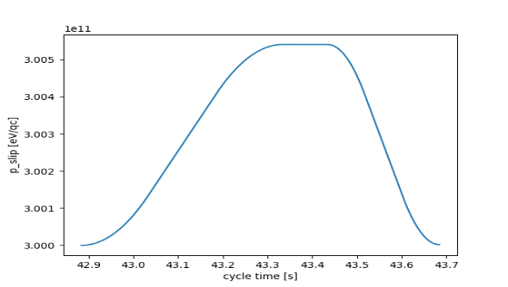
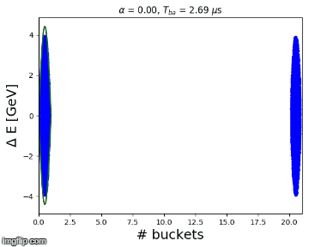
Examples with RF perturbation
Bunches become red when $T_{ba}^{}$ < $T_{ba}^{th}=1.3μs$
Example 1: $α_{end}=8$ -> perturbation practically not visible
$$p_{slip}$$
$$p_{d}$$
Example 2: $α_{end}=4$ -> perturbation is visible but bunch still inside bucket
$$p_{slip}$$
$$p_{d}$$
Example 3: $α_{end}=0$ -> bunch is lost
$$p_{slip}$$
$$p_{d}$$

Slide 13
Contents
Introduction
Slip-stacking principle
Slip-stacking simulations in SPS, setting up
Slip-stacking simulations in SPS, first results
Conclusions and next steps

Slide 14
Slip-stacking procedure in SPS
Two SPS batches, each batch contains 24 bunches spaced by 100 ns
Before slip-stacking the two batches are separated by $T_{ba}$= 2.7 $μs$
$T_{ba}$ is defined by the LLRF specifications: it has to be so large that when $T_{ba}$= $T_{ba}^{th}$ then $α≫4$ to avoid perturbation from the other RF
The two batches are captured by the two subsets of the 200 MHz TWCs
Each subset is tuned to a different bunch, $ω_{rf}^{1}=−ω_{rf}^{2},V_{rf}^{1}=V_{rf}^{2}$
Manipulation in phase space to make the two batches interleave
Bunch spacing from 100 ns to 50 ns
After slip-stacking the voltage recapture is done at the average (design) RF frequency

Slide 15
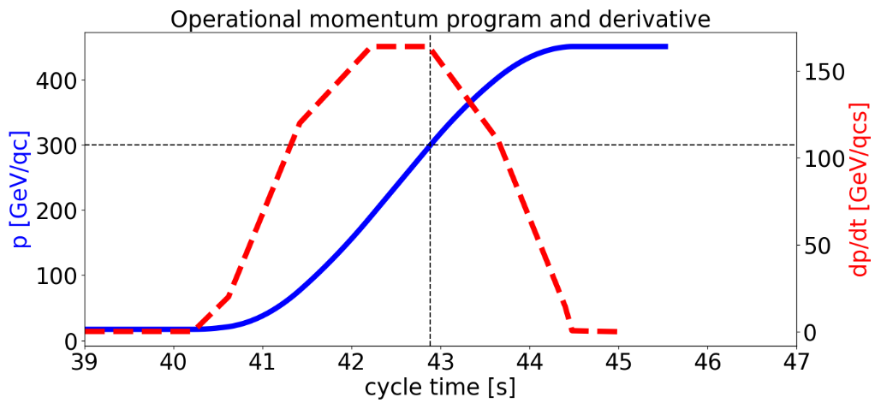
Momentum program design (1/2)
p
l
p
p -> parabolic momentum program
l -> linear momentum program
p
p
p
At which energy should slip-stacking be performed?
Flat bottom: strong space charge effects, IBS and RF noise (observed during operation)
Flat top: extra time for filamentation is needed and uncaptured beam is transfered to the LHC
Intermediate energy plateau: weak space charge (but instability threshold ~ 1/E), presence of time for filamentation and cleaner beam for LHC
The energy 300 GeV/qc is chosen for the following simulations

Slide 16
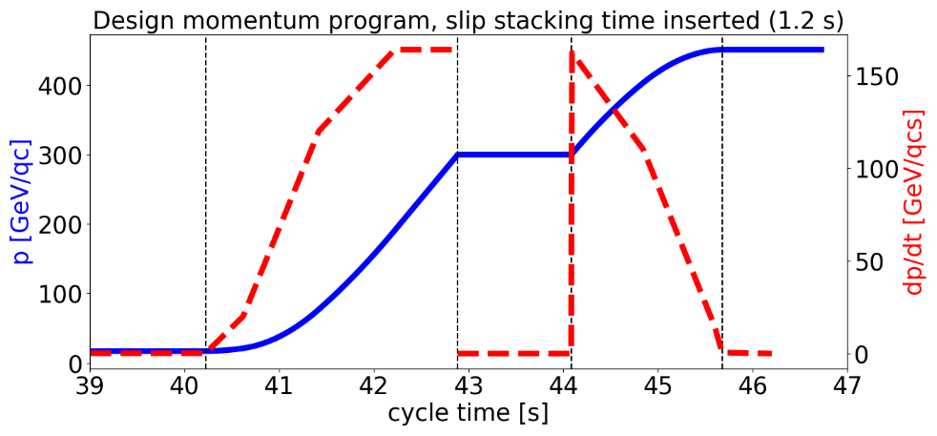
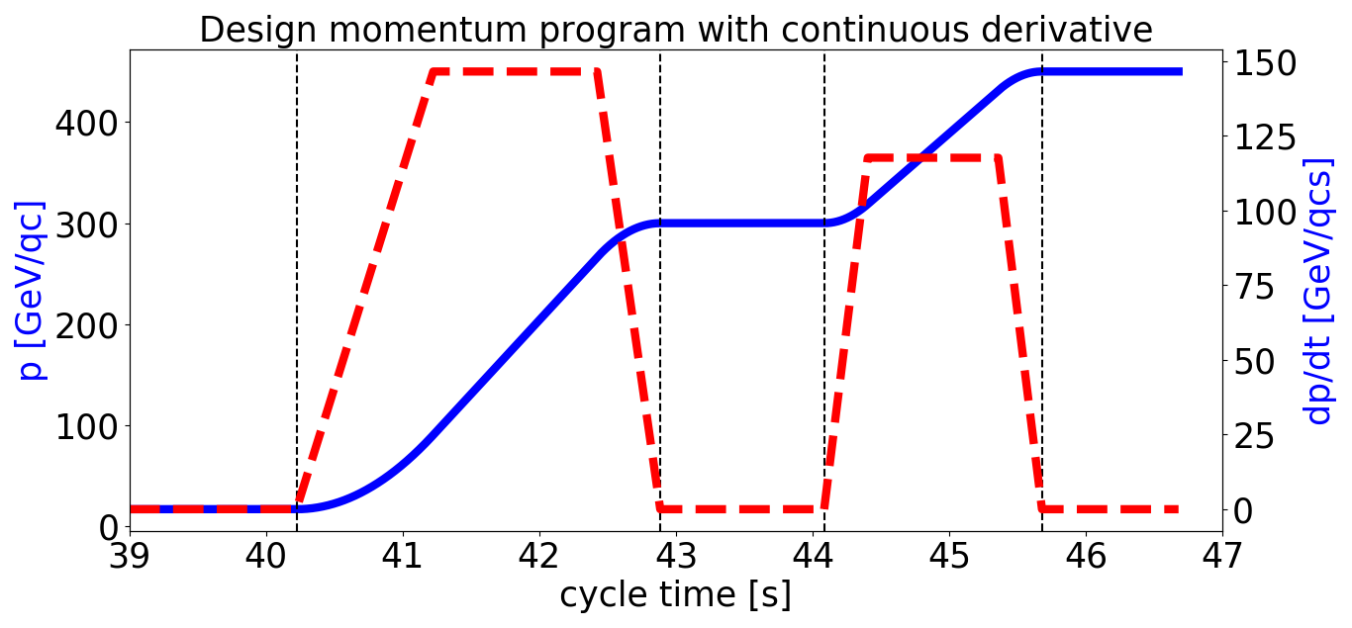
Momentum program design (2/2)
$$t_{1}$$
$$t_{4}$$
$$t_{1}$$
$$t_{4}$$
$$t_{2}$$
$$t_{3}$$
$$t_{2}$$
$$t_{3}$$
Multiples of 1.2 s (PSB cycle) can be added to the SPS cycle for slip-stacking
1.2 s are added at 300 GeV/c
The momentum derivative should be continuous to avoid jumps in synchronous phase $φ_{s}$
Parabolic (0.38 %), linear (0.45%) and parabolic (0.17%) program in $[t_{1},t_{2}]$
Parabolic (0.2 %), linear (0.6%) and parabolic (0.2%) program in$[t_{3},t_{4}]$
Max dp/dt is not increased after slip-stacking time insertion
Maybe small time interval to go from linear to parabolic and viceversa
Simulations started at $t_{2}$ with 0.8 s of slip-stacking and 0.4 s of filamentation after voltage recapture

Slide 17
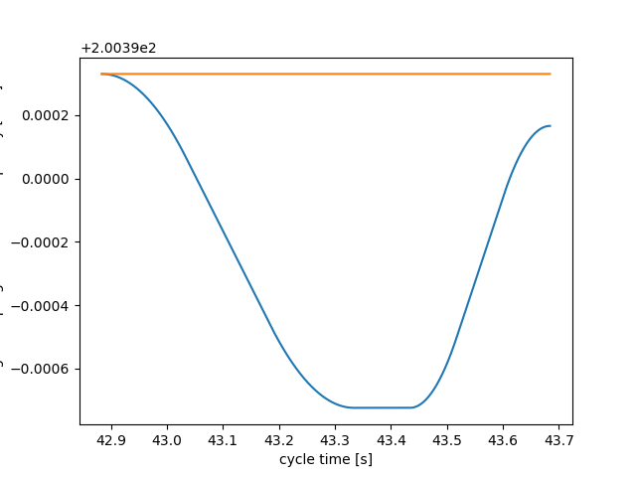
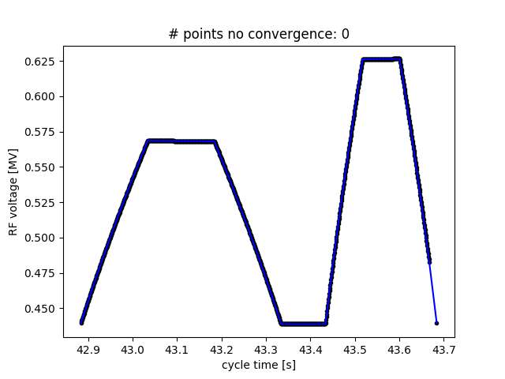
Slip-stacking programs (1/2)
$α_{end}≈4$ for all the simulations
$ω_{rf}^{1}=−ω_{rf}^{2}$ such that the momentum of the two batches is parabolic, linear and parabolic, then flat, and again parabolic, linear and parabolic
the voltage program is calculated from the momentum program for constant filling factor in energy, $V_{rf}^{1}=V_{rf}^{2}$
example of programs used in simulations for one of the two batches:
$$p_{max}$$
$$f_{rf,d}$$
$$V_{rf}$$
$$p$$
$$f_{rf }$$
$$p_{min}$$
$$p_{d}$$

Slide 18
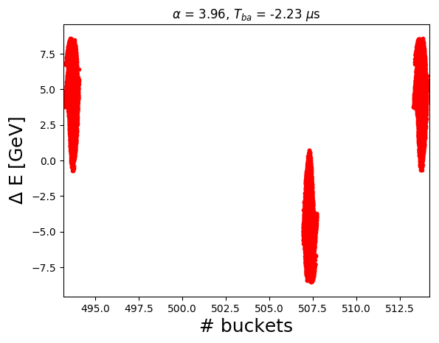
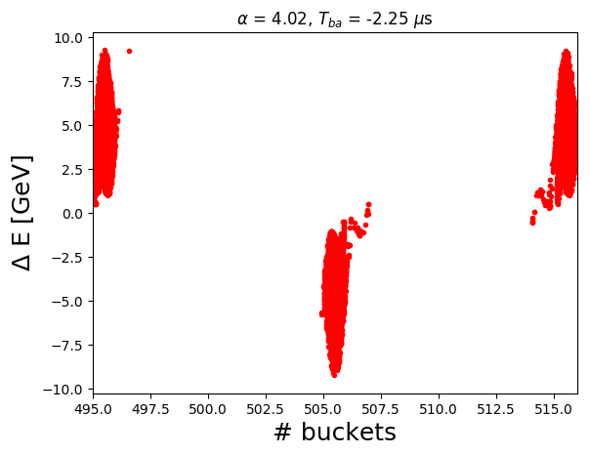
Slip-stacking programs (2/2)
Iterative algorithm 1 in BLonD which takes $α_{end}$ and gives $p_{min}$ assuming a voltage with given filling factor in energy (iteration on $p_{min}$ -> $V_{end}$-> $α_{end}$)
The final phase displacement of the two batches relative to the reference frame can be precalculated
However small variations of p leads to significant misalignment of the two batches
Just before capture
Misalignment
Alignment
Iterative algorithm 2 in BLonD which takes as input $p_{min}$ from Iterative algorithm 1 and ${dφ}_{rf,tot}^{}$ and compute a momentum program wich gives perfect alignment (iteration on $p_{max}$ -> $p$ -> ${dφ}_{rf,tot}^{}$)

Slide 19
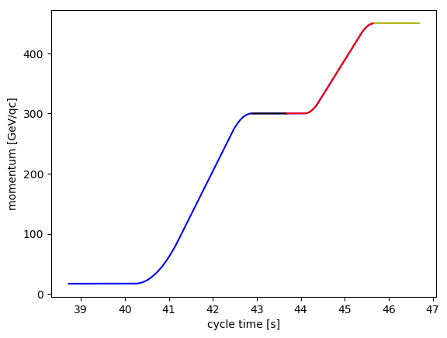
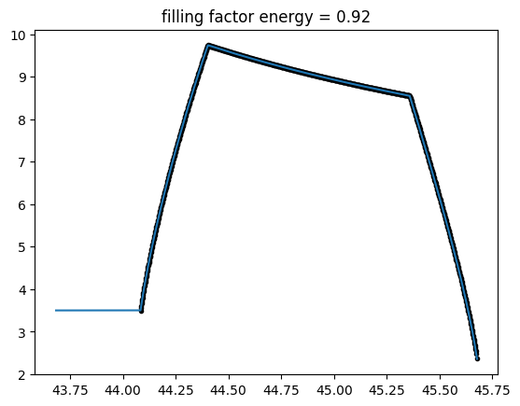
Voltage programs after slip-stacking
start slip-stacking
$$t_{4}$$
$$t_{2}$$
$$t_{3}$$
end slip-stacking
$$t_{1}$$
The capture voltage chosen after slip-stacking is used in [$t_{2}$+0.8 s, $t_{3}$], then the code computes the filling factor in energy at $t_{3}$ and uses it to calculate the voltage program in [$t_{3}$, $t_{4}$]
Example of $V_{rf}$ in [$t_{2}$+0.8 s, $t_{4}$] encountered in simulations
$t_{2}$+0.8s
$$t_{3}$$
$$t_{4}$$
$V_{rf}$ with filling factor = 0.92
Capture voltage
Here filling factor is computed
At flat top
$V_{rf}$ is increased linearly to 15 MV in 0.5 s (flat top length $≈$ 1 s) (bunch compression)
$V_{rf}$ is increased to 15 MV non adiabatically for bunch rotation

Slide 20
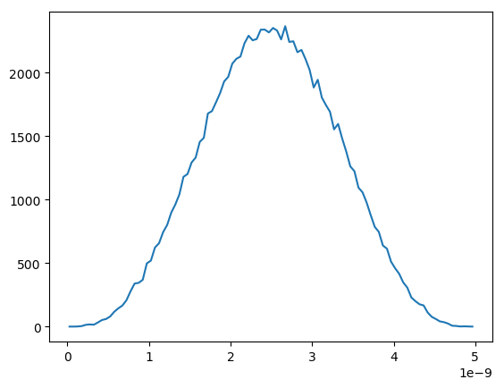
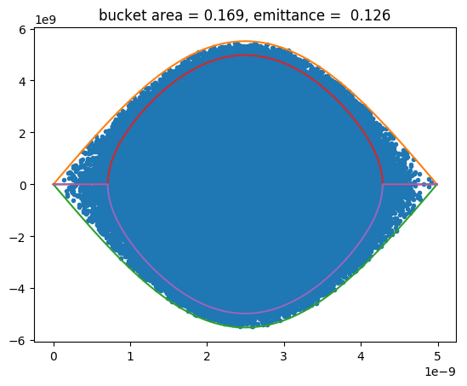
Initial beam parameters
Measurements done in December 2015 (courtesy A. Lasheen) show significant bunch to bunch variation in intensity and bunch length along the batch at various point along the ramp
At 300 GeV/qc the largest emittance found is $ε_{l}≈0.125$ eVs/A (found also by T. Bohl)
This value is used in simulation and corresponds to the worst case scenario for losses
However larger emittances can help counteract intensity effects through Landau damping
Binomial bunch matched with RF voltage at $t_{2}$, emittance computed using FWHM bunch length rescaled to 4 $σ$ Gaussian profile
Profile
EXAMPLE
Phase space
$ΔE$ [eV]
$$τ$$
Hamiltonian defining emittance
Separatrix
$Δt$ [s]
$Δt$ [s]

Slide 21
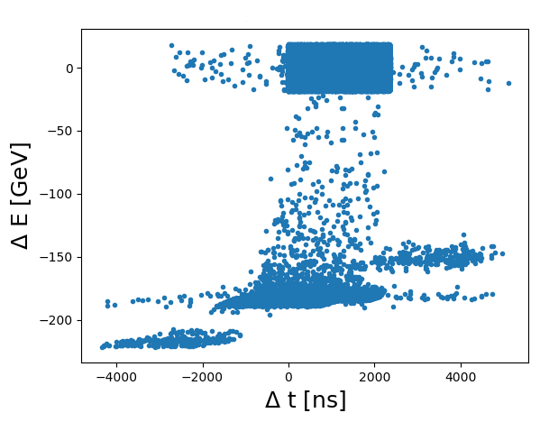
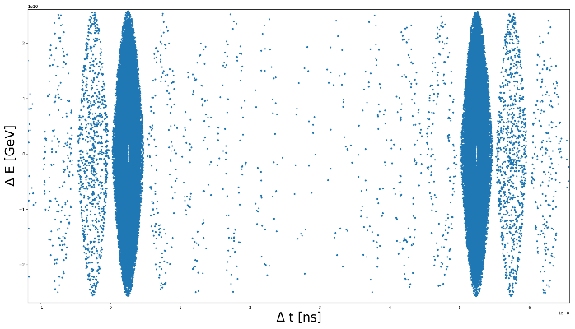
Losses computation
Losses inside the SPS
A particle is lost when its radial displacement is larger than the length of the horizontal aperture.
The smallest horizontal aperture is at the QDs (V. Kain “Update on SPS aperture studies”, 2017)
Calculations give 41.5 mm of total aperture
Measurements give roughly 28 mm and 35 mm as minimum aperture towards the inside and outside respectively
20 mm of internal and external apertures are assumed along the entire simulation
A particle is lost when its dp satisfies
Examples of losses
$$\frac{dp}{p_{d}}=γ_{tr}^{2}\frac{{dR}_{apert}}{R_{d}}$$
threshold for losses in SPS
the buckets are here
Total losses
The total losses comprise the losses in the SPS and all the particles forming satellite bunches at injection in the LHC
At the end of the simulation the particles which displacement from the bucket centre is more than 1.25 ns (half LHC bucket length) are considered lost
future LHC satellites
future LHC satellites
future LHC nominal buckets
future LHC satellites

Slide 22
Contents
Introduction
Slip-stacking principle
Slip-stacking simulations in SPS, setting up
Slip-stacking simulations in SPS, first results
Conclusions and next steps

Slide 23
Simulation parameters
$$t_{4}$$
Optics: Q20
Start simulation: $t_{2}$
End simulation: $t_{4}$ + 0.5 s (bunch compression)
or
$t_{4}$ + 31 $t_{rev}$ (bunch rotation)
Scan of capture voltage: 2.5 MV -> 7.5 MV
start slip-stacking
$t_{2}$+0.8s
$t_{4}$+0.5s
$$t_{2}$$
$$t_{3}$$
end slip-stacking
$$t_{1}$$
Parameter | Symbol | Value | Units
Design momentum in [$t_{2}$, $t_{3}$] | $$p_{d}$$ | 300 | GeV/qc
Longitudinal emittance at $t_{2}$ | $$ε_{l}$$ | 0.125 | eVs/A
Small amplitude synchrotron frequency at $t_{2}$ | $$f_{s0}^{t_{2}}$$ | 79 | Hz
Max RF voltage amplitude in [$t_{2}$, $t_{2}$+0.8s] | $$V_{rf,max}^{ss}$$ | 0.62 | MV
Max $δ$ per batch in [$t_{2}$, $t_{2}$+0.8s] | ${Δp}_{max}^{ba}$/$p_{d}$ | 1.73x10⁻³ | -
Max radial displacement per batch in [$t_{2}$, $t_{2}$+0.8s] | $${ΔR}_{max}^{ba}$$ | 5.9 | mm
Max RF frequency offset per batch in [$t_{2}$, $t_{2}$+0.8s] | $${Δf}_{rf,max}^{ba}$$ | 1054 | Hz
Filling factor in energy in [$t_{2}$, $t_{2}$+0.8s] | $$F_{E}^{ss}$$ | 0.85 | -
$α$ parameter at $t_{2}$+0.8s | $$α_{end}$$ | 4 | -
RF voltage at extraction | $$V_{rf}^{end}$$ | 15 | MV

Slide 24
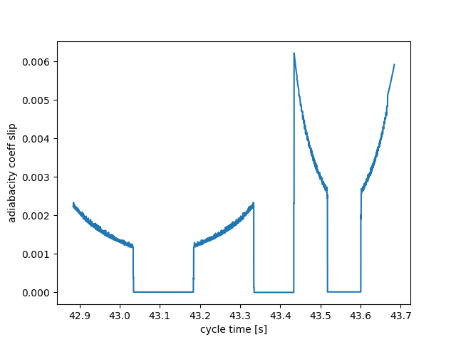
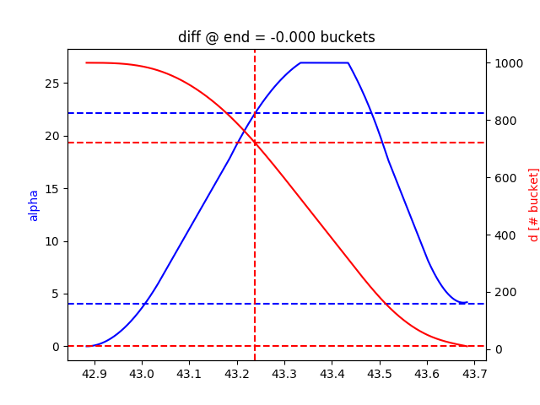
Programs during slip stacking
Momentum of batch 1
RF program relative of one batch
Adiabaticity coefficient
Slip-stacking parameter and $d_{ba}$
$$α_{d}=\frac{1}{ω_{s0}^{2}}\left|\frac{dω_{s0}}{dt}\right|$$
$$α=22$$
Discontinuities and noise caused by RF program
$$α=4$$
Cycle time threshold corresponding to $T_{ba}^{th}$
$d_{ba}$ decreases from 1000 to 10 buckets
However $α_{d}≤0.05$
Adiabatic synchrotron motion

Slide 25
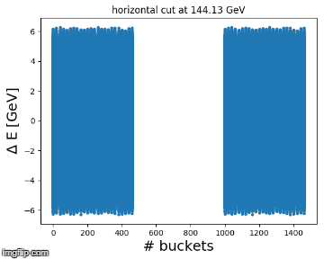
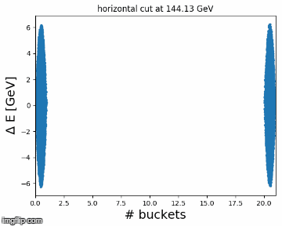
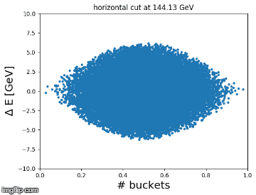
Slip-stacking simulation
Global overview
First two bunches of first batch
First bunch of first batch
Particles escaping the bucket when switching from acceleration to flat and from flat to deceleration
This effect is due mostly to the large emittance chosen and the distribution tails
No losses with a parabolic bunch and lower emittance
Using the estimated energy cut for losses of 144 GeV, the particles are not lost at the end of slip-stacking but continue drifting along the ring
Some of them will be lost during acceleration to flat top, others will be captured (satellite bunches)
Perturbation caused by $α_{end}=4$ implies also some particles which escape from the bucket

Slide 26
Summary of results: Q20 (1/2)
capture voltage [MV] | $ε_{l}^{av}$after filam. [eVs/A] | $F_{E}$ during ramp - | max $V_{rf}$ during ramp [MV] | losses in SPS % | $ε_{l}^{}$at extr [eVs/A] | $τ$ at extr [ns] | total losses % | $τ$ at extr [ns] | total losses %
2.5 | 0.42 | 0.97 | 8.5 | 3.4 | 0.54 | $$2.38$$ | 4.7 | 1.46 | 5.3
3.5 | 0.42 | 0.92 | 9.9 | 2.3 | 0.51 | 2.30 | 3.7 | 1.52 | 4.0
4 | 0.43 | 0.89 | 10.2 | 2.1 | 0.50 | 2.29 | 3.5 | 1.52 | 3.8
4.5 | 0.42 | 0.86 | 10.9 | 2.0 | 0.50 | 2.27 | 3.5 | 1.54 | 3.7
5 | 0.42 | 0.85 | 11.5 | 1.9 | 0.48 | 2.22 | 3.4 | 1.56 | 3.6
5.5 | 0.42 | 0.83 | 12.0 | 1.8 | 0.47 | 2.19 | 3.4 | 1.57 | 3.5
6 | 0.40 | 0.80 | 12.5 | 1.7 | 0.45 | 2.16 | 3.4 | 1.58 | 3.5
6.5 | 0.42 | 0.80 | 13.0 | 1.7 | 0.45 | 2.14 | 3.4 | 1.61 | 3.4
7.5 | 0.39 | 0.75 | 14.0 | 1.6 | 0.44 | 2.12 | 3.5 | 1.64 | 3.4
BUNCH COMPRESSION
BUNCH ROTATION
The scan stops at 7.5 MV since the maximum available voltage will be 15 MV
The emittance after filamentation does not depend on the capture voltage
Lower capture voltage implies higher filling factor and more losses around the separatrix in SPS, but the emittance is roughly preserved
Only bunch rotation allows to have the required beam parameters at extraction for the LHC
$τ≤$ 1.65 ns, losses $≤$5 % (acceptable values are in red)

Slide 27
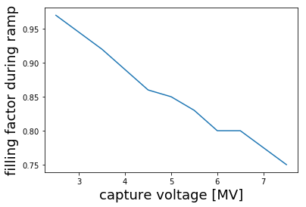
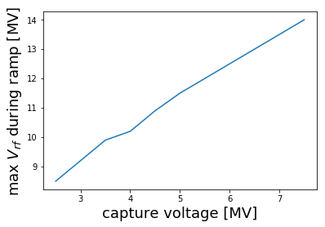
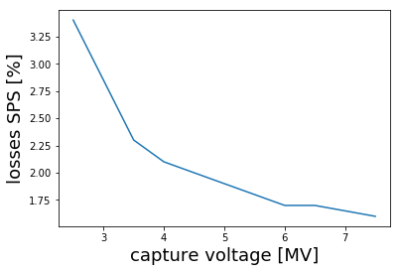
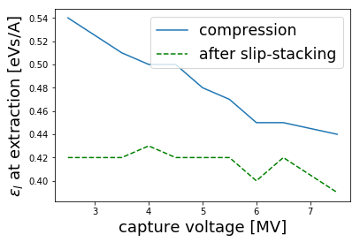
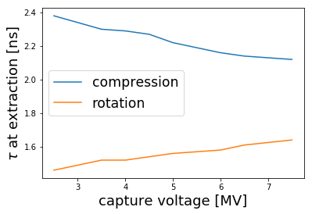
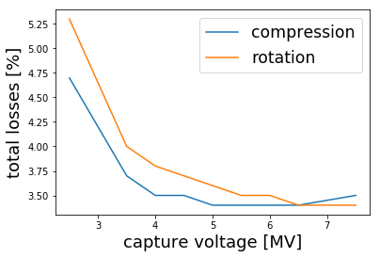
Summary of results: Q20 (2/2)
5%
1.65 ns
Increasing the capture voltage more particles are captured inside the RF bucket after slip-stacking
Less losses in SPS but satellites bunches are created (total losses reach equilibrium)
With bunch compression the emittance at extraction is larger than the one after filamentation
After capture the bunch profile changes shape (tails tend to disappear) and the emittance with FWHM rescaled to Gaussian is not preserved anymore
This effect is more visible decreasing the capture voltage (bunch shaving because of full bucket)
Even for the best case of bunch compression (7.5 MV) the value of 0.44 eVs/A is too large
Slip-stacking optimization could be performed to try reaching 0.27 eVs/A after filamentation, which corresponds to 1.65 ns at extraction supposing emittance preservation
More losses with bunch rotation (tails of the ‘S’ shape distribution are generally outside the acceptance)

Slide 28
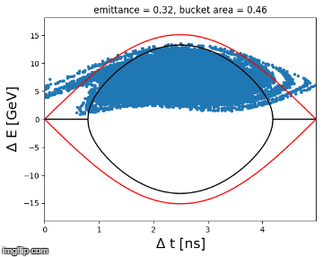
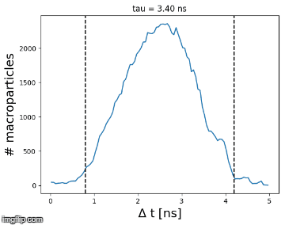
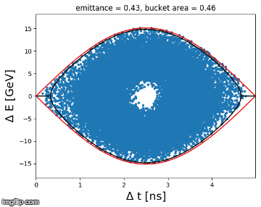
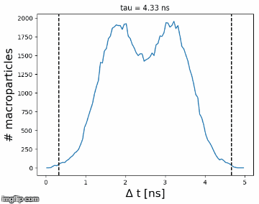
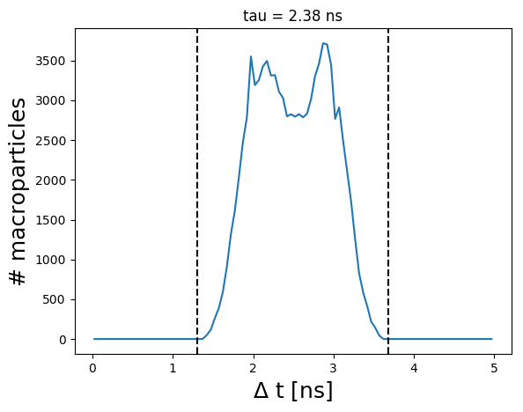
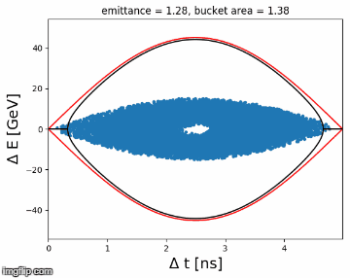
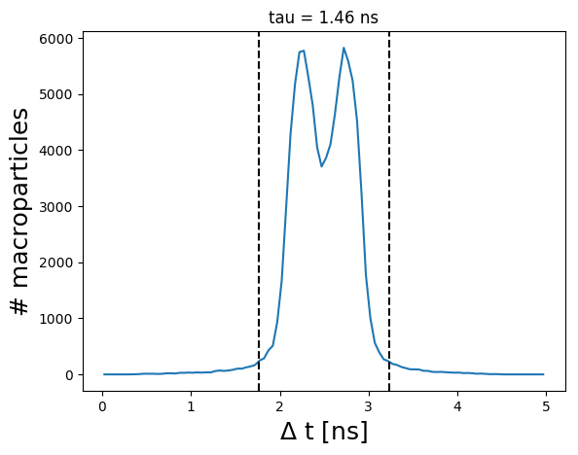
Example 1: capture voltage 2.5 MV
From capture to flat top ($t_{2}$+0.8s -> $t_{4}$)
Before ramp: $ε_{l}^{av}$= 0.42 eVs/A
After ramp: $ε_{l}^{av}$= 0.43 eVs/A
SPS losses = 3.4 %
$F_{E}$= 0.97
Flat top (bunch compression)
At extraction
$ε_{l}^{}$= 0.54 eVs/A, $τ$ = 2.38 ns, losses: 4.7 %
Flat top (bunch rotation)
At extraction
$τ$= 1.46 ns, losses: 5.3 %

Slide 29
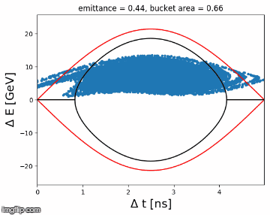
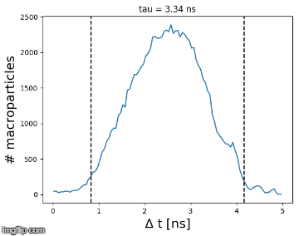
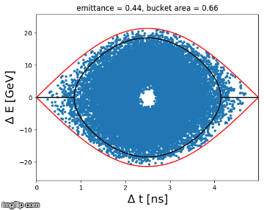
Example 2: capture voltage 5 MV
From capture to flat top ($t_{2}$+0.8s -> $t_{4}$)
Before ramp: $ε_{l}^{av}$= 0.42 eVs/A
After ramp: $ε_{l}^{av}$= 0.43 eVs/A
Losses = 1.9 %
$F_{E}$= 0.85
Flat top (bunch compression)
At extraction
$ε_{l}^{}$= 0.48 eVs/A, $τ$= 2.22 ns, losses: 3.4 %
Flat top (bunch rotation)
At extraction
$τ$= 1.56 ns, losses: 3.6 %

Slide 30
Example 3: capture voltage 7.5 MV
From capture to flat top ($t_{2}$+0.8s -> $t_{4}$)
Before ramp: $ε_{l}^{av}$= 0.39 eVs/A
After ramp: $ε_{l}^{av}$= 0.41 eVs/A
Losses = 1.6 %
$F_{E}$= 0.75
Flat top (bunch compression)
At extraction
$ε_{l}^{}$= 0.44 eVs/A, $τ$= 2.12 ns, losses: 3.5 %
Flat top (bunch rotation)
At extraction
$τ$= 1.64 ns, losses: 3.4 %

Slide 31
Comparison with Q22 and Q26
All the studies done before were repeated changing $γ_{tr}$
Symbol | Units | Value Q20 ($γ_{tr}$=18) | Value Q22 ($γ_{tr}$=20) | Value Q26 ($γ_{tr}$=22.8)
$$p_{d}$$ | GeV/qc | 300 | 300 | 300
$$ε_{l}$$ | eVs/A | 0.125 | 0.125 | 0.125
$$f_{s0}^{t_{2}}$$ | Hz | 79 | 63 | 48
$$V_{rf,max}^{ss}$$ | MV | 0.62 | 0.58 | 0.55
${Δp}_{max}^{ba}$/$p_{d}$ | - | 1.73x10⁻³ | 2.18x10⁻³ | 2.87x10⁻³
$${ΔR}_{max}^{ba}$$ | mm | 5.90 | 5.99 | 6.08
$${Δf}_{rf,max}^{ba}$$ | Hz | 1054 | 1063 | 1072
$$F_{E}^{ss}$$ | - | 0.85 | 0.85 | 0.85
$$α_{end}$$ | - | 4 | 4 | 4
$$V_{rf}^{end}$$ | MV | 15 | 15 | 15
Larger $γ_{tr}$ implies lower $f_{s0}^{}$ and $η$
The slipping speed is slower
The algorithm for batch alignment in BLonD increases automatically $p_{max}^{ba}$
Lower voltage is needed to have the same filling factor in energy

Slide 32
Summary of results for Q20, Q22, Q26 (1/2)
First value -> Q20, Second value -> Q22, Third value -> Q26 (acceptable values are in red)
capture voltage [MV] | $F_{E}$ just before ramp - | max $V_{rf}$ during ramp [MV] | losses in SPS % | $τ$ at extr [ns] | $ε_{l}^{}$at extr [eVs/A] | total losses % | $τ$ at extr [ns] | total losses %
2.5 | 0.97 0.93 0.87 | 8.5, 8.4, 8.3 | 3.4 2.3 1.8 | $2.38$ 2.20 1.96 | 0.54 0.53 0.49 | 4.7 3.2 2.3 | 1.46 1.37 1.21 | 5.3 3.6 2.5
3.5 | 0.92 0.86 0.78 | 9.9, 9.8, 9.7 | 2.3 1.8 1.4 | 2.30 2.14 1.94 | 0.51 0.50 0.48 | 3.7 2.7 1.9 | 1.52 1.40 1.28 | 4.0 3.0 2.1
4 | 0.89 0.83 0.74 | 10.2, 10.2, 10.1 | 2.1 1.7 1.3 | 2.29 2.10 1.92 | 0.50 0.48 0.47 | 3.5 2.6 1.9 | 1.52 1.41 1.30 | 3.8 2.8 2.0
4.5 | 0.86 0.80 0.74 | 10.9, 10.9, 10.8 | 2.0 1.6 1.2 | 2.27 2.11 1.87 | 0.50 0.48 0.44 | 3.5 2.6 1.8 | 1.54 1.43 1.32 | 3.7 2.8 1.9
5 | 0.85 0.80 0.72 | 11.5, 11.4, 11.3 | 1.9 1.4 1.2 | 2.22 2.07 1.90 | 0.48 0.47 0.46 | 3.4 2.5 1.8 | 1.56 1.45 1.35 | 3.6 2.7 1.9
5.5 | 0.83 0.77 0.70 | 12.0, 12.0, 11.9 | 1.8 1.4 1.2 | 2.19 2.03 1.85 | 0.47 0.45 0.44 | 3.4 2.5 1.8 | 1.57 1.47 1.37 | 3.5 2.7 1.9
6 | 0.80 0.75 0.67 | 12.5, 12.4, 12.3 | 1.7 1.4 1.2 | 2.16 2.03 1.84 | 0.45 0.45 0.43 | 3.4 2.6 1.9 | 1.58 1.47 1.37 | 3.5 2.6 1.8
6.5 | 0.80 0.73 0.66 | 13.0, 12.9, 12.9 | 1.7 1.4 1.1 | 2.14 2.02 1.85 | 0.45 0.45 0.44 | 3.4 2.6 1.9 | 1.61 1.49 1.38 | 3.4 2.6 1.8
7.5 | 0.75 0.71 0.65 | 14.0, 14.0, 13.9 | 1.6 1.3 1.1 | 2.12 1.93 1.77 | 0.44 0.41 0.40 | 3.5 2.7 2.1 | 1.64 1.52 1.43 | 3.4 2.6 1.8
BUNCH COMPRESSION
BUNCH ROTATION
Fixed the capture voltage and increasing $γ_{tr}$, the bucket area increases and $F_{E}$ decreases
However $V_{rf}$ during ramp decreases only slightly ($F_{E}$ is kept constant during ramp)
Increasing $γ_{tr}$ the synchrotron frequency decreases strongly
Filamentation continues during the acceleration to flat top (increase of emittance and $F_{E}$).
However small error in $F_{E}$ ($≤$ 3%) comparing the values just before ramp and at flat top
However the obtained results at extraction with Q22 and Q26 are better than the ones with Q20

Slide 33
Summary of results for Q20, Q22, Q26 (2/2)
BUNCH ROTATION
___
___
compression ---- rotation
compression ---- rotation
5%
1.65 ns
Bunch compression is insufficient for the HL-LHC requirements
Bunch rotation is sufficient independently of the optics used and for capture voltage >2.5 MV
Losses inside SPS, total losses and bunch length at extraction are lower increasing $γ_{tr}$
However lower filling factor could be detrimental when intensity effects will be introduced
Supposing to keep a filling factor of 0.85 during slip-stacking and along the ramp, the optimal values for capture voltage would be $V_{Q20}^{ca}≈5$ MV, $V_{Q22}^{ca}≈4$ MV, $V_{Q26}^{ca}≈3$ MV

Slide 34
Contents
Introduction
Slip-stacking principle
Slip-stacking simulations in SPS, setting up
Slip-stacking simulations in SPS, first results
Conclusions and next steps

Slide 35
Conclusions and next steps
The principle behind slip-stacking has been illustrated through different examples
The implementation inside the CERN BLonD code has been explained
The slip-stacking procedure has been simulated for the SPS-ion beams to verify its feasibility after LS2
Simulations included acceleration to flat-top but no intensity effects
Many ring parameters were designed (voltage and RF programs during and outside the slip-stacking time, duration of the different cycle phases)
Effort spent to use realistic bunch distributions, however the variability of the emittance along the batch before slip-stacking was not reproduced
Realistic losses count mechanisms and machine parameters used
The three different optics have been tested
Simulation results:
Bunch rotation at flat top is the only mean to satisfy HL-LHC requirements
Suggestions for the RF program have been given for the three optics
Next steps:
Variability of emittances and intensities along the batch before slip-stacking
Addition of intensity effects
Simulate injection into LHC bucket to count losses in a even more realistic way

