Slide 1
Monday 9:00
2018-04-23

Slide 2
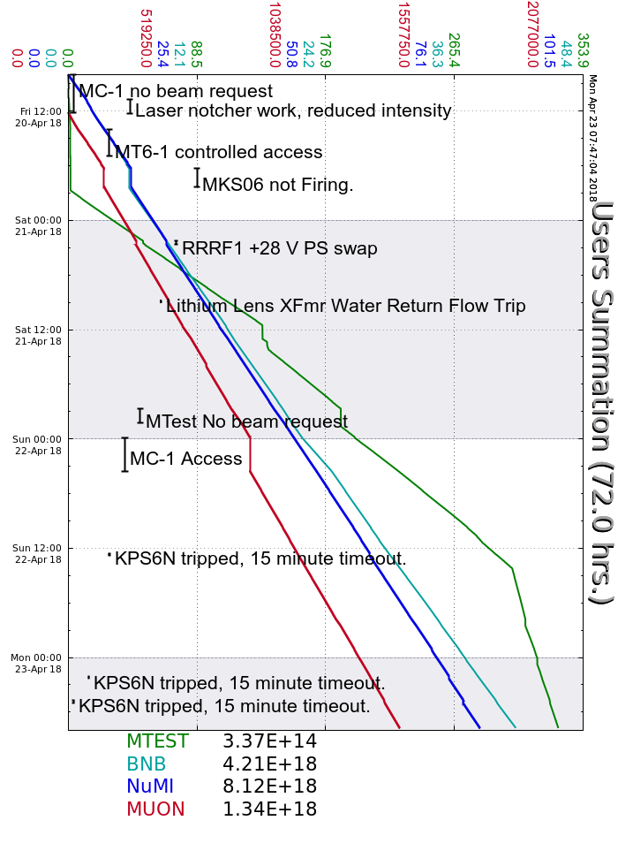
Friday
Laser notcher work
MKS06 trip, experts re-terminated cable
Saturday
RR RF01 trip, replaced +28 V PS
Lithium Lens transformer water return flow trip, noisy sensor, reset locally
NuMI neutralization tank high alarm, experts recovered evaporators
R:KPS5A delay fire trips, experts came in and adjusted trip limits
MIRF09 FBS door trips, adjusted interlock switch
Sunday
I:KPS6N filament trip, 15 minute timeout to reset
RFQ 4616 anode overload trips, reset locally
MIRF14 Cavity water leak indication, running without
Monday
Two more I:KPS6N filament trips
RFQ 4616 anode overload trips, reset locally
Current Conditions
Beam to NuMI, BNB, MTest and Muon Campus

