Slide 1
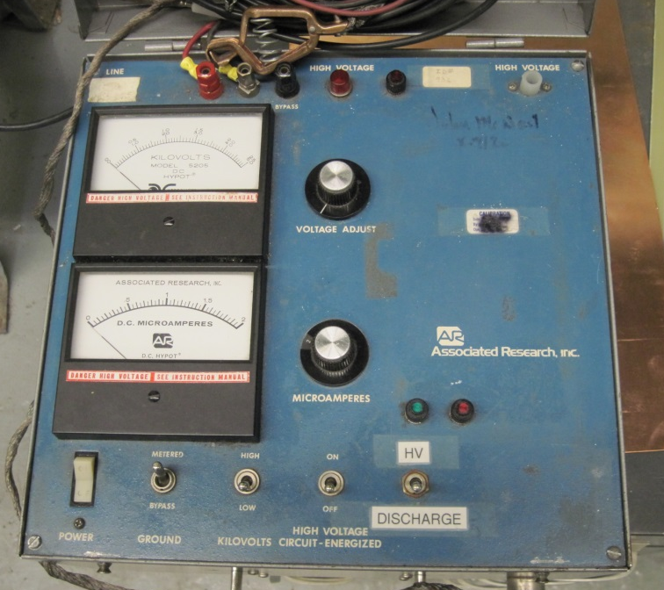
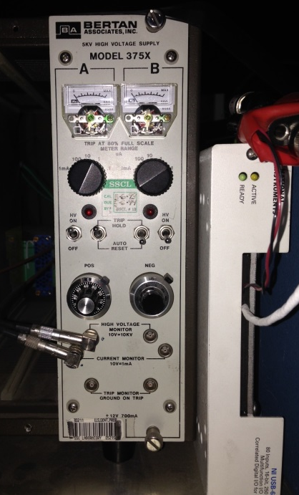
Hipot test units in LAPR
Manually-operated units with possibility of the analog remote control
LBNL
FNAL
BNL
An upgrade for a newer automated hipot system of same type, to be used by all labs may be desirable

Slide 2
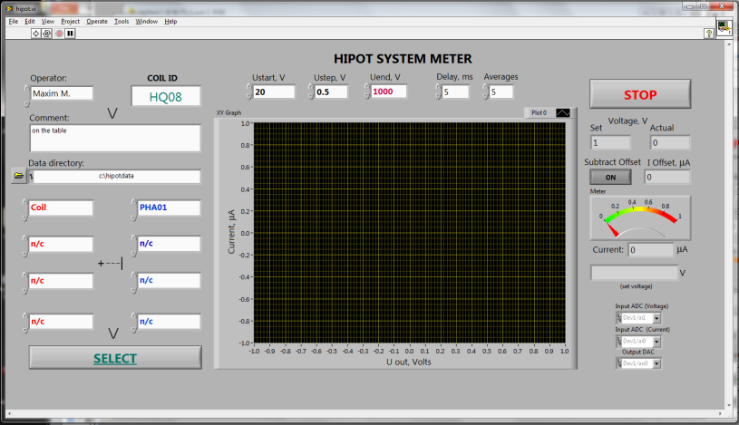
Hipot hardware at LBNL
We use Bertan 375X 5 kV power supply interfaced with NI DAQ / Labview control to ramp up voltage and measure leakage current. The setup allows to:
Controls voltage step, ramp rate and number of averages
Stores I-V data (.CSV) and graphs (JPG)
Safely interrupts voltage ramp, manually or by auto-trip at ∼80% of the current range
Typically we ramp up voltage at 1 V increments, at ∼4 V/s. Optional stops can be made at pre-set voltages
We normally choose current range of 1 μA; power supply then automatically “trips” at 0.8 μA
10 MΩ resistor is installed in series with the tested pair, to limit the current

Slide 3
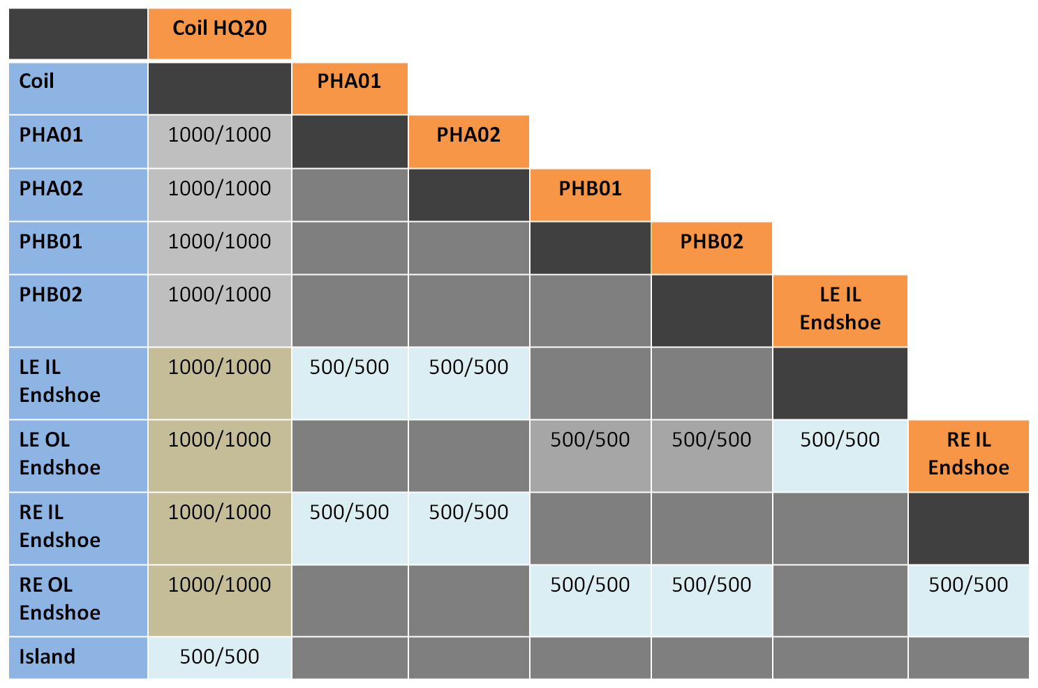
Hipot test table
HQ Coil 20
Current trip limit: 1 μA
Pairs | V_{limit}
Coil –> Heaters | 1000
Coil –> Endshoes | 1000
Coil –> Central Island | 500
Heaters –> Endshoes | 500
Endshoe –> Endshoe | 500
Positive electrode
Negative electrode

Slide 4
Recommendations on hipot testing
From the “ Electrical QA guidelines for magnet assembly and test” document (5/2014):
-> Note that the measured current I_{leak} = C*dV/dt + V/R. The first term can be large if ether capacitance C of the tested pair or ramp rate dV/dt is large. The former generally increases with coil dimensions; the latter is typically set to ∼4 V/s by choosing 1 V voltage increment step in the program. Ramp rate can be increased if the capacitance of the tested pair allows it, but voltage steps larger than 5 V are not recommended. It is a good idea to keep the capacitive contribution to I_{leak} below 0.2 μA.
-> One should watch the I-V curve plotted during test. If the slope is positive and constant, it means that resistive leakage is prevalent; this often happens due to excessive air humidity. A non-linear and/or jumpy I-V curve may be indicating an ongoing breakdown(s). Only if the PS trips on a linearly rising voltage, one can choose the 10 μA range and repeat the test; otherwise hipot failure is normally recorded.
-> Hipot testing may be potentially destructive to the coil, as conductive carbon channel can form along the breakdown path. The probability of this happening seems proportional to the stored energy of the junction that is CU²/2. Thus repeated testing of high-capacitance junctions (or high voltage stress) should be avoided when not absolutely necessary. Also, pairing several junctions together to speed up testing should be done carefully, to avoid building up excessive capacitance. Again, having < 0.2 μA of capacitive current at nominal ∼4 V/s ramp rate is a good starting criterion.

