Slide 1
APA5 installation and cold test results

Slide 2
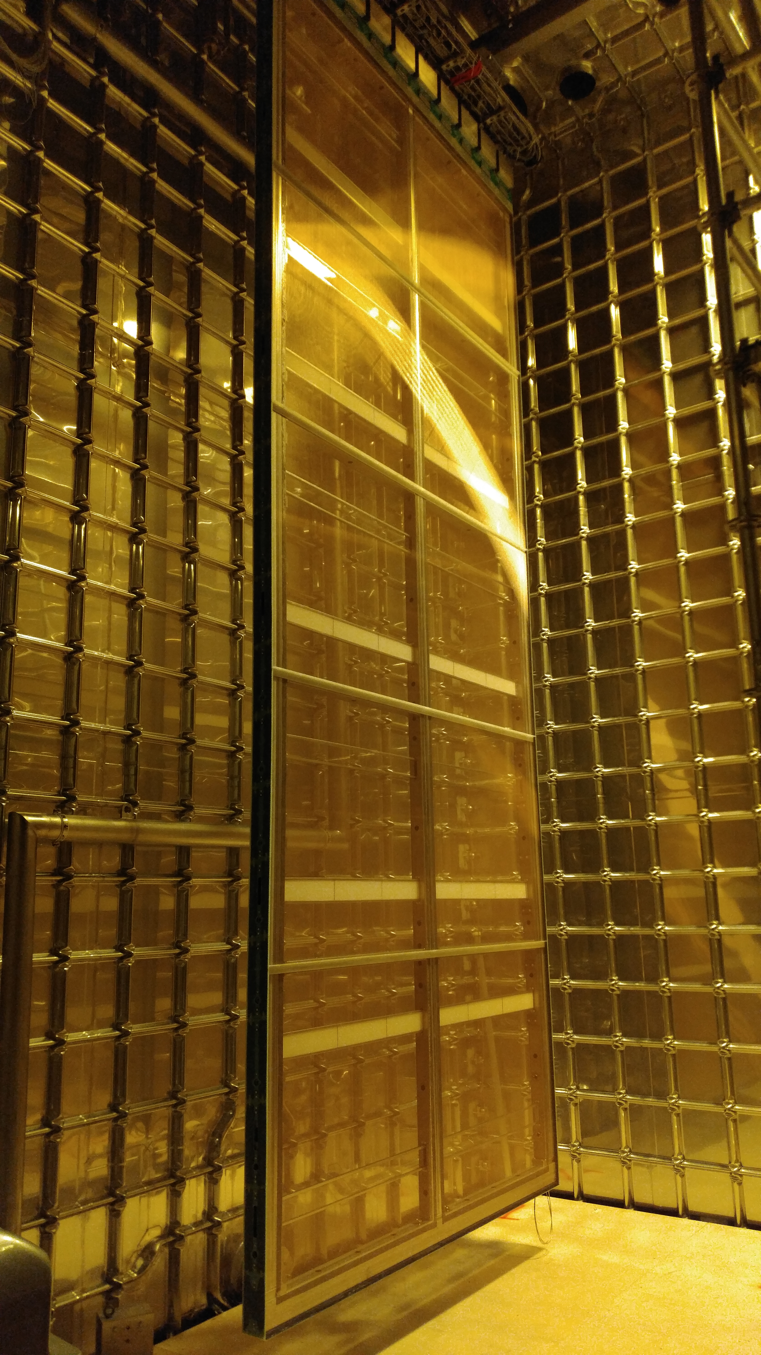
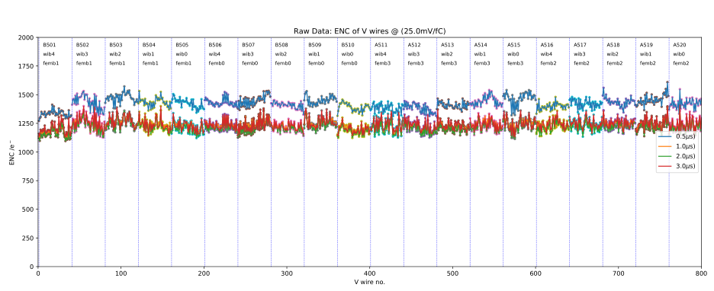
APA5 CE installation
(as usual) All 20 CE boxes have been tested before and after installation on APA5
The link connection between CE boxes and WIBs has been tested after the Cold Box flange cabling -> All FEMB were alive
<number>

Slide 3
(APA5) Overall Noise at Cold (~170K)
FE ASIC: 500pA leakage current
After filtering
After filtering
bias off
bias ON
<number>

Slide 4
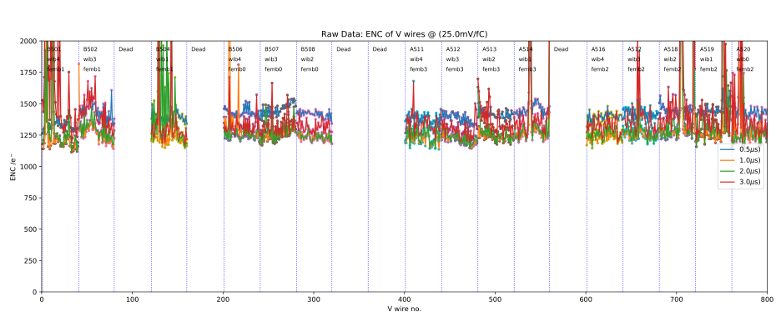
(APA5) Before the cool down
5 FEMB were dead before starting the cool down:
WIB0FEMB0: No power supply (WIB0 has been confirmed good at WIEC position 1) -> problem on the flange connector
WIB0FEMB1: 2 high speed links are broken
WIB0FEMB3: 100MHz clock is missing
WIB1FEMB0: No power supply -> to be investigated
WIB2FEMB1: 100MHz clock is missing
Noise at RT, no gas flow
<number>

Slide 5
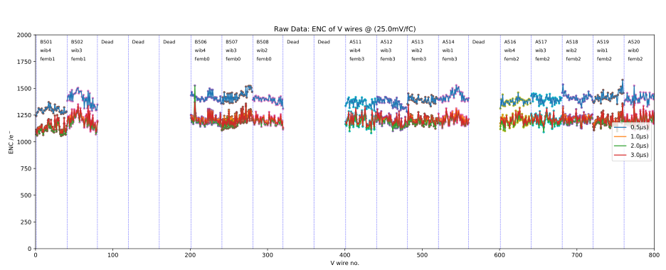
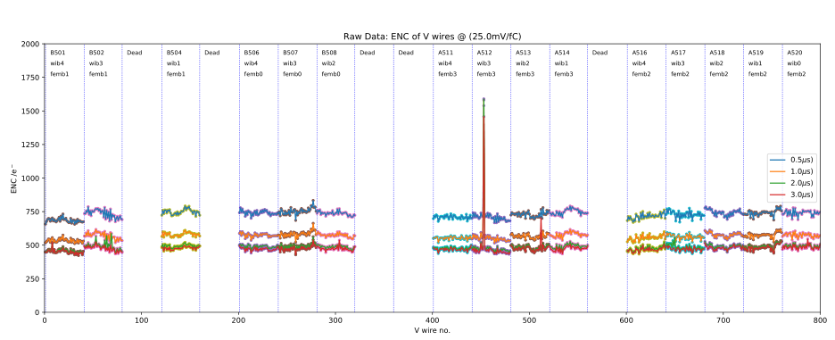
Bias Off (Noise study APA5)
Bias OFF
X=0V
U=0V
V=0V
SHV cables connected
V wires
Y axis:
Noise (range: 0~2000 e⁻)
X axis
APA Channel Number (range: 1~800)
Noise at RT, no gas flow
12run09rms
Configuration | Channels affected by bias
RT, no gas flow | 0
Before cooldown RT, warm gas flow | 0
Cold, cold gas flow | 1
After warmup 250K, warm gas low | 0
Noise at RT, warm gas flow
17run02rms
Noise at Cold, cold gas flow
18run02rms
<number>

Slide 6
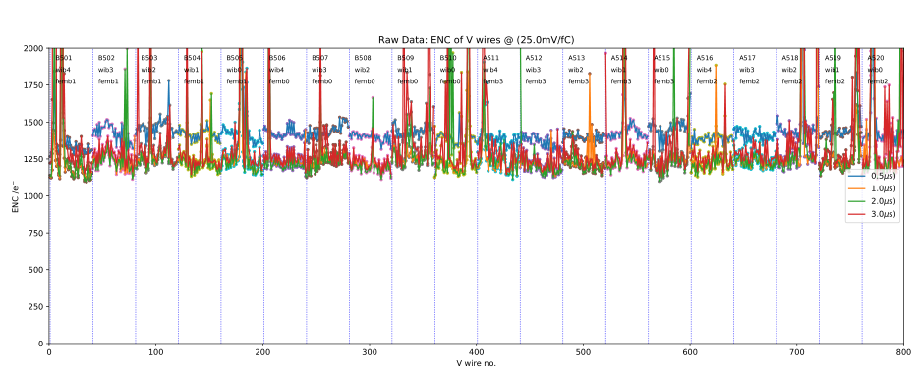
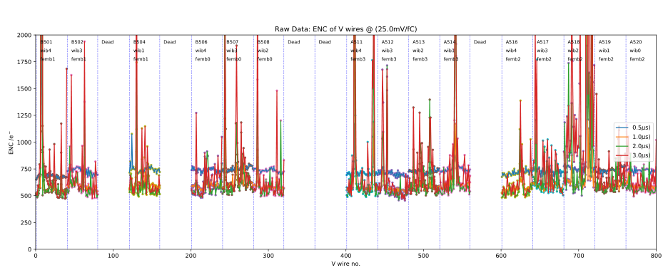
Bias On (noise study APA5)
Bias ON
X=820V
G=-665V
U=-370V
V wires
Y axis:
Noise (range: 0~2000 e⁻)
X axis
APA Channel Number (range: 1~800)
Noise at RT, no gas flow
12run05rms
Configuration | Channels affected by bias
RT, no gas flow | 0
Before cooldown RT, warm gas flow | 278(15FEMBs)
Cold, cold gas flow | 301(15FEMBs)
After warmup 250K, warm gas low | 444(15FEMBs)
Noise at RT, warm gas flow
17run03rms
Noise at Cold, cold gas flow
18run03rms
<number>

Slide 7
Summary
15 CE boxes on APA5 were good during the cold test
5 CE boxes were dead before cooldown
Just 3 CE boxes have been replaced, the other 2 boxes were good (connection problem)
Low frequency noise is related to the bias voltages
If bias voltages increase, more channels suffer serious low frequency noise
If bias voltages increase, low frequency noise becomes larger
Averaging FFT indicates that bias introduces coherent noise
~30Hz, 65Hz and 140Hz spikes
However, these spikes only contribute a little amount of low frequency noise
Low frequency noise is (probably) related to the gas flow
Indicates that the low frequency noise is very possible caused by wire vibration
<number>

