Slide 1
Passive Ganging of Hamamatsu SiPMs
Adam Para, Dante Totani
March 1, 2018

Slide 2
Ganging Boards and Setup
Boards designed and operated by Dante Totani
Two board designs, allowing for mounting up to 12 or up to 8 SiPMs per board
The actual SiPMs included in read out can be (de)selcted by removing the resistor connecting the SiPM
SiPM’s illuminated with low intensityLED light
SiPM s read out with a modified SSP with external trigger (LED pulser)
SiPMs placed inside an environmental chamber and operated at -70C

Slide 3
Data Sets
1sipm_board_x1
2sipm_board_x2
4sipm_board_x4
8sipm
4+8sipm
4sipm
6sipm
2sipm_board_x4
1sipm_light_board_x1
1sipm_light_5_in_board_x2
1sipm_light_5_in_board_x4 1sipm_light_5_in_board_x8
light5_board_x8_shortcable
light5_board_x8_longcable
Test performance of SiPMs as a function of the ganging level. 1,2,4 and 8 SiPM,s ganged onto one readout channels. 4 and 8 SiPMs boards connected in parallel to investigate x12 ganging
Select subset of SiPMs by disconnecting 2 and 4 SiPMs on x8 board and 2 SiPMs on x4 board.
Illuminate only one SiPM on a board
Test a potential impact of long cables (30 m GORE)

Slide 4
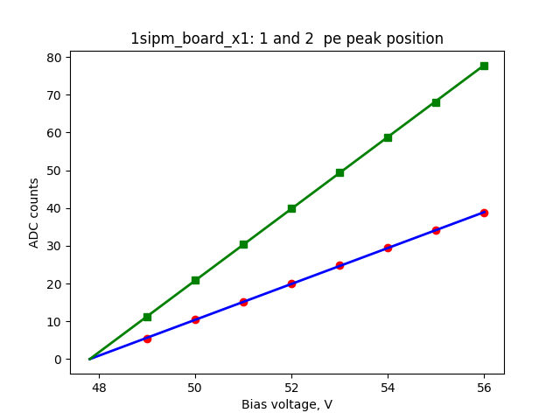
Data Analysis
For every detector configuration 2000 waveforms were recorded at different bias voltages
Low pass filter (elimination to high frequency Fourier components + time-averaging ) was applied
Histogram of the peak values: pedestal peak followed by a number of ‘pe’ peaks. Notice: the relative population of different pe’s reflects the light intensity and the PDE
Position of ‘one pe’ peak (red points on a lower plot) plotted as function of the bias voltage to determine the breakdown voltage (blue line).
Green line is a ‘prediction’: 2x the fitted single pe compared with the actual peak position of the fitted peak. This is just a test of consistency of the data with the expectations.
Figures of merit: position of the 0ne pe peak (Signal) and RMS of the pedestal peak (Noise)

Slide 5
Signal Evolution with Ganging
Signal is proportional to overvoltage. Choose 5V as a typical operating point.
Ganging of SiPMs leads to an increase of the parasitic capacitance of the detector (the capacitance of the pixel, hence the produced charge, staying the same) therefore the observed amplitude of the signal is reduced, as expected
Consistency check: read point corresponds to one SiPM illuminated on the x8 board. The one pe signal is the same as that in the case when the entire SiPM is illuminated

Slide 6
Noise Evolution with Ganging
Noise has several components. In the present system the SSP contribution is likely to be dominant
Noise (RMS of pedestal) strongly depends on the filtering/analysis procedure. Results presented here are likely to be far from optimal.
Increased capacitance of the ganged SiPMs is an additional source of the noise (0.4 -> 0.6 for 12 SIPMs)
Reading only one of the SiPMs on a ganged board of 8 (the red point at N=1) shows the noise consistent with the N=8. As expected.
Long cables can be an additional source of noise). Results with 30m long GORE cable are somewhat surprising (lower point at N=8). The quality of the cables/connectors likely more important than the length?

Slide 7
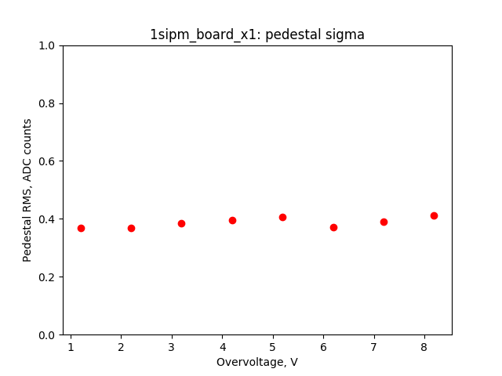
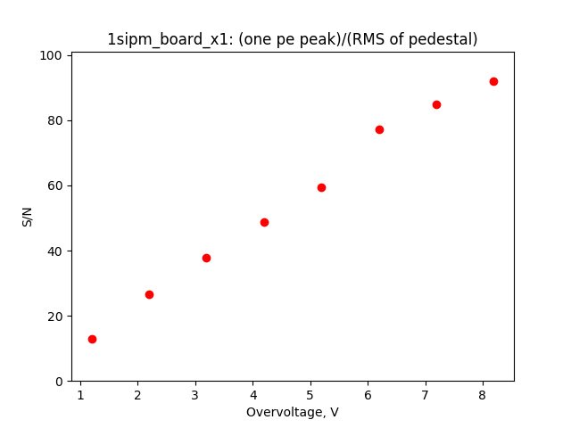
Figure of Merit
The S (signal) is proportional to the overvoltage
The N (noise) is determined by the cables/environmental conditions and it is independent of the bias voltage
Operating conditions should be optimized for the overall performance of the experiment

Slide 8
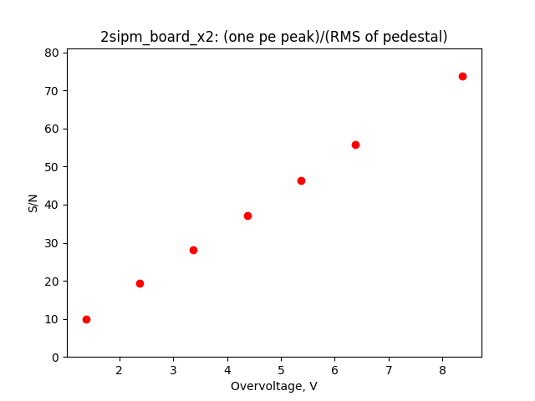
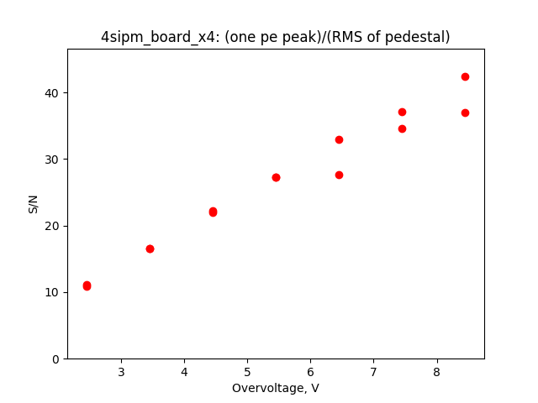
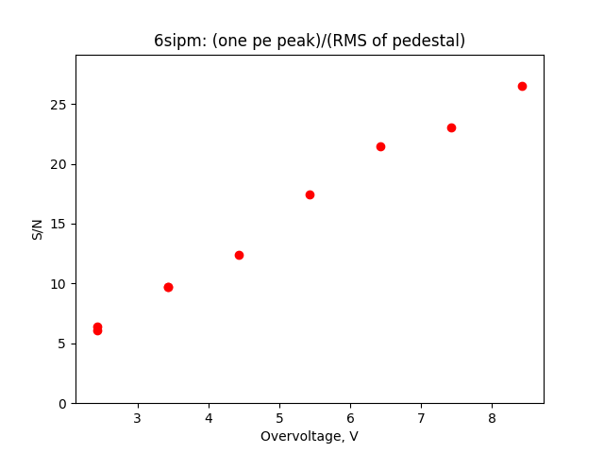
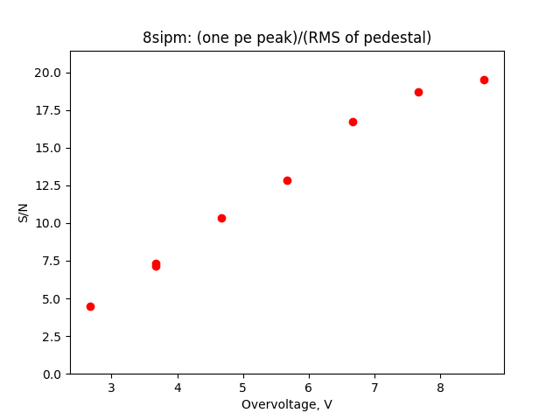
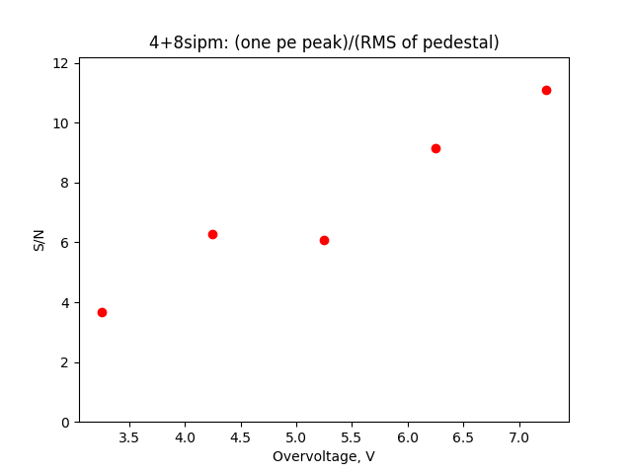
FOM = (One pe)/(RMS of pedestal)

Slide 9
Summary
Signal observed with the ganged SiPMs operated at 5V of overvoltage decreases from ~25 ADC for N= 1 to ~ 5 for N=12
The overall noise level of the system depends critically on the details of the filtering and analysis. The results presented here were obtained with very minimal optimization of the noise cancellation
Ganging of the SiPMs increases the overall noise from 0.4 ADC count at N=1 to 0.6 ADC count at N=12.
The noise level does not depend on the bias voltage
Backup includes detailed results for many configurations. They include: FOM, gain calibration, signal and noise RMS and different overvoltages and examples of the actual pulse height spectra at various bias voltages.

Slide 10
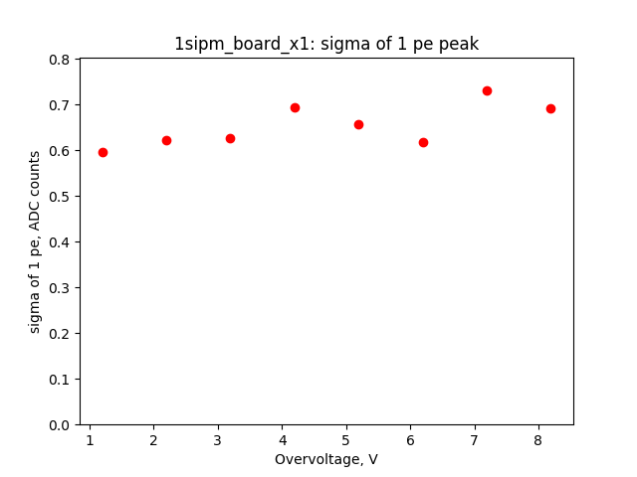
1sipm_board_x1

Slide 11
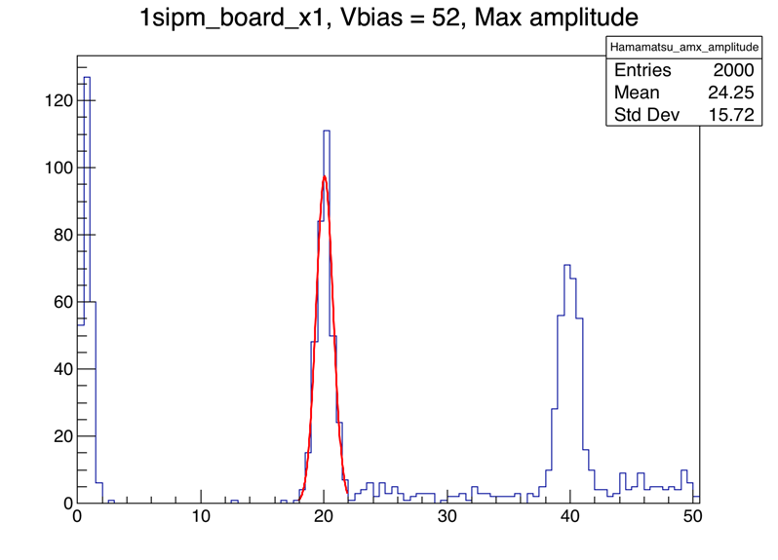
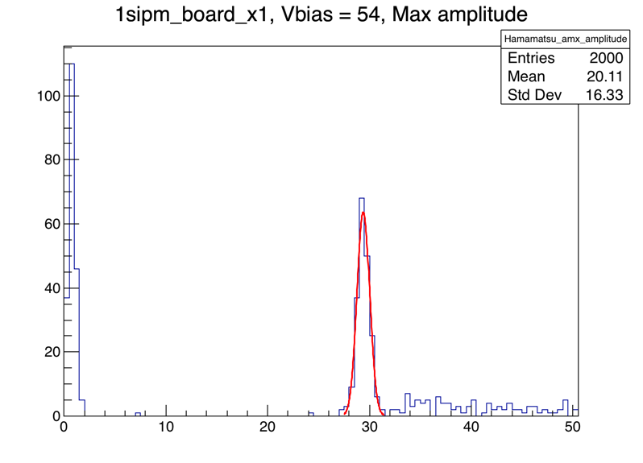
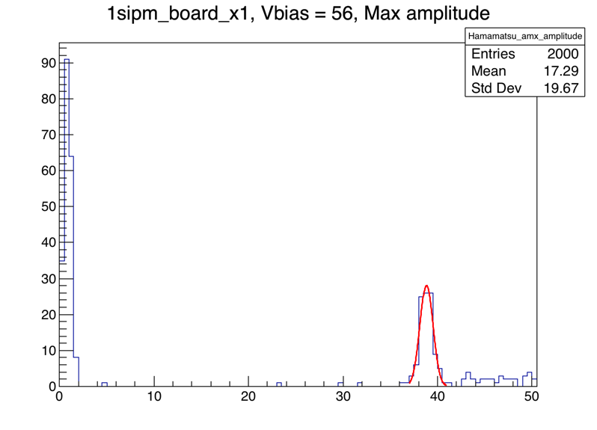
1sipm_board_x1

Slide 12
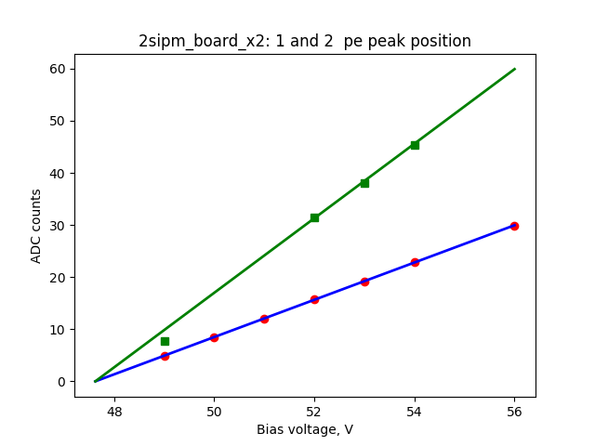
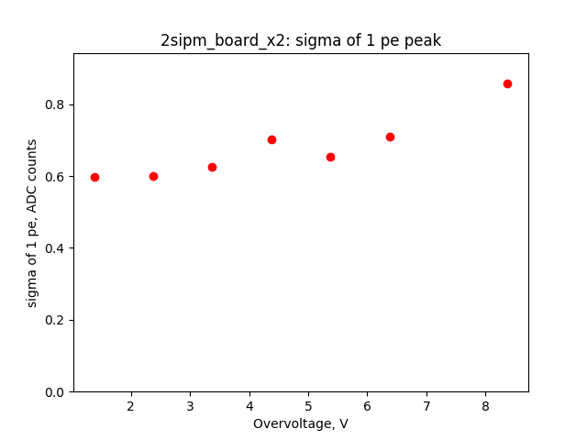
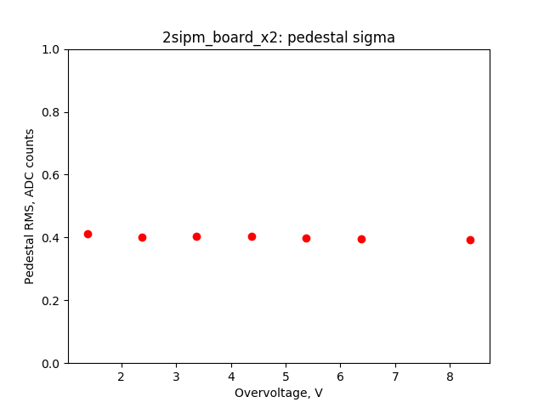
2sipm_board_x2

Slide 13
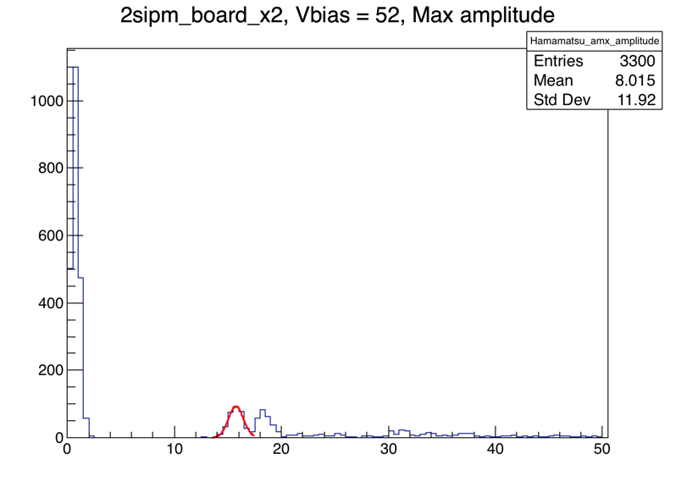
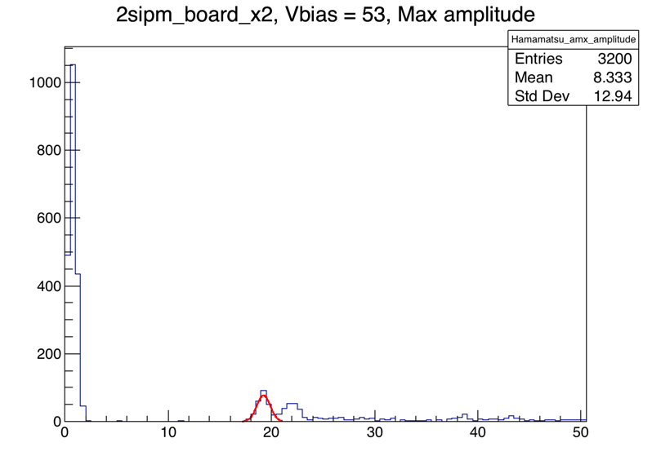
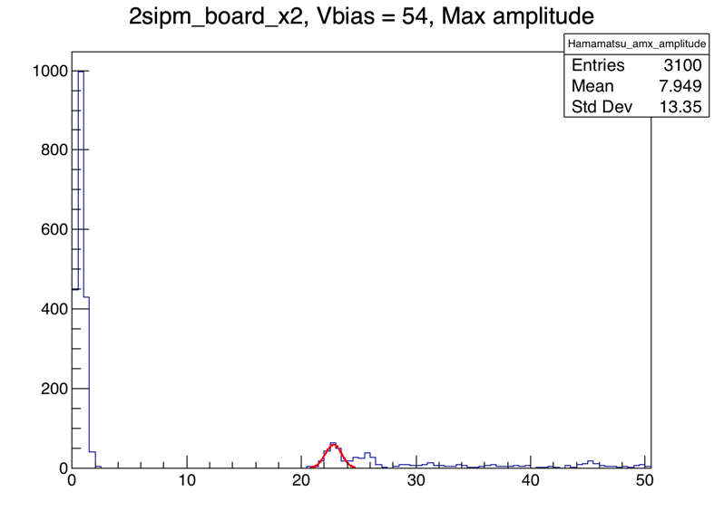
2sipm_board_x2

Slide 14
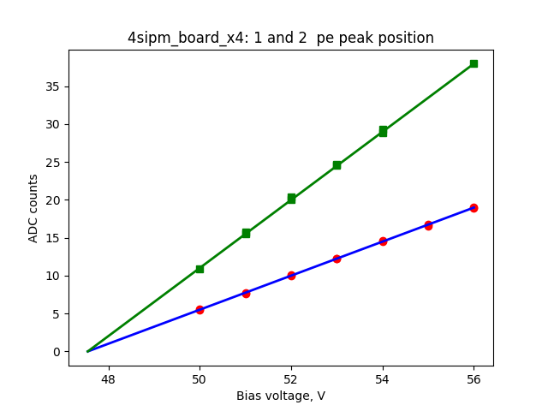
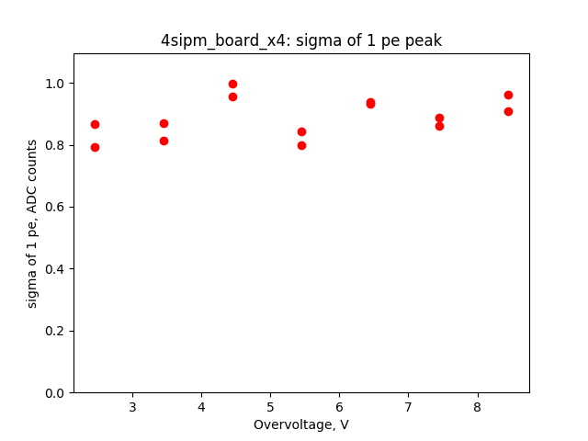
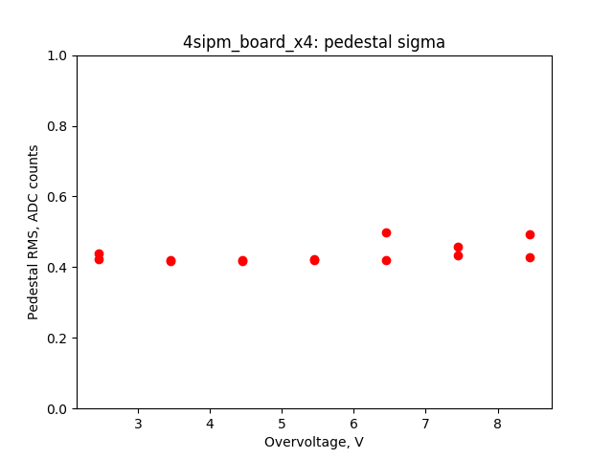
4sipm_board_x4

Slide 15
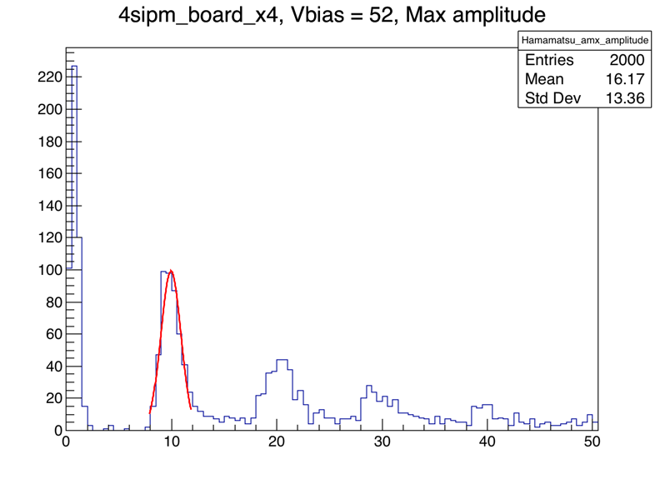
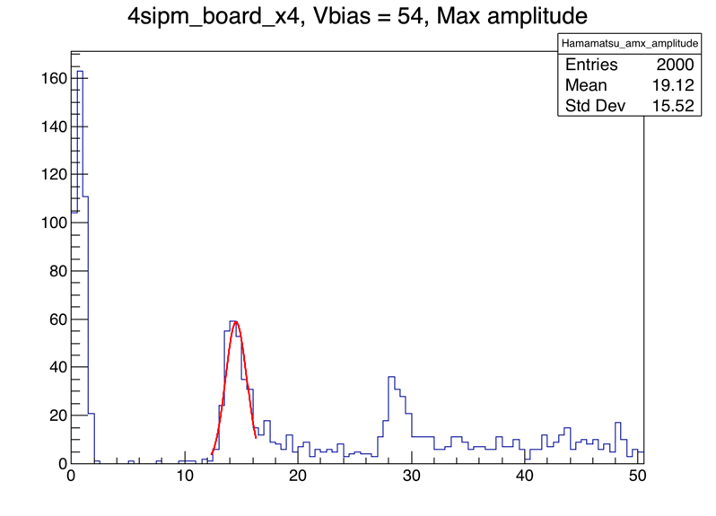
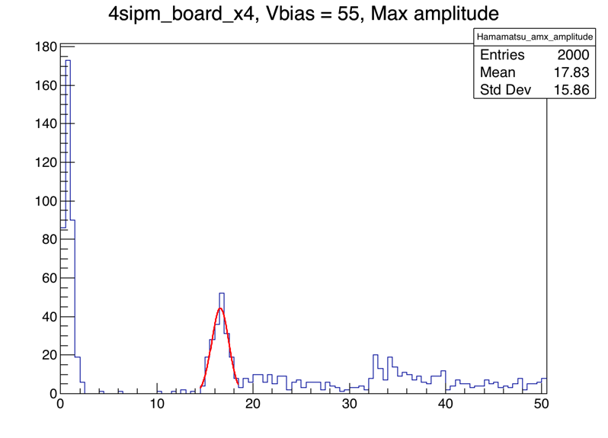
4sipm_board_x4

Slide 16
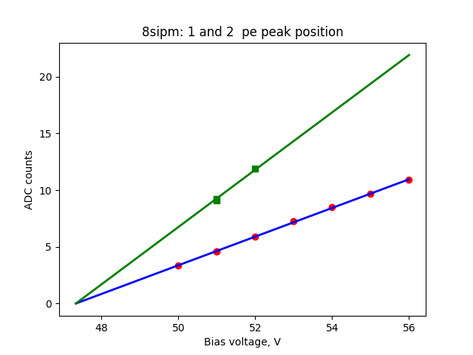
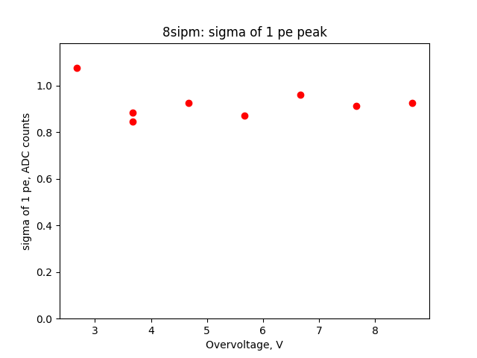
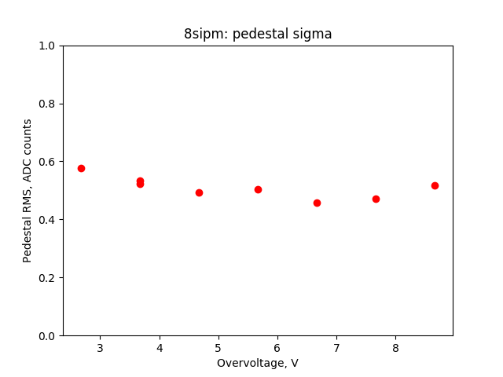
8sipm

Slide 17
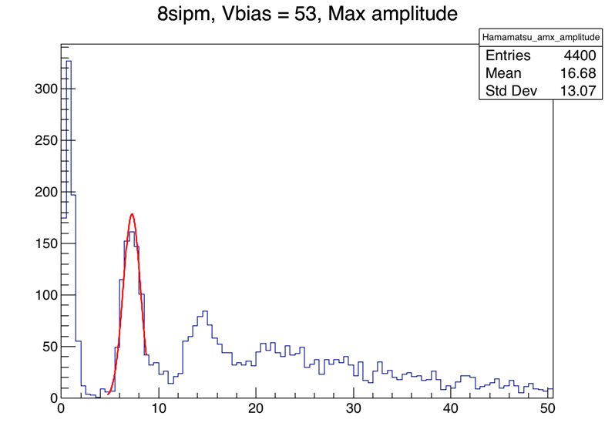
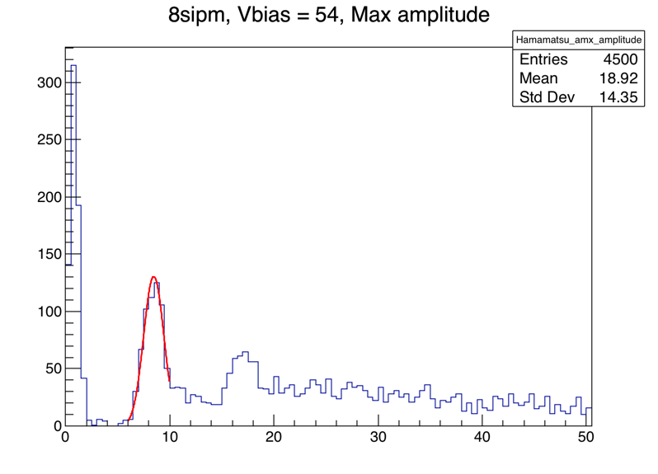
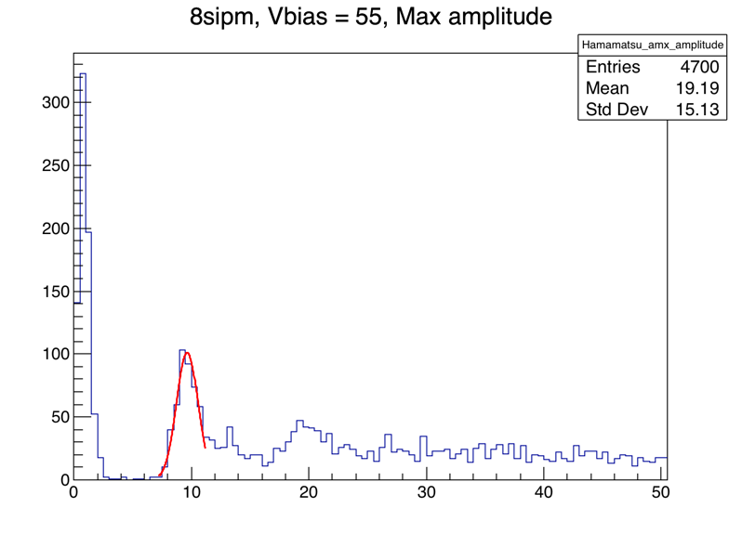
8sipm

Slide 18
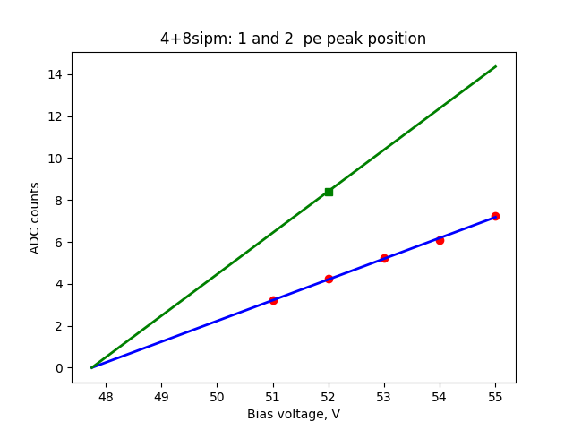
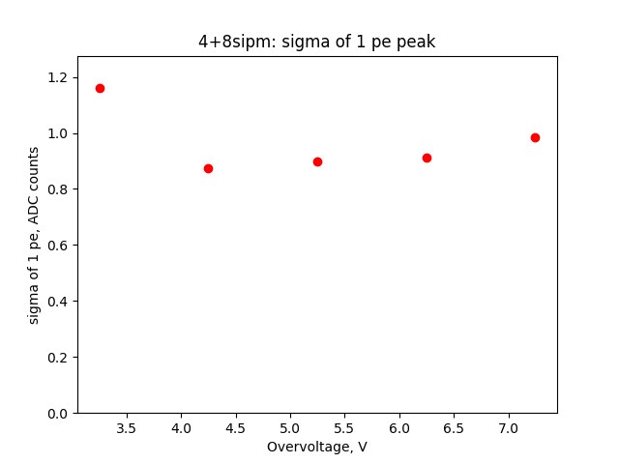
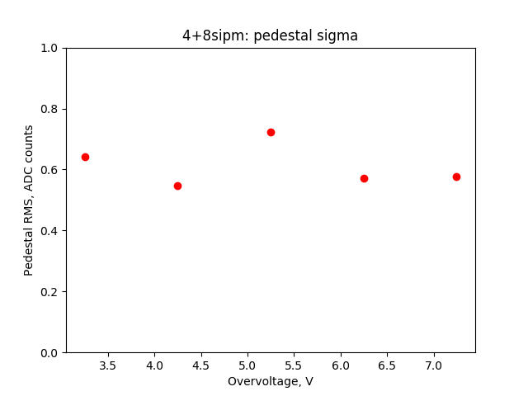
4+8sipm

Slide 19
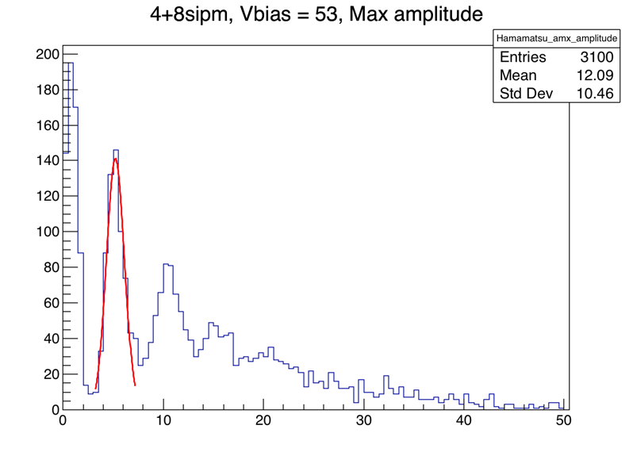
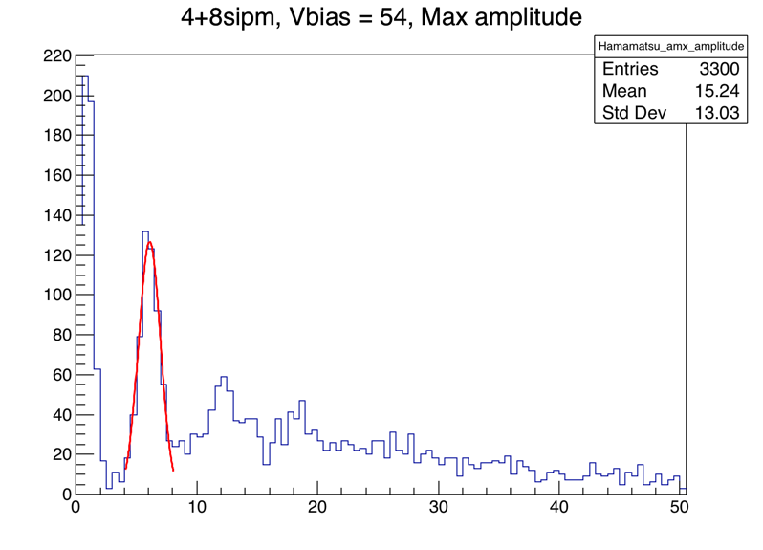
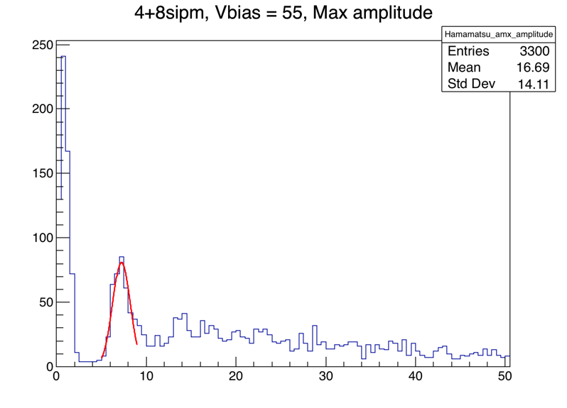
4+8sipm

