Slide 1
Machine status
Ming-Jen Yang
Friday 9:00am Meeting,
April 27, 2018

Slide 2
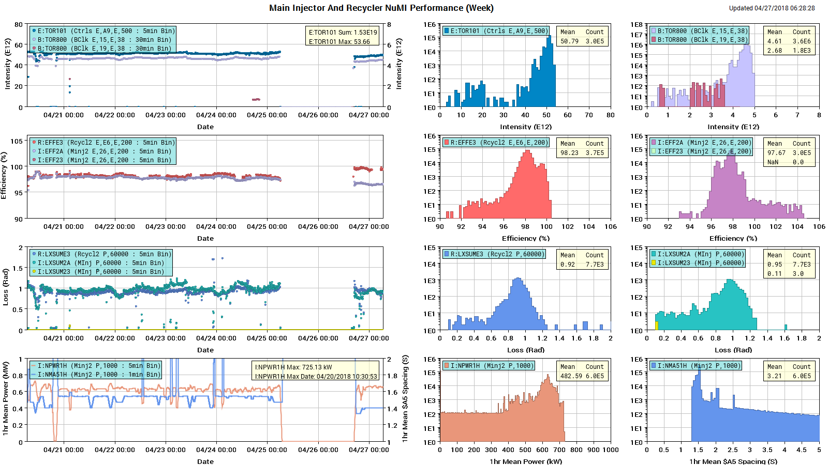
NuMI

Slide 3
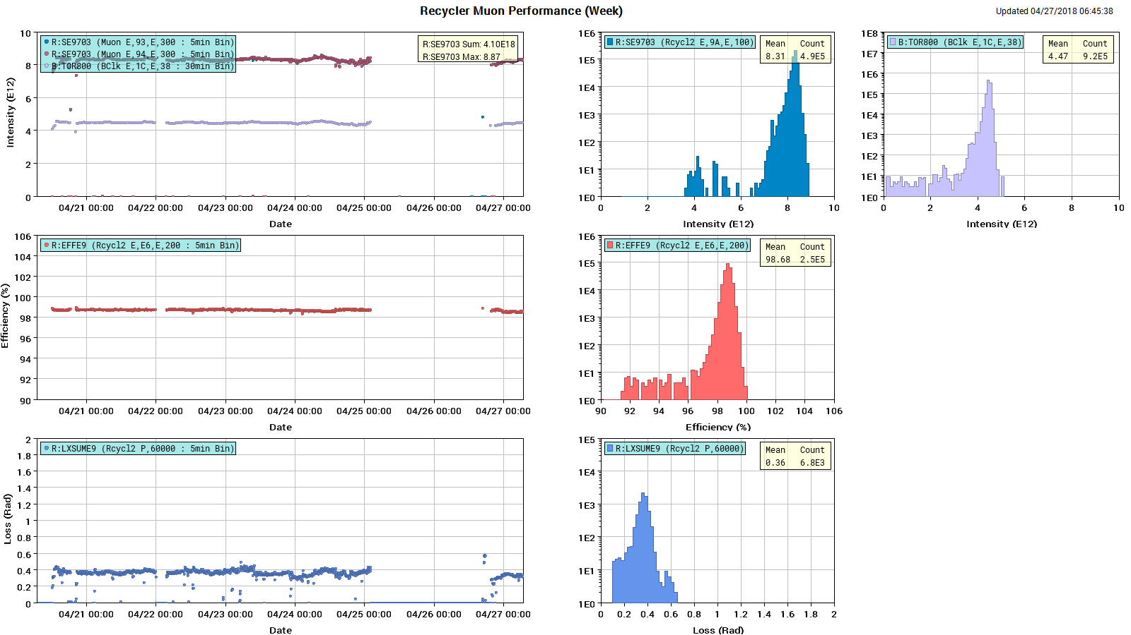
Muon

Slide 4
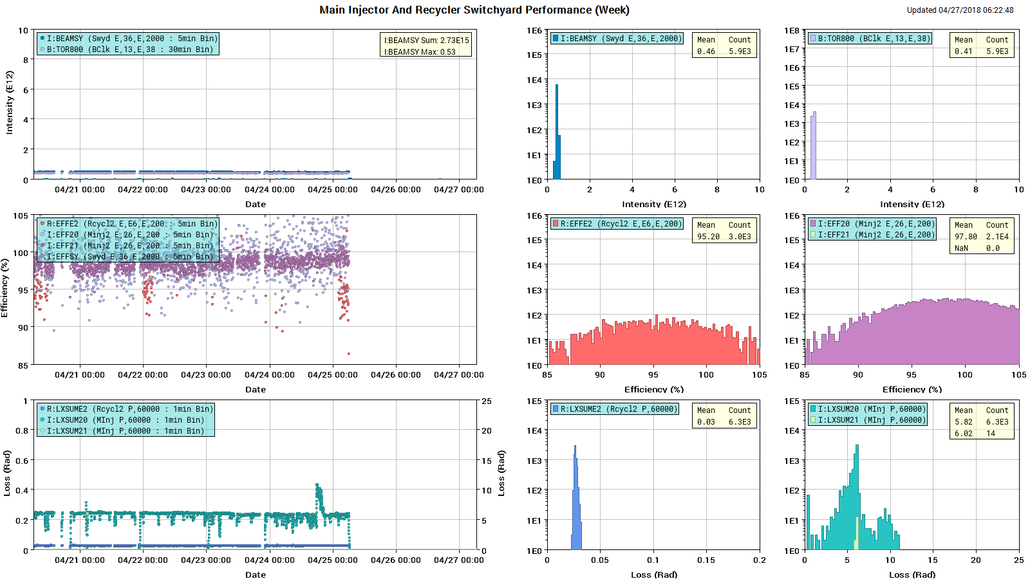
SY

Slide 5
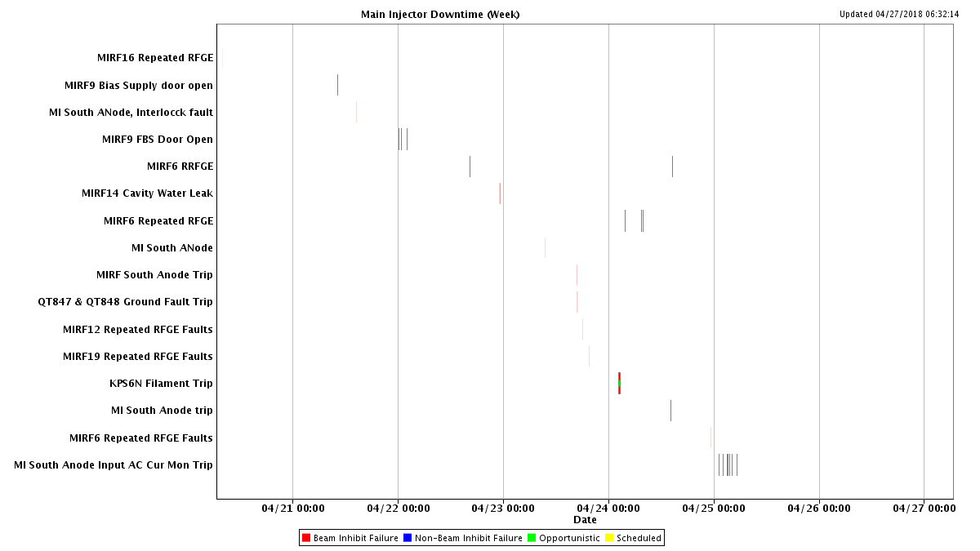
MI Downtime

Slide 6
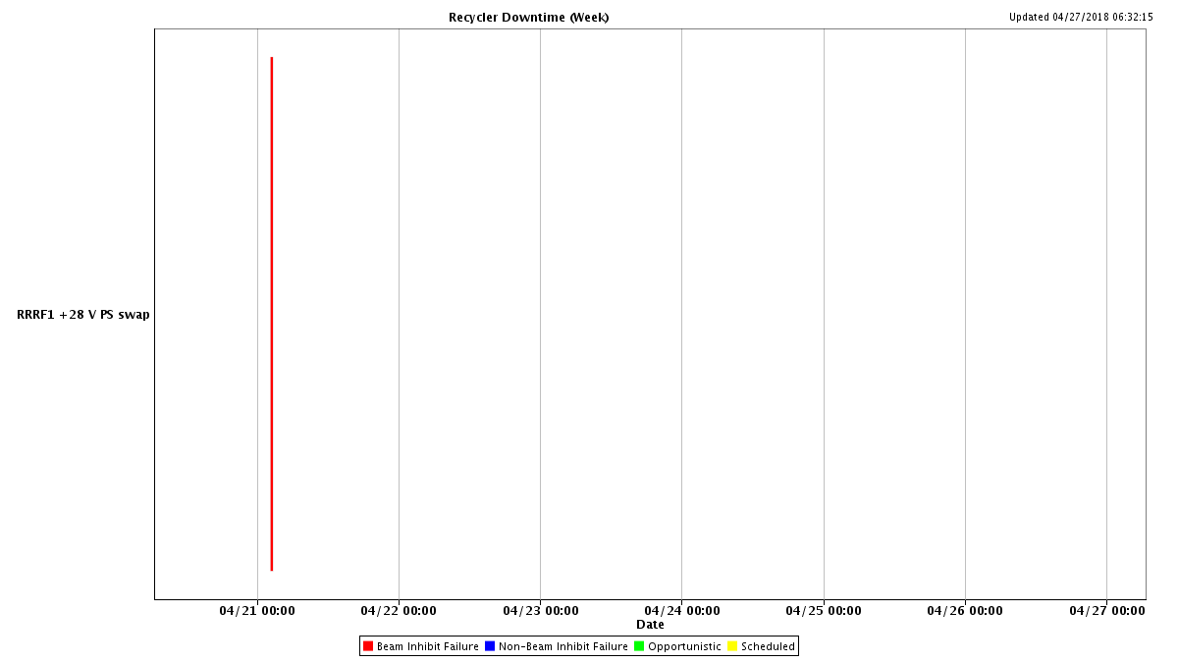
RR Downtime

Slide 7
Wednesday & Thursday shutdown
MI30 ion pump cable
MI8 line ion pump HV connector
MI60 north bus penetration
Found likely cause for soft ground fault.
Looking for ways to divert rain water away from service building
MI60 RF
South Anode trip limit was adjusted higher
MIRF14 found aspirin tablet evaporated over time, no water leak.
Found MIRF10 water leak and was fixed.

Slide 8
Studies
1.2 sec fast ramp.
MI TBT lattice measurement
RR TBT lattice measurement

