Slide 1
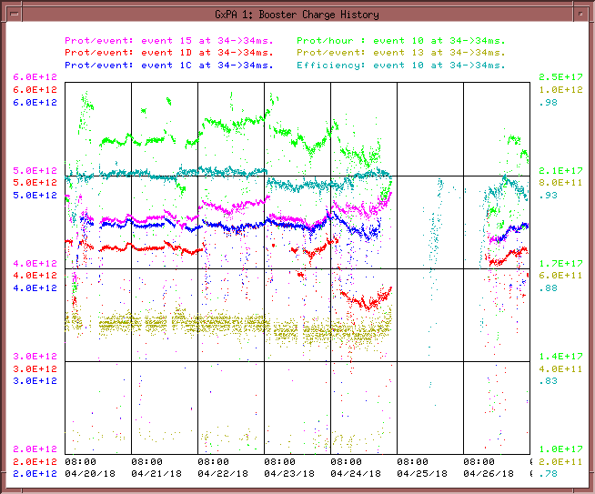
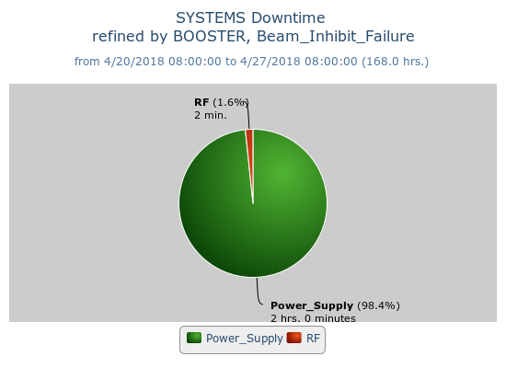
Booster Operations 4/20/18 – 4/27/18
F
T
F
F
Sa
Su
M
F
F
F
W
F
Sa
W
F
F
F
F
F
F
F
Sa
Su
Su
M
Tu
F
F
F
M
M
Su
M
Th
F
M
W
W
W
Th
Sa
W
F
F
Sa
Tu
F
Sa
F
F
Sa
Su
M
F
M
F
Sa
Su
M
Sa
Su
M
Tu
Th
Su
Su
Sa
Su
F
Sa
M
F
Sa
F
W
Su
W
F
M
W
Th
F
Sa
M
F
Sa
Su
W
Th
F
F
Su
W
F
Sa
Su
M
Tu
Sa
M
Su
M
M
W
Th
F
M
F
Su
M
W
Sa
Su
u
F
Sa
Th
Sa
M
W
F
Sa
Su
W
F
Su
M
Capture/Transition Issues
Access to replace BRF16 Cavity
MKS06 Kicker
BRF8 Cable Fault
DOGL3 Flow Switch
MKS06 Cable Termi
Collimator Studies
Downtime:
2hr downtime to repair faulted PFN cable for MKS06 extraction kicker Friday evening.
Access, BRF21 installed
Studies
Scheduled shutdown
MKS06 PFN fault
This week:
General tuning. Working to increase efficiency and intensity post shutdown.
Currently $15 ~4.45E12 92%, $1C ~4.44E12 92%, $1D ~4.16 E12 92%,
Opportunistic access Wednesday, BRF Station Fan-back phase measurements, BRF16 damper plate repair, found during inspection of cavity. BRF21 small water leak found and repaired. Spare TORL10 amp installation. MP03 Ion Pump PS, Notch Absorber LVDT checkout.
Studies this week:
RF balancing studies
Capture studies

