Slide 1
Muon Campus Status
Brian Drendel
Weekly Status
April 27, 2018

Slide 2
Beam to g-2 this week
Continued tuning improvements.
Access Period
  D30 Vacuum
  Comprehensive Rad Survey
  Target Station Work
  D:IB Substation Upgrade
  Power Supply Work
  LCW Leak Repair
  Interlocked detector change

Slide 3
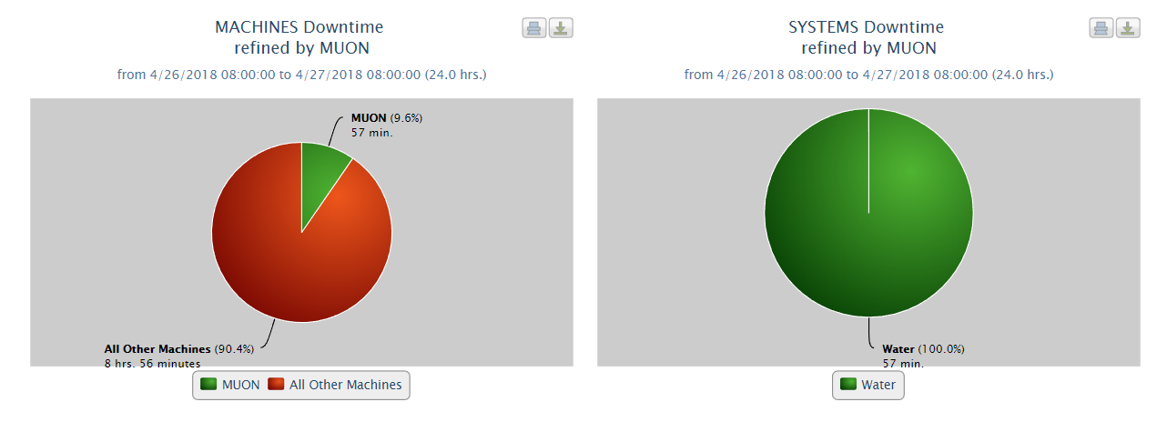
Downtime
A0 compressor trip
Lens transformer water flow trips
  Periodic trips due to flakey readback
  Replaced flow meter during Thursday’s downtime.
  Problems with readback from new flow meter.

Slide 4
Upcoming Studies
  Tune-up (Morgan) – Couple hours of beam optimization.
  Ap0 chipmunk measurements (Drendel): Transparent to operations
    Data is being be collected with a set of temporary chipmunks in various configurations. At this time, this work is completely transparent to operations.
  Delivery Ring Tune Measurement work (Scarpine). Requires 8 GeV operations.
  Dispersion in RR-Target (Nagaslaev, Adamson). Destructive study. 2-4 hours
    Primary 8GeV transport beam line RR-Target. We need to establish a procedure for the dispersion measurement in this line. We will have to do transfers in a slow manner, kind of 20 sec between transfers and run the waterfall display in the RR for each transfer. We will also modify the RF frequency in RR so that the beam will be slightly off momentum. This change doesn't necessarily impact the yield on the target, but may result in increased beam losses, while tuning. This study is opportunistic. Time estimate is 2-4 hours. Will impact the beam delivery to g-2, so needs to be aligned with their planning.

Slide 5
Machine Coordinator
Jim Morgan takes over as machine coordinator following this meeting.

