Slide 1
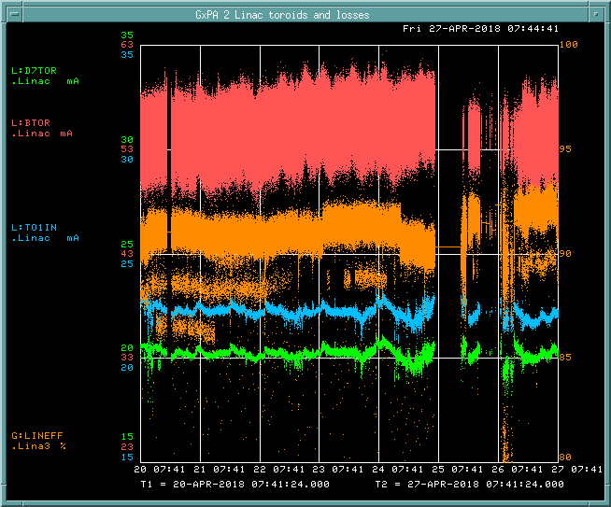
PREACC/LINAC Weekly Performance (April 20 – April 27, 2018)
BTOR: 55.1mA
TO1IN: ~22 mA
D7TOR: ~20 mA
LINAC efficiency:
91.0%

Slide 2
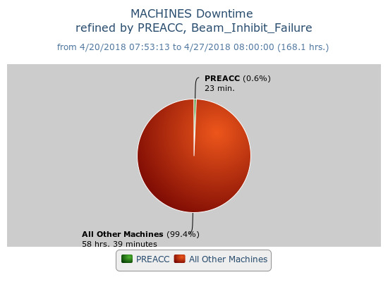
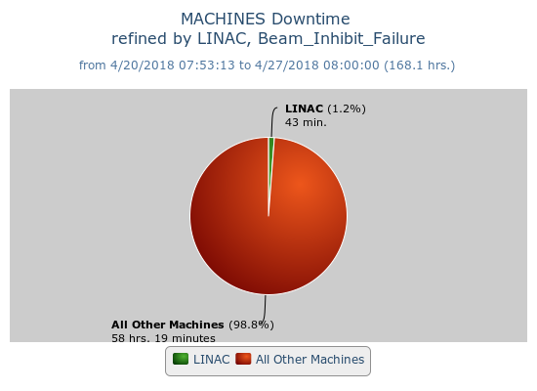
Beam inhibit downtime PREACC: (23min)
LINAC: (43min)
Shutdown (04/25/18)
Laser Notch cavity replacement
Source B extractor PS
MUQ2 PS replacement
LRF2 18 Max cells replacement
Marx code update
Rad Survey

