Slide 1
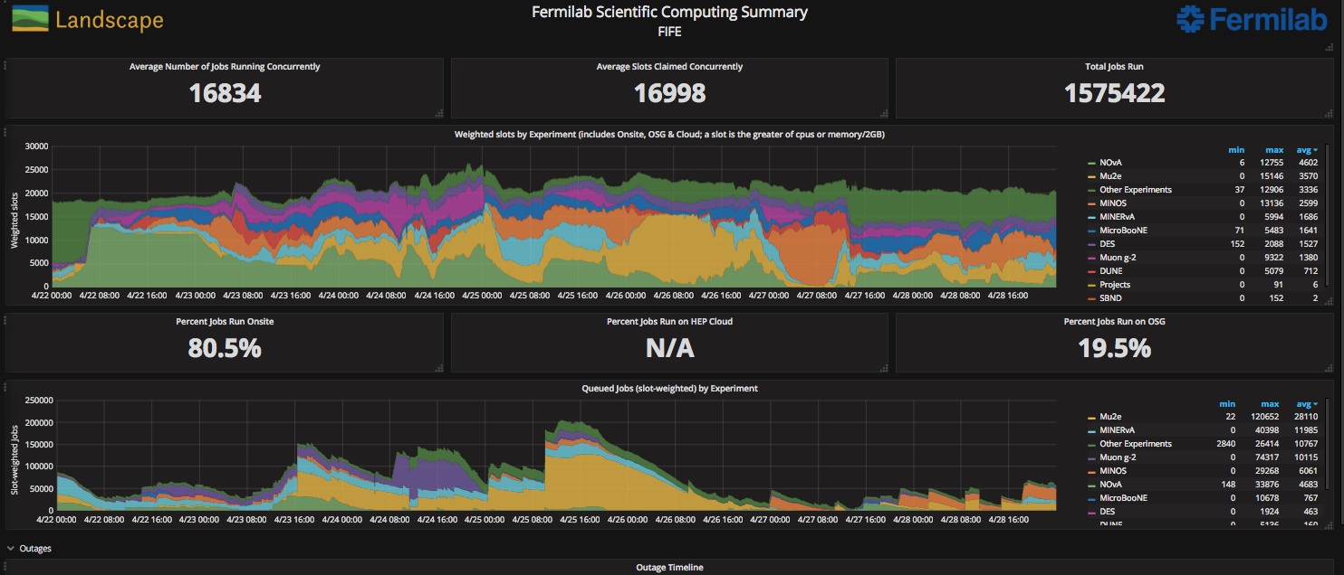
FIFE Operations (combined offsite and onsite)
Gm2 backlog clearing. See a new behavior wrt to small file aggregation. Understand the cause. Working on a fix.

Slide 2
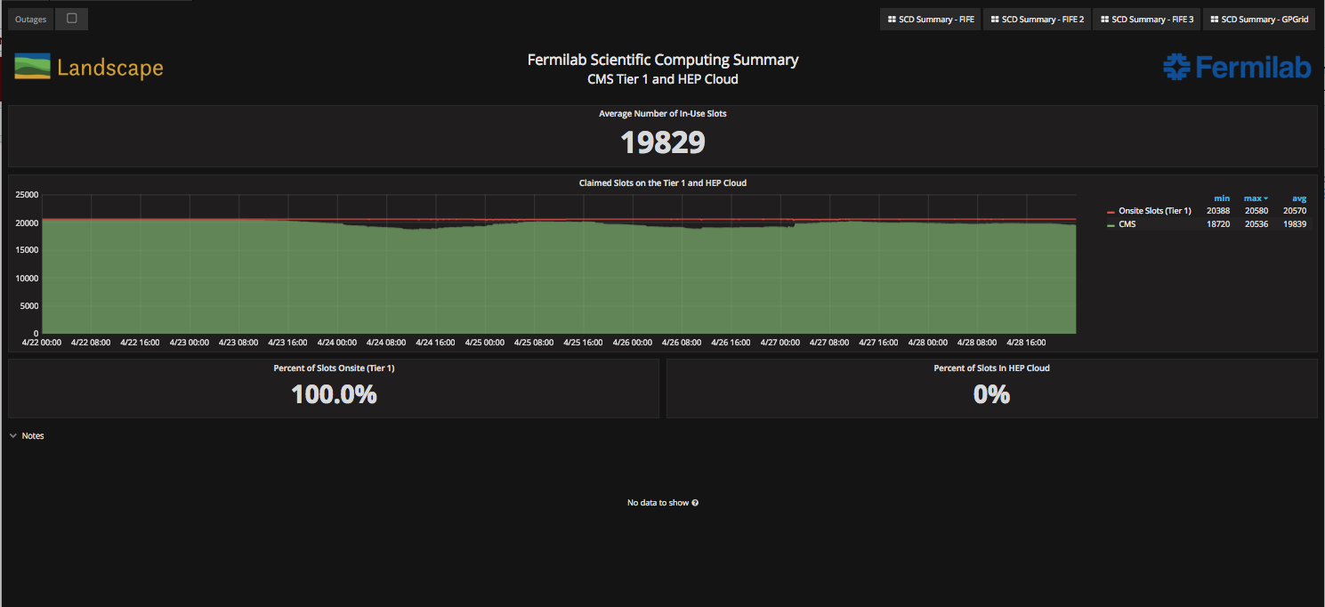
CMS Operations

