Slide 1
Proton PMG
Tom Kobilarcik
Accelerator Plans for E1039
3 May 2018

Slide 2
Overview of AD Plan for E1039
Week of April 30: Nigel grants stage 2 approval; codes open for charging.
May and June: fabrication and installation.
July and August: summer shutdown – AD resources unavailable for E1039 work.
September: complete installation.
October - December: initial commissioning.
January 2019 – March 2019: further commissioning in conjunction with experiment.
April 2019 – July 2022: provide beam to experiment (assumes two years of running and one year of contingency).

Slide 3
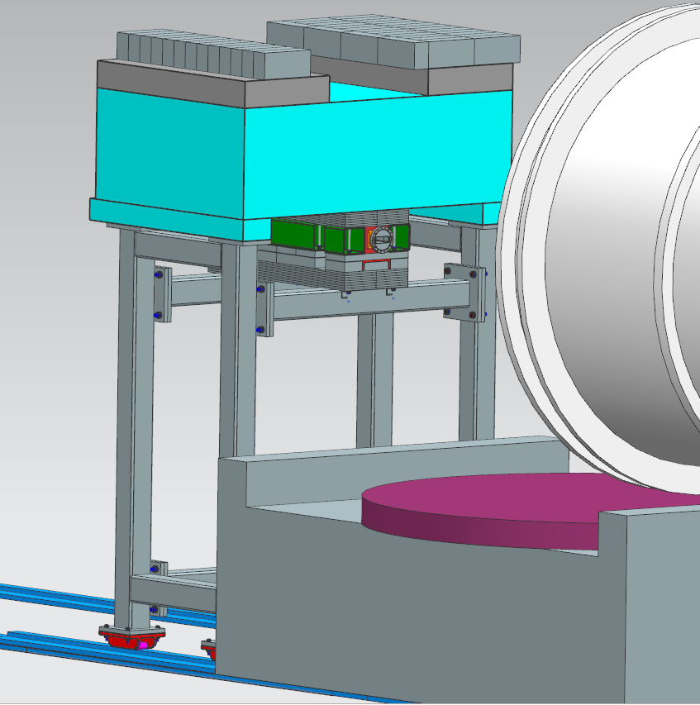
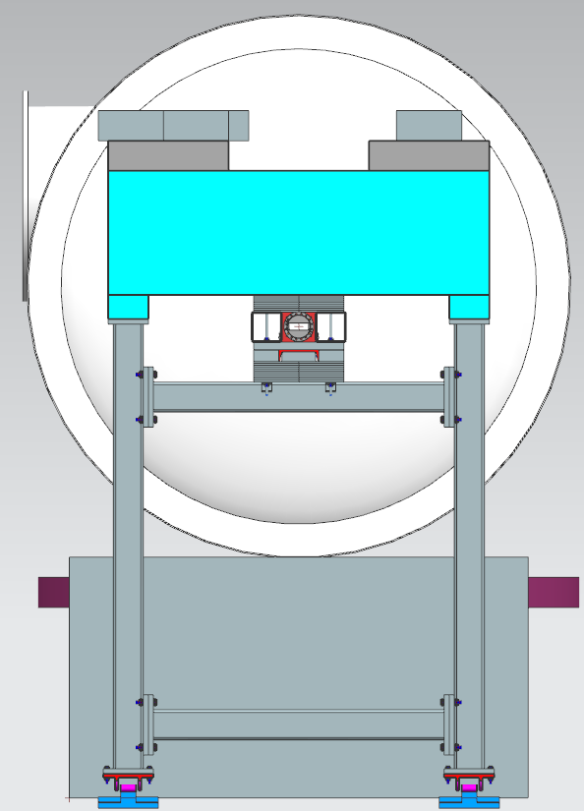
Modification to Beamline

Slide 4
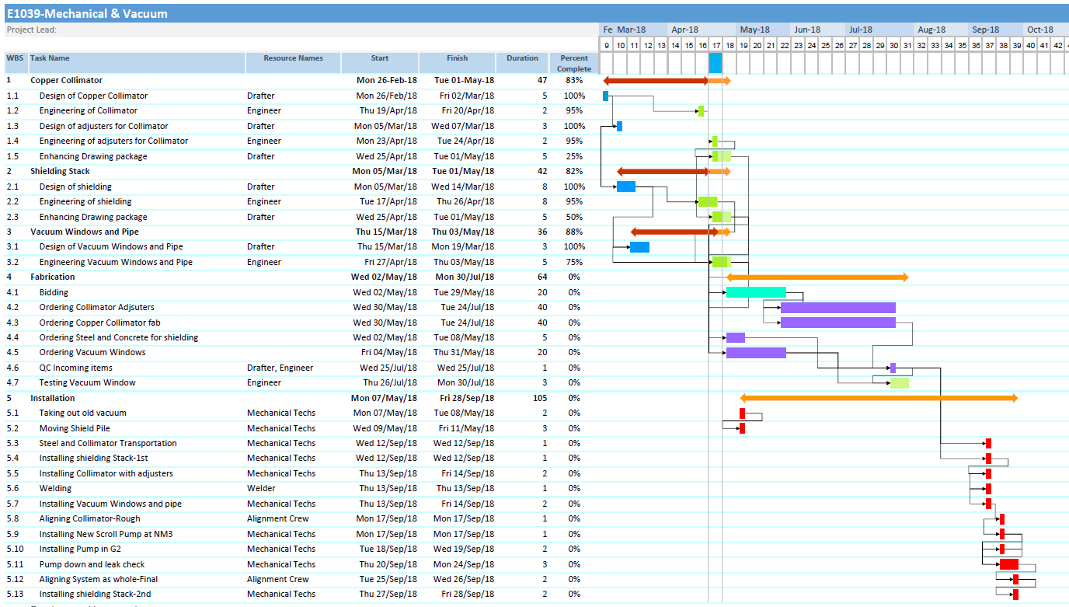
AD Installation Schedule
Jesse Batko, lead AD engineer

Slide 5
AD Resources for E1039
Commissioning:
AD Accelerator Systems: 2 FTE
AD Engineering & Support: 0.75
Large error bars on these numbers
Annual operating:
AD Accelerator Systems: 1 FTE
AD Engineering & Support: 0.5 FTE (80% technician and 20% engineering is typical)
AD M&S: $30k

Slide 6
Summary: AD Plans for E1039
Accelerator Division is ready to begin installation when funds area available.
The existing installation, commissioning, and operating resources have been identified.
Accelerator Division plans for E1039 are aligned with the scheduled set forth by program planning.

