Slide 1
TD Operations Status
Guram Chlachidze
All Experimenters and Laboratory Status Meeting
May 7, 2018

Slide 2
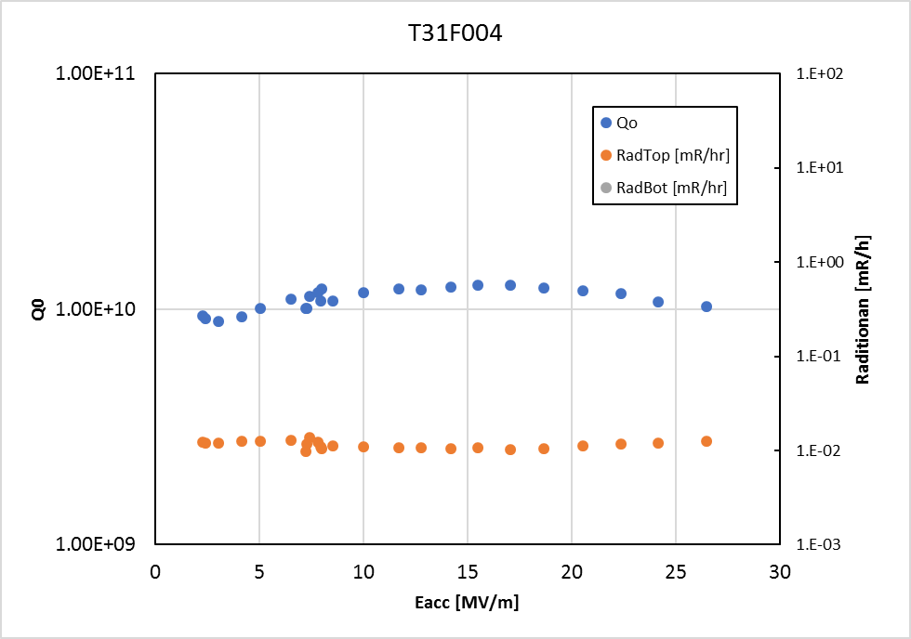
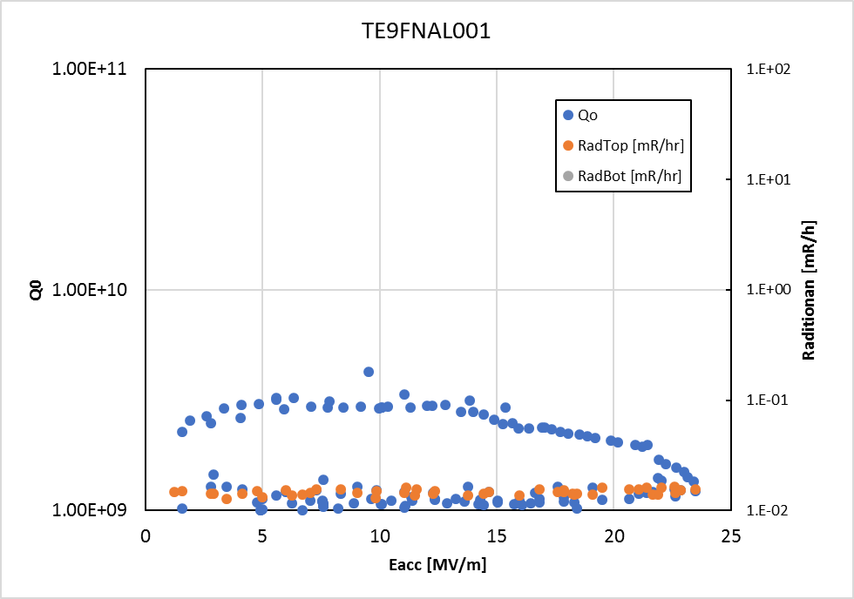
SRF Sector
R&D
Quantum computing measurement continues. First 9 GHz cavity test showed very good performance. See Fig. 2.
High Q₀ high gradient: Nitrogen infusion program continues. 3.9 GHz doping continued to show very good Q0 at high gradient. (Fig. 1)
Nb3Sn group continues cavity preparation and coating. Additional cavity coating is in progress.
High field Q slope: HF rinsing study is in progress
Plasma processing continues.
Nb/Cu vacuum chamber installation is in progress.
Radiation
Radiation
Fig 1: M. Martinello et al.
Fig 2: A. Romanenko et al.

Slide 3
SRF Sector
LCLS-II 1.3 GHz Cryomodules
Retro-fit BPM procedure was approved by SLAC, all work restarted.
CM03 dis-assembly was completed. Rebuild started as a filler job between cryomodules.
CM02, CM04 CM05 and CM07 beam line were back filled and warm end coupler were dis-assembled. They are ready for extraction and repair BPM. Actual repair is pending for approval.
CM06 autopsy showed the catastrophic failure was not BPM vacuum, instead it was coupler bellows that cracked during the shipping. Two couplers’ bellows showed cracks. They will be dissected and analyzed for thickness inspection and failure mode analysis. JLAB CM7 was shipping tested during the last weekend. Sensor was on a coupler location. Shipping data is being analyzed. It is being dis-assembled and will clear the WS3 stand for CM11.
CM08 finished WS3 and WS4. It is in WS5 and warm end couplers are being installed.
CM09 tests at CMTF test cave were completed. Warm-up is completed.
CM10 is in WS3. BPM fix is on hold before thermal shield weldment.
CM11 WS2 is finished, it is parked in WS2 waiting for proceed to WS3 as soon as WS3 at ICB is cleared.
CM12 WS1 is in progress.
CM13 cavities were identified
LCLS-II Cavity Preparations
1.3 GHz No cavity test.
3.9 GHz: 3HRI03 dressed cavity is being dis-assembled in HTS. 3.9 GHz Design verification is completed.
PIP-II
Spoke Cavity S111 was tested. It had high field emission and needs re-HPR.
Spoke cavity S113 had high power coupler installed and will be installed to test at STC.
LARP
One RF deflecting cavity was tested. Cavity did not meet Q0/Eacc specifications (3e9, 11 MV/m). FE was present however.

Slide 4
Magnet Sector
HL- LHC, AUP
QXFA108 coil vacuum impregnation is complete. Coil QXFA109 is in its reaction cycle. The inner coil winding is complete in QXFA110.
MQXFS1d short model test is in progress. The magnet exceeded both the nominal and the ultimate (~108% of the nominal) currents.
Completed Magnet Design Criteria Review. Next is the preliminary design review of the Q1/Q3 cryo-assembly and Final Design review of the MQXFA magnets in May.
LCLS II
SPQA130 cold test completed. SPQA131 is delayed, current estimate for shipping is May 8th.
Mu2e
The first Test Solenoid (TS) production module has been mounted to a HAB dish-head A. Electrical, cryogenic and mechanical connections are on going. The second TS production module is expected in the middle of June
The Detector Solenoid (DS) coil DS1 winding started last week.
Milhous Company reports that coil winding for all ISA magnets is expected to be complete in two weeks. The cores are in production. The lead engineer is visiting the company this week.
G-2
Winding of the inner and outer coils for the new g-2 inflector is complete. The case and other surrounding hardware is being prepared for assembly and vacuum impregnation.
MDP 15-17 T dipole R&D
15T dipole coil fabrication in progress.
Accelerator Support
Winding of a replacement coil for the leaking MDCC has resumed.
SDG001 magnetic field mapping scans completed.
EDWA (g-2 dipole) installed for magnetic measurements.

Slide 5
Cryogenic Sector
LCLS-II Procurements
Distribution Boxes – Fabrication continues at vendor, delivery expected in June.
Surface Transfer Line Procurement – Delivery expected in July – Factory Acceptance Testing on May 23-24th
Providing SLAC with guidance on installation activities for tunnel components – Final welding in tunnel commencing
Alex Martinez is at SLAC for the DOE review May 8-10
Mu2e Procurement
Distribution Box – Fabrication in progress, delivery expected in May/June
Feed Boxes – Contract is being awarded
HL-LHC AUP
Began EVMS practice reporting this month. Working on Stand 4 upgrade tasks. Waiting for final docs from CERN.
Meson Controls Upgrade
Project is underway in parallel with existing controls, preparing for system shutdown in June to switch system over
MDB completed as far as possible without shutdown, MCC in progress
PIP-II Activities and Procurement
External Cave Transfer Line fabrication in progress (in-house), final tie-in piece in fabrication, all others complete
PIP-II Cave Transfer Line procurement, delivery expected in June – Factory Acceptance Testing week of May 21
Field installation at CMTF have begun with the external cave TL segments and supports
Sub-Kelvin Cryogenics
SuperCDMS Snolab – Operations review schedule for June 19 in Germantown, internal E-Tank review on May 18
ADMX – Procurement issues with vendor ongoing (several iterations with DOE on legal waiver regarding procurement liability) verbally committed to expediting the delivery as much as possible to avoid schedule slippage
Nexus – Draft cryogenic review (5032) documents complete except for follow up questions to dilution refrigerator vendor
Facilities:
Meson Detector Building: STC – 2 x Spoke cavities tested, HTS warm, HTSC warm, swapping magnets.
Cryomodule Test Facility: Plant under repair, LCLS-II F1.3-09 disconnection in progress
Industrial Building 1: VTS stands: 2 RF cavities tested as part of Fermilab R&D effort; VMTF - MQXFS1d testing in TC1 completed; Test Stand 3 – SPQA130 test completed last week
Muon Campus: Supporting g-2 operation
Heavy Assembly Building: Test of cryostat Head B complete and at room temp, LOTO in place today. Head-A with production solenoid installed and check-outs ongoing.

Slide 6
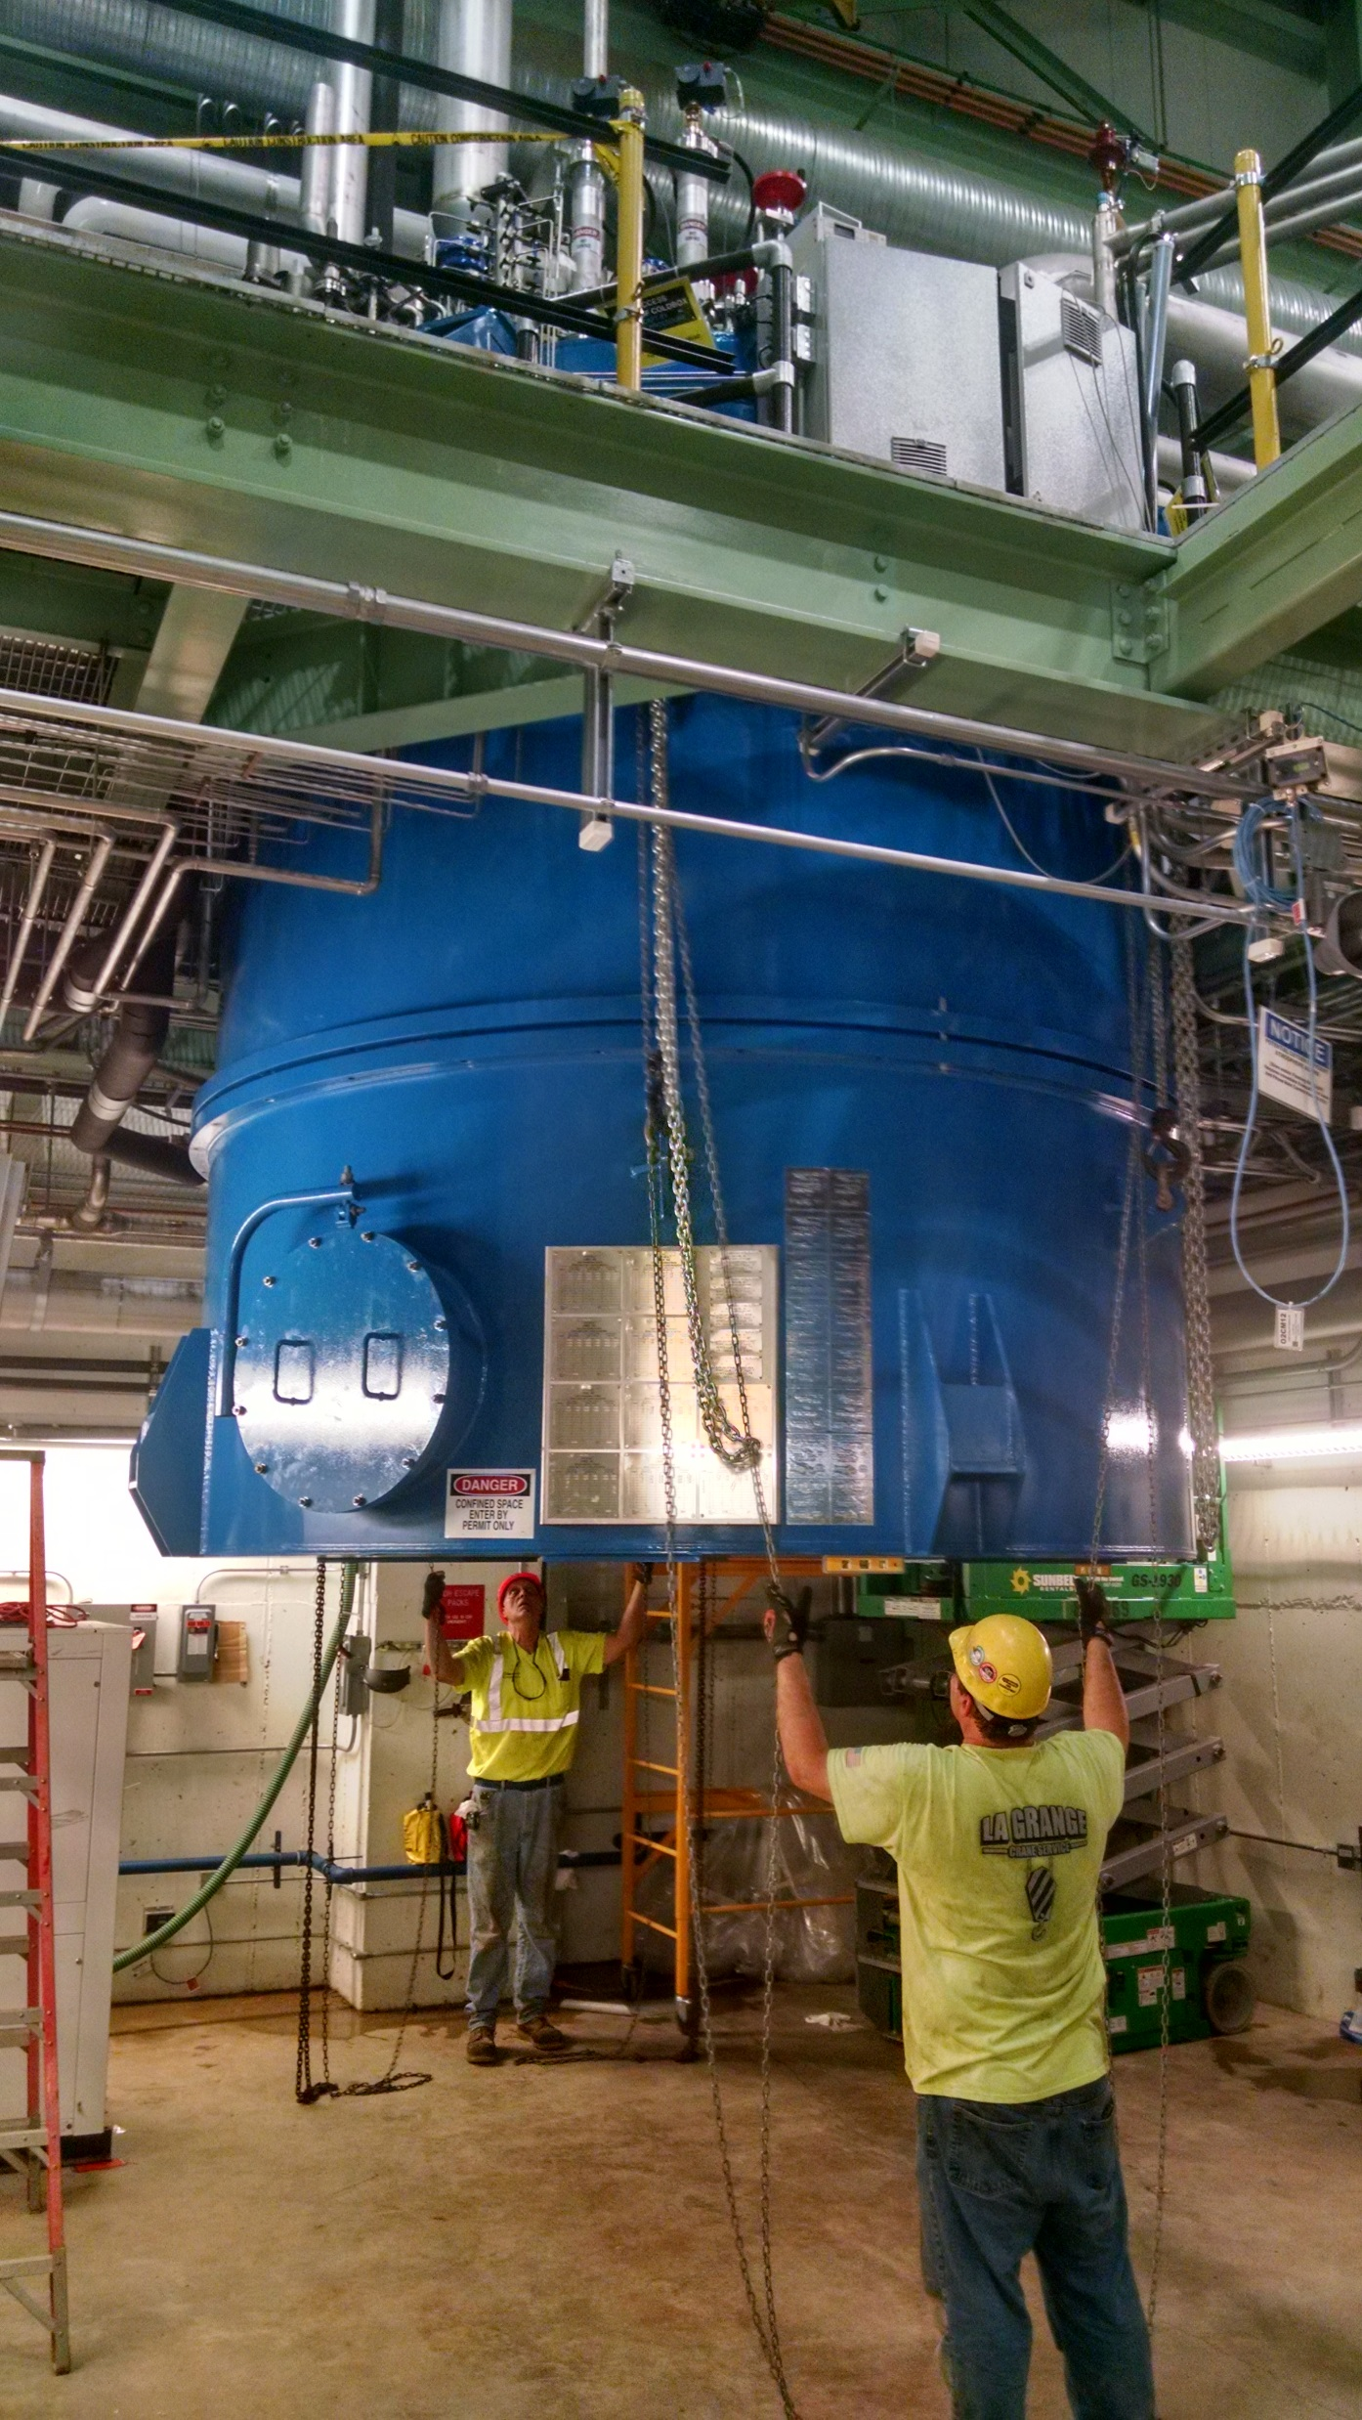
Cryogenic Sector
CMTF Cryogenic Plant Repair Update
Vacuum shell reinstalled last Thursday
Pump-down insulating vacuum over last weekend
Final leak check this week
System purification and scrubbing this week
External electrical and instrumentation this week
Controls program updates in progress
Plant cool down anticipated week of May 14
CM8 anticipated end of May at the earliest

