Slide 1
Accelerator Division Status
Duane Newhart
All Experimenters’ Meeting/Lab Status Meeting
07 May 2018

Slide 2
Accelerator Operations Summary
From: April 30, 2018 (0000 hours)
To: May 07, 2018 (0000 hours)
Calendar Week # 18
NuMI Weekly Integrated Intensity 1.89 E19 protons
Beam Hours To NuMI 157.6 hours
BNB Weekly Integrated Intensity 8.65 E18 protons
Beam Hours To BNB 162.7 hours
Muon Weekly Integrated Intensity 5.02 E18 protons
Beam Hours To Muon 149.0 hours
MTest Weekly Integrated Intensity 4.70 E14 protons
Beam Hours To MTest 76.8 hours
MCenter Weekly Integrated Intensity 0.00 E12 protons
Beam Hours To MCenter 0.0 hours

Slide 3
NuMI Operation

Slide 4
BNB Operation

Slide 5
Muon Operation

Slide 6
Complex Status
LINAC
Minor 400 MeV LCW leak
Booster
Tuning continues
MI/RR
Tuning continues
MI40 abort vacuum degrading
MI52 vacuum bursts
Residual Gas Analyzer (RGA) Scans
Residual Fluorinert?
NuMI
Lower power with vacuum recovery
NuMI target (TA-02) started leaking helium over the weekend
Assessing the situation
Expectation to make it to the shutdown possibly longer.
Booster Neutrino Beamline (BNB)
Stable operation
Switchyard
Meson Test operating
Muon Campus
G-2 operating
General
Anticipate at least one maintenance day before the summer shutdown.

Slide 7
PIP-II Injector Test & FAST/IOTA Status
PIP-II Injector Test
Starting Up
RFQ, & Bunchers conditioning
RFQ, B1 & B2 Under vacuum
B3 at atmosphere
New wire scanner alignment
FAST/IOTA
IOTA RF cavity work continues
Pumped down with gradient
Conditioning cavity
Injection line magnet power supplies are installed and connected to their controllers
Dipoles trims tested
All but 2 skew quads tested
Injection Lambertson assembly is finishing and bakeout should begin this week.

Slide 8
CMTS1 Status
LCLSII Cryomodule F1.3-09
Module performed well
Warmed Up
Prepping for removal
Cryo plant repairs
Complete last week
External electrical work finishing
Purification this week, turn on next week
LCLSII Cryomodule F1.3-08
Testing in June

Slide 9
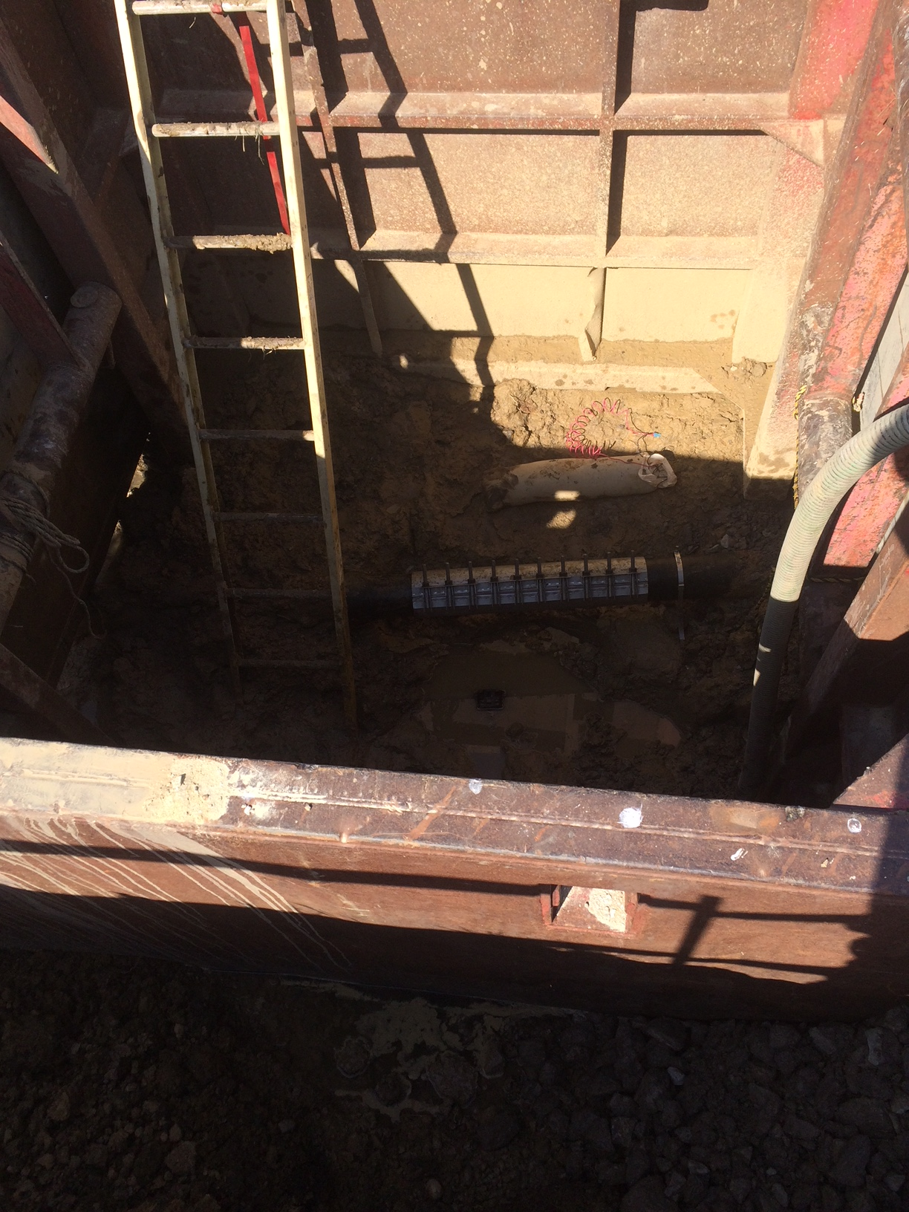
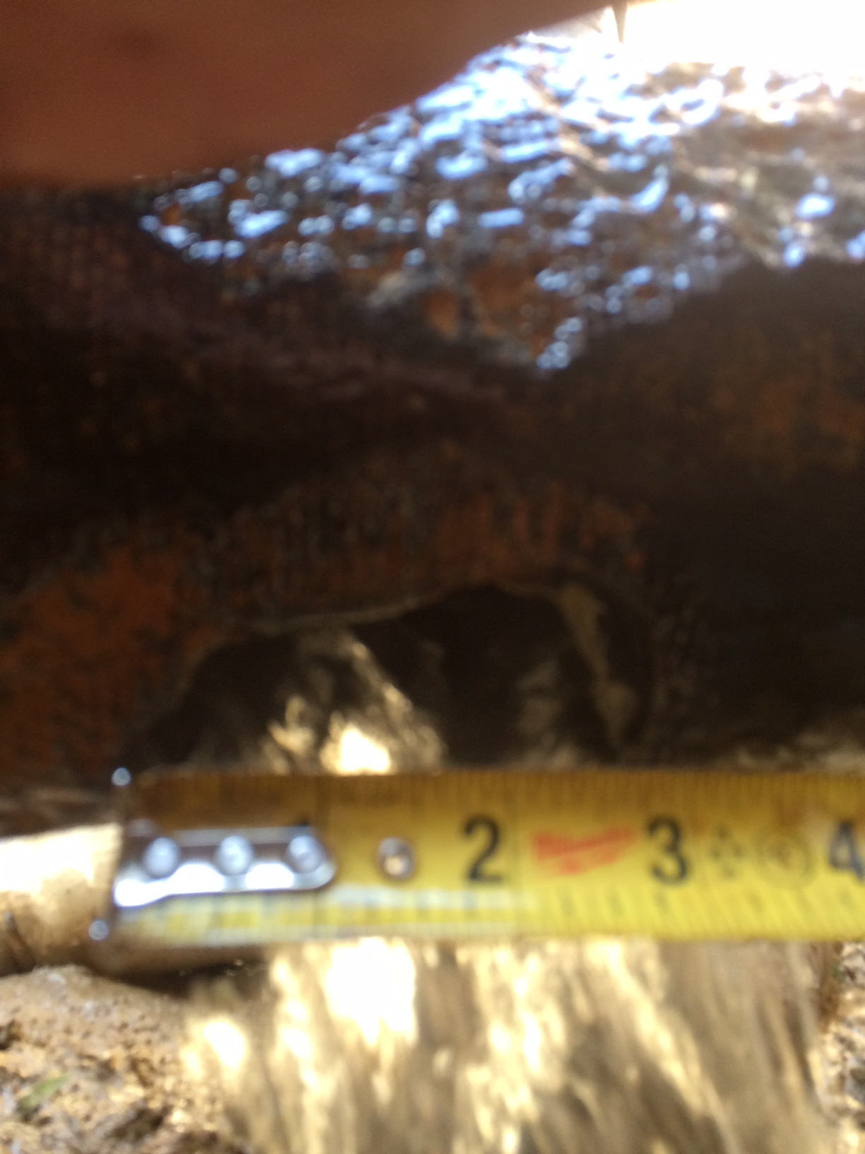
MI-8 Domestic Water Repair
Pipe looks a little rough
3” hole
Repair clamp
Anode bag

Slide 10
Schedules and Links
Schedule can be accessed from the Operations Department Home Page
Schedules -> Operations Schedule
Direct link to schedule
http://www-ad.fnal.gov/ops/schedule.html

