Slide 1
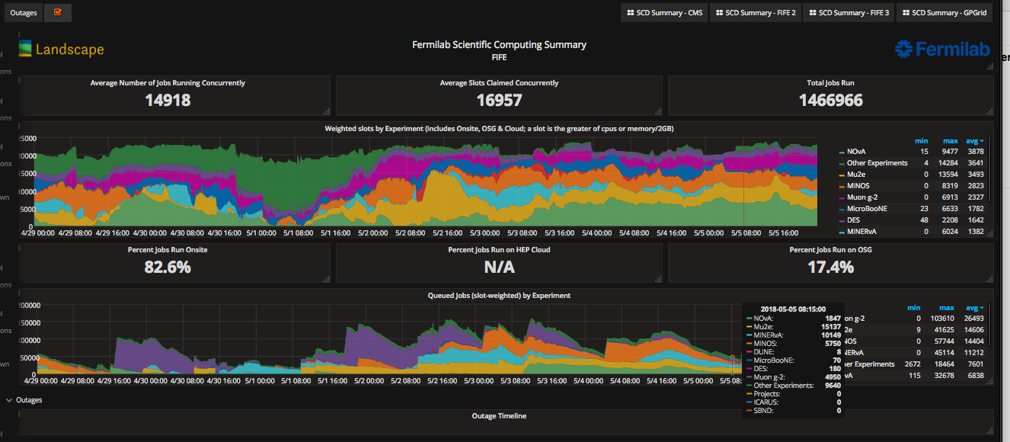
FIFE Operations (combined offsite and onsite)

Slide 2
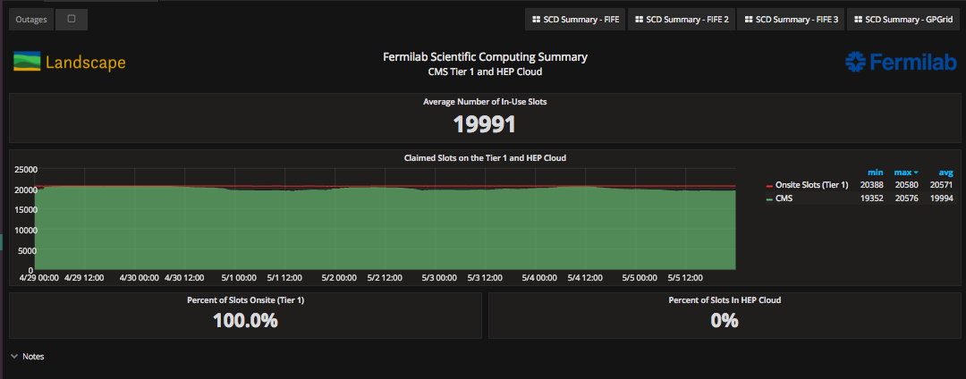
CMS Operations

