Slide 1
48 Hour Summary
Donovan Tooke
Wednesday 09:00 Meeting
2 May 18

Slide 2
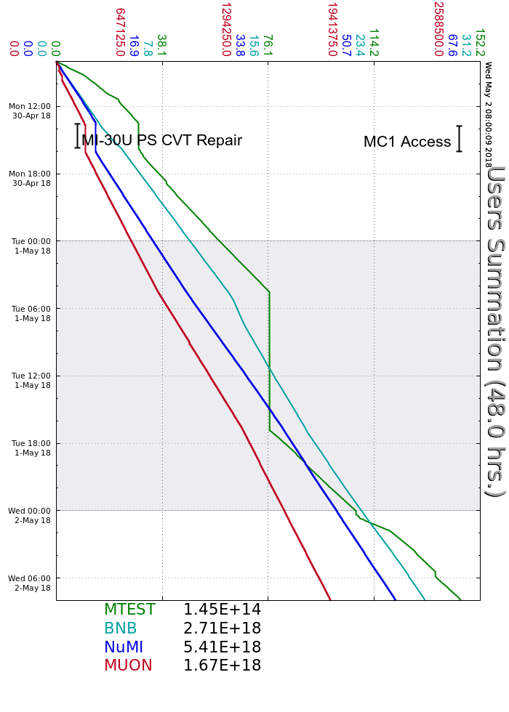
Monday
MI30U PS: CVT firing ckt – replaced PS
Tuesday
MI 1.2s ramp studies
Source B pressure burst
Wednesday
BRF20 gap issues
Bypassed BRF20/ BRF16 on
F:MT4Q3 front panel breaker trip while changing energies

Slide 3
Current Conditions
Beam to NuMI
639.4 kW
51.2 e12
Beam to BNB
5.61 e16 p/hr
Beam to g-2
Beam to MTest

