Slide 1
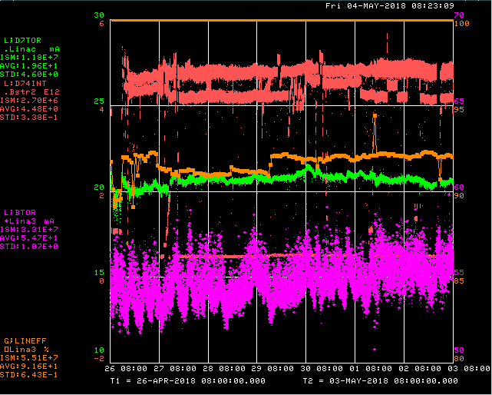
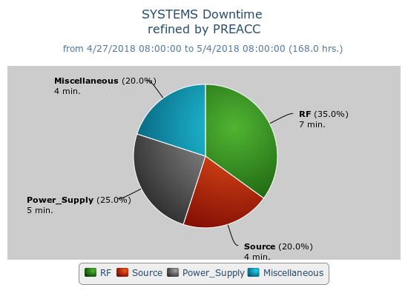
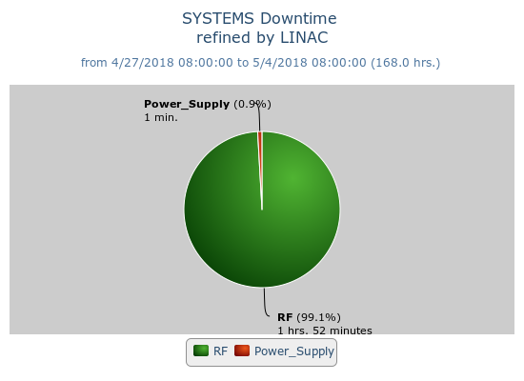
Preacc/Linac Weekly Performance
Weekend – LRF2 gradient hops
Tuesday – Source B gas burst

Slide 2
Current Conditions/Plans
Source B – 56 mA
Linac input – 22 mA
Linac output – 20 mA, ~4.5E12 p/pulse
No planned downtime

