Slide 1
Muon Campus Status
Jim Morgan
Weekly Status
May 4, 2018

Slide 2
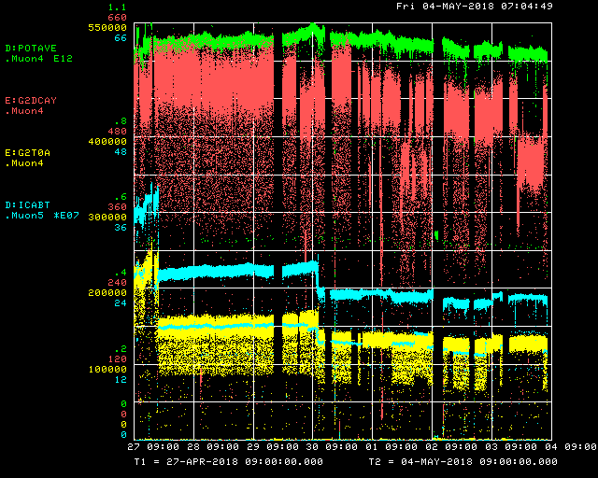
Beam to g-2 this week
Beam from Recycler
Decay Positrons
Trolley Run
Trolley Run
MI Access
MC-1 Controlled Access
Booster Chipmunk
Delivery Ring
g-2 T0 Detector

Slide 3
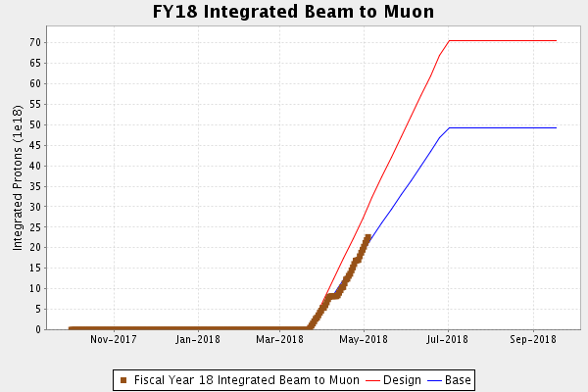
Protons on Target

Slide 4
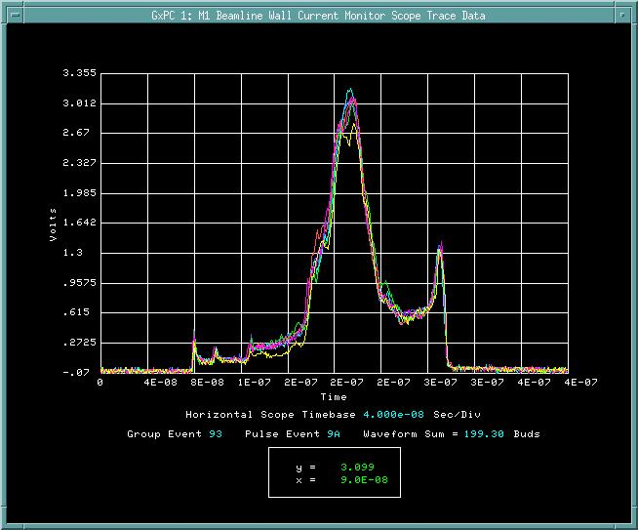
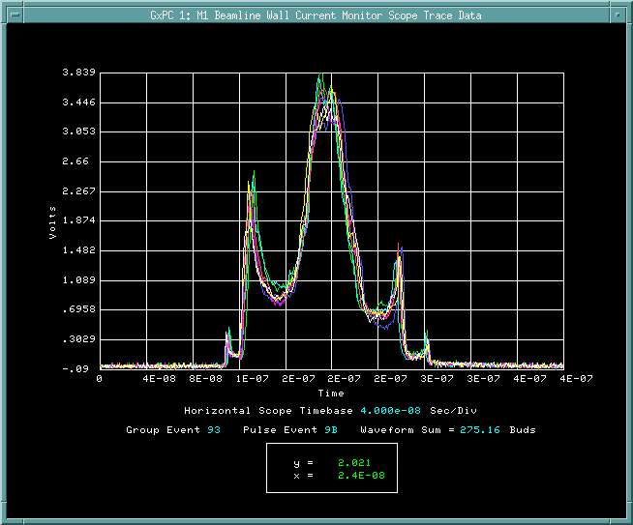
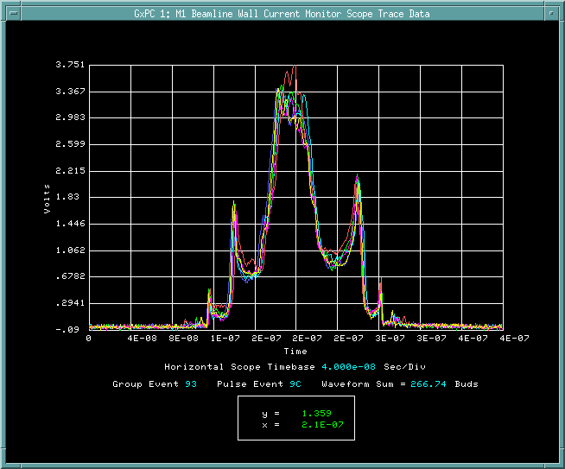
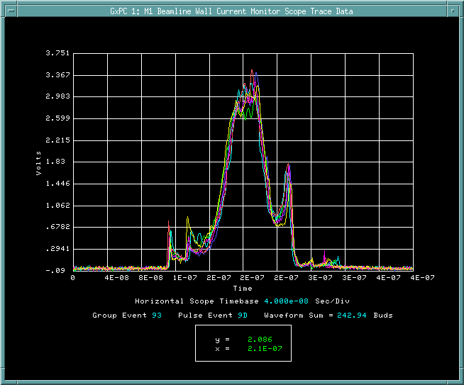
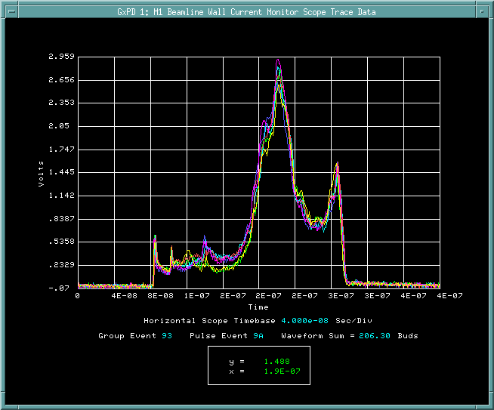
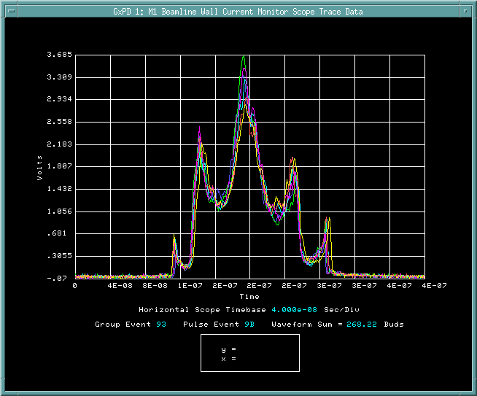
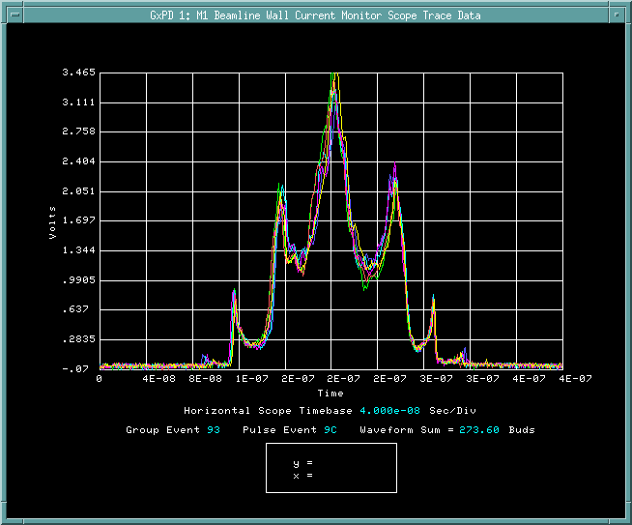
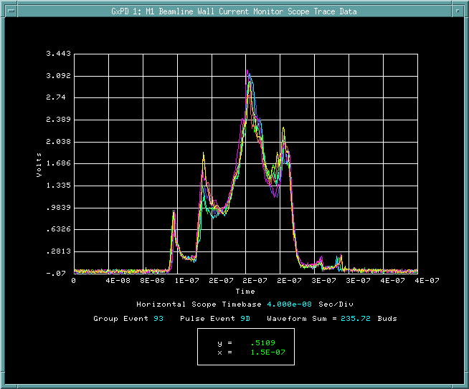
In the past week
RR 2.5 MHz RF adjusted Friday to narrow bunches
Delivery Ring momentum scrapers inserted last Friday
Reduces beam to g-2 Storage Ring outside of their momentum acceptance
Brought in further on Monday
Investigated poor transmission on cycle after SY120 on Wednesday
Good up time and muon delivery this week!
$9A - $9D, April 27 before tuning (above) and after tuning (below)

Slide 5
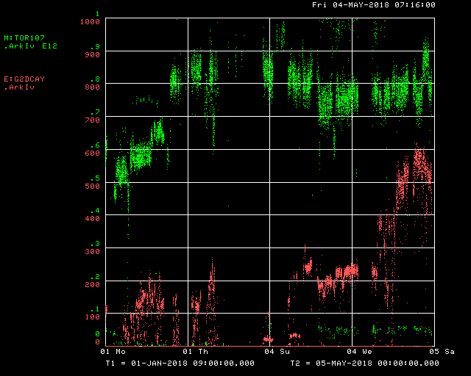
Beam to g-2 since January
Beam from Recycler
Decay Positrons
16 bunch operation March 22

Slide 6
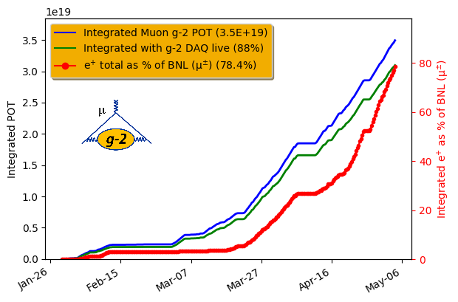
G-2 Experiment summary

Slide 7
Plan
Primary short-term goal is to concentrate on maximizing g-2 data taking with existing rate of muon delivery
Accelerator studies will be parasitic or coordinated with experiment downtime
Maximize up-time, accesses only for repairs
Parasitic studies
Understanding and mitigating lower efficiency cycles after SY120
Improving yield from Target Station (without turning up lithium lens)
General tuning to maintain or improve current muon delivery
More destructive studies
Dispersion measurement in primary beamlines
Delivery Ring 8 GeV proton tune measurement
“Straight-through” muon storage studies to quantify Delivery Ring efficiency
Beam intensity to end of M5 with 1, 2, 3 & 4 turns in the Delivery Ring
3 turn proton removal

