Slide 1
Main Injector/Recycler
D. Capista
Friday Operations Meeting
4 May 2018

Slide 2
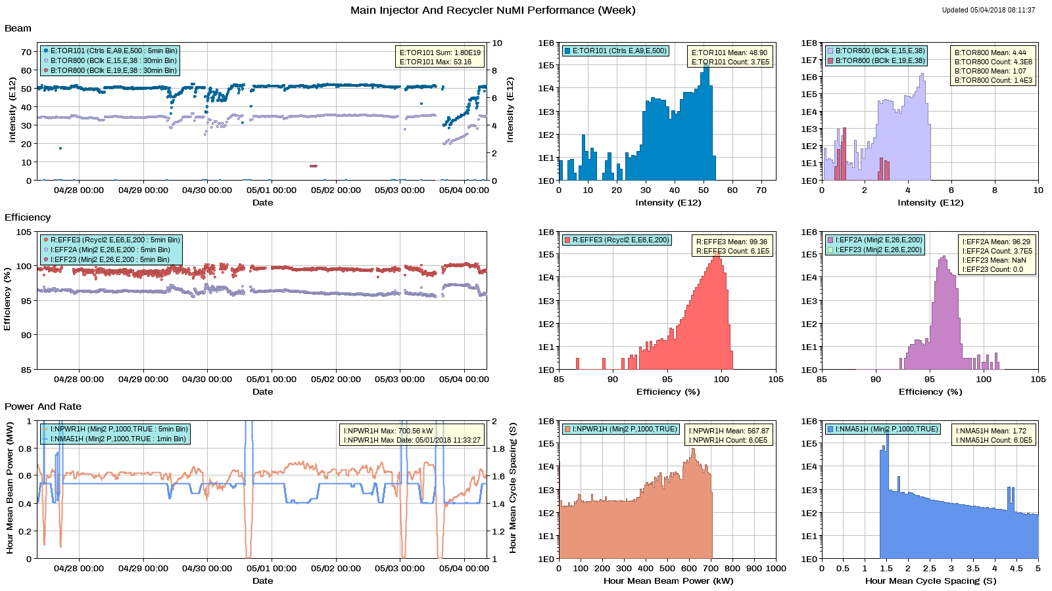
NuMI Performance

Slide 3
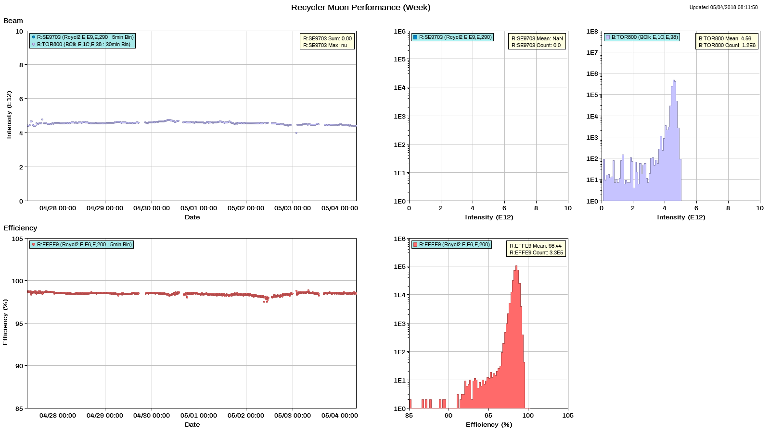
Muon Performance

Slide 4
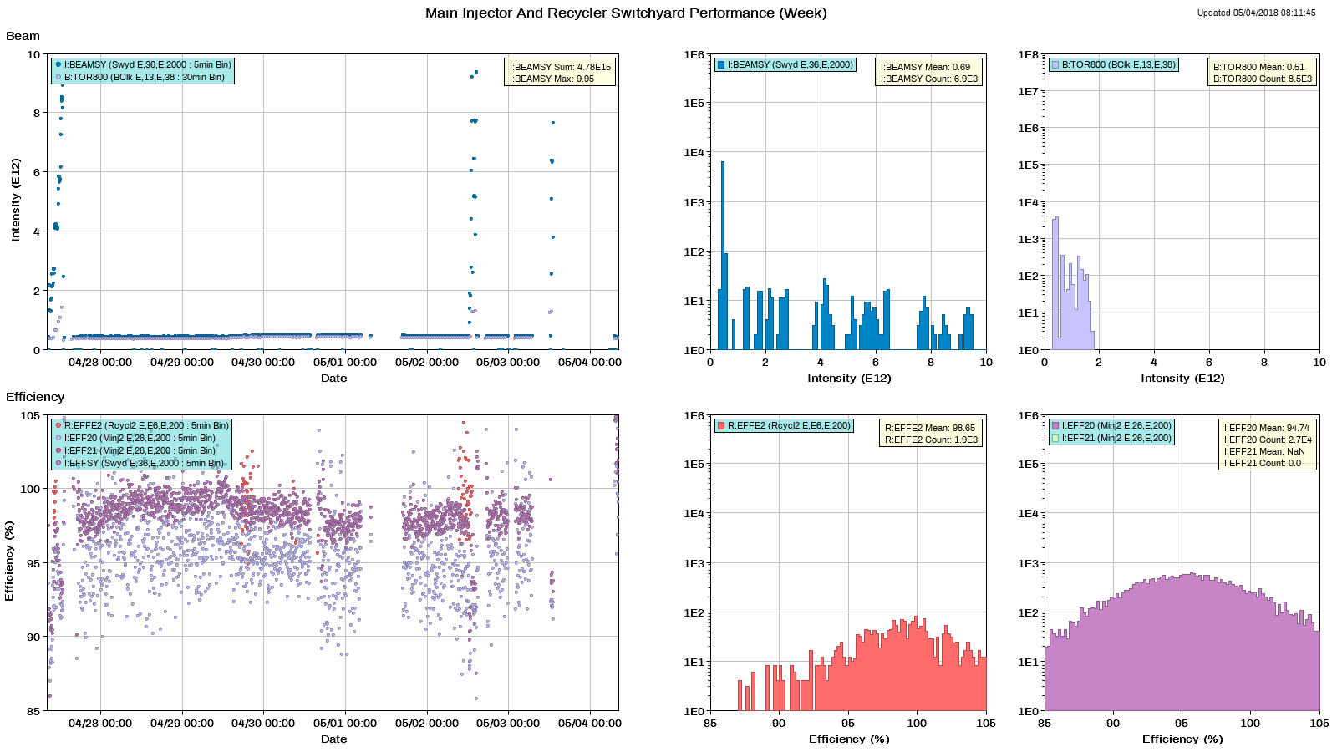
SY Performance

Slide 5
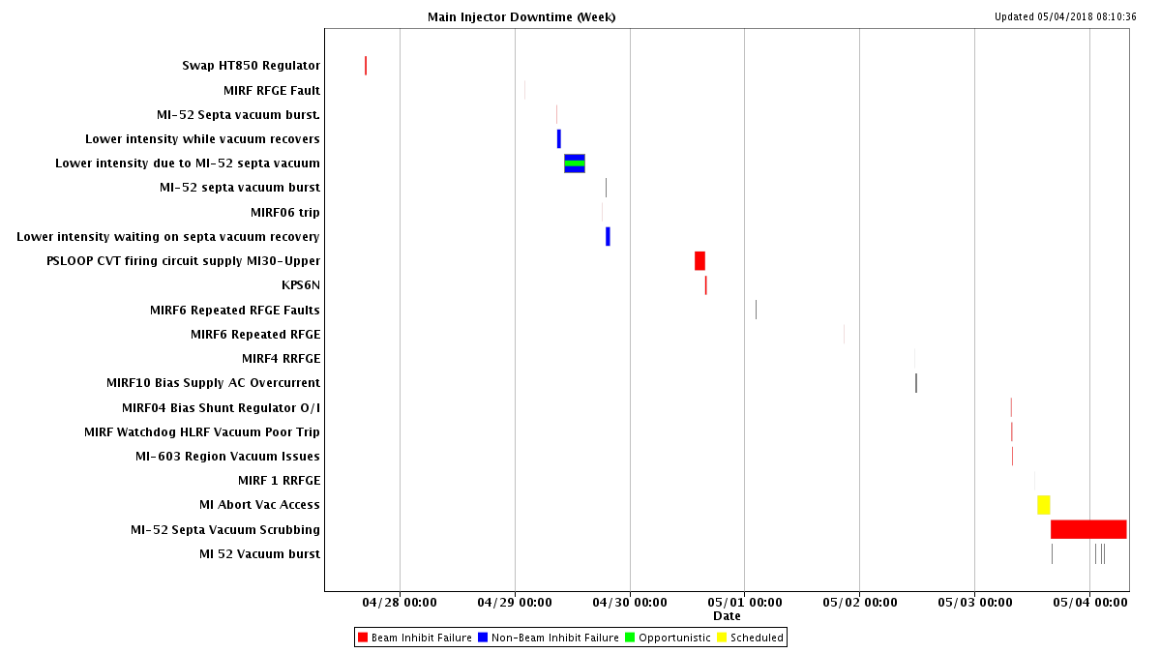
Downtime MI

Slide 6
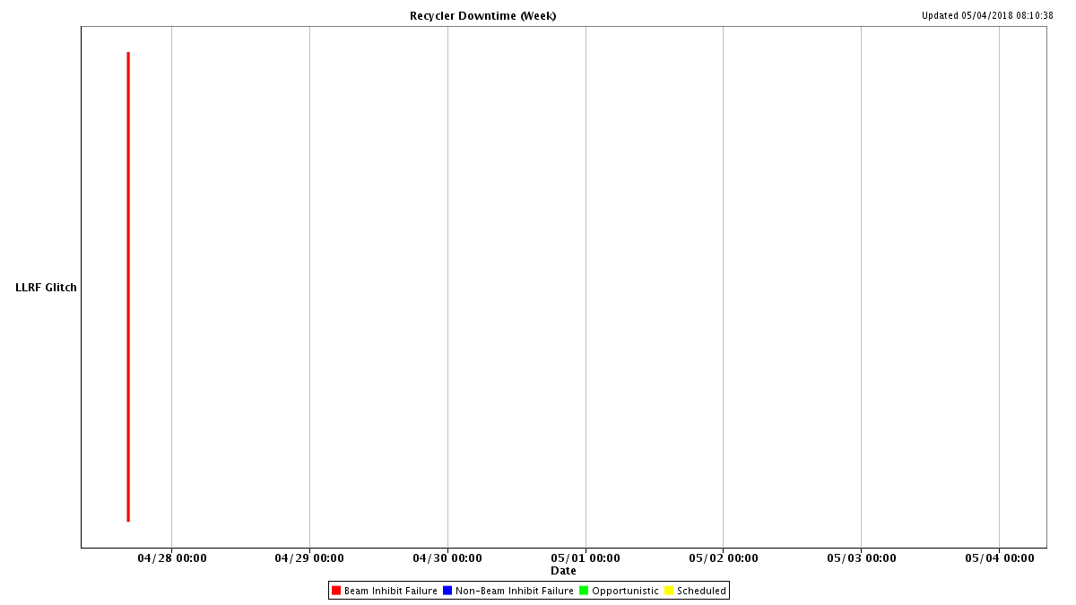
Downtime RR

Slide 7
MI Access
Repaired water leak on RF station
Inspected buss penetration at MI60 north
  Found leaking wall behind buss penetration
  Installed water guard
Repaired vacuum cables and connectors in the 8Gev line and MI30 areas
Repaired QT846 and HT850
Verified that the soft fault on upper buss (60-10) is not in the MI60N penetration
Thursday access tor recover abort vacuum (still a problem)

Slide 8
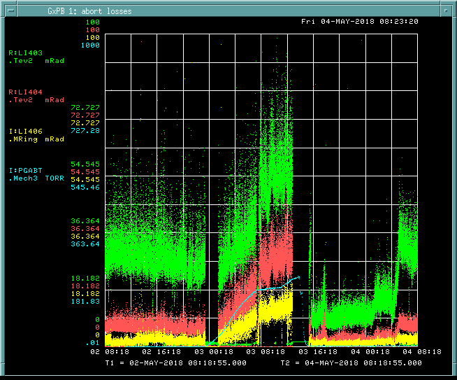
Abort Line Vacuum and Losses

Slide 9
Next Week
Studies
  1.2 sec fast ramp.
  MI TBT lattice measurement
    8-GeV.
    Use $2B ramped 1.67 second cycle.
  RR TBT lattice measurement
Vacuum issues
  MI52 septa
    Need more RGA data
    Studies turning off ion pumps
  Abort line vacuum

