Slide 1
48 Hour Summary
Donovan Tooke
Friday 09:00 Meeting
May the 4th be with you 2018

Slide 2
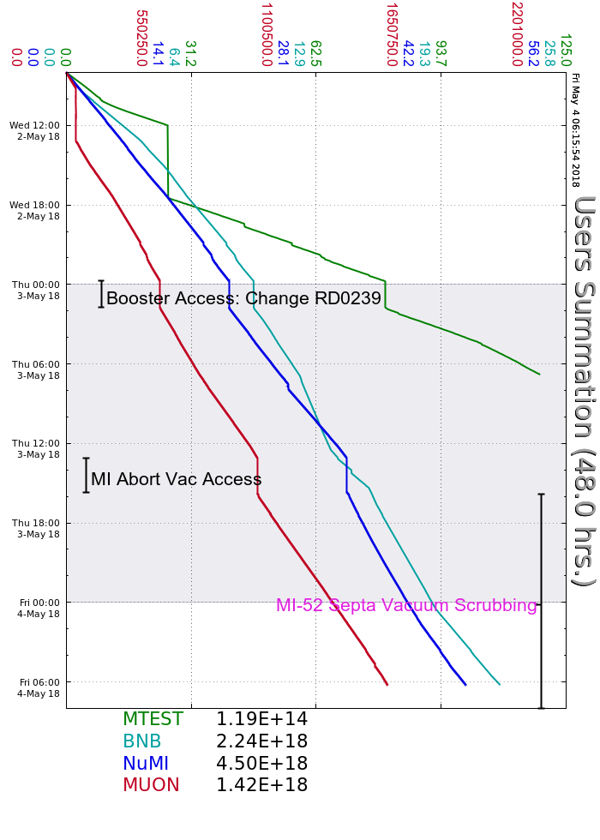
Wednesday
BRF20 gap envelope troubleshooting
SY intensity study
MC-1 open access
Small power glitch
Booster Access: S01 chipmunk
Thursday
MI20-62 Access: MI abort vac valve
Upstairs jobs performed during access
MI 520 vac issue followed
Full intensity mid owl shift
No SY until 14 turns (septa vac) 07:30
Friday
RR scrubbing on eve/owl shift

Slide 3
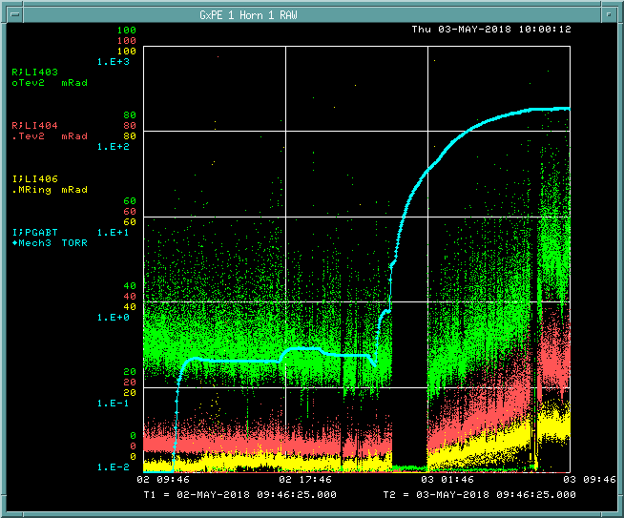
MI Abort vacuum & losses

Slide 4
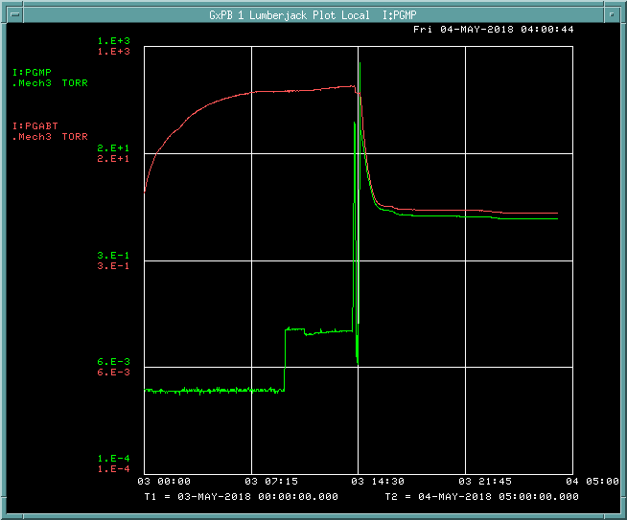
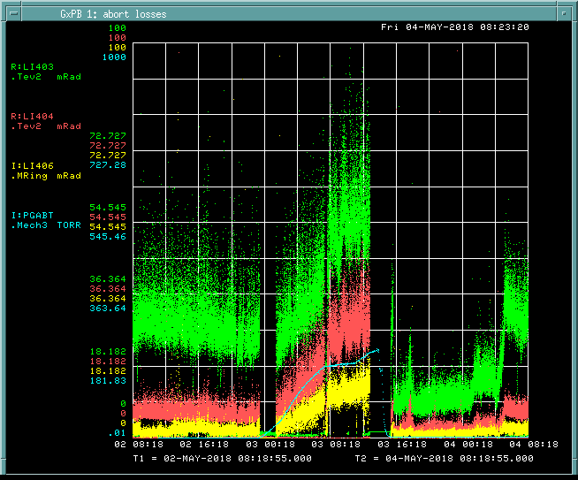
MI Abort vacuum & losses

Slide 5
Current Conditions
Beam to NuMI
630.5 kW
50.8 e12
Beam to BNB
5.37 e16 p/hr
5 Hz
Beam to Mtest
Beam to g-2
1 e12 POT

