Slide 1
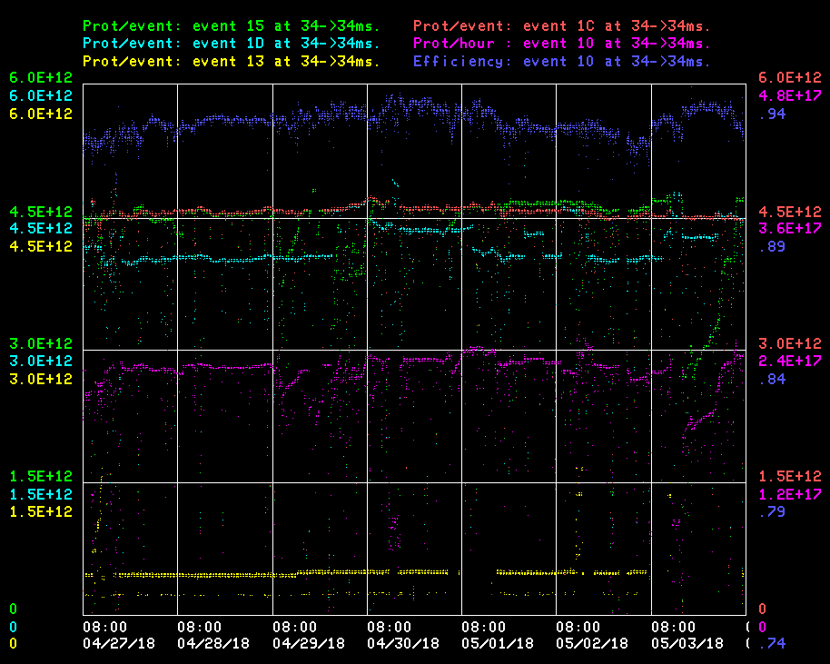
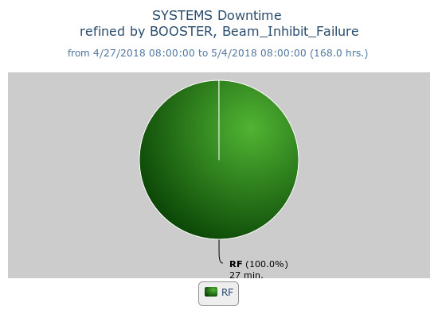
Booster Operations 04/27/18 – 05/04/18
F
Sa
Su
M
Tu
W
Th
F
Capture/Transition Issues
BRF8 Cable Fault
Downtime:
27 minutes for the week
Various minor RF trips
DOGL3 Flow Switch
MKS06 Cable Termi
Collimator Studies
Access, BRF21 installed
Currently:
Beam to NuMI $15 ~4.65E12 92%
Beam to BnB $1D ~4.4E12 93%, ~5.6E16 P/hr
Beam to Muon $1C ~4.4E12 93%
Beam to SY $13 ~5.0E11
Worked to keep efficiency up, and efficiency spread minimized
Thanks to Ops for their efforts and diligence in tuning!

