Slide 1
Accelerator Status Report
Friday - Monday 5-7-2018

Slide 2
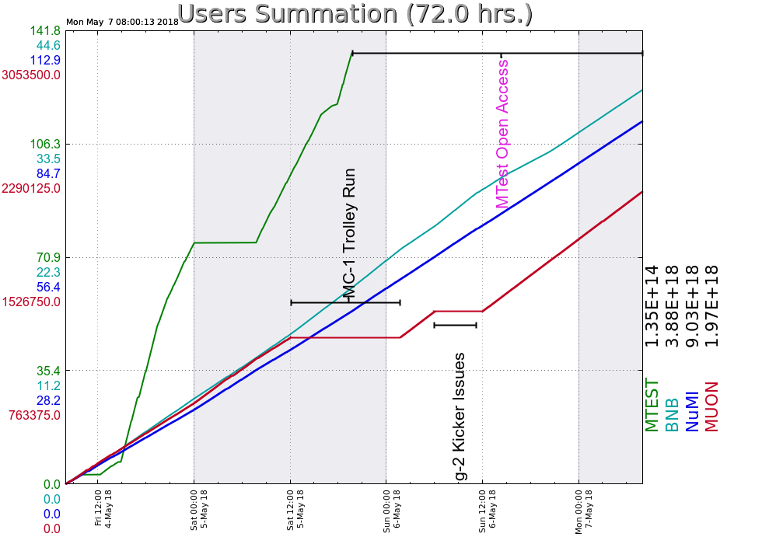
Friday
MI52 vacuum bursts improve
Source pressure bursts
Muon Beam dump water return flow #1
Saturday
Muon FE-C190-D:IB permit inhibit
Sunday
YA MCC/CTF ODH alarm from N2 fill
Monday
400 MeV H20 levels down, candidate leak
on pump fitting
Your Shift Plot
could be here!
Ask me how!
Weekend Update

