Slide 1
Photosensor R&D: Status & Plans at Prague
Jaroslav Zalesak

Slide 2
Road map - Liquid Nitrogen Photodetectors Measurement Lab
2017
Building laboratory
Crucial to be involved and responsible in EoI (spring/summer consortia formation)
Dewars with LN2 with pumping equipment, Electronics rack(s) with VME crates
Measurement table with the Cold/cryogenic (black) box
First measurement on the characteristics of different SiPM (SensL, Hammamatsu)
Long-term measurement of PD samples with some variety in models
Might we have some input on ProtoDune PDS.
2018
Full setup for the Lab with multi -line and -task measurements
Automatisation of the Test stand for quick and repeating measurement under different condition requested by the DUNE experiment.
2019
Input for DUNE TDR for Far detectors, in particular Photon detection system (PDS)
Qualification of the Laboratory for the SiPM QA/QC.
2020-2021
QA/QC test of ~ thousands SiPMs for building 1st FD module (starting 2021)
Participation in the task accordingly EoI defined in 2017
2022-2024+ continuous work for the FD modules assembly.

Slide 3
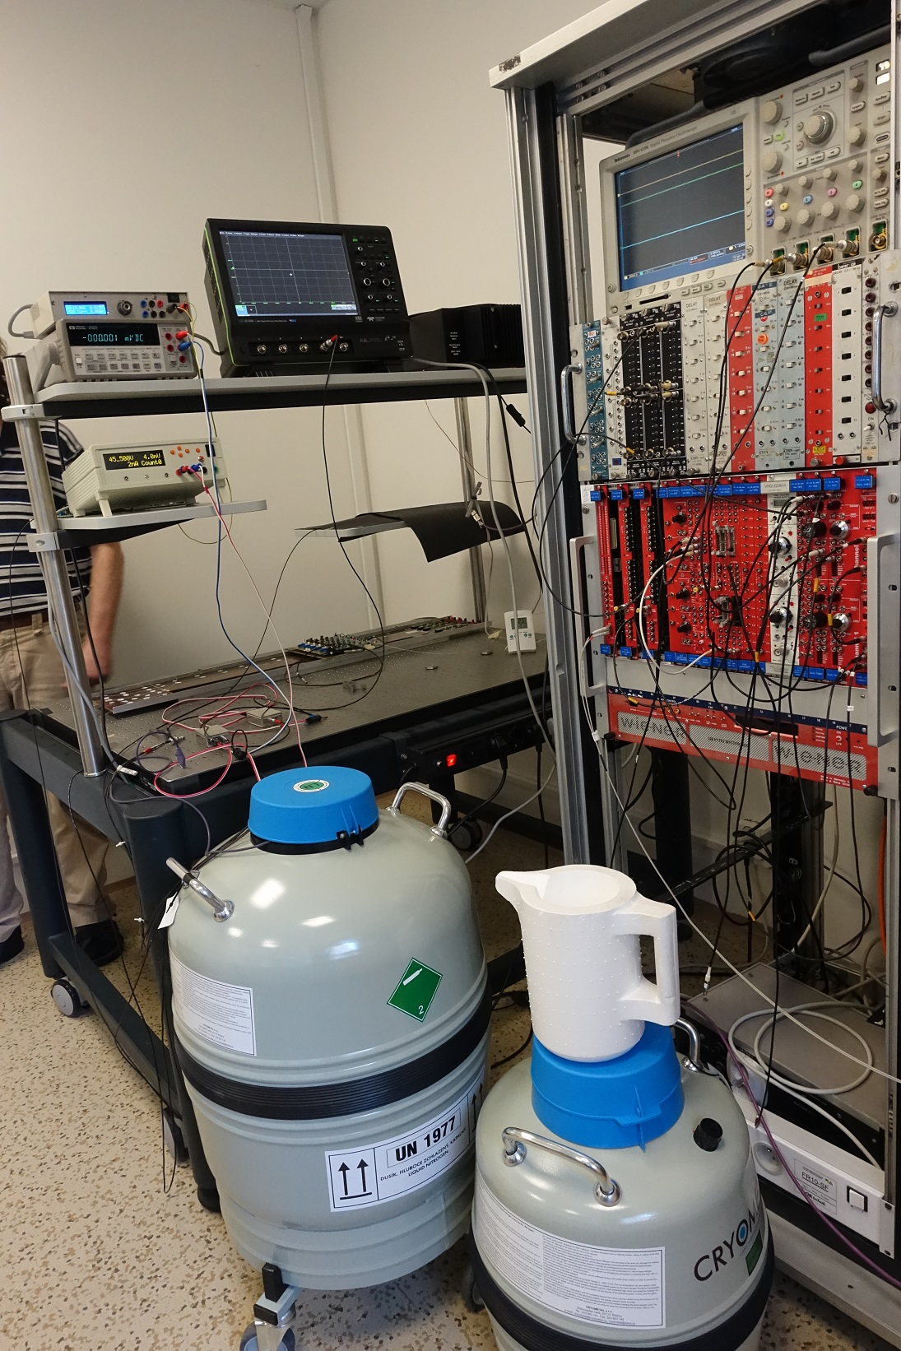
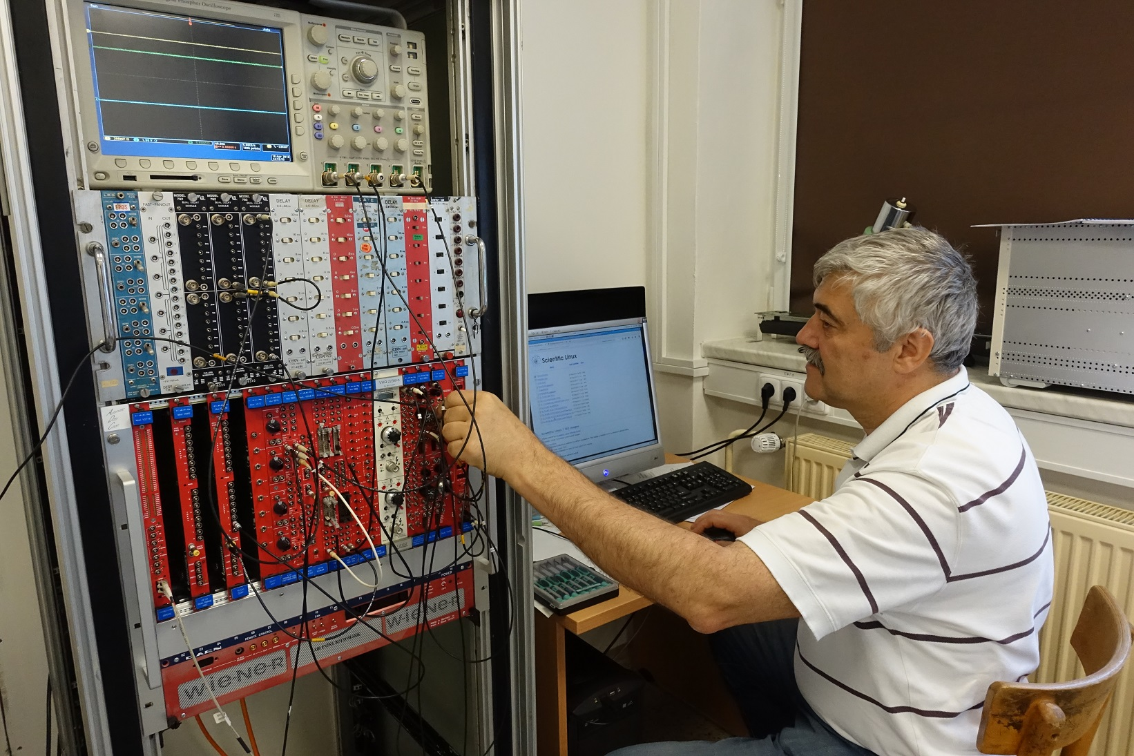
Photo-detection laboratory @ PRG
Moved and rebuild this Spring
Using VME ADC read-out with LabView on PCs
LED driver remotely controlled (~ns width pulses) @ 400 nm
Power sources – ability to program them.
2-3 scientists, 1-2 engineers, 1-2 technical stuff.

Slide 4
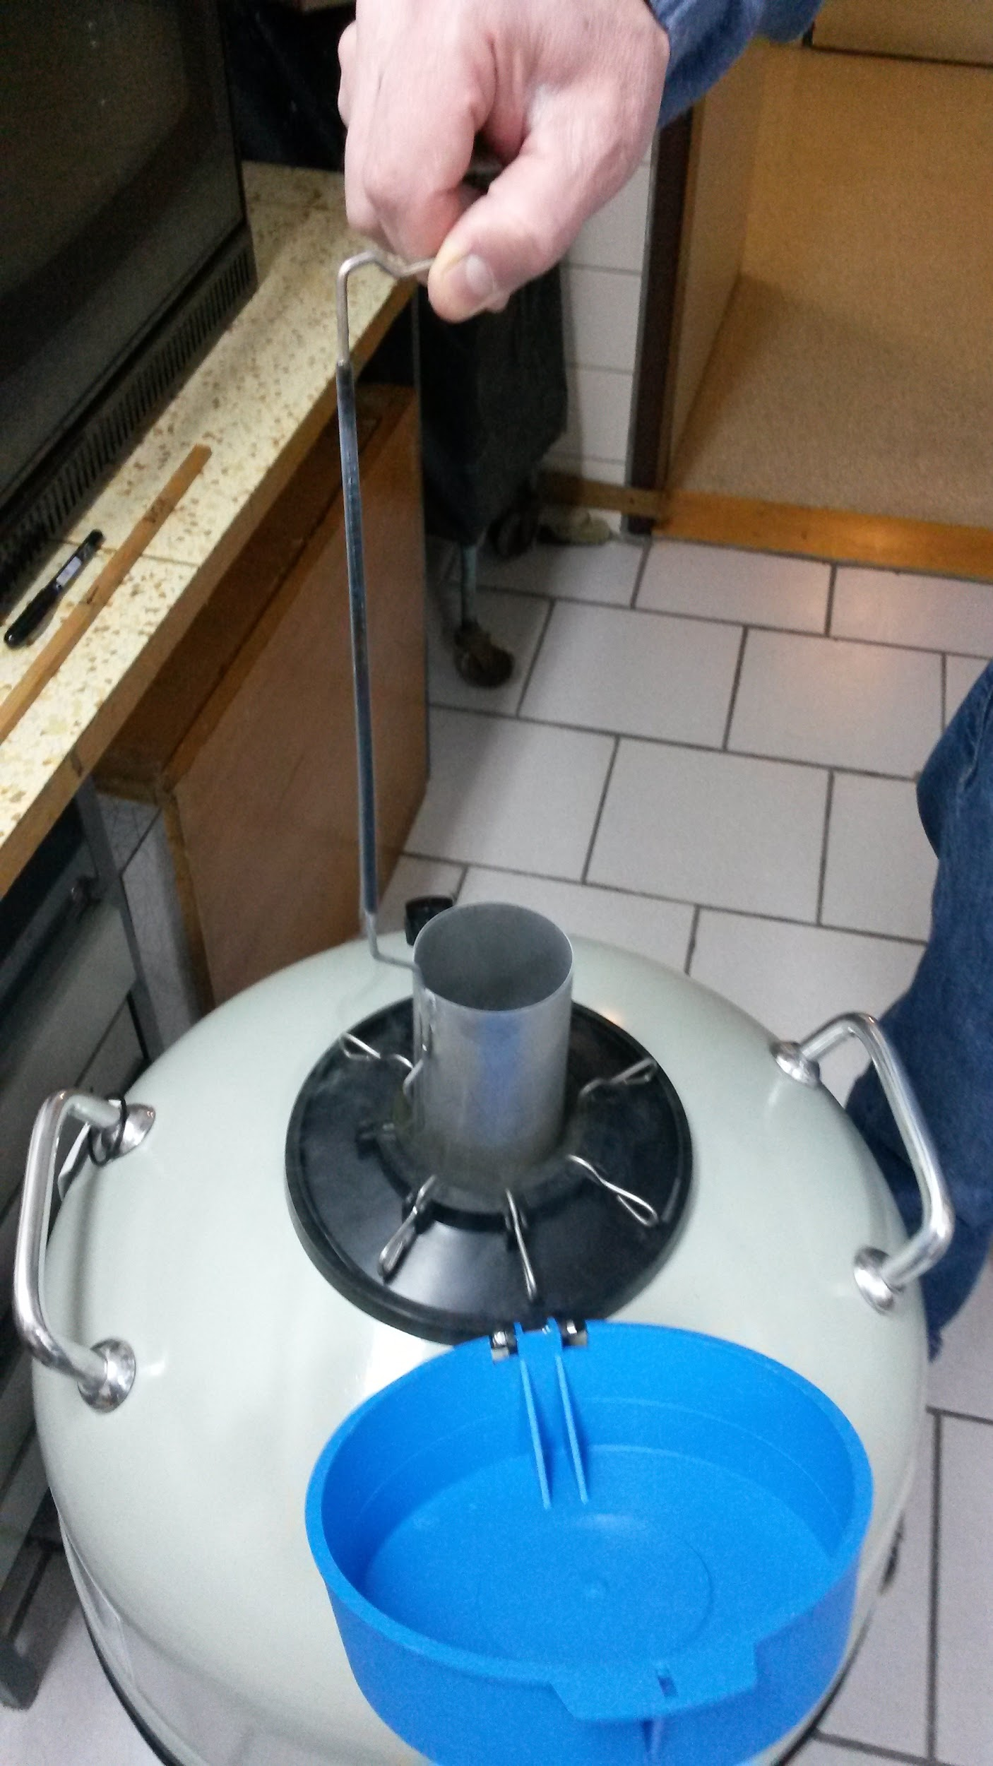
Current status:
- Warm and cryogenic – LN2 – signle SiPMs
The measurement dewar:
32 liters of LN2 kept with at same level for months
8 inserted cilinders – ability similtanously measure (66 mm radius)
Putting SiPMs into the cylinders on small pcbs
This setup is going to be changed after some discussion.
Also kind of the read-out discussion

Slide 5
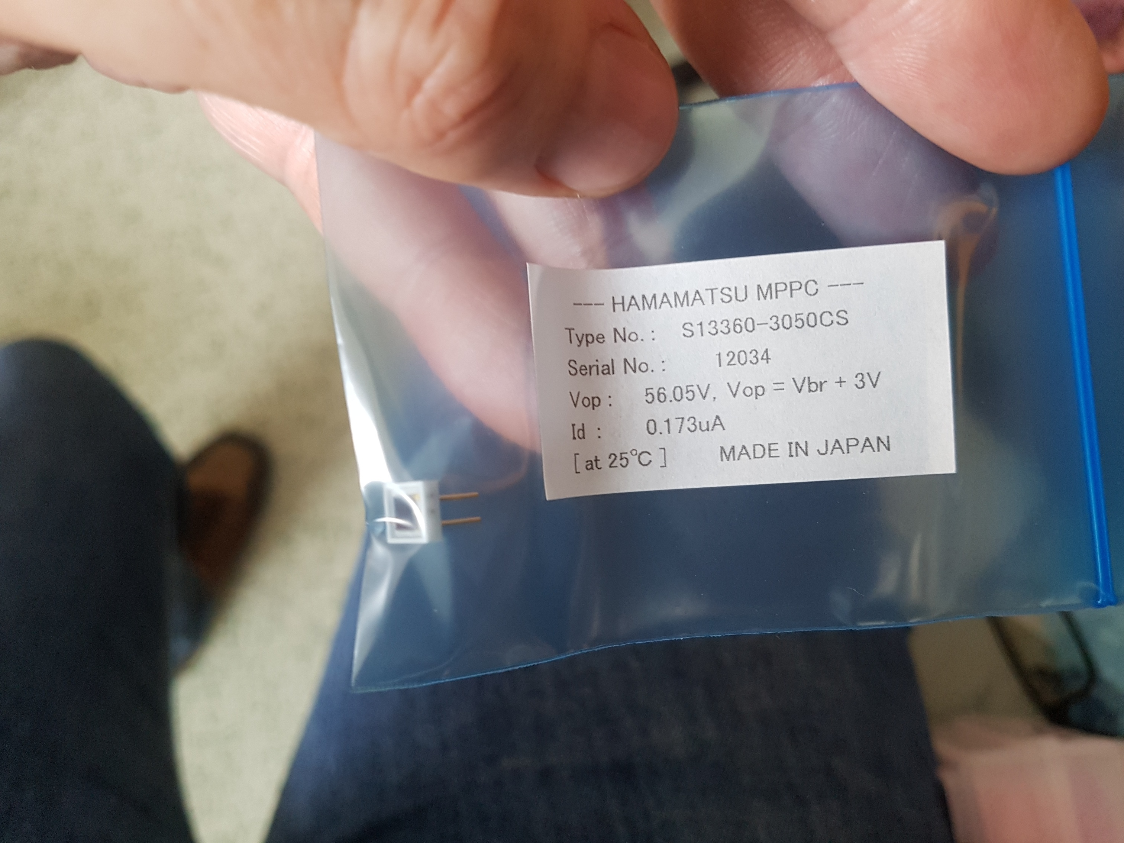
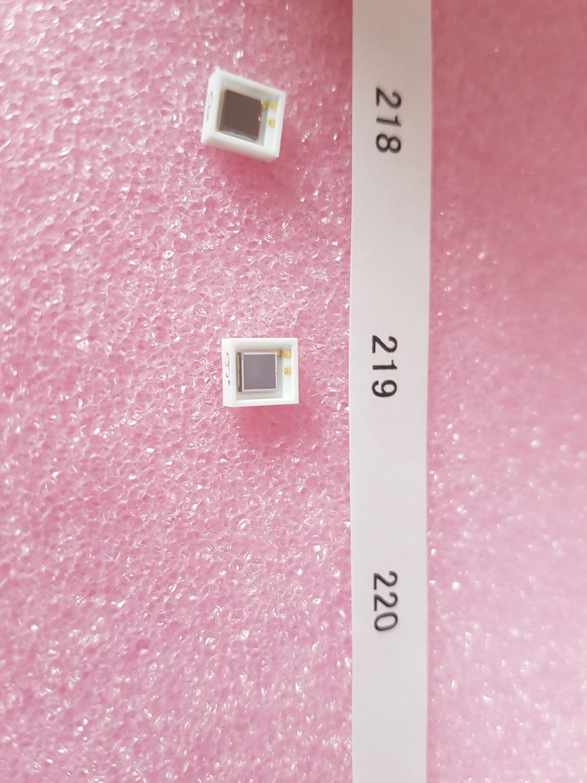
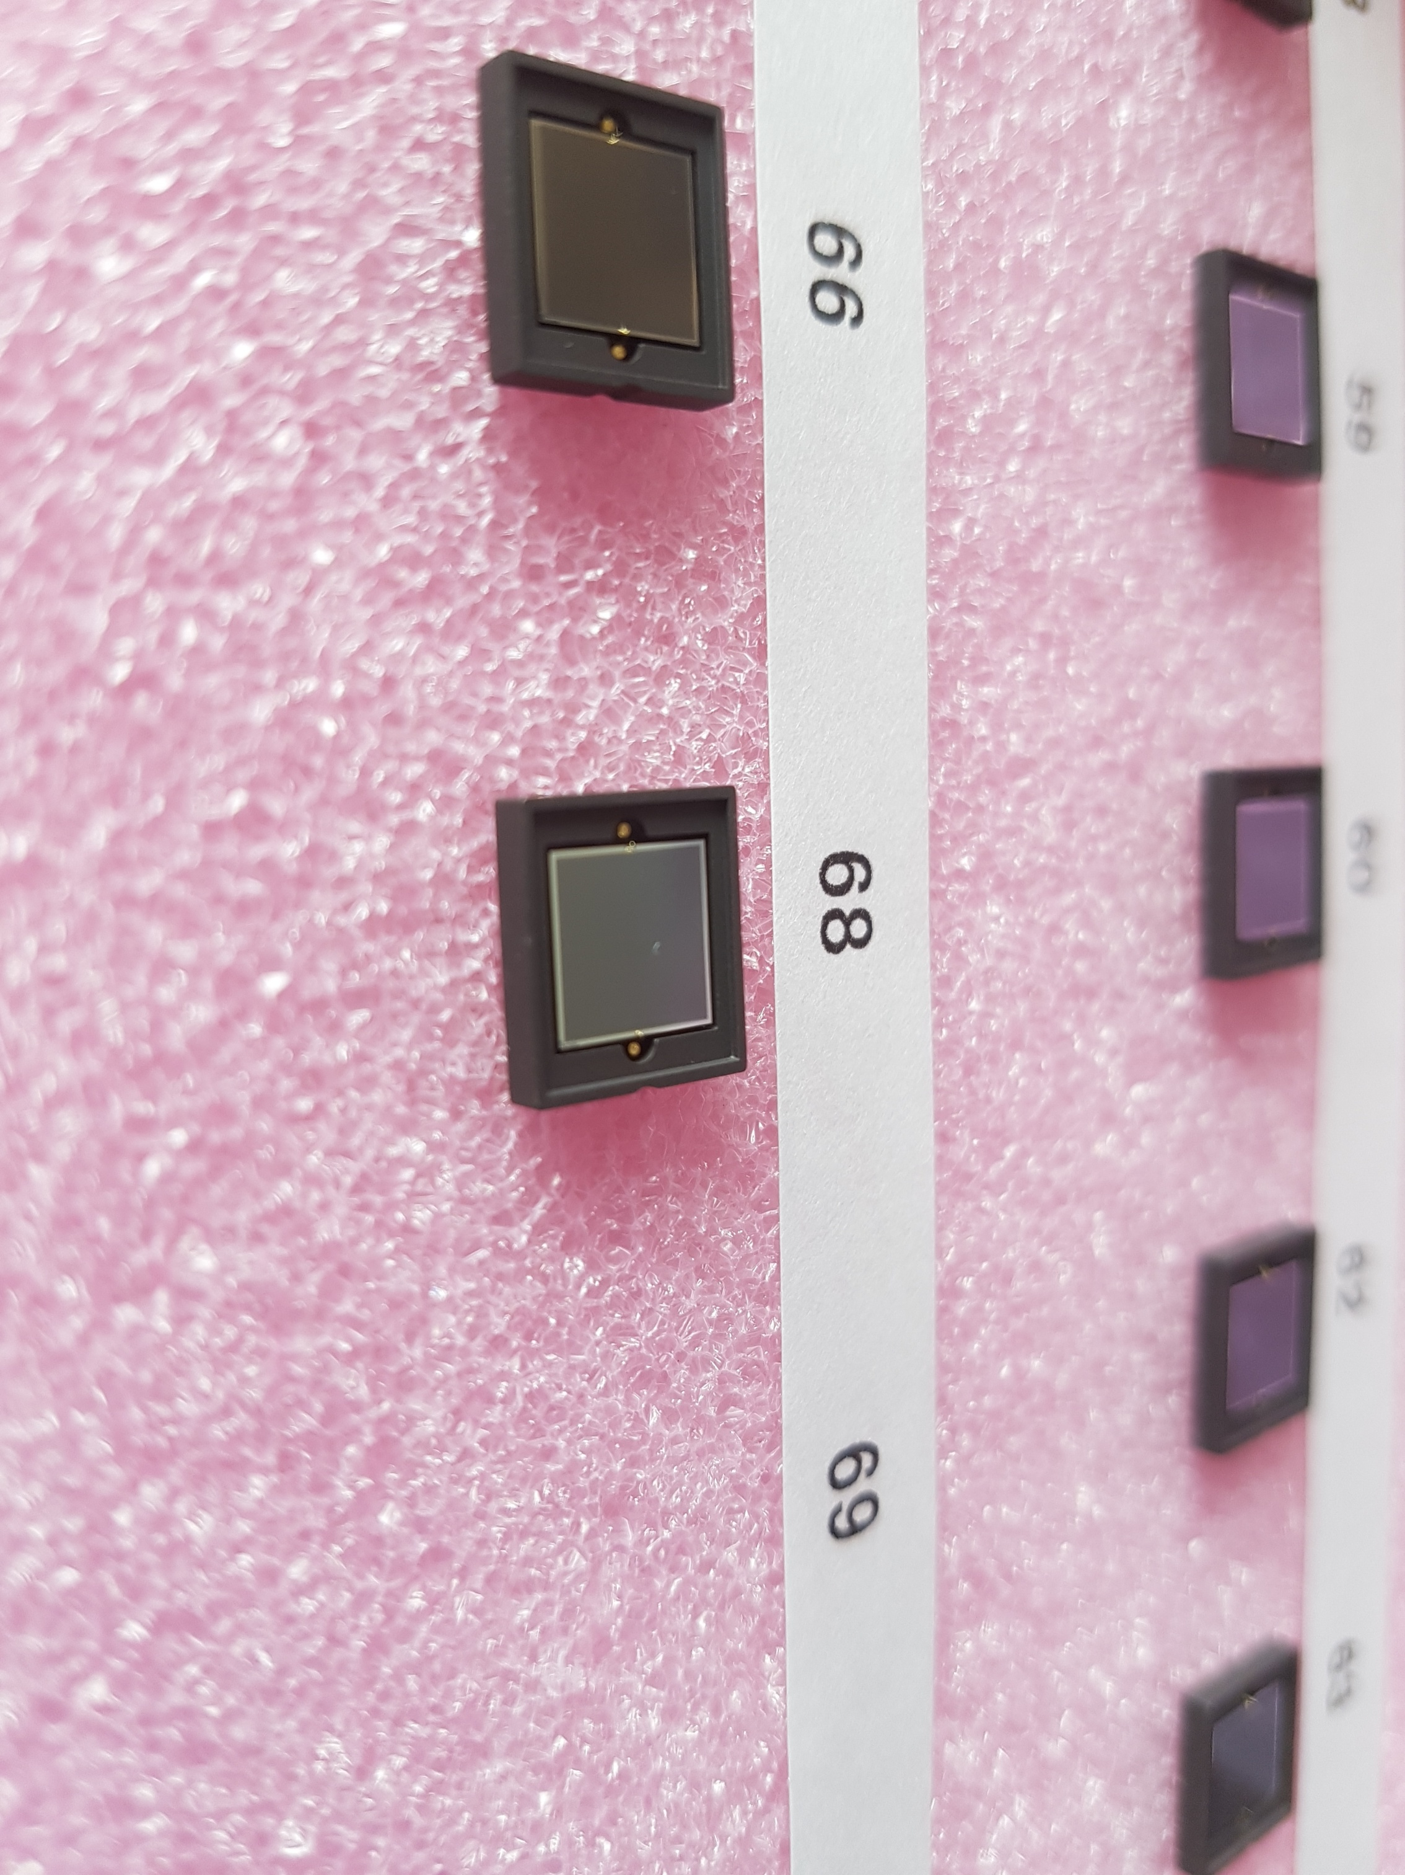
SiPM/MPPC
SensL:
MicroFC-60035-SMT (6x6 mm2) ~ 10 pcs
Hamamatsu:
S13360 – 3050 CS (6x6 mm2) 5pcs
Cryo S11370-6329 (6x6 mm2) 10 pcs
Cryo S11370-6330 (3x3 mm2) 5 pcs

Slide 6
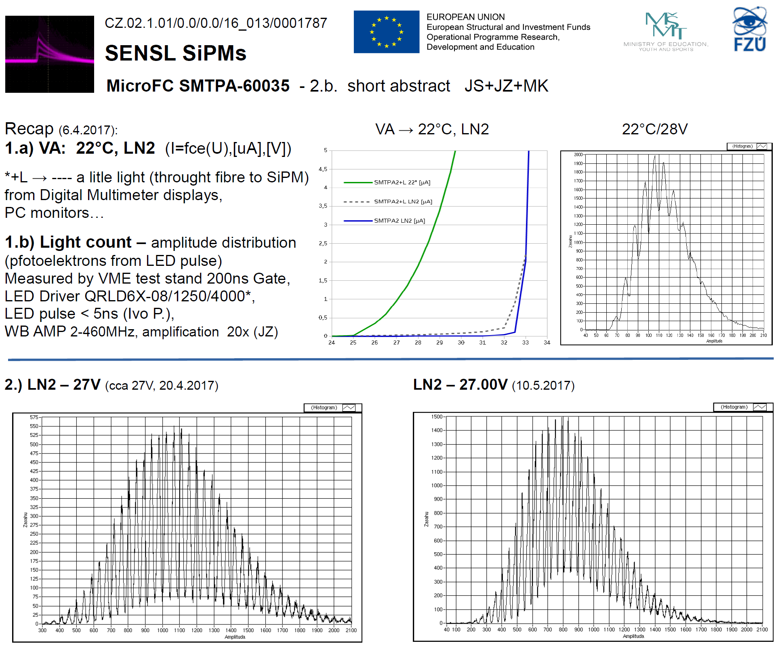
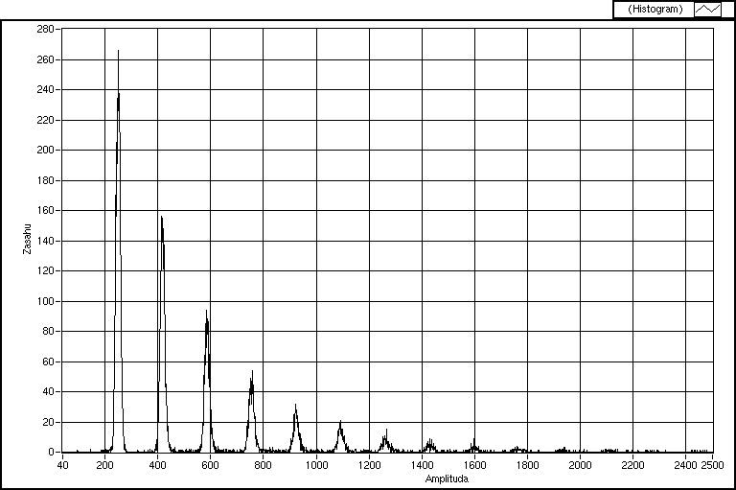
Some (preliminary) measurements SensL

Slide 7
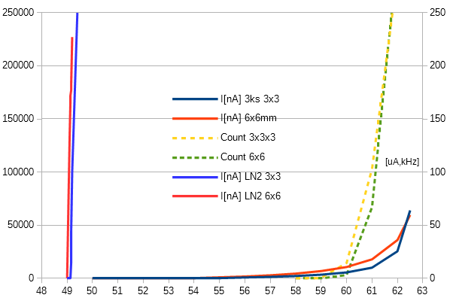
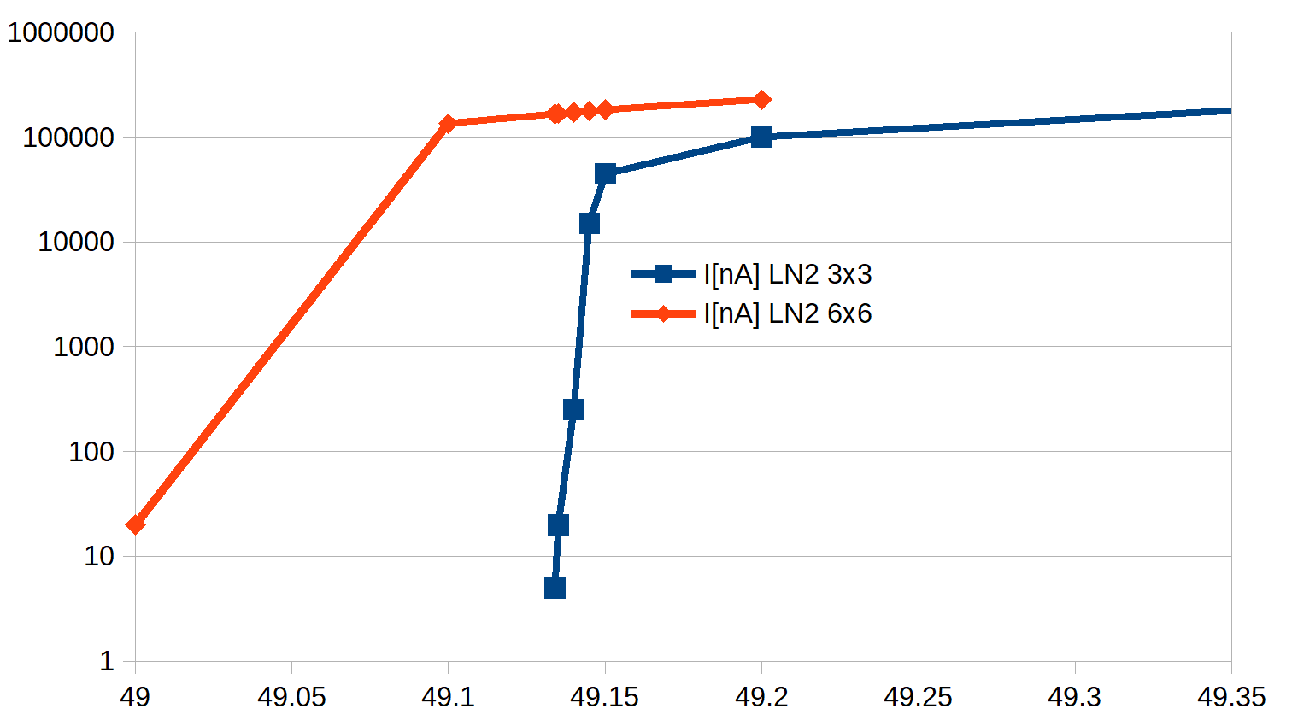
Hamamatsu cryo version (3x3 and 6x6 mm) at warm and LN2 temp.
Dark current Cryo-type Hamamatsu
shows very low values till V-overvoltage

Slide 8
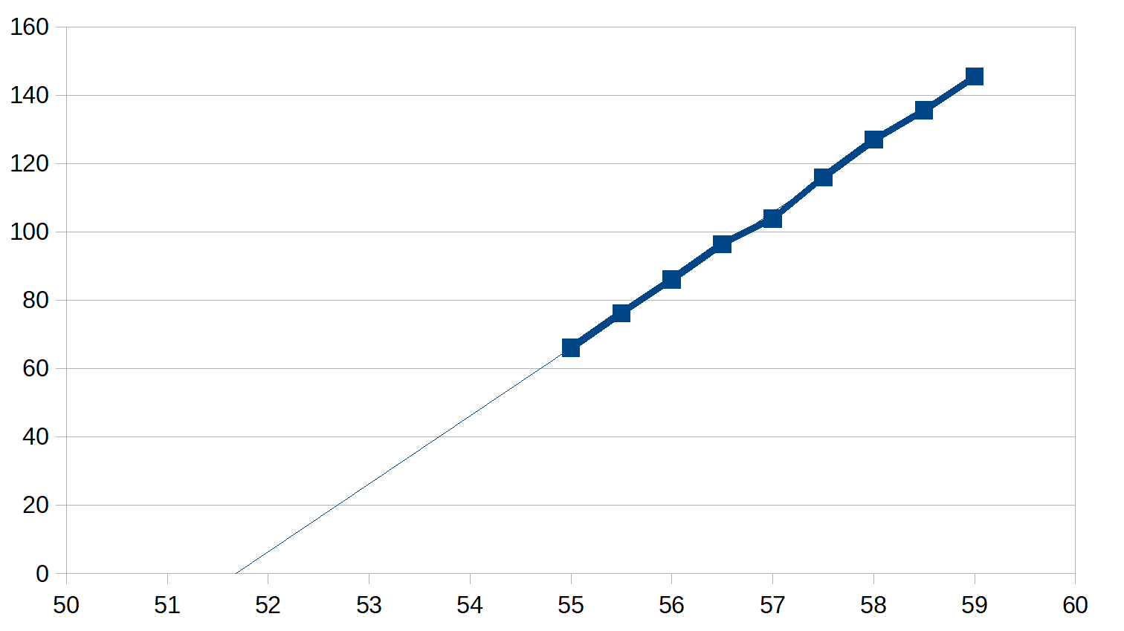
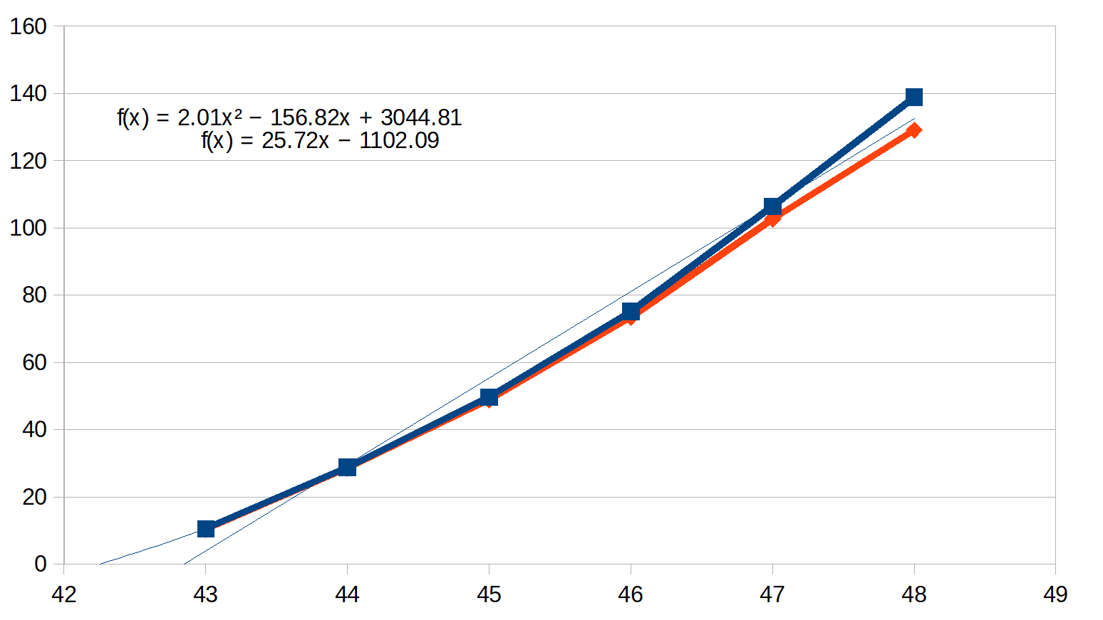
Some (preliminary) measurements
Cryogenic Hamamatsu MPPC S11370-6330 (3x3 mm2)
Breakdown voltage Vbr at LN2 temperatures and warm
First single p.e. peak determined via FFT
Gain (ADC/p.e.) vs Vbias

Slide 9
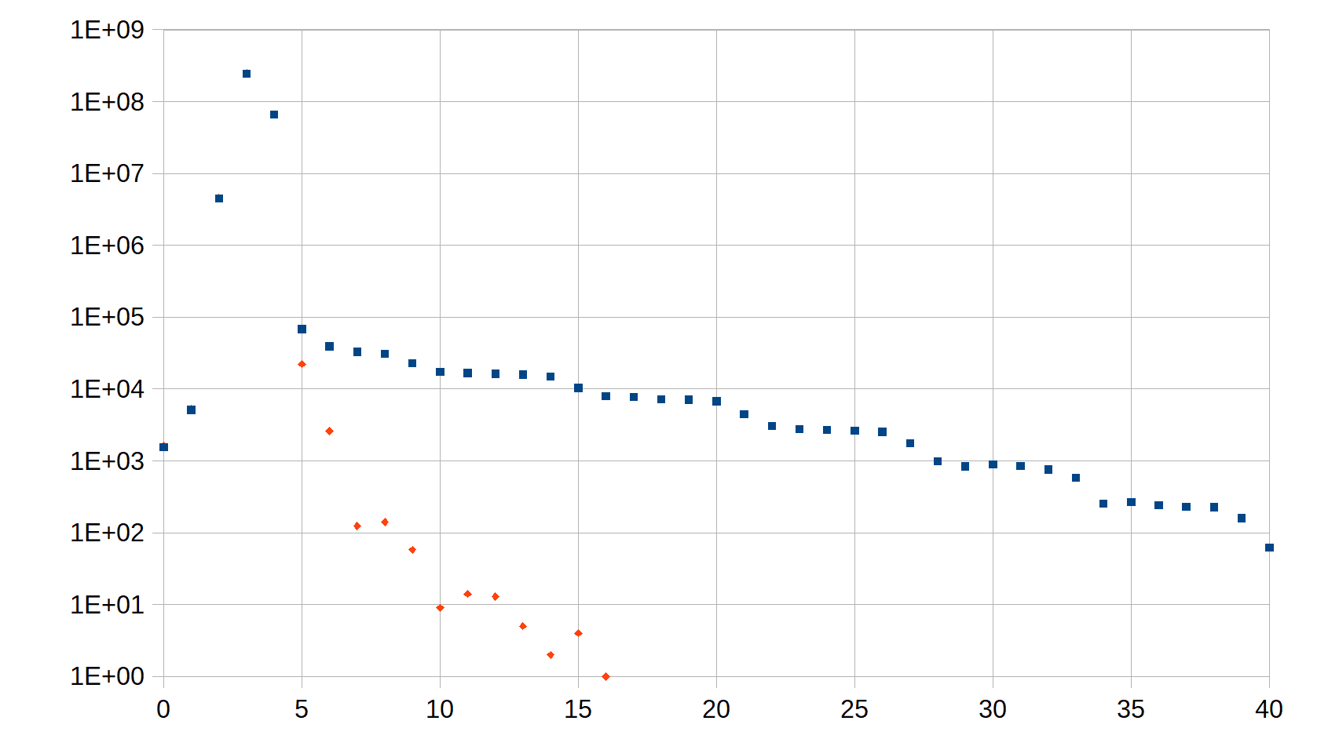
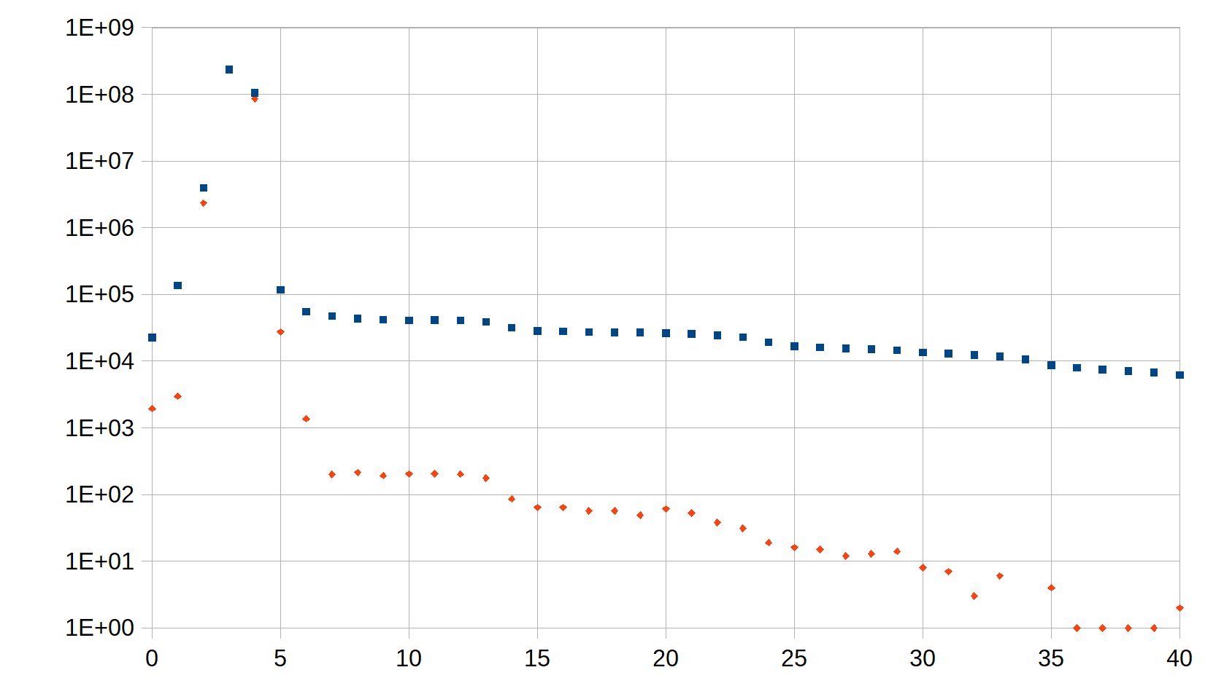
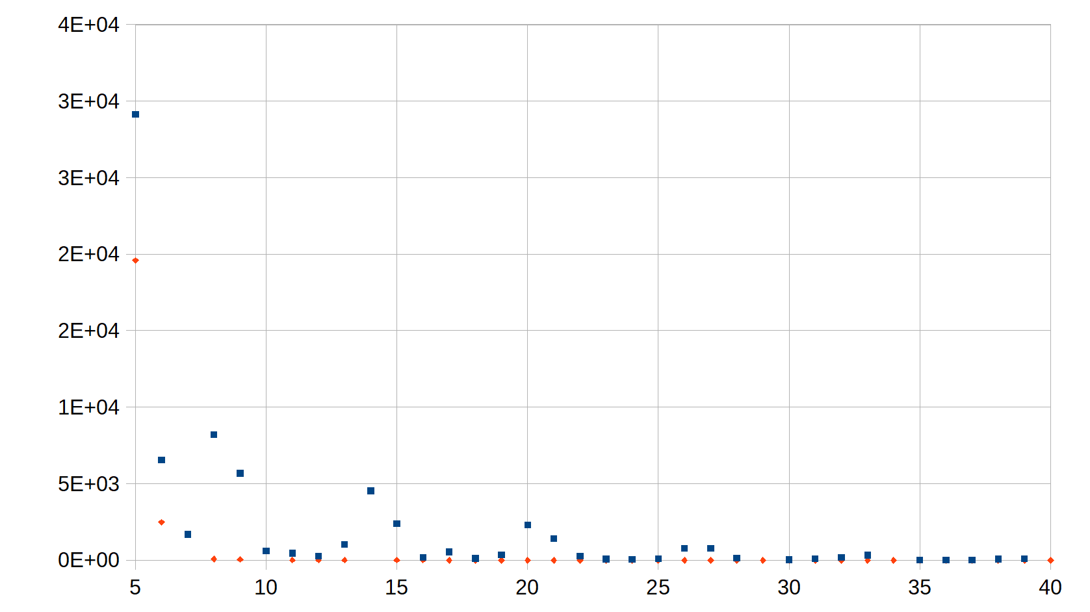
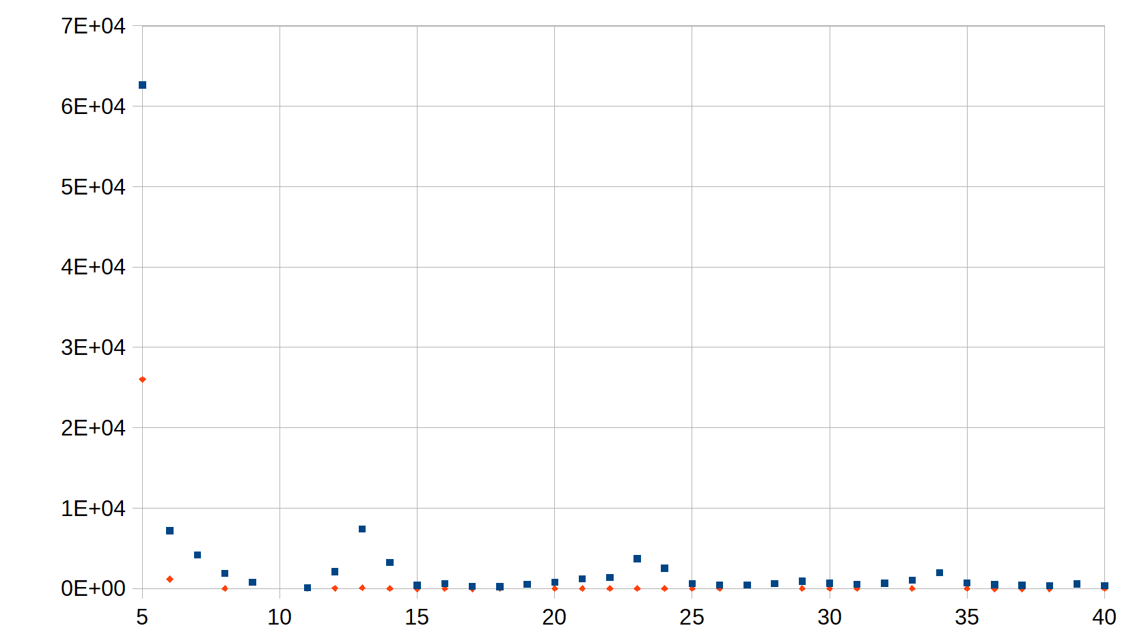
Cryogenic Hamamatsu MPPC S11370-6330 (3x3 mm2)
Rates (dark + low-light) scan dep. on ADC thresholds
Integral sum LN2 45V
Integral sum LN2 47V
Difference LN2 45V
Difference LN2 47V

Slide 10
Plans – photo sensors measurements
Single SiPM characterics measurements -> establish laboratory and sensors benchmarks
Multiple/mass QC measurement -> determine how to more automatize process -> provide sorted SiPMs on.
Long-term and/or thermo-cycling sensor measuremnts – subsidiary measuremnet along QC -> learn more on the cryogenic behaviour
Ganging / couplning SiPMs on base PCB boards -> efficiency study – under discussion how and what.

Slide 12
