Slide 1
Serial Ganging of SensL 3mm x 3mm C series SiPMs
PRELIMINARY
Kurt Francis
5/9/2018

Slide 2
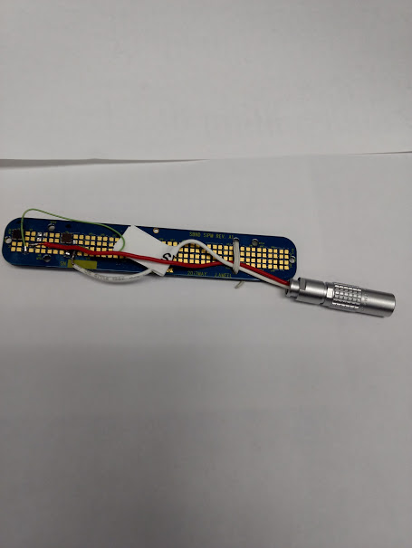
Sensl 3mm x 3mm C series are ¼ size versions of
The 6mm x 6mm for protodune
Vbr = 24.2V to 24.7V (~24.5)

Slide 3
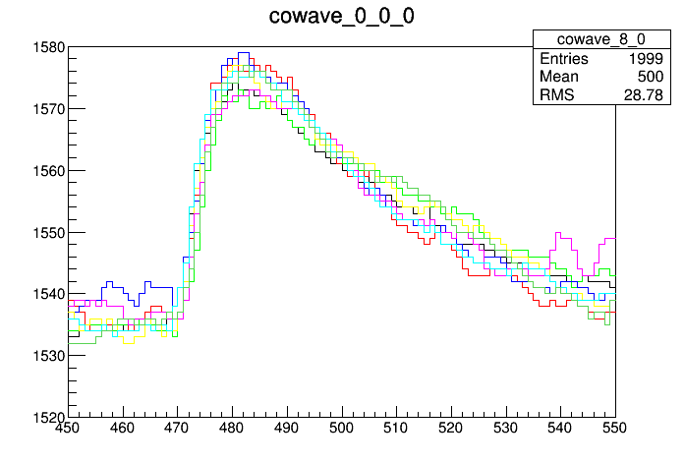
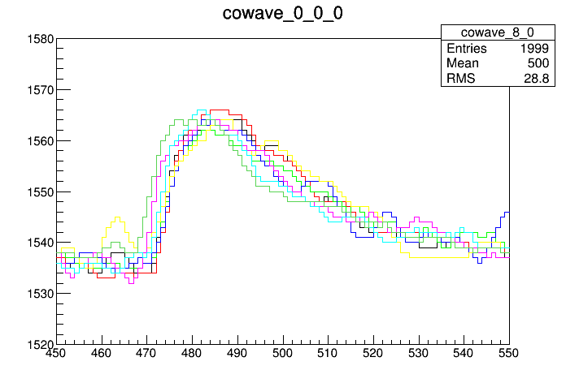
I presented this data a month ago -> question why is series lower
SINGLE SIPM
TWO in SERIES
40 ADC/PE for single
30 ADC/PE for series (75%)

Slide 4
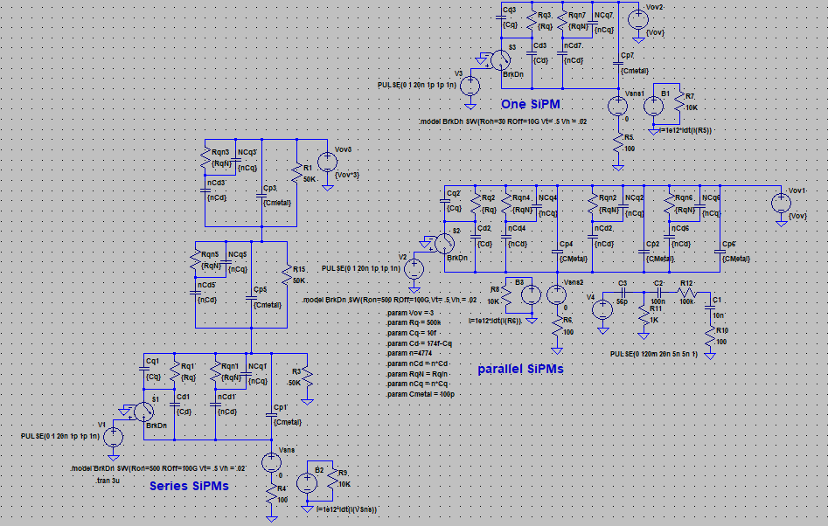
6x6 SIPM has 18980
3x3 SIPM has 4774 pixels

Slide 5
280uV
Green: Single SIPM – 53 uVuS
Blue: Three SIPM in series– 18 uVuS
Red: Three SIPM in parallel– 53 uVuS
205uV (75%)
3x3mm
6x6mm
Green: 53
Blue: 18
Red: 53
127uV
107uV (86%)

Slide 6
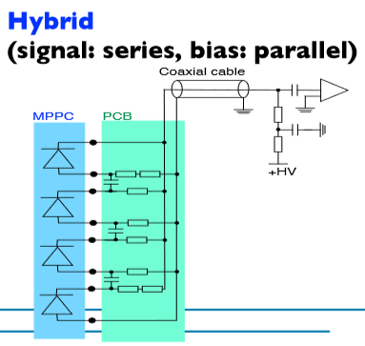
Green: Single SIPM
Blue: Three SIPM
with Hybrid bias

