Slide 1
Cold electronic noise and warm electronics requirements
Gustavo Cancelo

Slide 2
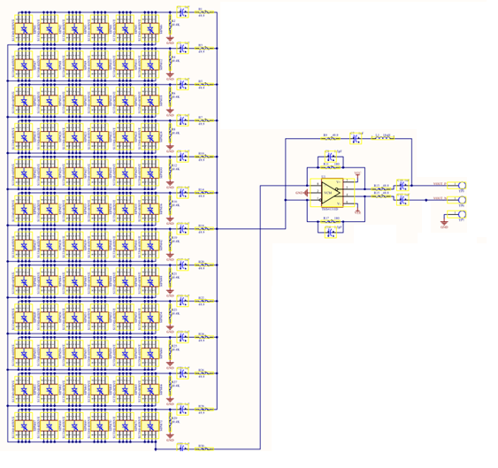
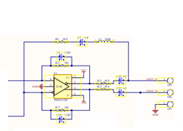
Noise
Warm electronics
Preamp Gain
Preamp Gain
Long cable and connectors
Vn_total
SPn
A/D
+
Impedance matching
Impedance matching
Diff Vn
In
Grounding and shielding noise
Total ADC noises
Output noise
$$N_{total} =N_{sipm}∗A_{1}∗A_{2}∗A_{ADC}+N_{G}∗A_{2}∗A_{ADC}+N_{ADC}∗A_{ADC}$$
Eq (1)
Noise referred to the input
$$N_{in}=V_{sipm}+V_{G}/A_{1}∗A_{ADC}+V_{ADC}/(A_{1}∗A_{2})$$

Slide 3
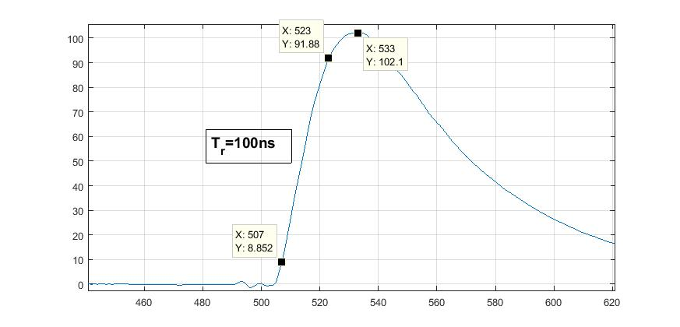
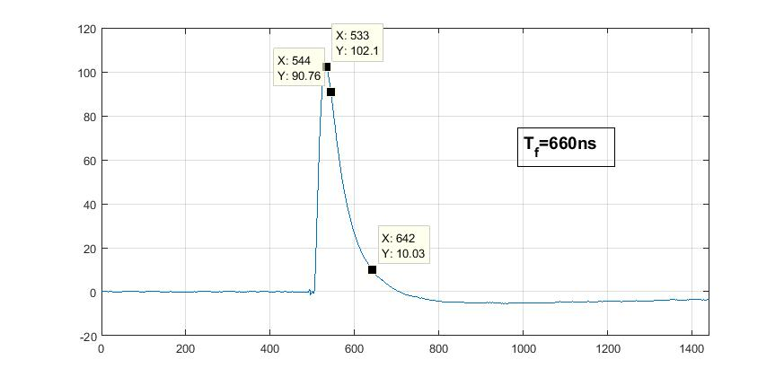
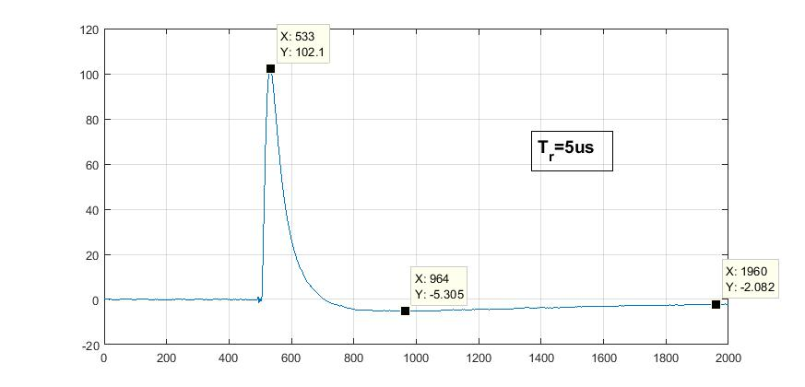
Mean signal 72 MPPCs at -70C and Vb=47
Rise time 100ns, Fall time 660ns, slow undershoot recovery.
SSP time constant has not been modified.

Slide 4
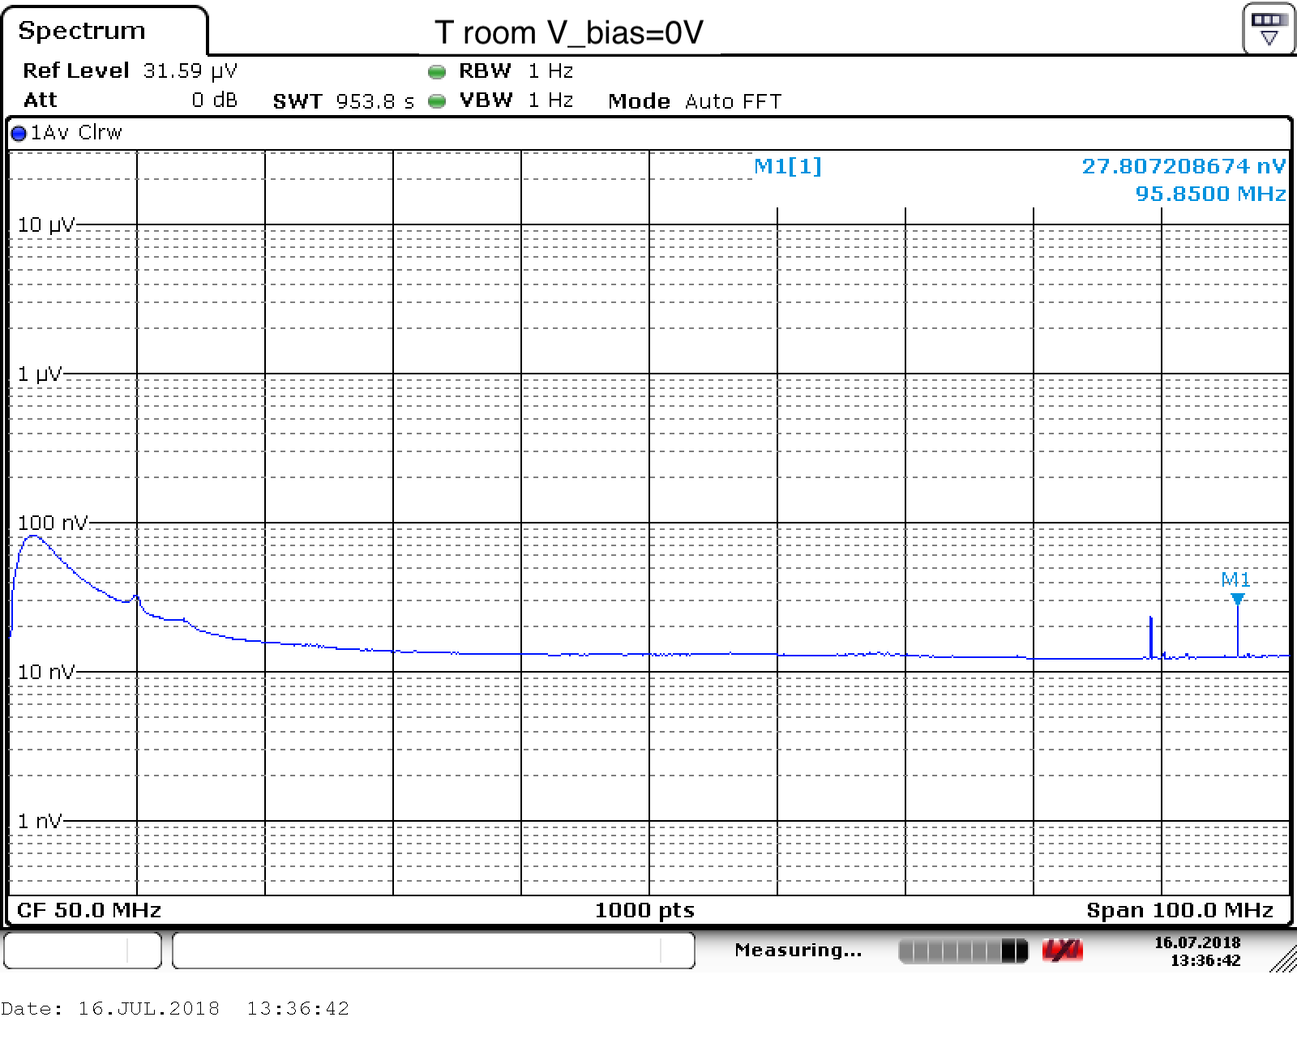
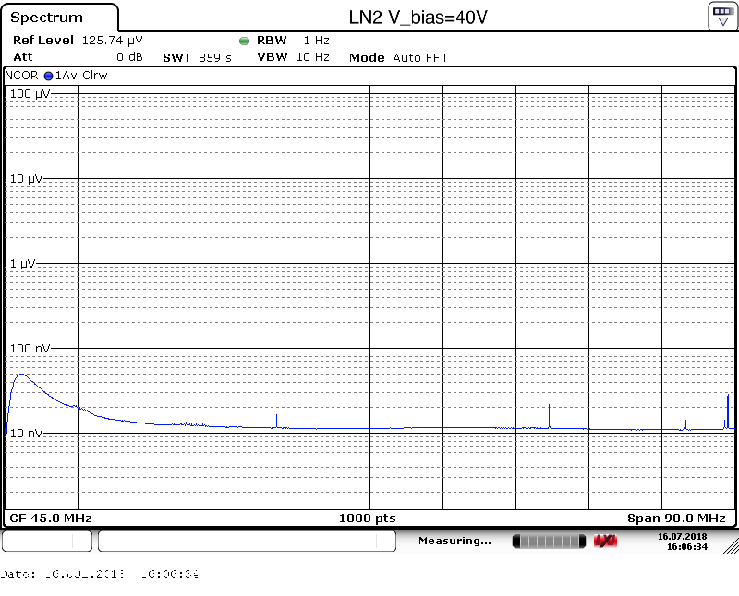
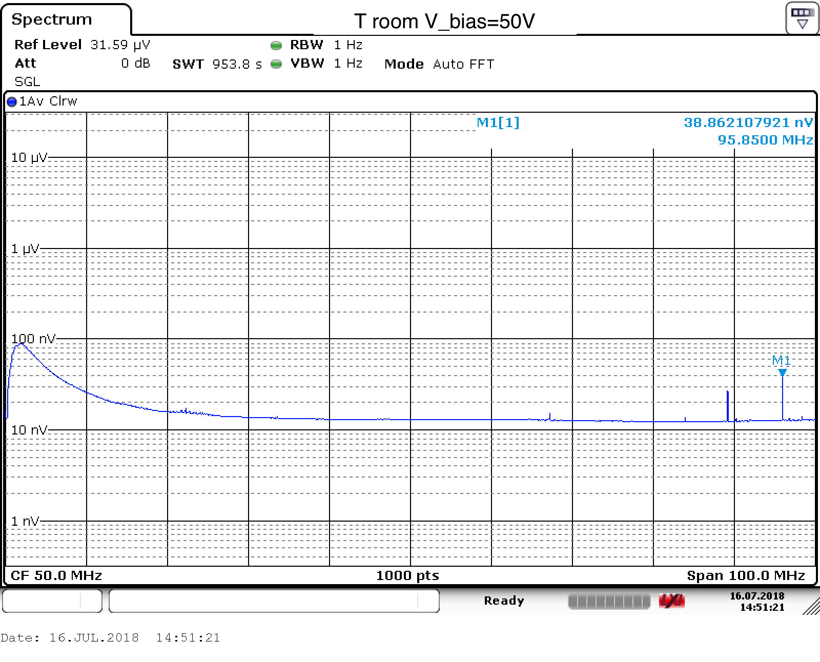
Noise spectrum
Noise is 10nV/sqrt(Hz)
1/f at lower frequencies.
It does not vary much with T and Vb

Slide 5
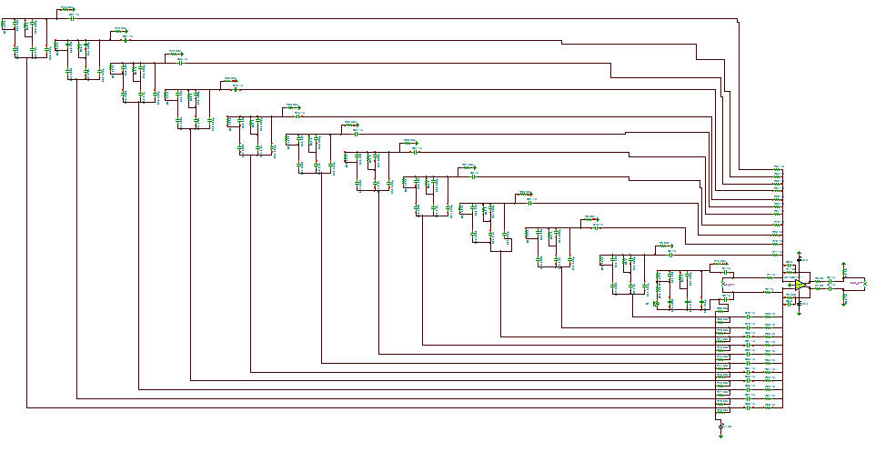
Simulations
Simulations are in agreement with results from data.

Slide 6
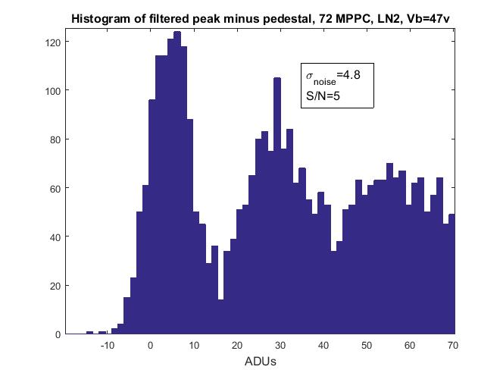
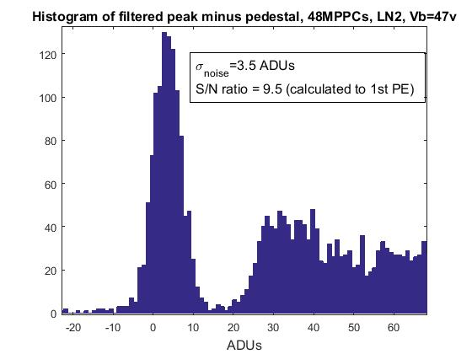
72 MPPCs vs 48 MPPCs
72 MPPCs: noise is higher and signal is smaller. S/N=5.
48 MPPCs: S/N=10.
S/N measured as the fit of the 1st PE peak to the σ_{noise}.

Slide 7
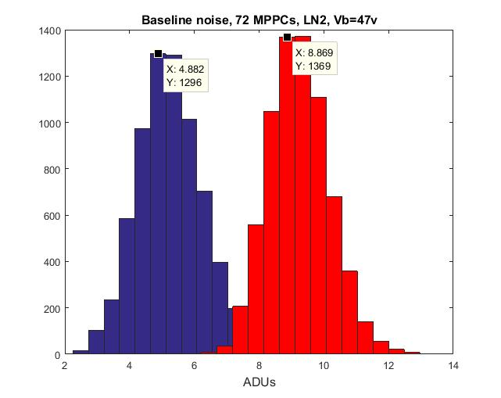
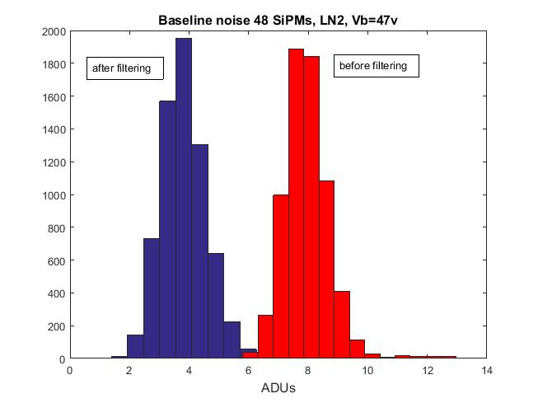
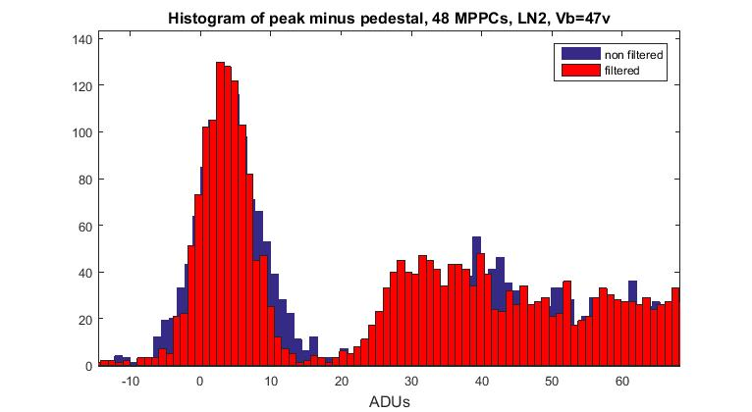
Filtering the signal with a matched filter (50 taps long)
Histograms of
σ_{noise}
Good reduction of noise by filtering.
The 1st, 2nd PE spectrums do not change.
Histograms of
Noise and 1st , 2nd PE

Slide 8
When the SSP input is terminated to 50 ohm the noise is ~3 ADUs. We can make this noise negligible in equation (1) adjusting the preamp gain. The maximum preamp gain (tread off) is signal dynamic range.
The current noise is NOT dominated by ADC noise.
An MPPC is $50, let say you can get them for $20 in large volumes.
One channel $20x48 ~ $1K. You can make warm electronics for less than $100/channel.
Warm electronics requirements:
Noise should be low enough to see 1st PE with a S/N >> 10.
Dynamic range should be enough to the largest signals of interest.
Cost should be at ~$50/channel.
Good impedance matching with cold electronics to avoid undershoot.
Integration of SIPM Vbias and cold electronics preamp bias voltages.
Alternative: external bias for cold preamps

