Slide 1
PIP-II Cryomodule Development Plan Overview
Allan Rowe
TD/PIP-II Mini-Retreat
10 May 2018

Slide 2
Outline
Cryomodule Development and Activity Planning Approach
  General Design Strategy
  RLS & Estimate Development
650 MHz CM Development Summary
  LB650
  HB650
PIP-II Partnerships
  Areas of interest
  Planned deliverables
HB650 CM Development Notes
HWR CM Development Notes
Next Steps

Slide 3
High-Level Strategies
FNAL is responsible for all CM component designs except:
  HWR CM and components
  SSR2 Dressed Cavity
  LB650 CM and Dressed Cavity
    FNAL responsible for RF coupler and tuner
Maintain long design durations overlapping with prototyping efforts.
Move CM testing out as far as possible to accommodate uncertain Partner schedules
Prioritize SSR1 CM1, followed by HB650 CM1
Keep SSR2 on the critical path – more controllable than other areas of the schedule
Standardize as many CM elements as possible
Majority of integrated design effort in CMs #1

Slide 4
General PIP-II Cryomodule Design Strategy
PIP-II CM Platform*
Common Design Features
  Room temperature lower Strongback support
  Fully segmented – individual cryogenic feed/return
  Integrated thermal shield in cavity support base
  Side-mounted cryogenics feed and control box
  Tuner access ports
  Individual RF sources/RF Coupler/SRF cavity
  Instrumentation strategy
  Physical and operational interfaces
Design uniformity kept to the extent practical
  Facilitates CM assembly and repairs, shortens design cycle
  Shared components by frequency: couplers, tuners, interfaces
Reduces LINAC System Complexity
*Design details covered in V. Roger’s talk

Slide 5
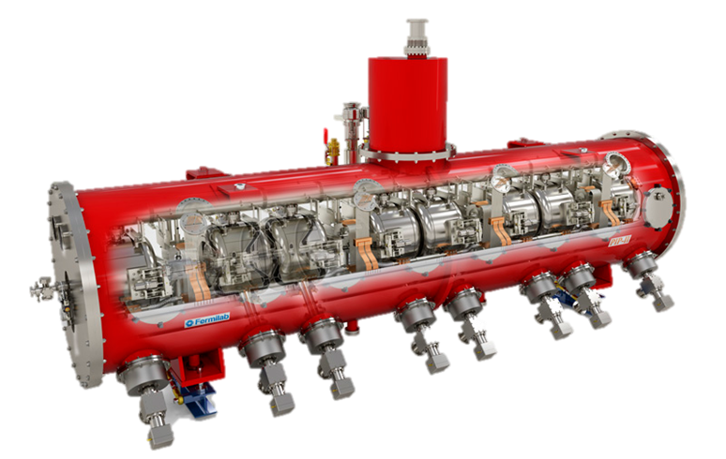
SSR1 CM1 – The PIP-II Prototype CM
SSR1 CM1 serves as the design basis for the strategic goals listed on the previous slide.

Slide 6
Cryomodule/Cavity sub-System Development Cycle
GRD
Prototyping/Design Verification/First CMs
SCD FRS/TRS DESIGN PDR FDR PRR
Cavity and Cryomodule performance requirements flow down from Global Requirements Document (GRD)
Requirements establish design targets and help set boundary conditions
Designs are reviewed at various maturities (preliminary, final, procurement ready)
Critical prototyping activities follow complete design/review sequence
  (cavities, couplers, CMs)
Production design cycle linked to prototype feedback
FDR DESIGN
TESTING PROTOTYPING
PRR PRODUCTION
VALIDATION END USE
Final Design / Production CMs

Slide 7
Cavity and Cryomodule Performance/Design Parameters
PIP-II CMs/cavities/RF couplers/etc. designs developed initially during Project X. Changing parameters driving different design decisions/changes.
  2 mA beam current now the requirement (instead of 5 mA)
  Pulsed beam, but CW RF (rather than dual operating modes)
  *Ozelis talk provides details on current operating parameters
Special consideration:
  CMs must be transported across the ocean
    Nothing specifically considered in the designs
    Transportation issues currently assumed to be Partner responsibility

Slide 8
Planned Reviews
Critical Reviews are tracked in P6 as milestones.
PDR, FDR, PRR serve as sequence authorizing procurement
  ORC required for system-level operation
‘Non-critical’ components or subsystems are managed within the Division or Department review process as required by the FNAL Engineering Manual.
Design reviews are planned for Partner deliverables as appropriate to ensure technical and ESH&Q requirements are met. Partner milestones identified and implemented in P6.
Design Review Deliverables are detailed in the PIP-II Design Review Plan

Slide 9
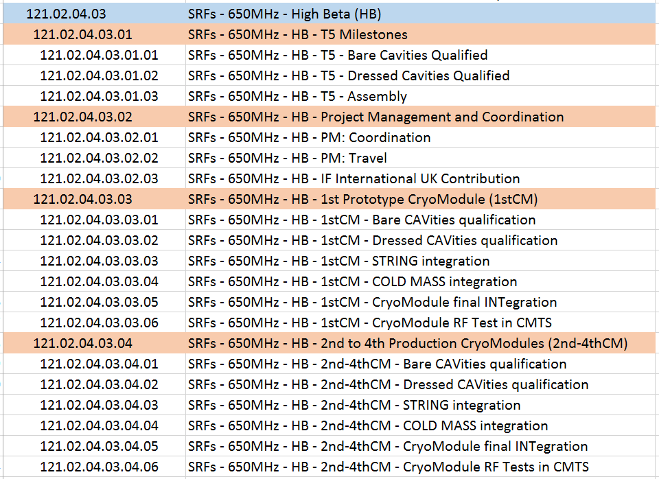
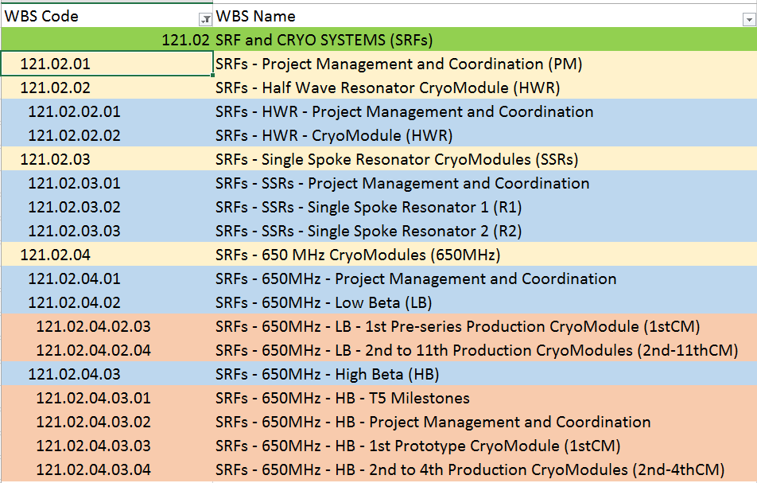
Planning (RLS Elements)
Work Breakdown Structure

Slide 10
Planning (RLS Details)
L2/L3, Partner oversight, Project Review support, all travel M&S included in PM&Coordination structure
Effort and M&S defined down to Level 8/9 (component level)
Engineering/design included to support vendors
Partner oversight defined at the device, sub-system, & system levels depending on the deliverable
  Matches review plans
T4 milestones identified (L2 manager owns these)
  e.g. CM Test complete (hand-off to another L2 manager)
T5 milestones identified (L3 manager owns these)
  e.g. string assembly complete, coldmass assembly complete, CM assembly complete, etc.
T6 milestones and below (L3 manager owns these)
  Reviews, qualified cavity tests, etc.

Slide 11
Estimating Approach
Developed Bases of Estimate at L6 through all CMs
M&S estimates include a combination of actuals and engineering estimates (preliminary design maturity with commensurate uncertainties)
  Developed complete hardware lists, segregated large elements like cavities, vacuum vessels, etc. for cost estimate clarity.
Design, procurement, assembly, QA/QC effort estimated with guidance from LCLS-II ongoing experience, in particular the pCM experience.
Partner oversight effort estimated without internal historical experience
  Very difficult to know how much travel, what problems will arise, etc.
  Considered anecdotal DESY oversight experience – PIP-II is lower
  Distributed nature/capabilities of the Partners increases uncertainty
CM testing, cavity preparation, touch labor reference actuals from LCLS-II.
Largest uncertainty is in CM design effort. Careful review of design deliverables underway which must be compared to CD1 resource requirements.
Full suite of BOEs and RLS getting reconfigured to match anticipated contributions, changes in scope, address time-phasing issues, etc.

Slide 12
Cost Estimate and Schedule Details
Perform analysis outside this forum – L2s, L3s, L4s working to align everything
See CD1 presentations for previously reviewed details
Primary Planned Changes from CD1
SSR2 – 100% production cavities are partner deliverables
  FNAL will do VT qualification pre-string integration
HB650 – CMs 2-4 are partner deliverables
  All CMs still tested at CMTF

Slide 13

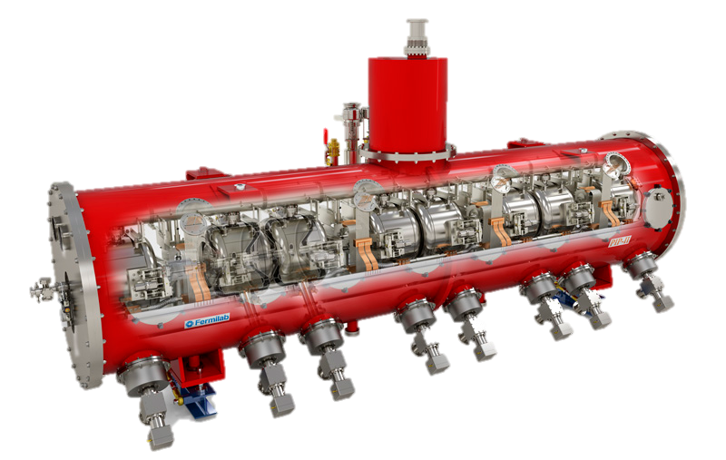
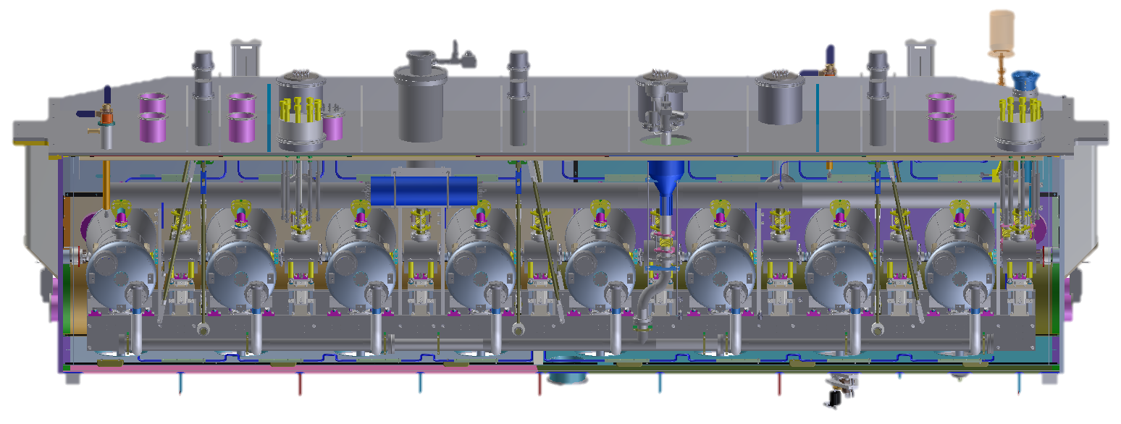
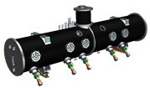

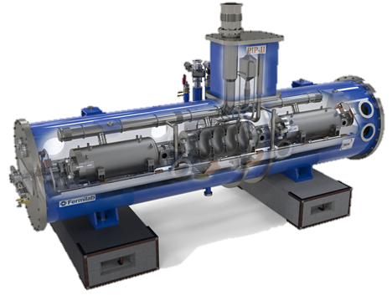


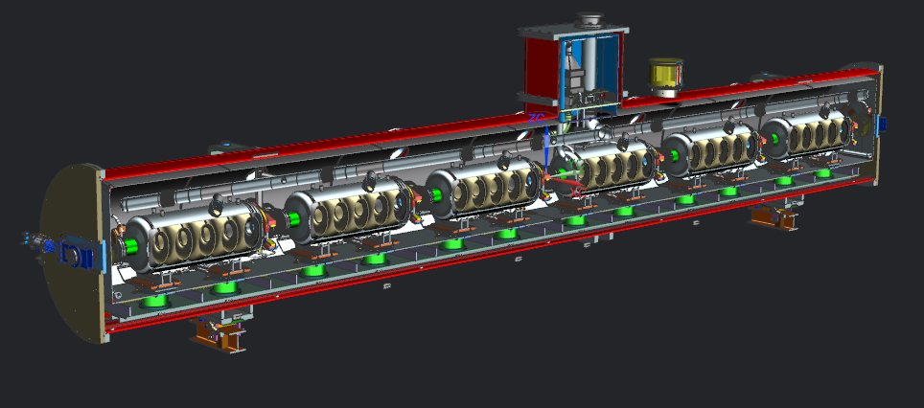

PIP-II SRF Linac Partnership Overview
HWR X 1
SSR1 X 2
SSR2 X 7
LB650 X 11
HB650 X 4

Slide 14
In-Kind Deliverables Assumptions
Item | Quantities required installed | Quantities assumed in-kind for CD-2 RLS (as of 08-May-2018) | In-kind Deliverables not installed (proto/spare) | Produced at Fermilab
CryoPlant
CryoPlant Delivered | 1 | 1
SSR1 CM1
Jacketed Cavities [note: Jacketed = cavity + He vessel (no tuner, coupler)] | 8 | 1 | 1 | 10*
SSR1 CM2
Bare Cavities | 8 |  |  | 9
Jacketed Cavities | 8 |  |  | 9
Couplers | 8 |  |  | 10
Tuners | 8 |  |  | 9
Solenoids | 4 |  |  | 4
BPM | 4 |  |  | 4
SSR2 CM1
Bare Cavities | 5 |  | 2
Jacketed Cavities | 5 | 4 |  | 2
Couplers | 5 | 4 |  | 2
Tuners | 5 | 4 |  | 2
Solenoids | 3 | 4
BPM | 3 | 4
*tuners+RF couplers

Slide 15
In-Kind Deliverables Assumptions
SSR2 CM2-7
Jacketed Cavities | 30 | 30 | 4
Couplers | 30 | 30 | 4
Tuners | 30 | 30 | 4
Solenoids | 18 | 18
Cold BPMs | 18 | 18
HB650 CM1
Jacketed Cavities | 6 | 2 | 2 | 6
Couplers | 6 | 2 | 2 | 10
Tuners | 6 | 2 | 2 | 9
HB650 CM2-4
CM (including shipping) | 3 | 3
Jacketed/Dressed Cavities | 18 | 18 | 2
LB650 CM1
CM (including shipping) | 1 | 1
Jacketed Cavities | 3 | 3 | 1
Couplers | 3 | 3 | 1
Tuners | 3 | 3 | 1
LB650 CM2-11
CM (including shipping) | 10 | 10
Jacketed Cavities | 30 | 30
Couplers | 30 | 30
Tuners | 30 | 30

Slide 16
Half-wave Resonator Cryomodule Development Notes
Activity treated differently than all other CMs
To date, generally a hands-off approach
General guidance from FNAL only, high level of trust
Oversight limited to tracking activities and occasional technical support on specific items
Interface/Installation planning discussions have engaged FNAL integration team. Highlights need to formalize work.
Lack of deliverables definitions from FNAL, in particular to achieve ORC, needs to be resolved.
Schedule and technical delays at ANL requires unplanned effort by PIP-II to correct.
Scope of FNAL support under discussion.

Slide 17
650 MHz CM Development Notes
Look to optimize schedule.
  opportunity to advance by 1 year if design activity ramps up
  Dependent on Partner deliverables to complete string unless FNAL prototype B.92’s used.
  Don’t overlook dependencies like RF source availability!
STC design verification testing critical for both B.90 and B.92
  High power operation of cavities/RF couplers
  Resonance control
Design incorporates many SSR1 elements – awaiting feedback from CM integration.
Current Critical Dates:
  String Assembly = March ‘21 – June ’21 (gap due to B.92 proto. tests)
  Coldmass Assembly = Nov ‘21 – March ‘22
  Final Integration = March ‘22 – June ‘22
  CM Test = June ‘22 – Nov ‘22

Slide 18
Statements on Risk
Risk Register will be revised during upcoming risk workshop
  CW RF operation may change the risk rankings
  Targets specific technical risks like CM performance, resonance control, deliverables, etc.
Spares – none planned, only yield losses anticipated
  Cavity or CM losses along LINAC can’t be readily absorbed (protons)
Technical risks
  CM design platform (first-of-a-kind for cryomodules)
  CM Performance (Q0, FE, integrated gradient)
  Cavity alignment (new CM type, unknown results)
  Transportation (14 CMs transported across the ocean)
Redundancy risks
  Personnel, facilities, back-up production.
  Written redundancy plan recommended

Slide 19
Next Steps
Align L2 SCDs & L3 FRSs to GRD Parameters
Establish CM development approach to match the expectations of a DOE 413.3B Project
  Increase in formality, i.e. documentation requirements (ICDs, reviews, design deliverables)
  Demonstrate technical achievements (HWR complete, SSR1 complete, HB650 and SSR2 advancement)
Achieve CD2
  Finalize FNAL planned Scope of Work
    Negotiate scope changes with the Project (if deemed necessary)
      Risk mitigation, efficiencies, insufficient prototyping, etc.
      *purpose of this retreat and ongoing planning adjustments*
  Reconfigure BOEs and RLS to match scope accounting for all planned Partner deliverables
  Engage, enable, and deploy CM development organization
Establish redundancy plan

Slide 20
Back-up slides

Slide 21
CM Test Schedule @ CD1

Slide 22
Links to reference presentations
CD1 review
  Cryogenics Systems Overview
  650 MHz
  HWR
P2MAC
  In-kind contributions
  Cavity and Cryomodule Fabrication Strategy

