Slide 1
SSR Cryomodule Development
Donato Passarelli
PIP-II mini-Retreat
10 May 2018

Slide 2
Outline
Overview of SSR1 and SSR2
Requirements
Scope and Deliverables
Cost
Schedule
Risk
Design maturity and Technical progress to Date
Summary

Slide 3
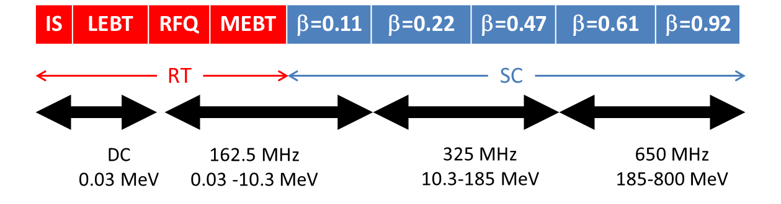
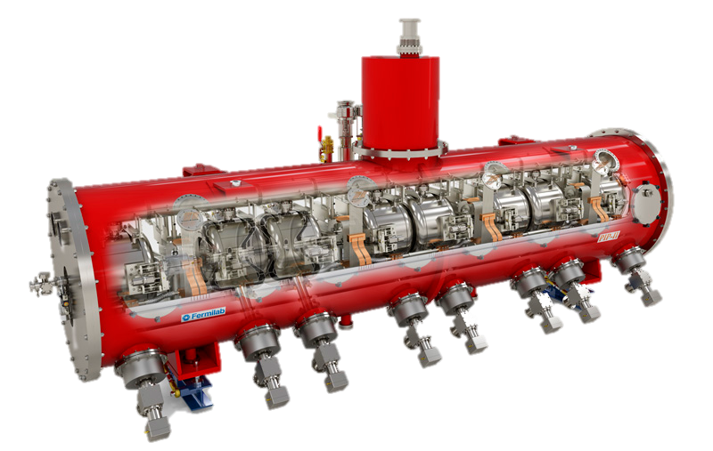
SSR1, SSR2: Overview
SSR: Single Spoke Resonator
PIP-II Conceptual Design Report: DocDb# 113
 | SSR1 | SSR2
# CMs | 2 | 7
Cavities per CM | 8 | 5
Solenoids per CM | 4 | 3
CM configuration c: cavities; s: solenoids | 4x (csc) | sccsccsc
CM length (m) | 5.2 | 6.5
SSR1 cryomodule
SSR CMs capable of operating in both pulsed and CW modes with a beam current of 2 mA avg.

Slide 4
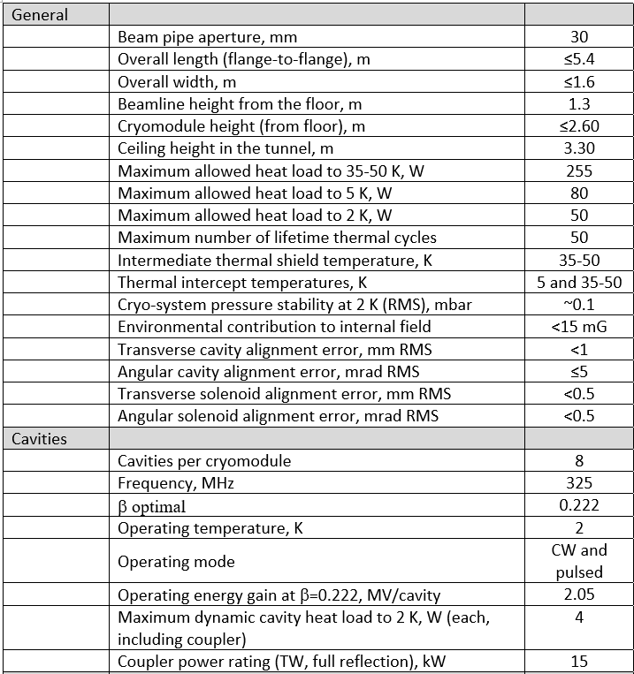
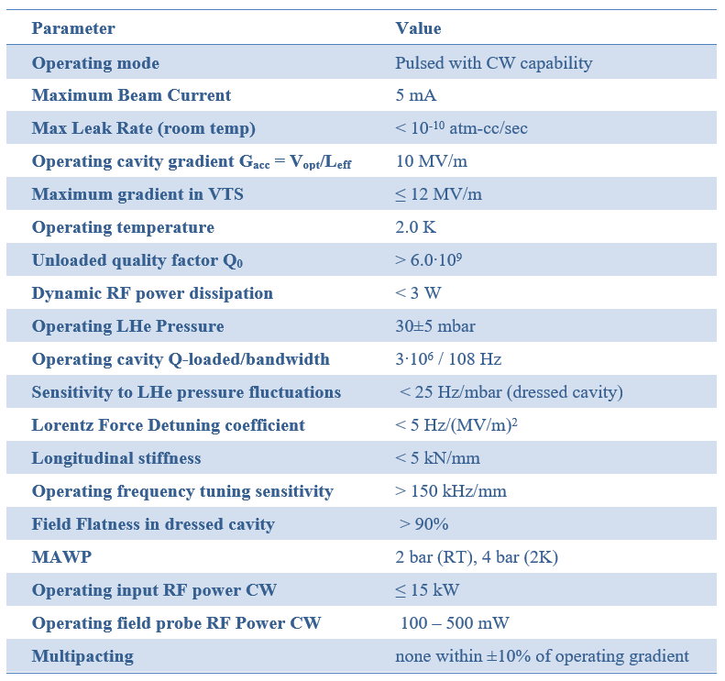
SSR1: Requirements
Functional Requirement Specification (FRS) are defined and traceable in Teamcenter:
SSR1 cryomodule: TC# ED0001316
SSR1 cavities: TC# ED0001317
Table of cryomodule requirements
Cavity operational/test requirements

Slide 5
SSR1: Scope and Deliverables
121.3.5.2 Project management and coordination
  Travel costs for management and vendor visits
121.3.5.3 SSR1 1st Prototype CM
  FNAL scope:
    Qualification of 8 jacketed cavities with coupler and tuner
    Complete design, procurement, QA/QC and integration of all cryomodule components
    RF testing and verification of cryomodule performance at PIP2IT
  DAE (BARC/IUAC) deliverables:
    Delivery of 2 dressed cavities
  FNAL deliverables:
    delivery of tested SSR1 1st CM for installation at PIP-II tunnel
121.3.5.4 SSR1 2nd Production CM
  FNAL scope:
    Finalization of design and procedures using lessons learned from CM #1
    Procurement, QA/QC and testing, and integration of the full cryomodule
    RF testing and verification of cryomodule performance at PIP2IT
  FNAL deliverables:
    delivery of tested SSR1 2nd CM for installation at PIP-II tunnel

Slide 6
SSR1: Cost Summary
P6 generated cost table
Estimates and activities developed down to the L8 for SSR1 CMs.

Slide 7
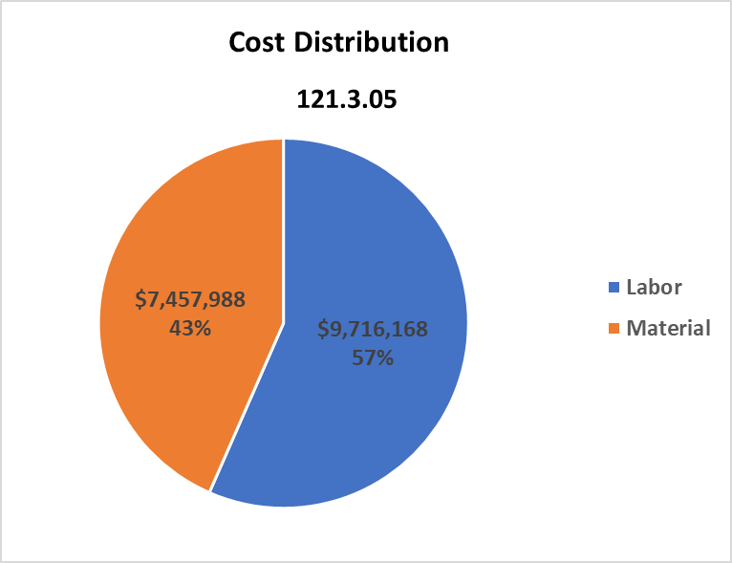
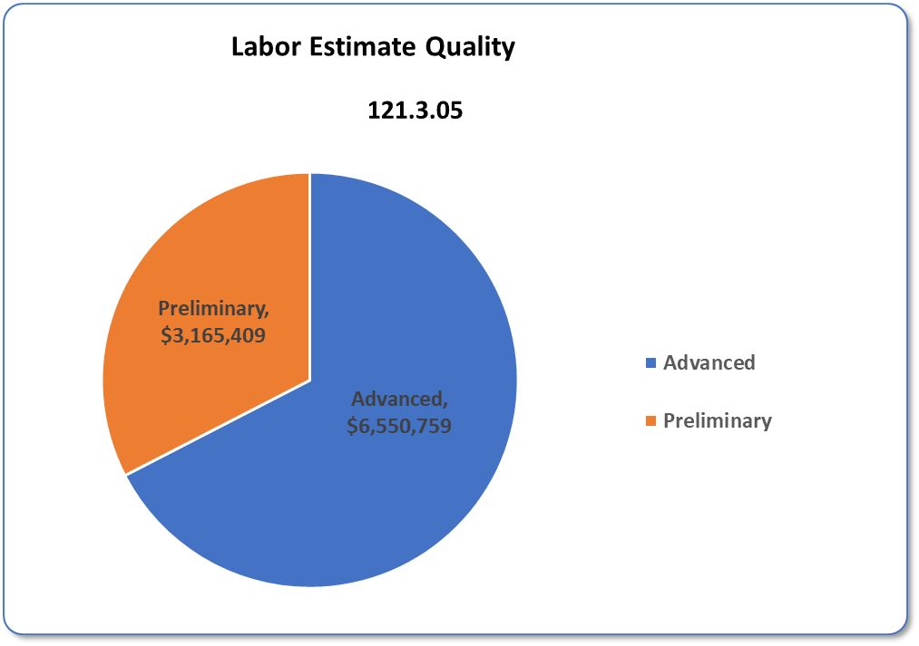
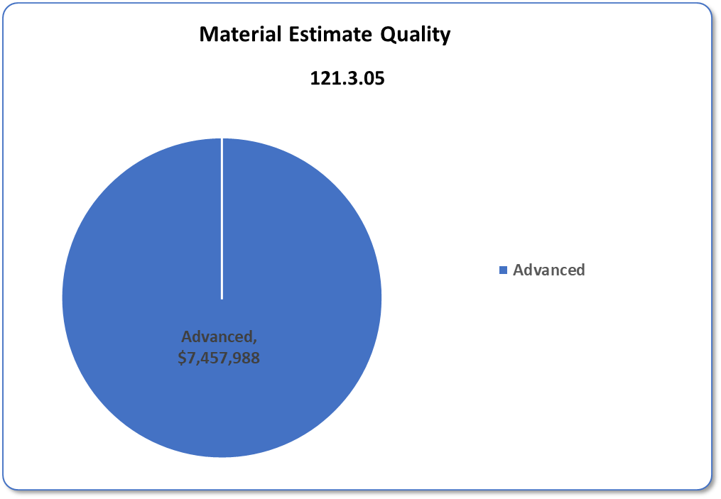
SSR1: Cost Distribution and Estimate Quality
“Preliminary estimation”: based on similar work (ILC, LCLS-II)
“Advanced estimation”: based on nearly identical work (SSR1)

Slide 8
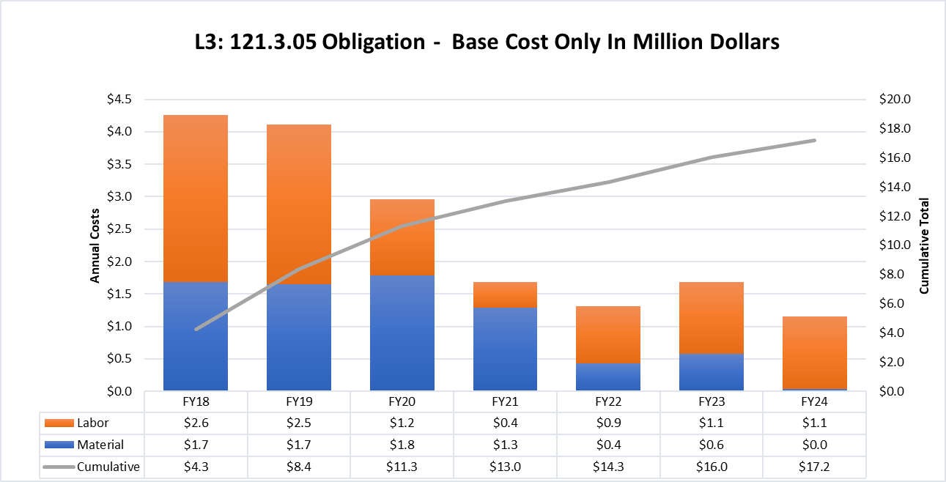
SSR1: Obligation Profile – P6 Base Cost Only
P6 Base Costs = BOE + Overheads + Escalation

Slide 9
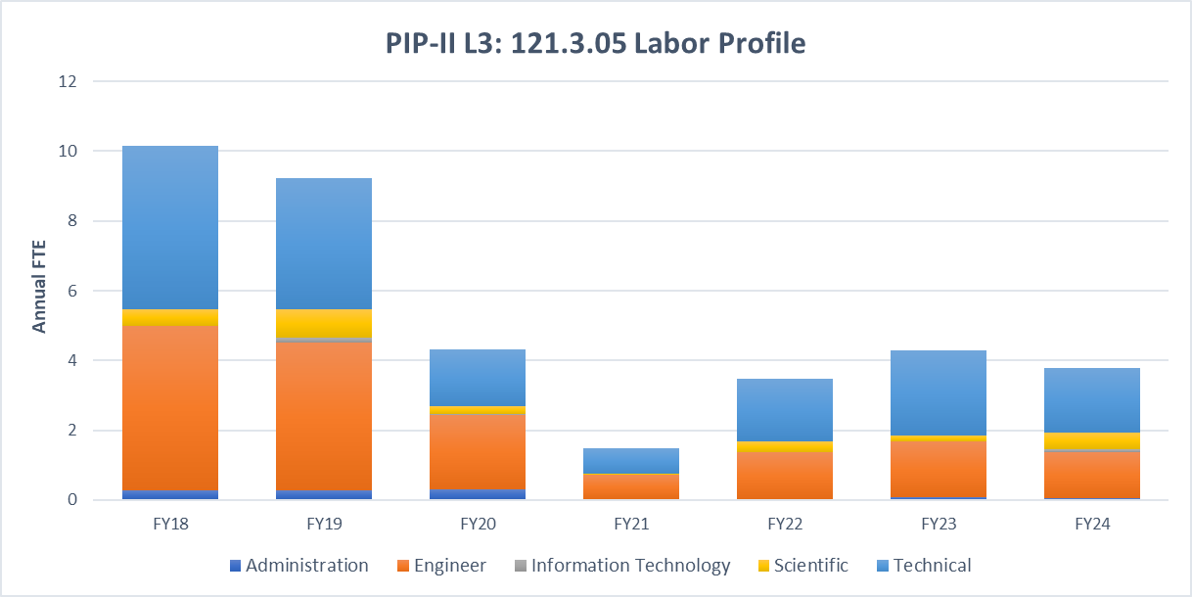
SSR1: Labor Profile – P6 Hours/FTE

Slide 10
SSR1 CM1 Schedule

Slide 11
SSR1 CM2 Schedule

Slide 12
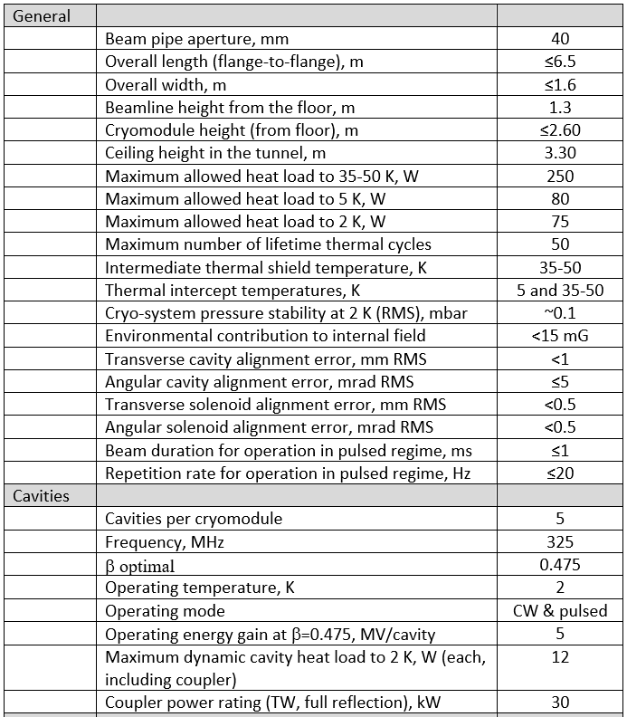

SSR2: Requirements
Functional Requirement Specification (FRS) are defined and traceable in Teamcenter:
SSR2 cryomodule: TC# ED0001829
SSR2 cavities: TC# ED0001854
Table of cryomodule requirements
Cavity operational/test requirements

Slide 13
SSR2: Scope and Deliverables
121.3.6.2 Project management and coordination
121.3.6.3 SSR2 1st Prototype CryoModule
  FNAL scope:
    Design, analysis, reviews, procurement, QA/QC, device design verification testing, and integration of 5-cavity cryomodule.
    Support DAE partners (BARC) in design and fabrication of their deliverables
    RF testing and verification of cryomodule performance at PIP2IT
  DAE (BARC) deliverables:
    Design of bare and jacketed cavities
    2 prototype jacketed cavities for qualification at FNAL, 1 tuner, 3 couplers, 3 solenoids and BPMs
  FNAL deliverables: delivery of qualified SSR2 1st CM for installation at PIP-II tunnel
121.3.6.4 SSR2 2nd-7th Production CryoModule
  FNAL scope:
    Finalization of design and procedures using lessons learned from CM #1
    Support DAE partners (BARC) in design and fabrication of their deliverables
    Procurement, QA/QC and testing, and integration of the full cryomodules
    RF testing and verification of 2nd-7th cryomodule performance at PIP2IT
  DAE (BARC) deliverables:
    18 jacketed cavities, 19 tuners, 17 couplers, 18 solenoids and BPMs
  FNAL deliverables: delivery of qualified SSR2 2nd-7th CM for installation at PIP-II tunnel

Slide 14
SSR2: Cost Summary
Full Burden + Esc = BOE + Escalation + Overhead
P6 generated cost table
Estimates and activities developed down to the L8 for SSR1 CMs.

Slide 15
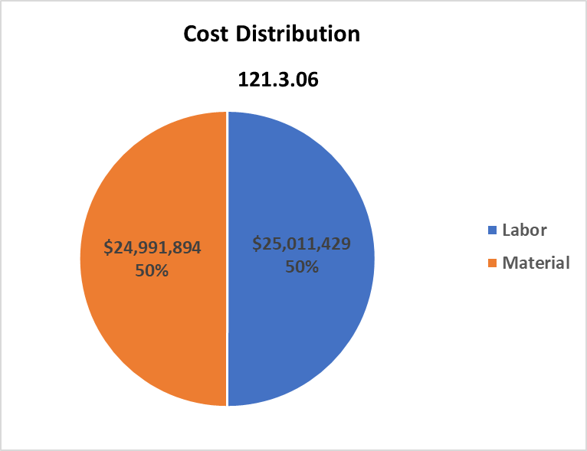
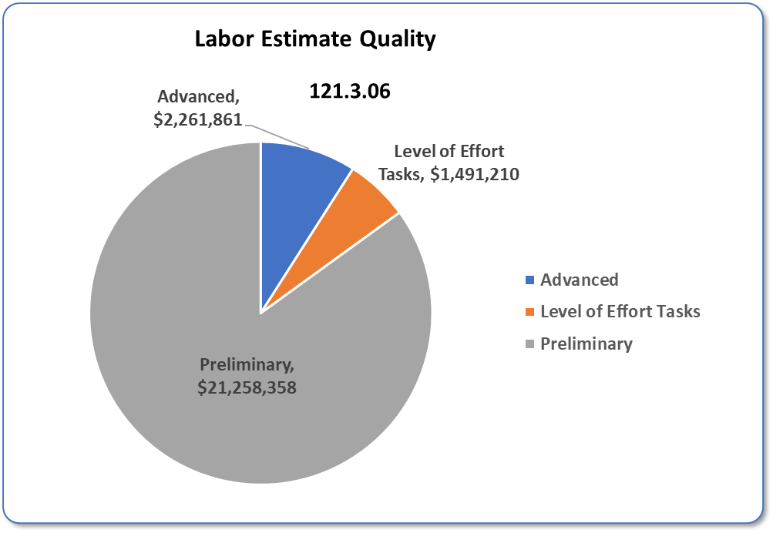
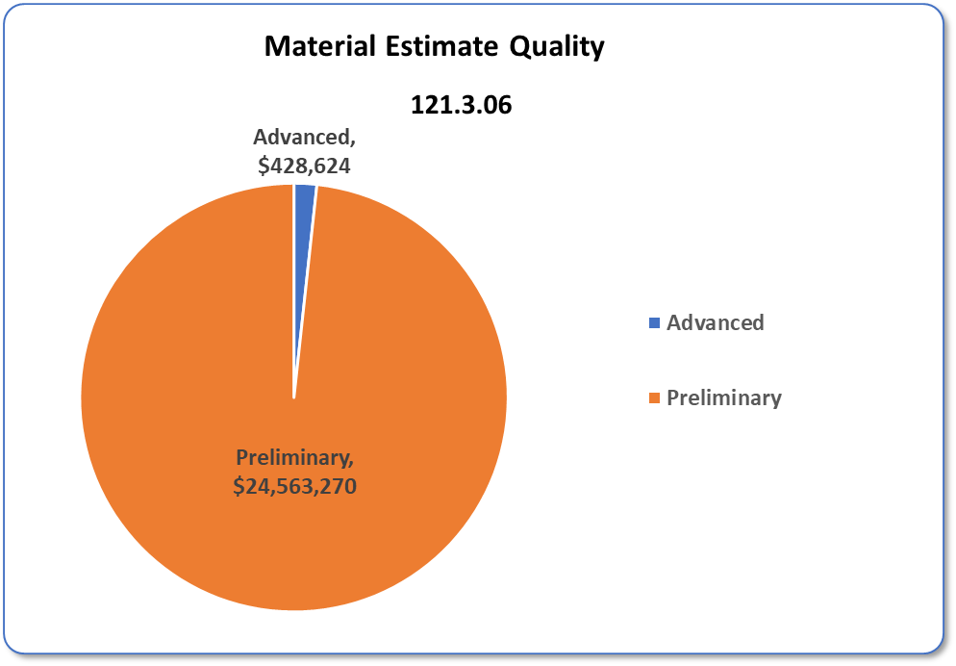
SSR2: Cost Distribution and Estimate Quality
Estimations for SSR2 CMs are based on experience with SSR1 CM1
(similar work --> preliminary estimations).

Slide 16
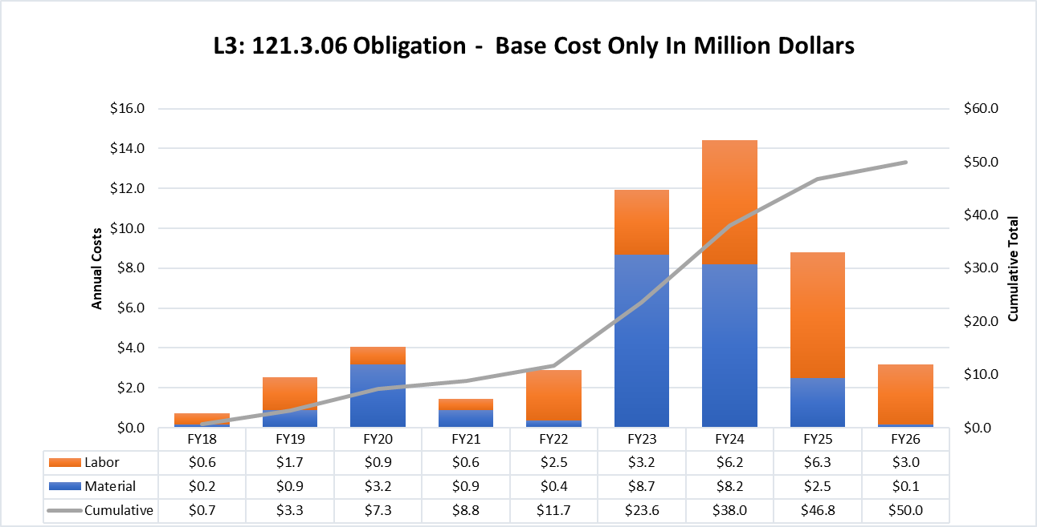
SSR2: Obligation Profile – P6 Base Cost Only
P6 Base Costs = BOE + Overheads + Escalation
The costs build up moving from prototyping to production

Slide 17
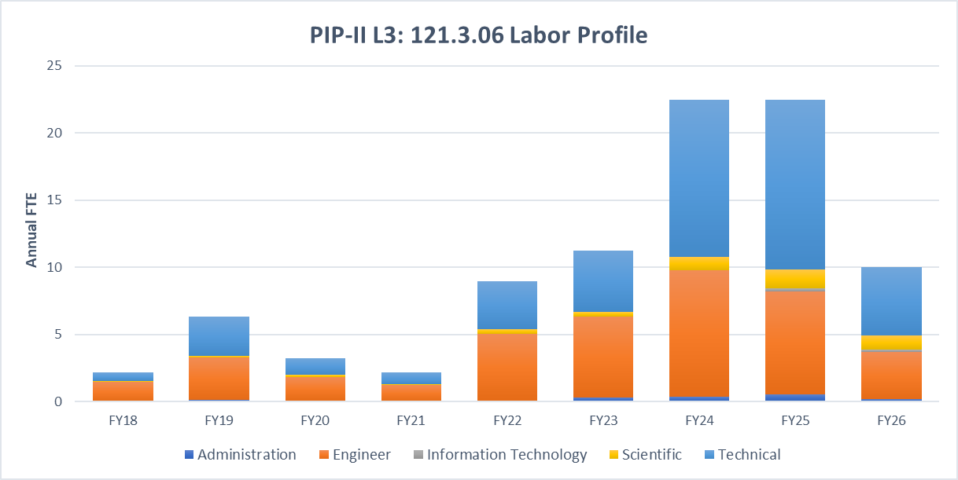
SSR2: Labor Profile – P6 Hours/FTE
The labor build up moving from prototyping to production

Slide 18
SSR2 CM1 Schedule

Slide 19
SSR2 CM 2-7 Schedule

Slide 20
SSR2 CM1 is on the critical path

Slide 21
Risk: SSR Cavity and CM
SSR1 CM (1) Performance at PIP2IT does not meet technical requirements
SSR2 CM (1) Performance at PIP2IT does not meet technical requirements
SSR1 Cryomodule design modifications identified late in design cycle

Slide 22
Risk Mitigation: SSR1 CM (1) Performance at PIP2IT does not meet technical requirements
SSR1 CM (1) designed to meet/exceed specifications
  Structural, thermal and multiphysics finite element analyses
  Dressed cavities with very low df/dp
  Piping systems and pressure vessels designed to comply the ASME codes
  Features to mitigate thermal acoustic oscillations and mechanical instabilities
Pre-qualification of key-components
  Cold testing fully integrated cavities with coupler and tuner
    RF and structural/cryogenic performance
    Resonance control studies
    Assessment of field emission, multipacting, magnetic field, and other limiting factors
  Testing solenoids, BPMs
  QA/QC inspections at each critical step from manufacturing to final installation
Integration of lessons learned about low beta cavities and cryomodule
  Processing of cavity surfaces and cleanroom procedures
  Handling of cavity string assembly, coldmass, cryomodule

Slide 23
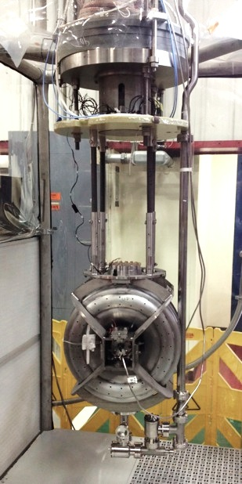
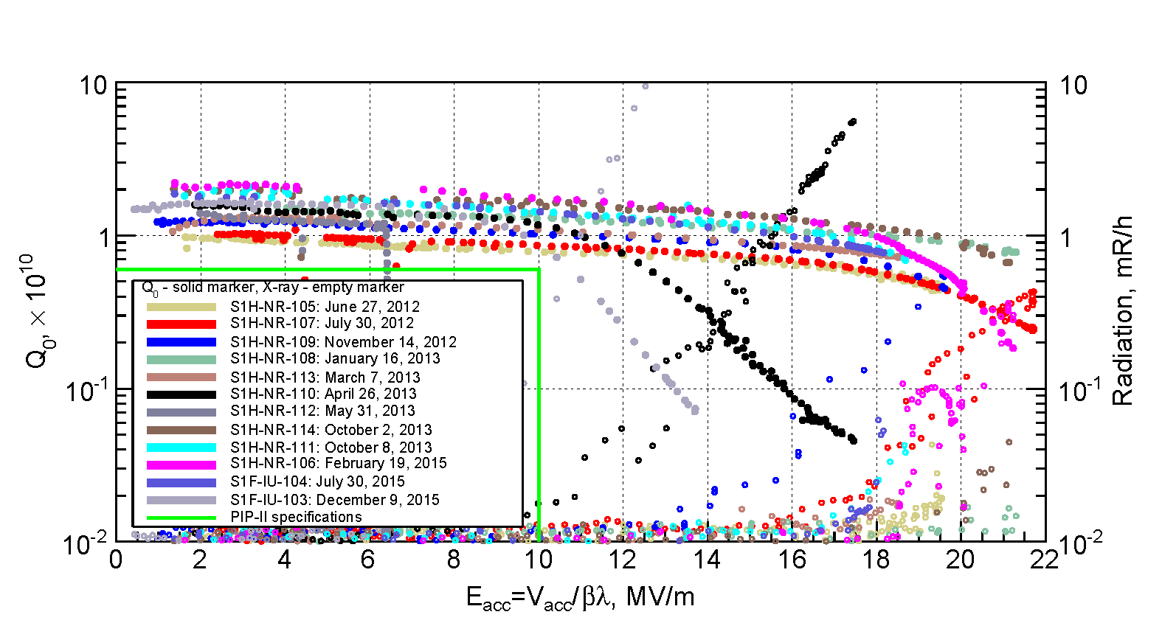
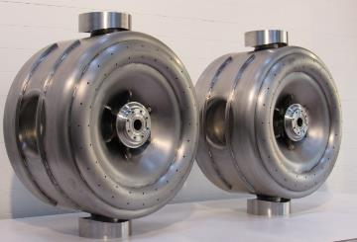
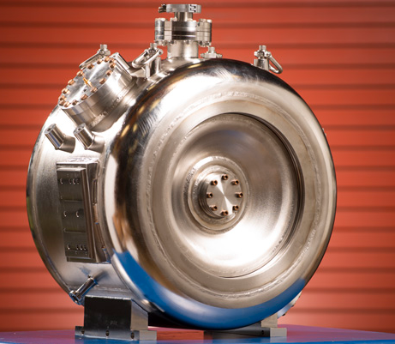
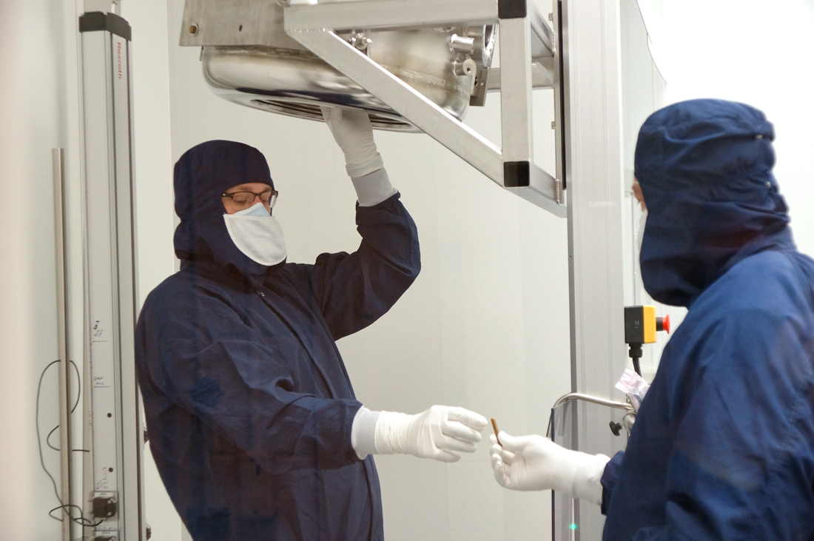
SSR1: Cavities Design Maturity
  VTS testing: 12 bare SSR1 cavities (10 FNAL and 2 DAE BARC/IUAC) met PIP-II requirements in VTS.

Slide 24
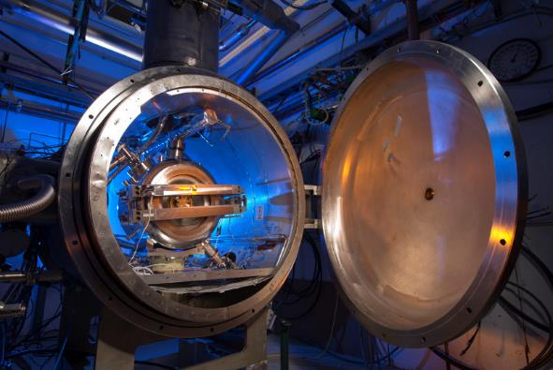
Qualification of jacketed cavities
                STC testing: 6 jacketed SSR1 cavities with LPC and 1 jacketed SSR1 cavities with HPC have been qualified in the STC so far.
                Ongoing activities
                Processing and preparation at ANL
                120C baking at MP9
                Coupler installation at MP9 (and Lab 2)
                Testing with LPC/HPC at STC
Qualification plan
S107: BCP+HPR → LPC qualif. → Coupl. Install./Baking → HPC testing
S110: BCP+HPR → LPC qualif. → Coupl. Install./ Baking → HPC testing
S111: BCP+HPR → LPC qualif. → Coupl. Install. Baking → HPC testing
S112: BCP+HPR → LPC qualif. → Coupl. Install. Baking → HPC testing
S113: BCP+HPR → LPC qualif. → Coupl. Install./Baking → HPC testing
S114: BCP+HPR → LPC qualif. → Coupl. Install./Baking → HPC testing
S109: BCP+HPR → LPC qualif. → Coupl. Install./Baking → HPC testing
S106: BCP+HPR → LPC qualif. → Coupl. Install./Baking → HPC testing
S103 (IIFC): BCP+HPR → LPC qualif. → Coupl. Install./Baking → HPC testing
S104 (IIFC): BCP+HPR → LPC qualif. → Coupl. Install./Baking → HPC testing

Slide 25
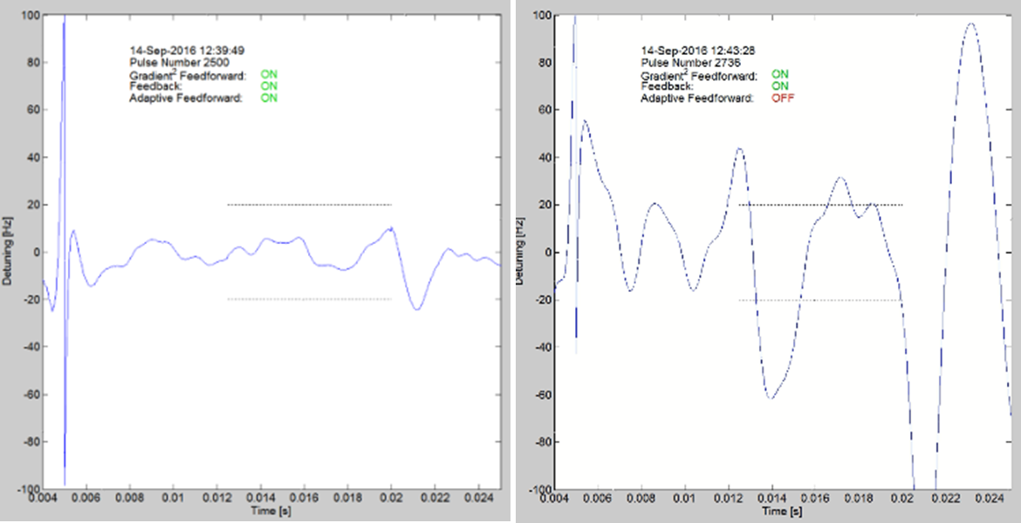
SSR1: Tuner and resonance control
Prototype SSR1 tuner
Design completed and one unit was prototyped
Successfully tested at 293K and cold temperature
Production SSR1 tuner
Design completed
1 out of 10 units was received and currently used for resonance control of SSR1 cavities
SSR1 cavity in the Spoke Test Cryostat (STC)
Resonance control studies
  Requirements: microphonics <20 Hz
  Good progress during cold tests at STC and requirements are nearly achieved.

Slide 26
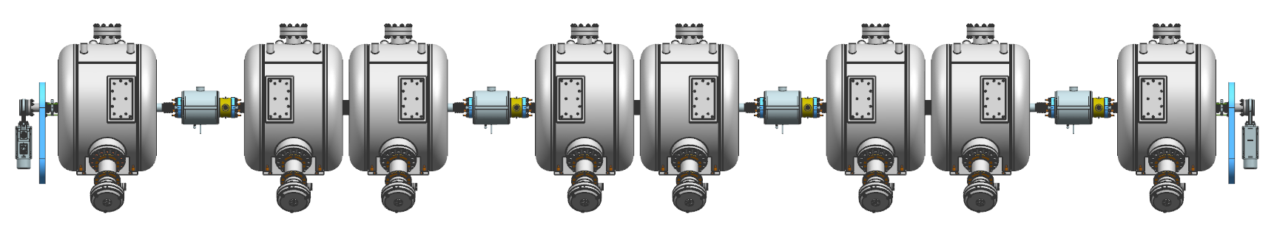
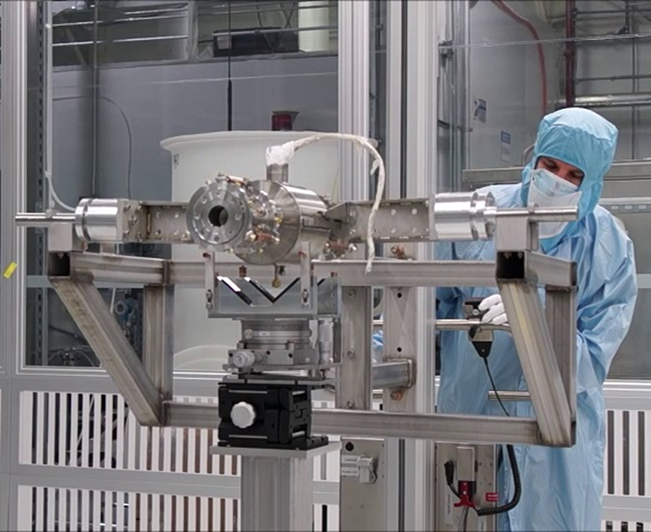
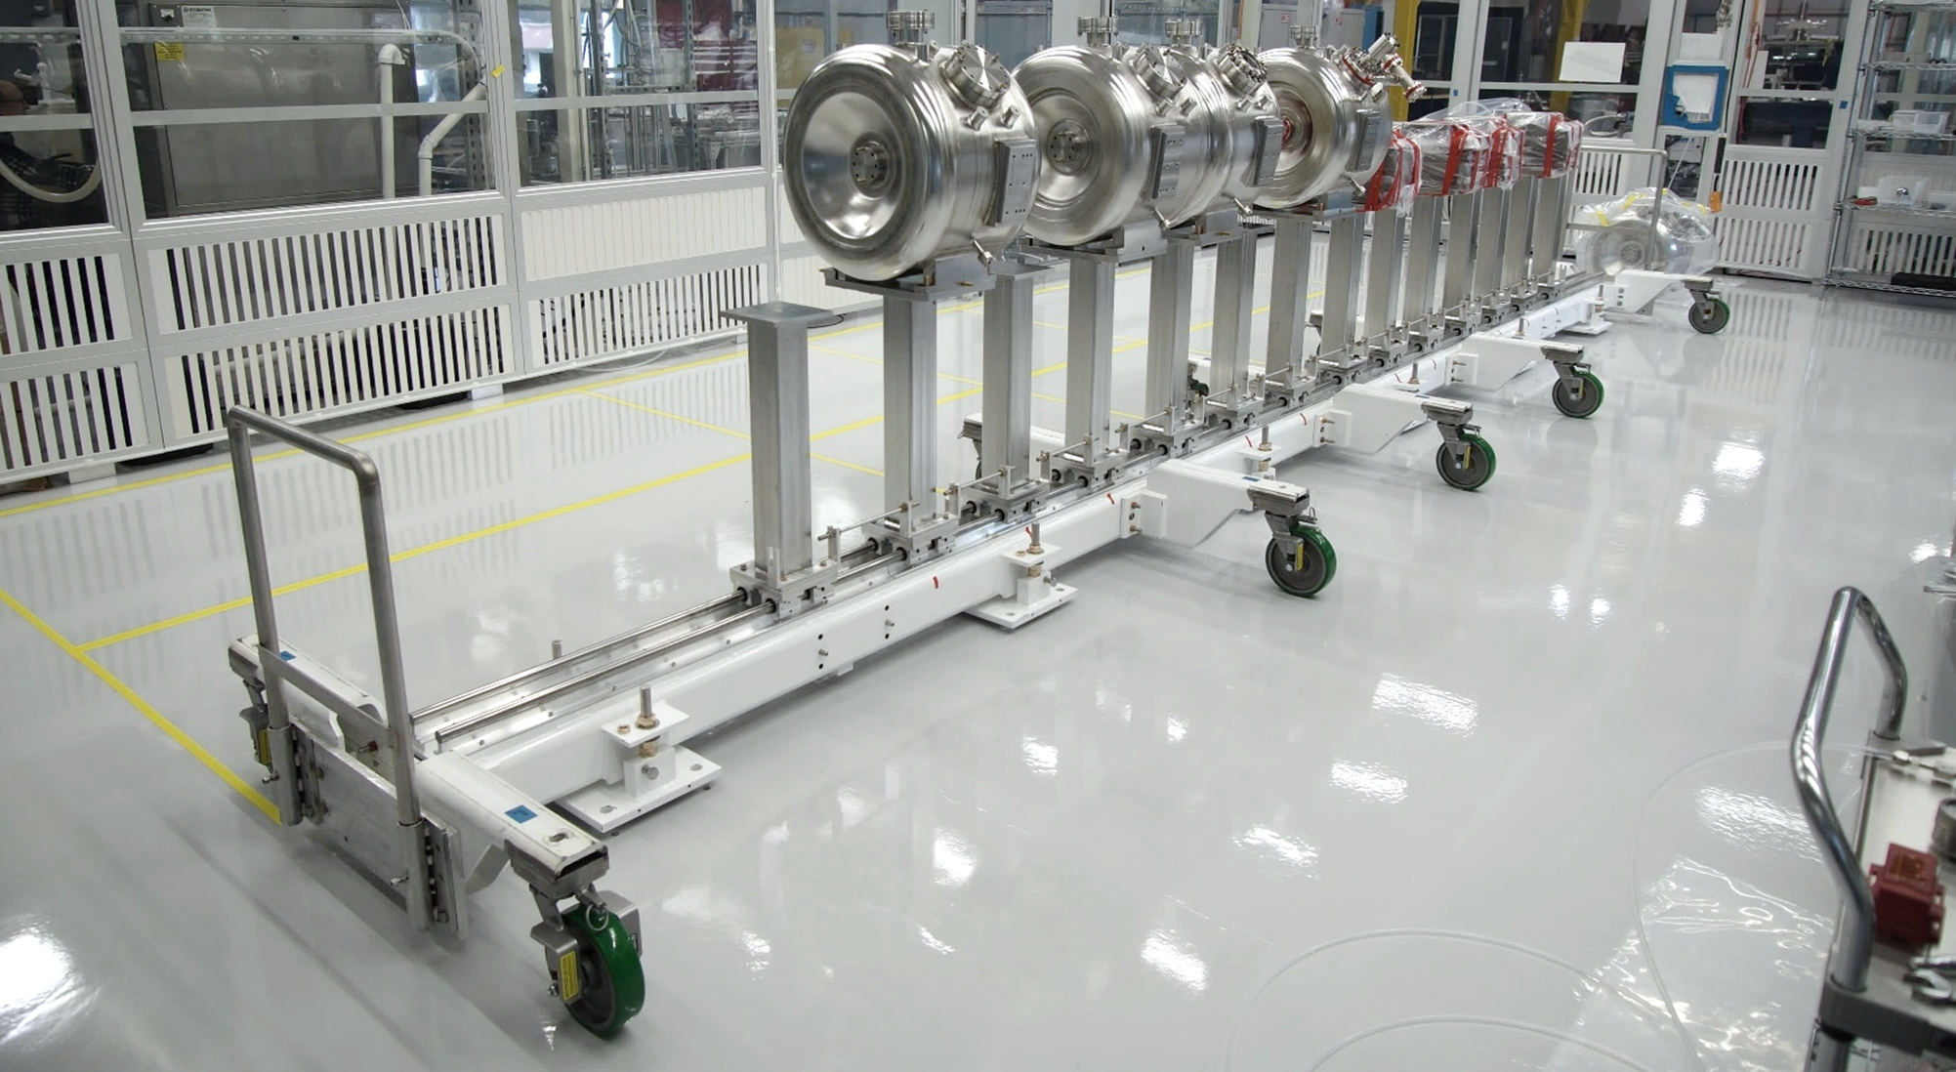
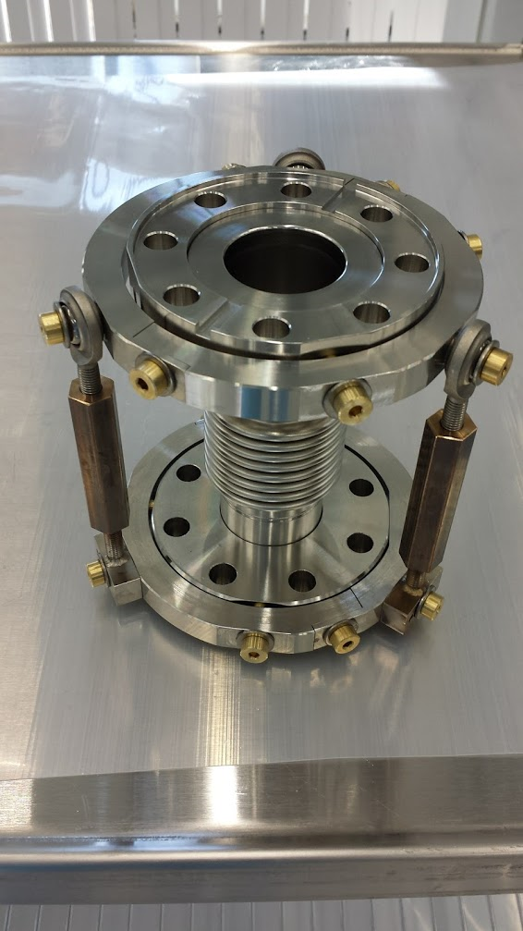
SSR1: cavity string assembly
20mm
IIFC SSR1 cavity
BPM
Solenoid
SSR1
Type A
SSR1 Type B
SSR1
Type A
SSR1 Type B
SSR1
Type A
SSR1 Type B
SSR1
Type A
SSR1 Type B
Gate Valve
Coupler
(vacuum-end)
Gate Valve
Free particle assembling procedure for cleanroom activity at Lab 2

Slide 27
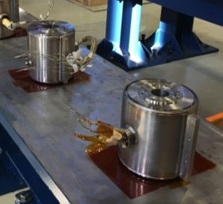
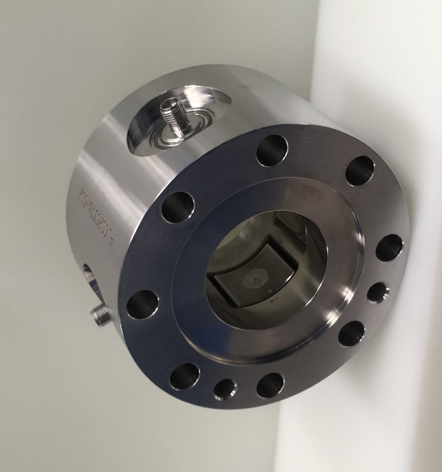
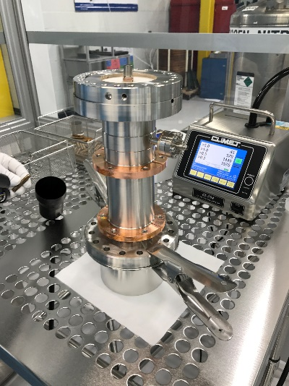
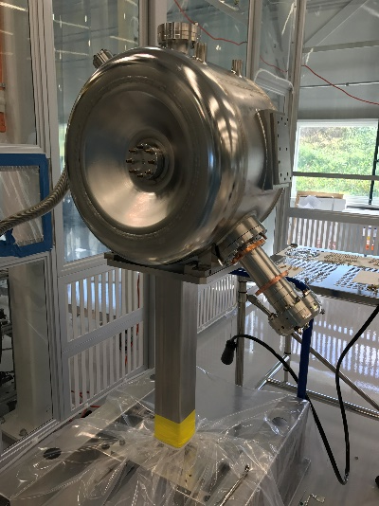
SSR1: Solenoid, BPMs, couplers
Four production solenoids were successfully designed, procured and qualified.
Four production BPMs were successfully designed, procured and qualified.
Joint collaboration ANL &FNAL
TC# ED0005680
TC# ED0001264
Prototype main power couplers
Design, procurement and testing: completed
Three prototypes were procured and successfully tested
Production main power couplers
Design completed
Procurement: in progress
  The procurement of coupler antennas presented a series of technical issue that led them to be on the SSR1 CM1 critical path.

Slide 28
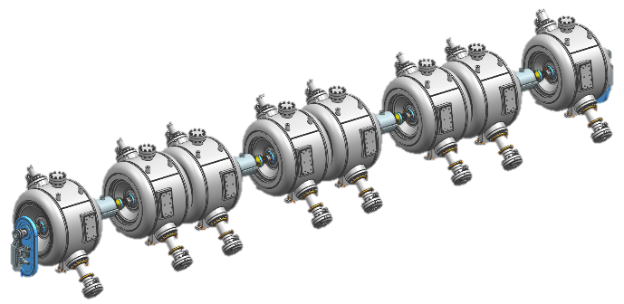
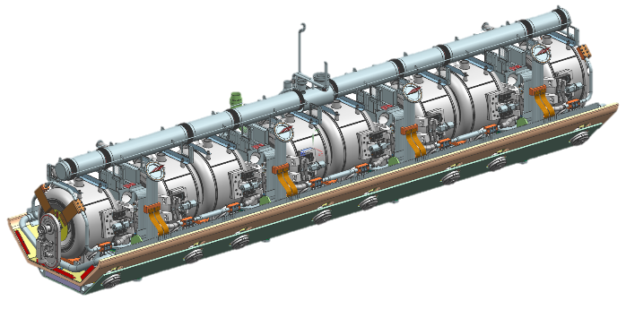
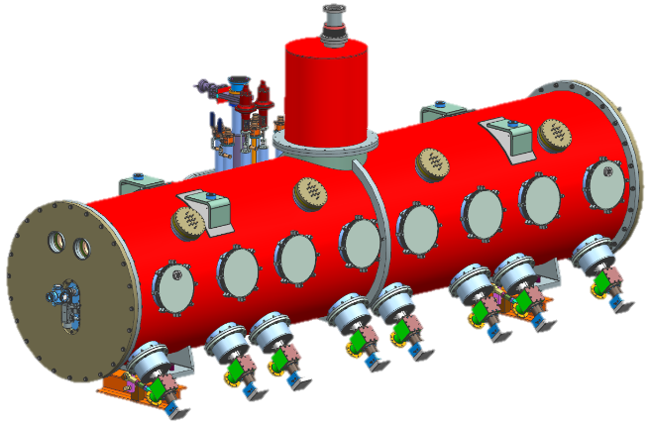
SSR1: CM Design Maturity
SSR1 1st cryomodule
SSR1 cavity string assembly
Design: completed
Procurement: completed
SSR1 coldmass
Design: completed (closing FDR)
Procurement: in progress
Main tooling: design in progress
SSR1 final cryomodule
Design: nearly completed
Open topics:
  Detailed assembly plan
  Detailed alignment strategy
  Magnetic shielding
  External interfaces (updating ICD)
  We are collecting lessons learned and list of improvements from the experience in designing and developing the SSR1 1st cryomodule.

Slide 29
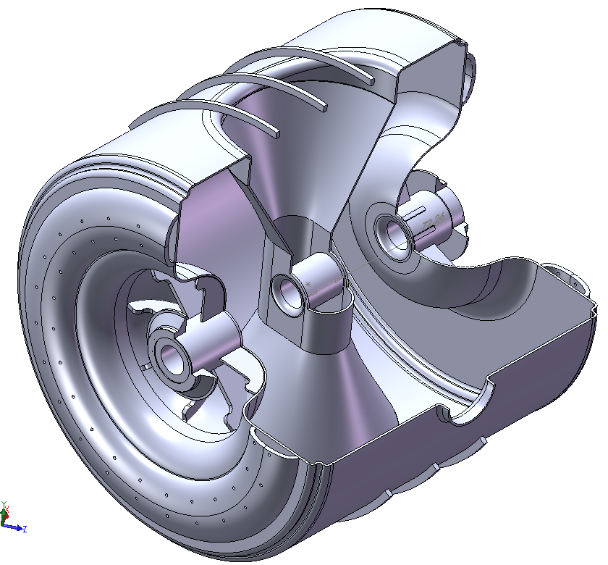
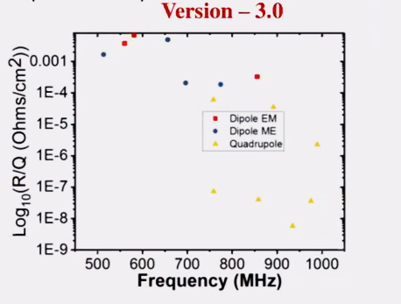
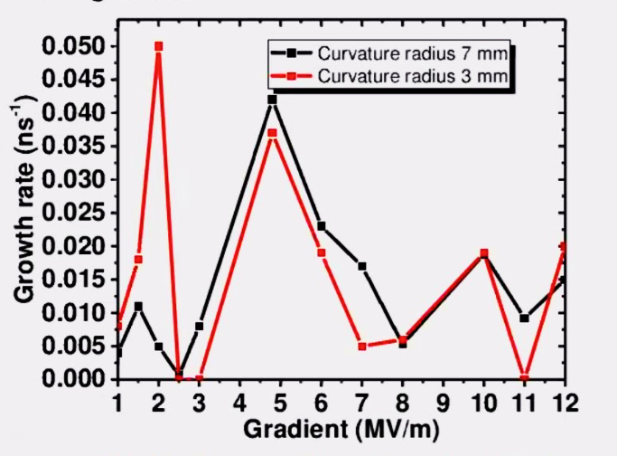
SSR2: Design Maturity
SSR2 cavities:
  RF Design Initially developed by Fermilab
  DAE (BARC) is currently working on mechanical design.
  Bare Cavity Design Status Review held at BARC Nov 7th 2017
Structural analyses performed by BARC
SSR2 Electric and Magnetic fields
HOM Analysis
Multipacting Analysis
Design of SSR2 cryomodule and components will be based on SSR1 experience.
SSR2 Cavity & Cryomodule development is on the critical path for the SRF Linac because it is the least mature of the SRF CMs

Slide 30
Summary
What is the current cryomodule design and construction strategy? Slide 5 and 13 What is planned to be done at Fermilab and what by the partners? Slide 5 and 13 Is the current model the one that aligns best with our in house capabilities and competences?...
Is the cost estimate consistent with the current experience with LCLS-2? LCLS-II costs were used as inputs where applicable Are there alternative strategies for cavity and cryomodules design and production that could reduce the cost of the SRF linac? Reorganize Int’l collaboration to minimize oversight activities. Avoid parallel design approach centralizing design activities at FNAL.
Is the proposed SRF CM schedule funding limited? Facilities limited? Limited by international partners contribution? Is there anything that can be done to pull the schedule back? It seems that the available eng\tech resources are a not sufficient
In the current proposed FNAL scope, do we envision bottlenecks/conflicts in facility usage (eg CM assembly or test)? Or in personnel? Given the LCLS-2, HL-LHC current schedule and LCLS-2 HE projected schedule, plus other activities involving SRF personnel, review any potential conflicts and outline solutions….
What are the current highest technical risks and how to mitigate them? Cryomodule performance. Complete and test SSR1-CM1 as soon as possible…
What are current performance specifications for all cryomodules? Agree on target/performance specifications and development needed to reach them. Slide 4 and 12.

