Slide 1
Cavity and Cryomodule Prototype & Test Plan
Joe Ozelis
PIP-II Retreat
10 May 2018

Slide 2
Scope Of CM Design And Development
PIP-II entails developing and assembling 5 cryomodule types (HWR, SSR1, SSR2, LB650, HB650)
  HWR is a basic extension of current technology at ANL
    Long-standing development program at ANL (ATLAS)
    All cavities tested/qualified at ANL before CM assembly
    CM Testing at PIP2IT
  SSR1/2 and HB/LB650 are new, unique CM designs (using a common design approach)
  Require development and verification of new designs for
    Cavities (incl Helium vessel and magnetic shields)
    Couplers
    Tuners
    Focusing elements (SSR1/2)
    Cryomodule support, cryogenics, and thermal management systems
Component, sub-system, and overall CM performance of these 4 types of CM will need to be rigorously verified
Component and CM requirements, flowing down from Linac requirements, are captured in the relevant FRS/TRS documents
  These documents are version controlled and follow a review/approval/release process managed in Teamcenter

Slide 3
SRF Test Program Goals
Within the WBSs for the 4 CM types are numerous activities associated with design verification of components and sub-systems, and qualification of production components.
  These activities are integrated into our overall project planning
  Except for production qualification, they typically precede final design activities and production procurements.
Each WBS also includes comprehensive testing of “1st CMs” for all CM types, followed by production testing of all cryomodules.
  These activities are also integrated into our overall project planning
  This is the final activity that addresses “global” CM performance risks
  Cryomodules are not “released” for installation in the Linac without this qualification stage
The Test Program addresses performance risks from the component to sub-system to final integrated CM level.

Slide 4
Testing Hierarchy – from the simple to the complex
Components
Sub-Systems
Integrated System
Cavity
Dressed Cavity
Coupler
Tuner
Cavity
Dressed Cavity
Cryomodule
Coupler
Tuner
The Test Program addresses performance risks from the component to sub-system to final integrated CM level.
Cavity
Dressed Cavity
Coupler
etc.

Slide 5
CM-Specific Components – SSR1/SSR2
Cavities
  SSR1 bare & jacketed/dressed cavity design already verified (VTS/STC), but minor design upgrade underway for CM#2
  SSR2 cavity is a new design, will require complete testing/verification of bare and jacketed cavities in the VTS (and then STC)
  MP and FE are of concern for all SSR1/SSR2 cavities
Couplers
  Prototype and pre-Production couplers tested in RT test stand and in STC w/ cavity
    Design meets performance goals for SSR1
  Still need to test production couplers
    Verify vendor manufacturing processes, reliability
    Verify meets performance requirements for SSR2

Slide 6
CM-Specific Components – SSR1/SSR2
Tuner/Resonance control
  Prototype and production tuner design bench tested and tested on dressed SSR1 cavity in STC.
    Prototype used for extended resonance control studies
    Production tuner now being used in STC testing for additional further resonance control studies on SSR1 cavities.
  Resonance (microphonics) control pushes state-of-the-art
Focusing Elements (solenoids)
  Prototype solenoids for SSR1 #1 tested in SC Magnet Test Facility (IB1)
    LHe bath
  Current leads need to be tested (current capacity, heat load)
    Using HWR CM style leads (ANL experience)
      Established technology

Slide 7
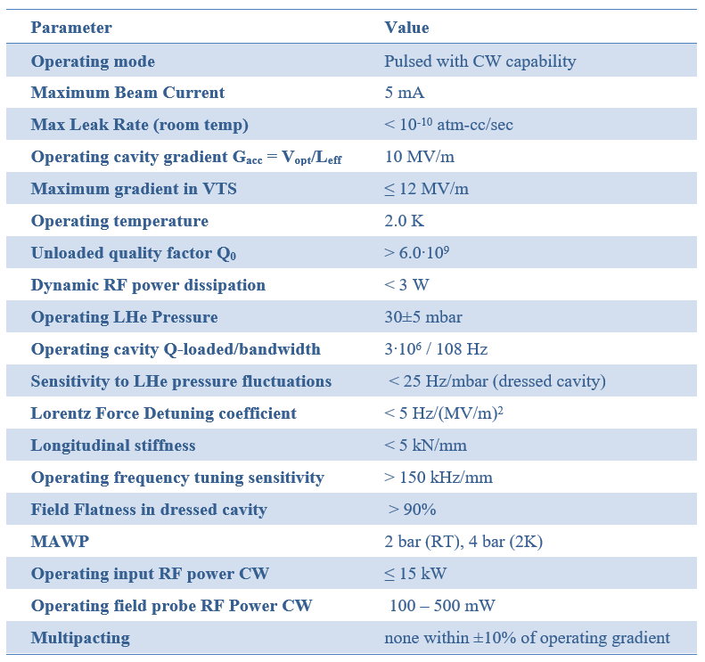

Performance Parameters – SSR1/SSR2 Components
SSR1 SSR2

Slide 8
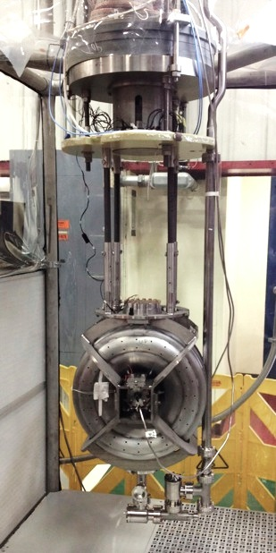
Testing CM-Specific Components – SSR1/SSR2
Bare Cavities
  Updated SSR1 cavity design for CM#2 will be tested bare in VTS – qualification for CM#2
    All 9 cavities to be tested bare in VTS
    All 9 cavities to be tested jacketed (w/He vessels) in VTS
  SSR2 cavity new design
    2 prototype cavities built for FNAL, 2 prototype cavities built by DAE
      All (4) prototypes tested bare at FNAL VTS
        3 process/test cycles/cavity for FNAL cavities in schedule
      All (4) prototypes tested jacketed at FNAL VTS
    4 pre-production cavities built for FNAL
      All (4) pre-production cavities tested bare at FNAL VTS
      All (4) pre-production cavities tested jacketed at FNAL VTS
  SSR2 production cavities
    All jacketed production cavities supplied/tested (VTS) by partners prior to shipment to FNAL for integration, re-tested (VTS) at FNAL
SSR1 cavity – VTS test

Slide 9
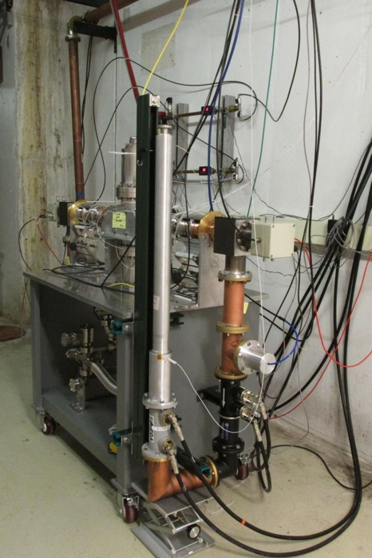
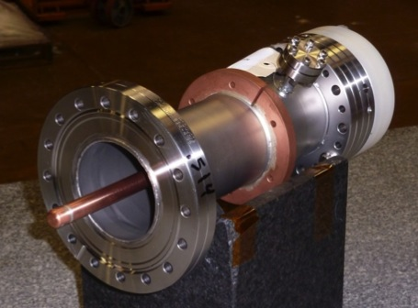
Testing CM-Specific Components – SSR1/SSR2
Couplers
  Couplers for SSR1 CM#1/CM#2
    All CM#1 couplers tested on room-temperature test stand after initial QA/QC
    Testing sub-set for CM#1 on dressed cavities in STC (cavity qualification for SSR1 CM#1)
      Couplers for CM#2 ordered after these tests (and any design updates)
    All CM#2 couplers tested on room-temperature test stand after initial QA/QC
    Testing 2 couplers for CM#2 on dressed cavities in STC
  A set of SSR1 Couplers have been tested on test stand to SSR2 spec (30kW)
    One tested to failure at 47kW (50% above spec)
RT Test Stand
  2 Prototype SSR2 couplers to be procured
    Tested on room-temperature test stand after initial QA/QC
    Tested on (2) prototype cavities in STC
    6 Pre-production couplers (for CM#1) to be procured
      After tests pf prototypes in STC
    All tested on room-temperature test stand after initial QA/QC
  Testing of 2 pre-production couplers with pre-production dressed cavities (supplied by partners) in STC
325MHz Coupler – cold end

Slide 10
Testing CM-Specific Components – SSR1/SSR2
Tuner/Resonance control
  SSR1 CM#2 tuners ordered after testing of SSR1 CM#1 tuners in STC
    Continued testing of SSR1 CM#1 cavities with tuners (qualification testing) allows for additional resonance control studies
  Pre-production tuners for SSR2 (based on SSR1 design) ordered only after tests in STC of SSR1 production tuners
  Production tuner design for SSR2 finalized after tests of SSR2 prototype cavities and pre-production tuners in STC. Supplied by partners
SSR1 Cavity with Tuner in STC
Focusing Elements (solenoids)
  4 Solenoids for SSR1 #2 will be tested in SC Magnet Test Facility (IB1) in like manner as those for SSR1 CM#1
  Current leads undergo QA/QC upon receipt
  SSR2 solenoids (provided by partner labs) undergo incoming QA/QC followed by testing in SC Magnet Test Facility

Slide 11
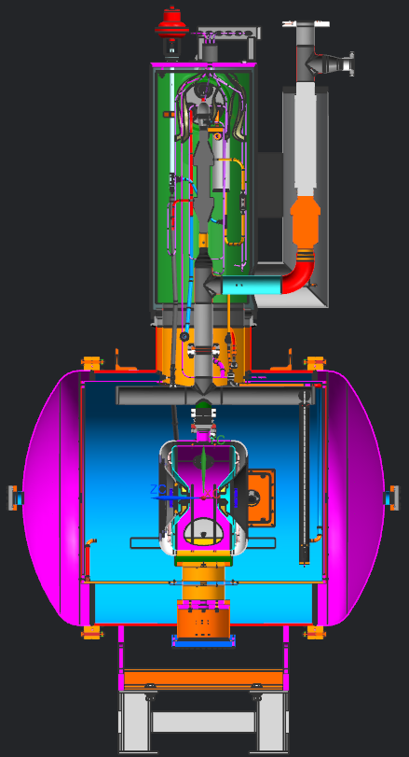
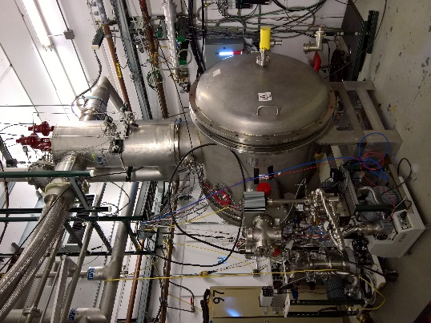
Testing CM-Specific Sub-Systems – SSR1/SSR2
Sub-System tests with dressed cavities (cavity/HeV/tuner/
coupler) are also planned, as part of system and extended component design verification.
    Adequate (extended) durations planned
    Using prototype or “first-article”/pre-production components
    Serve as “gatekeeper” to FDR or PRR
Uses existing STC facility & ancillaries

Slide 12
Testing CM-Specific Sub-Systems – SSR1/SSR2
STC test program:
  SSR1 CM#1 Dressed cavities and prod couplers/tuners (4)
    Qualification testing – 2 weeks cold testing (1 week RC studies)
  SSR1 CM#2 Dressed cavities and prod couplers/tuners (2)
    Qualification/vendor production testing – 5 weeks cold testing
  SSR2 Prototype dressed cavities and prot tuner/coupler (2 FNAL, 2 DAE)
    Design verification testing – 7-8 weeks cold testing
  SSR2 Pre-production dressed cavities and pre-prod tuner/coupler (2)
    Design verification/vendor qualification testing – 4-7 weeks cold testing
  SSR2 Production dressed cavities and prod tuner/coupler (up to 5, supplied by partners)
    Qualification/vendor production testing – up to 4 weeks cold testing
A total of 15 STC test cycles for ~80 “cold weeks” for SSR1/SSR2

Slide 13
CM-Specific Components – HB650 & LB650
The SRF Test Program at FNAL for elliptical cavities is focused on the requirements of the HB650 CM. The LB650 CM development (where not identical to HB650) is generally the responsibility of International Partners (with close FNAL involvement).
Bare Cavities
  HB650 (β=0.92) cavity design is new
    2 prototype cavities to be fabricated by vendor
    Cavity Q₀ (r_{s}) specification may require N-doping recipe similar to LCLS-II
      Flux expulsion (fast cooldown) & magnetic shielding may be critical
      Recipe being developed using existing β=0.90 cavities for CM#1
  LB650 (β=0.61) cavity design is new
    Prototypes will be fabricated by partner labs
    FNAL will process/test ~2 SC and ~2 5-cell prototypes produced by INFN/VECC
    Similar stringent requirements on Q₀ (r_{s}) : N-doping, flux expulsion, magnetic shielding may be critical design/process considerations
      Adopt HB650 processing recipe for LB650 as a baseline
      Utilize similar (identical) magnetic shielding and flux-expulsion techniques
  FE-free performance requires optimization of HPR tools
  Enables technology transfer (processing recipe) to partner labs and industry

Slide 14
CM-Specific Components – HB650 (LB650)
Couplers
  New coupler design : coaxial, 650MHz, 120kW (suitable for both HB/LB CMs)
    Two cold end designs being prototyped
    Prototypes to be evaluated on RT test stand and also in STC tests with β=0.90 cavities
  Verification of RF (power), thermal, and vacuum performance required before pre-production/production procurement
Tuner/Resonance control
  Tuner design based on LCLS-II tuner, suitable for both HB/LB cryomodules (with slight adaptation); prototype received and bench tested.
    Design being refined, order to be placed soon
    Cryogenic operation to be evaluated during STC tests with β=0.90 cavities
  Resonance/microphonics control to be studied during all STC testing, no experience yet in use of this type of tuner w/650MHz cavities

Slide 15
Performance Parameters – LB650/HB650 Components
LB650 HB650
RF Cavities | LB650
Iris aperture, mm | 88
Effective length Leff = 5∙(βoptλ/2), mm | 703
Geometrical beta, βg | 0.61
Optimal beta, βopt | 0.65
Optimal shunt impedance (R/Q)opt, Ω | 341
Energy gain at optimal beta Vopt, MeV | 11.9
Maximum surface RF electric field Epeak, MV/m | 40
Maximum surface RF magnetic field, Bpeak, mT | 75
Operating cavity gradient Gacc = Vopt/Leff, MV/m | 16.9
Maximum gradient in VTS, MV/m | 20
Operating temperature, K | 2
Unloaded quality factor Q0 | 2.15E+10
Maximum dynamic RF power dissipation, W | 20
Operating cavity Q-loaded | 1.04E+07
Operating cavity bandwidth, Hz | 63
Maximum sensitivity to LHe pressure fluctuations, Hz/mbar | 25
Maximum Lorentz Force Detuning coefficient, Hz/(MV/m)2 | 1.4
Maximum longitudinal stiffness, kN/mm | 5
Minimal operating frequency tuning sensitivity, kHz/mm | 150
Maximum operating input RF power CW, kW | 70
Coarse frequency range, kHz | 200
Coarse frequency resolution, Hz | 3
Coarse tuner hysteresis, Hz | 100
Fine frequency range, Hz | 1000
Fine frequency resolution/stiction, Hz | 0.5
RF Cavities | HB650
Iris aperture, mm | 118
Effective length Leff = 5∙(βoptλ/2), mm | 1060.8
Geometrical beta, βg | 0.92
Optimal beta, βopt | 0.97
Optimal shunt impedance (R/Q)opt, Ω | 610
Energy gain at optimal beta Vopt, MeV | 19.9
Maximum surface RF electric field Epeak, MV/m | 40
Maximum surface RF magnetic field, Bpeak, mT | 75
Operating cavity gradient Gacc = Vopt/Leff, MV/m | 18.8
Maximum gradient in VTS, MV/m | 24
Operating temperature, K | 2
Unloaded quality factor Q0 | 3.00E+10
Maximum dynamic RF power dissipation, W | 22
Operating cavity Q-loaded | 9.80E+06
Operating cavity bandwidth, Hz | 66
Maximum sensitivity to LHe pressure fluctuations, Hz/mbar | 25
Maximum Lorentz Force Detuning coefficient, Hz/(MV/m)2 | 1
Maximum longitudinal stiffness, kN/mm | 5
Minimal operating frequency tuning sensitivity, kHz/mm | 150
Maximum operating input RF power CW, kW | 100
Coarse frequency range, kHz | 200
Coarse frequency resolution, Hz | 3
Coarse tuner hysteresis, Hz | 100
Fine frequency range, Hz | 1000
Fine frequency resolution/stiction, Hz | 0.5

Slide 16
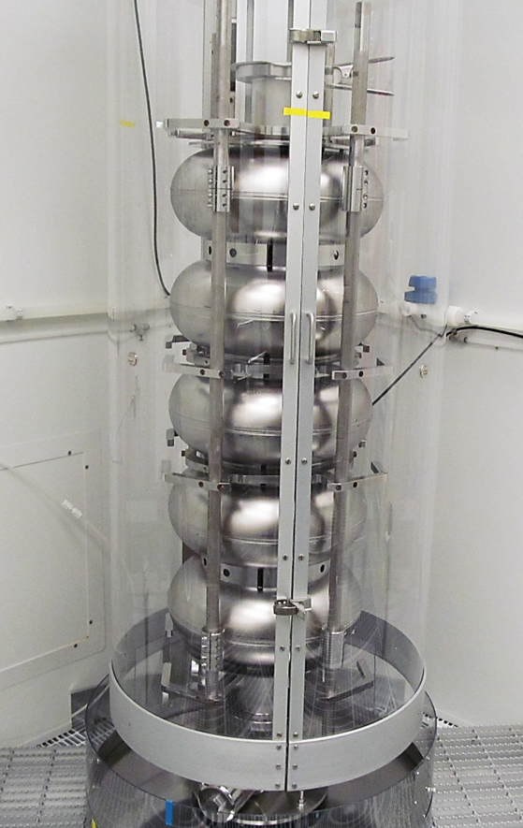
Testing CM-Specific Components – LB/HB650
Bare Cavities
  LB650 cavity new design (b=0.61)
    FNAL will process/test ~2 SC and ~2 5-cell prototypes
    produced by INFN/VECC
  HB650 cavity old design (β=0.90)
    4 jacketed cavities to be tested in the VTS
  HB650 cavity new design (β=0.92)
    2 prototype cavities built for FNAL
      Tested bare at FNAL VTS
        3 process/test cycles/cavity in schedule
        Use N-doping/processing recipe developed
        for β=0.90 cavities as baseline
        HPR tooling to be optimized
      Then tested jacketed at FNAL VTS
    4 prototype cavities being fabricated and jacketed by DAE
      Tested jacketed at FNAL VTS (tested bare (VTS) & dressed (HTS) by DAE). These cavities are potentially used in CM#1
  HB650 production cavities
    Production cavities supplied by UK (STFC) and DAE (RRCAT) - tested (qualified) jacketed in VTS at respective partner lab – FNAL will participate in initial testing
650MHz β=0.90 Cavity in HPR Tool

Slide 17
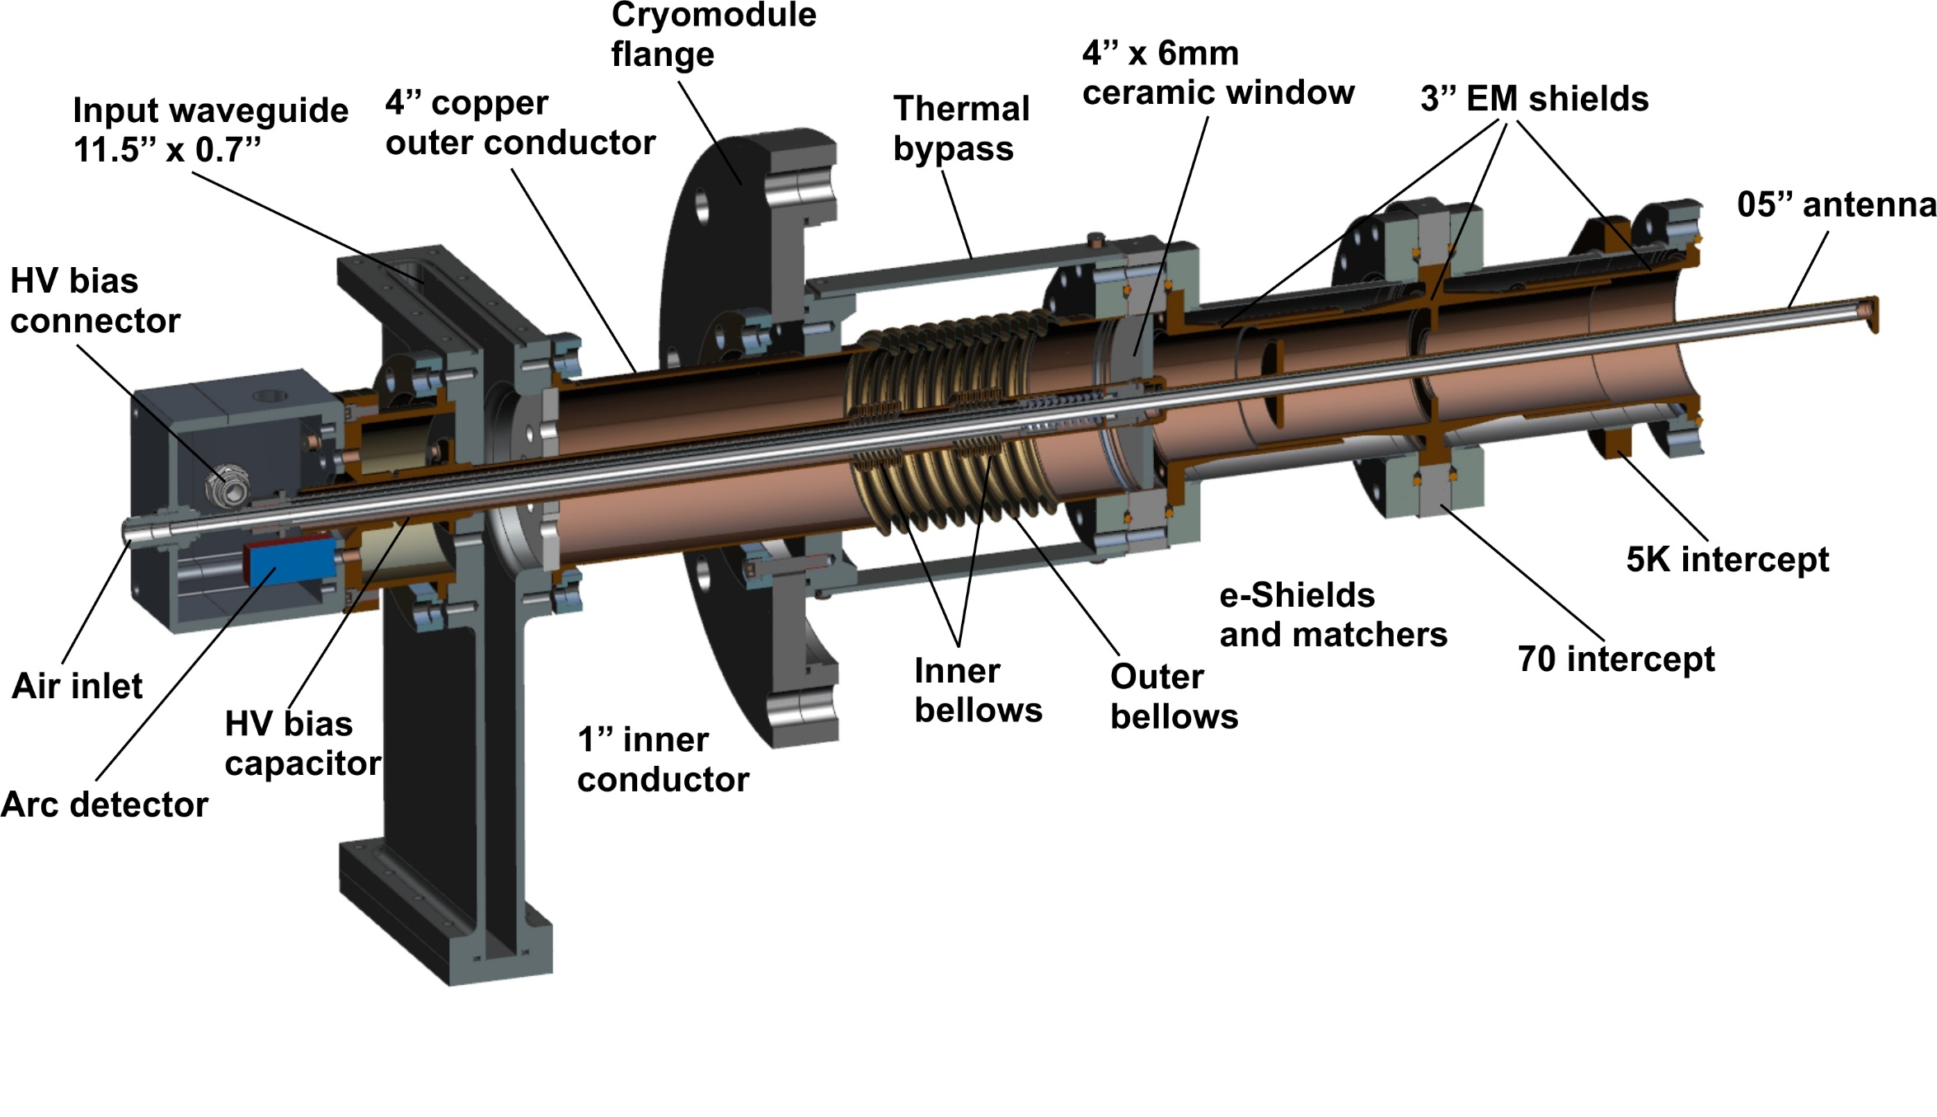
Testing CM-Specific Components – HB650 (LB650)
Couplers
  4 Prototype HB650 coupler cold-ends have been procured
    Two of each (cold end) design, two “universal” warm ends
    Tested on room-temperature test stand after initial QA/QC
    Tested on first 2 β=0.90 cavities in STC
      One of each kind, unless RT testing indicates otherwise
  8 Pre-production couplers to be procured (for CM#1)
    After initial tests of prototypes in STC
    All tested on room-temperature test stand after initial QA/QC
    Tested on two remaining β=0.90 cavities in STC (for CM#1)
    Tested on two prototype β=0.92 cavities in STC
650 MHz Coupler

Slide 18
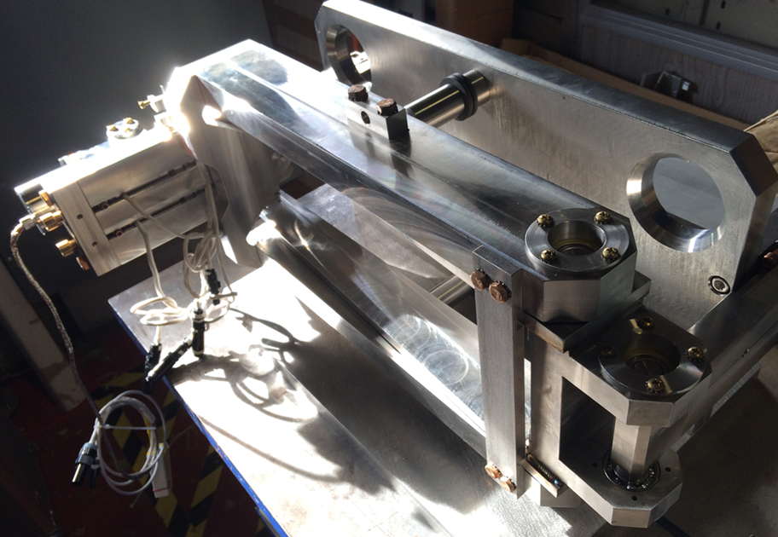
Testing CM-Specific Components – HB650 (LB650)
Tuner/Resonance control
  1st (upgraded) prototype to be tested in STC using β=0.90 cavities
  4 “production” tuners for β=0.90 cavities and 3 “production” tuners for β=0.92 cavities ordered after prototype tested in STC
    tested with β=0.90 and β=0.92 cavities in STC
      β=0.90 cavities used on CM#1
  Production tuner design for CMs 2-4 finalized after prototypes and early “production” tuners and CM#1 tested at CMTF. Tuners supplied by partners.
  Resonance/microphonics control studies part of all extended (design verification) STC testing with β=0.90 and β=0.92 cavities
  Tuner motor and piezo lifetime tests planned as part of “bench-testing”
650 MHz Prototype Tuner V. 1

Slide 19
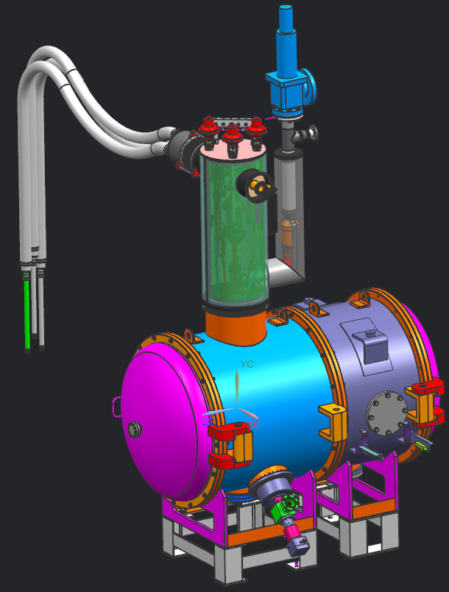
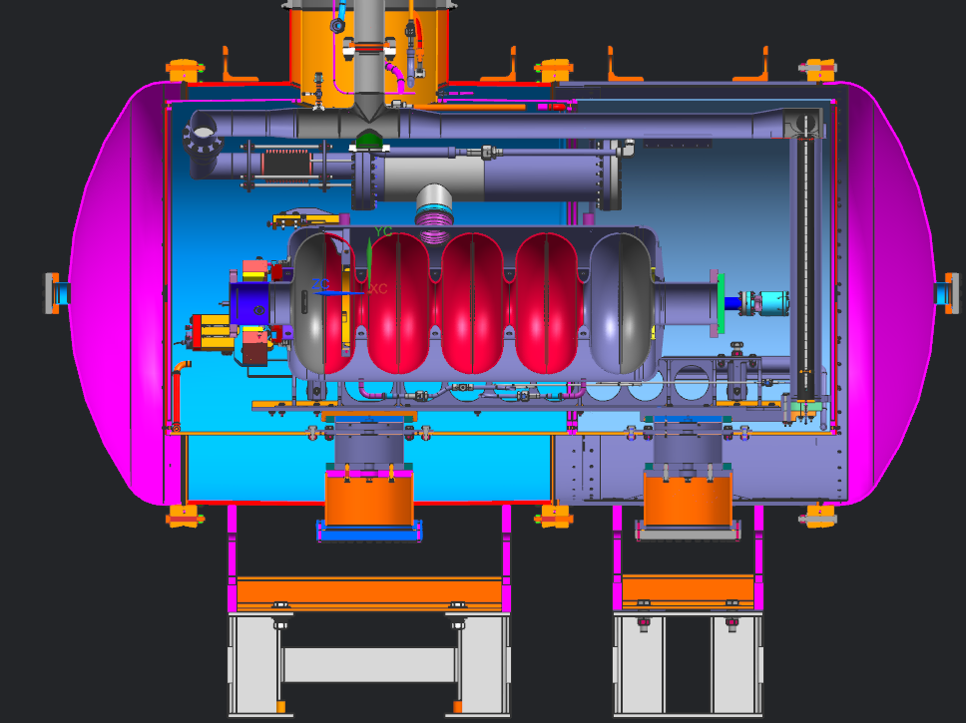
Testing CM-Specific Sub-Systems – HB650
Sub-System tests with dressed cavities (cavity + HeV + tuner + coupler + magnetic shield(s)) are also planned, as part of system design verification.
    Adequate (extended) durations planned
    Multiple iterations
    Using prototype or “first-article”/pre-production components
    Serve as “gatekeeper” to FDR or PRR
Use modified (extended) STC facility & ancillaries (available 1QFY19)

Slide 20
Testing CM-Specific Sub-Systems – HB650
STC test program:
  HB650 CM#1 β=0.90 cavities (4) tested in STC with prototype and pre-production couplers/tuners
    Design verification testing – 8 weeks cold testing cavities 1,2; 5 weeks cold testing cavities 3, 4
      This allows multiple (fast) cooldowns (if needed), coupler thermal studies, extended resonance control studies
  HB650 prototype β=0.92 cavities (2) with pre-production couplers/tuners
    Design verification testing – 8 weeks cold testing
      This allows multiple (fast) cooldowns (if needed), coupler thermal studies, extended resonance control studies
  Potential for HB650 production dressed cavities and prod tuner/coupler testing
    Qualification/partner (UK/DAE) production testing – up to 4 weeks cold testing
A total of 8 STC test cycles for ~50 “cold weeks”, for HB650

Slide 21
General CM Risks – SSR1/SSR2/LB650/HB650
In addition to the challenges related to cryomodule components, there remain the overall cryomodule performance risks (specifically from the Project’s Risk Register):
  Pulsed and CW cryomodule operating modes may lead to cryogenic or mechanical instabilities
    Potentially increases difficulty of resonance control due to enhanced microphonics form higher heat load in CW mode
  CM(1) Performance at PIP2IT/CMTS may not meet technical requirements
    CM might not achieve performance necessary to operate in the Linac
  Q₀ performance of installed cavities
    Increased CM heat load, especially in CW operating mode
  Resonance control : microphonics
    Small bandwidths lead to greater difficulty in compensating de-tuning due to microphonics

Slide 22
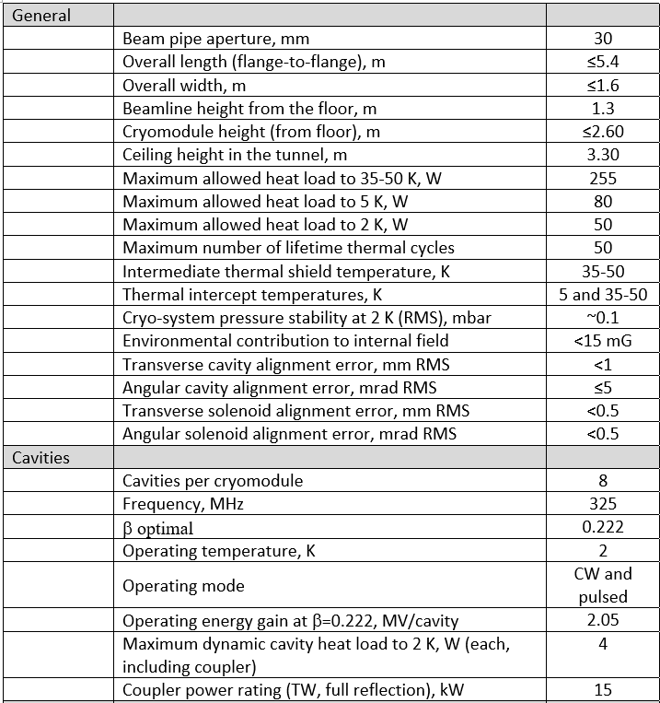
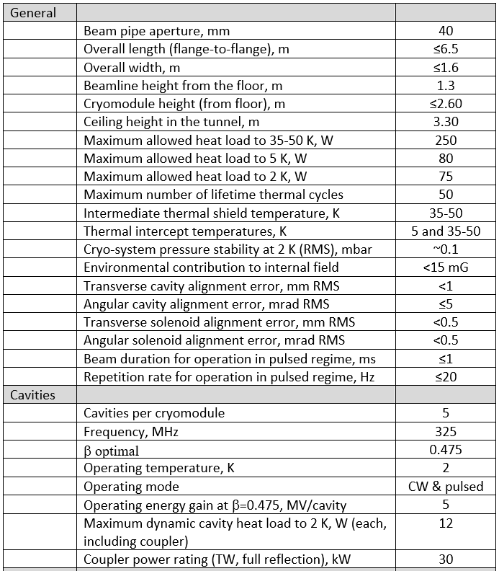
Performance Parameters – SSR1/SSR2 CMs
SSR1 SSR2

Slide 23
Performance Parameters – LB650/HB650 CMs
LB650 HB650
Cryomodules | LB650
Beam pipe aperture, mm | 118
Overall length (flange-to-flange), m | 5.25
Overall width, m | 1.6
Beamline height from the floor, m | 1.3
Cryomodule height (from floor), m | 2
Ceiling height in the tunnel, m | 3.2
Maximum allowed heat load to 35-50 K, W | 100
Maximum allowed heat load to 5 K, W | 16
Maximum allowed heat load to 2 K, W | 100
Maximum number of lifetime thermal cycles | 50
Environmental contribution to internal field, mG | 10
Transverse cavity alignment error, mm RMS | 0.5
Angular cavity alignment error, mrad RMS | 1
Cavities per cryomodule | 3
Frequency, MHz 325 | 650
Maximum dynamic cavity heat load to 2 K, W (each, including coupler) | 21
Coupler power rating (TW, full reflection), kW | 70
Cryomodules | HB650
Beam pipe aperture, mm | 118
Overall length (flange-to-flange), m | 9.56
Overall width, m | 1.6
Beamline height from the floor, m | 1.3
Cryomodule height (from floor), m | 2
Ceiling height in the tunnel, m | 3.2
Maximum allowed heat load to 35-50 K, W | 300
Maximum allowed heat load to 5 K, W | 32
Maximum allowed heat load to 2 K, W | 220
Maximum number of lifetime thermal cycles | 50
Environmental contribution to internal field, mG | 10
Transverse cavity alignment error, mm RMS | 0.5
Angular cavity alignment error, mrad RMS | 1
Cavities per cryomodule | 6
Frequency, MHz 325 | 650
Maximum dynamic cavity heat load to 2 K, W (each, including coupler) | 23
Coupler power rating (TW, full reflection), kW | 120

Slide 24
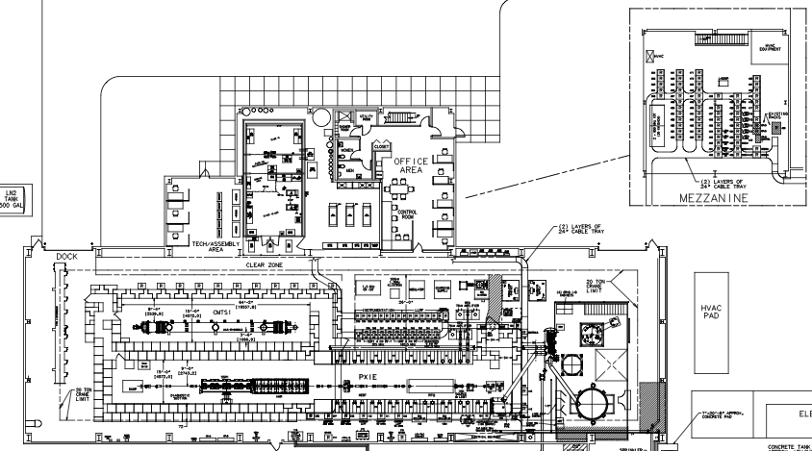
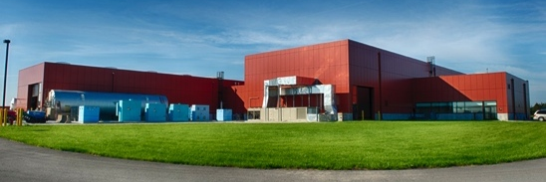
Addressing General CM Risks
Comprehensive testing of cryomodules addresses global CM performance risks documented in the Risk Register, and also provides design verification of CM support, thermal, and cryogenic structures, that can not be otherwise evaluated.
HB650/LB650/SSR1/SSR2 CM#1s are extensively tested in the CMTS or PIP2IT facilities.
CMTS1
650MHz Test Cave
PIP2IT 325MHz Test Cave
Cryogenic Plant

Slide 25
Addressing General CM Risks
HB650/LB650/SSR1/SSR2 CM#1s are extensively tested in the CMTS or PIP2IT facilities.
  A test plan using lessons-learned from LCLS-II pCM testing will be developed for CM#1s
    Two months (60 calendar days) of cold testing is planned for each 1st CM type.
      Additional time for installation, checkout, preparation, and cooldown are also included, based on experience with LCLS-II pCM
      Multiple cooldown cycles (“fast cooldowns”, where appropriate)
      Extensive diagnostics
      Performance feedback to inform Final Design efforts, precursor to FDR/PRR
Production cryomodules (SSR12 #2, SSR2 #2-7, HB650 CM#2-4, LB650 CM#2-11) are also fully tested in CMTS.
  Test durations from 16-8 days (decreasing with later production)
  Potential testing of LB CMs at partner lab – would be invaluable in quantifying shipping effects, but adds delays

Slide 26
CM Testing Schedule – HB650 #1
Current P6 schedule shows CM #1 completion by August 2022. CMTS must be ready then
LCLS-II (non-HE) finishes 3.9GHz CM testing by August 2019
  2 months to begin CMTS reconfiguration (Oct 2019)
  6 months to reconfigure CMTS
  CMTS available for 650MHz CM testing April 2020
If FNAL performs LCLS-II HE CM fabrication, ~ 12mo delay, CMTS available April 2021
Around 1 year of float between CMTS availability and CM#1 completion, in “worst case” (LCLS-II HE project)
  Can accelerate completion of HB650 CM#1 by 1 year
    (the bigger issue may be RF amplifier(s) availability – RRCAT deliverable)

Slide 27
CM Testing Schedule – HWR/SSR1 #1
ANL schedule shows delivery of HWR CM at end of April 2019
  (Potential opportunity to compress this by a few months)
  PIP2IT ready for HWR by January 2019
SSR1 CM1 completion in late FY19 (summer 2019)
  This aligns with availability of PIP2IT and completion of 1st round of HWR CM testing
PIP2IT remains available for testing of SSR1 #2 and SSR2s in the following years
      (again RF amplifiers (8 @ 325MHz) are needed by summer 2019 – BARC deliverable)

Slide 28
Summary – SRF Component/System Testing Matrix
  All components, systems, subs-systems are tested in various configurations/facilities, representing simpler → more complex (realistic) environments.

Slide 29
Summary
A comprehensive “Test Program” has been formulated in order to
    evaluate prototype designs
      provide feedback to production design
    qualify production components
      provide feedback to vendors
    validate sub-system performance
      provide feedback to design and assembly teams
    qualify overall cryomodule design/performance
      provide feedback to assembly and commissioning teams
The overarching goal is to complete prototype testing before Final Design Reviews (FDRs) and Procurement Readiness Reviews (PRRs) are held for production components (allow for design optimization/improvement)
These activities ultimately are intended to retire the risks associated with cryomodule performance in the Linac.
It is our intent that this testing program be agile – testing can be added, test plans can be modified/lengthened, depending upon results. (Significant cost/schedule impacts will need to be understood and accommodated of course, via BCRs)

