Slide 1
Cavities & Cryomodules - Design Strategy
PIP II Mini-Retreat
Vincent Roger

Slide 2
Layout
Introduction
Cavity - Design strategy
    CW operation
    Pulsed operation
    PIP II cavities
Cryomodule - Design strategy
    Strong-back
    Layout of the cryomodule
    Cryogenic lines
    LCLS II experience
Assembly process of SSR1 Cryomodule
    Heat loads
    Workstations
    Alignment

Slide 3
1. Introduction
The Functional Requirements Specifications have been defined for each cavity, cryomodule and coupler. These elements have been designed for CW and pulsed operations.
Cavity requirements
Cryomodule requirements
Max variation of pressure in the 2-phase helium pipe: 0.1 mbar
Coupler requirements

Slide 4
1. Introduction
Vacuum vessel
2-Phase He pipe
Thermal shield
35-50K
Dressed cavity
5 K Line
Support post
Coupler
Strong-back
Critical elements for CW operation
  Coupler design
  Thermal intercept design
  Heat loads
  Sensitivity to LHe pressure fluctuations

Slide 5
2. Cavity - Design strategy
Cavities have been designed and optimized to operate at high Q₀ by minimizing df/dp. This design strategy is essential to reduce as much as possible the cost of the project.
Accelerator gradient
The best is to have a passive compensation by having a parallel approach in performing RF and mechanical analyses.
PIP II requirements: < 25 Hz/mbar
f₀
Frequency

Slide 6
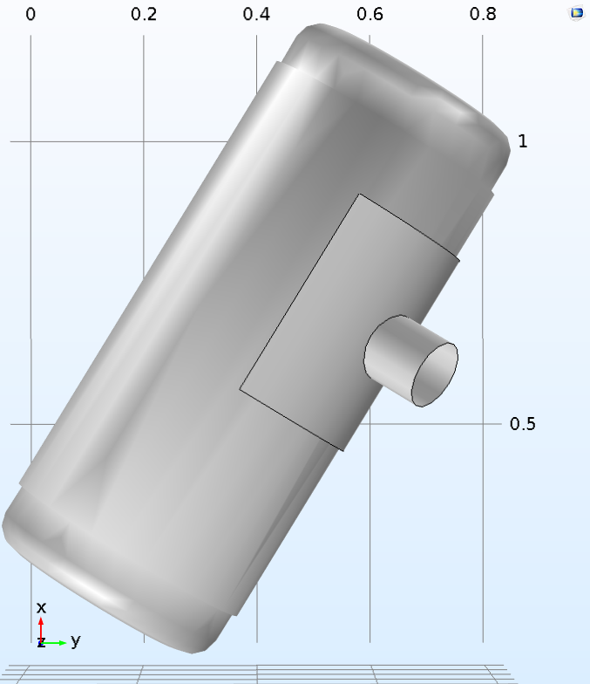
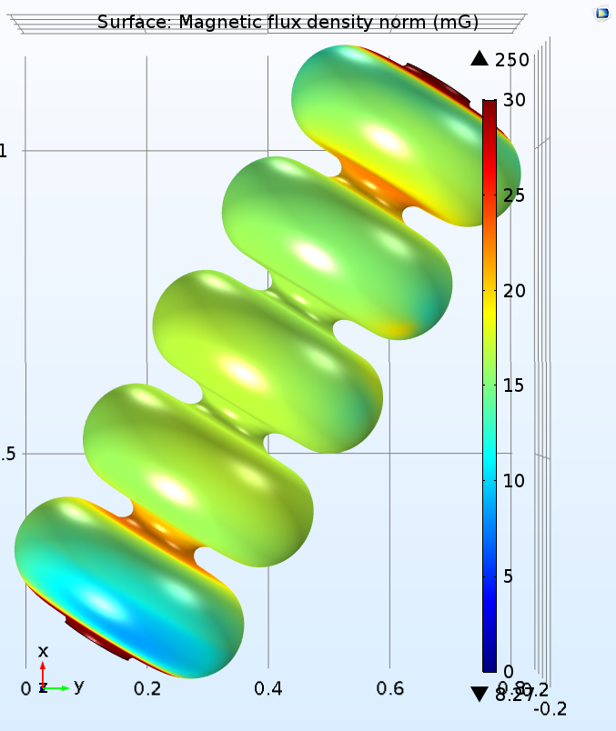
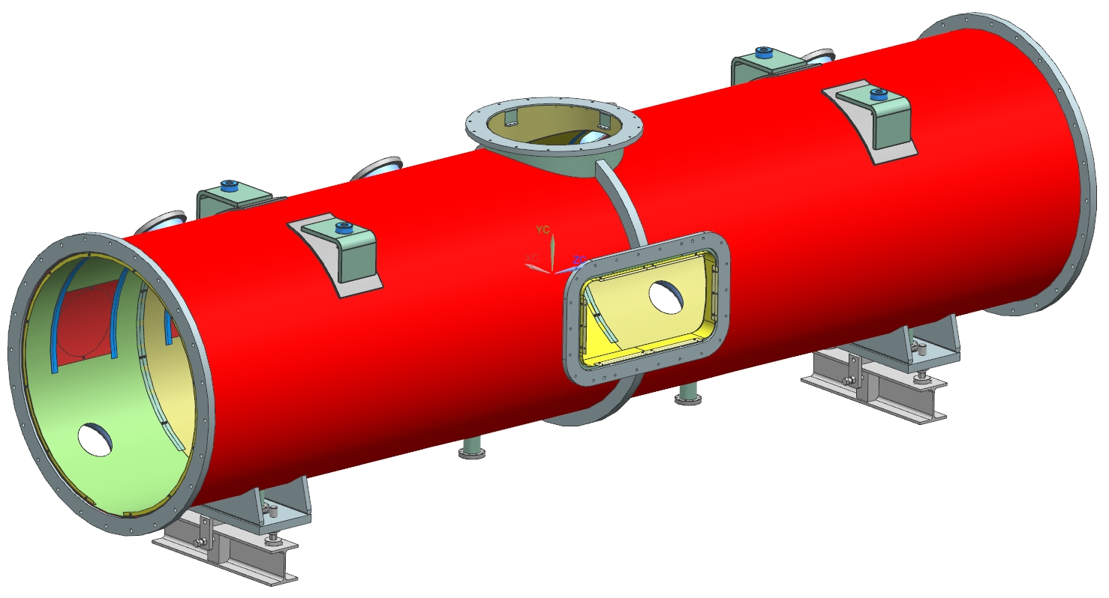
2. Cavity - Design strategy
In CW operation, the Q₀ is also an important parameter to decrease the heat-loads.
The residual magnetic field has an effect on the surface resistance which is connected to the Q₀. We are gathering statistics to evaluate this correlation.
Each LB650 and HB650 cavities will have their own cold magnetic shield
Requirements : 10 mG
Spoke cavities are less sensitive to residual magnetic field.
A warm magnetic shield will be used on the inner surface of the vacuum vessel
By courtesy of S.K. Chandrasekaran

Slide 7
2. Cavity - Design strategy
In pulsed operation, the main driving parameter for cavity design is the Lorentz Force Detuning coefficient. All PIP-II cavities meet the requirements, and this case we rely on the active tuning :
Since active compensation can be used with the tuner to lower the Lorentz Force Detuning coefficient, the design strategy has been first to mitigate the df/dp and then to optimize the design in order to decrease the Lorentz Force Detuning coefficient and to mitigate microphonic.

Slide 8
2. Cavity - Design strategy
SSR1 Cavities
The jacketed SSR1 cavities were designed to have very low sensitivity to helium pressure fluctuations. We physically coupled the Nb cavity and the helium vessel such that we obtain a combination of cavity walls deformations (x1+x2) and (x3+x4) giving a 𝑑𝑓/𝑑𝑝 close to 0.
By courtesy of D. Passarelli
df/dp (Hz/mbar) | S106 | S107 | S108 | S109 | S110 | S111 | S112 | S113 | S114
Bare cavity (with transition ring) | -564 | -561 | -553.5 | -555.1 | -568.8 | -525.8 | -524.6 | -544.7 | -557.2
With He vessel (without tuner) | 8 | 8 | -1.2 | 5.4 | 7.9 | 2.7 | 9 | 6.3 | 10
Fully integrated (estimation) | 4 | 4 | 0 | 2 | 4 | 2 | 5 | 3 | 5
The measured df/dp is very small < 10 Hz/mbar
SSR2 Cavities
BARC is in charge of the design of SSR2 cavities. They are following the same design strategy to optimize the design.

Slide 9
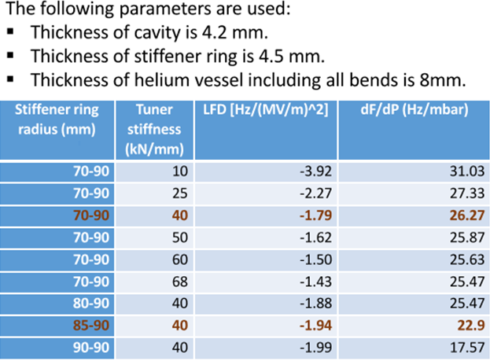
2. Cavity - Design strategy
By courtesy of I. Gonin
HB650 Cavities
The df/dp is below the requirement. Around 10-15 Hz/mbar for a tuner stiffness of 40 kN/mm.
FRS
LB650 Cavities
VECC is in charge of the RF and mechanical design of LB650 cavities. The design is not yet finalized, but preliminary calculations shows that the df/dp will be close to the requirements.

Slide 10
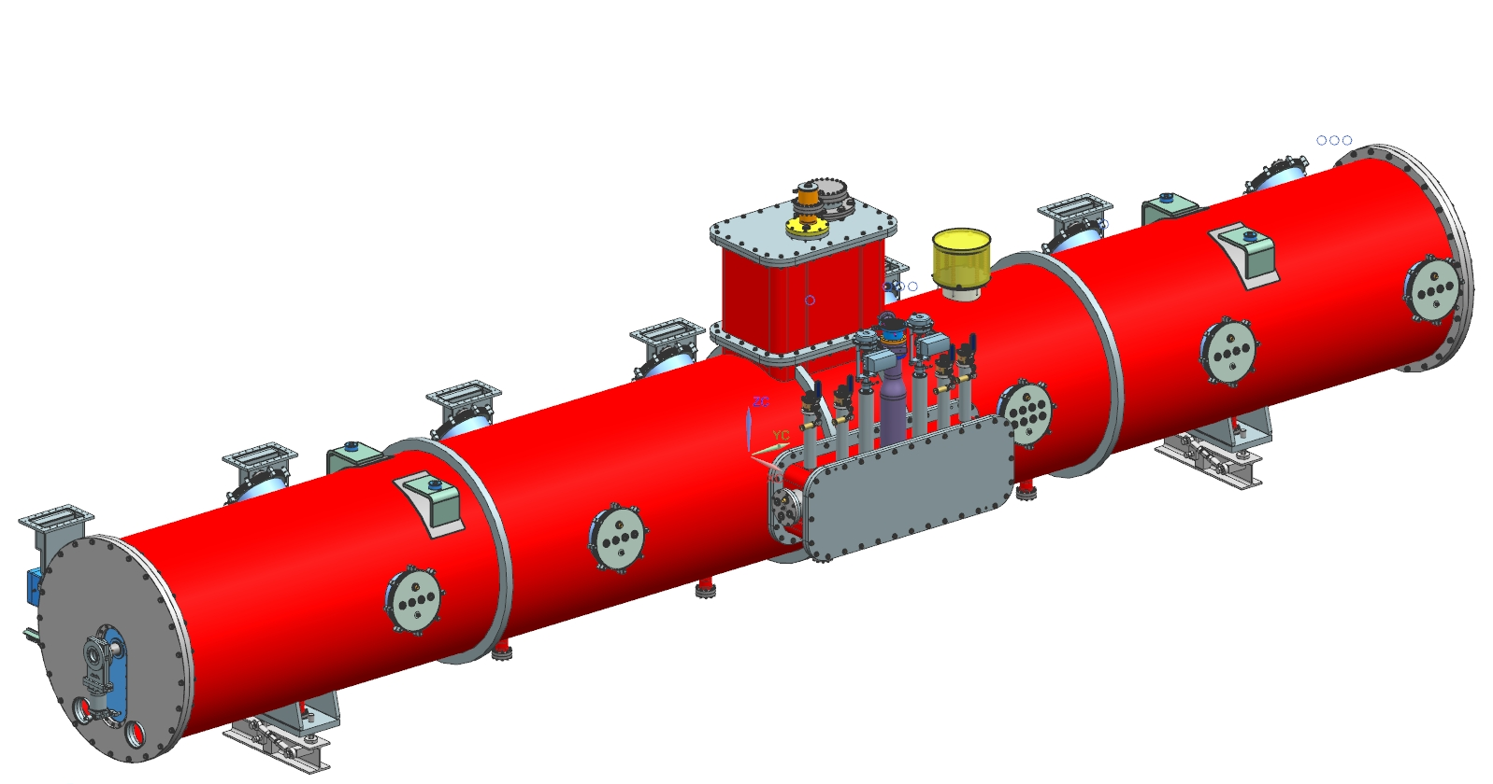
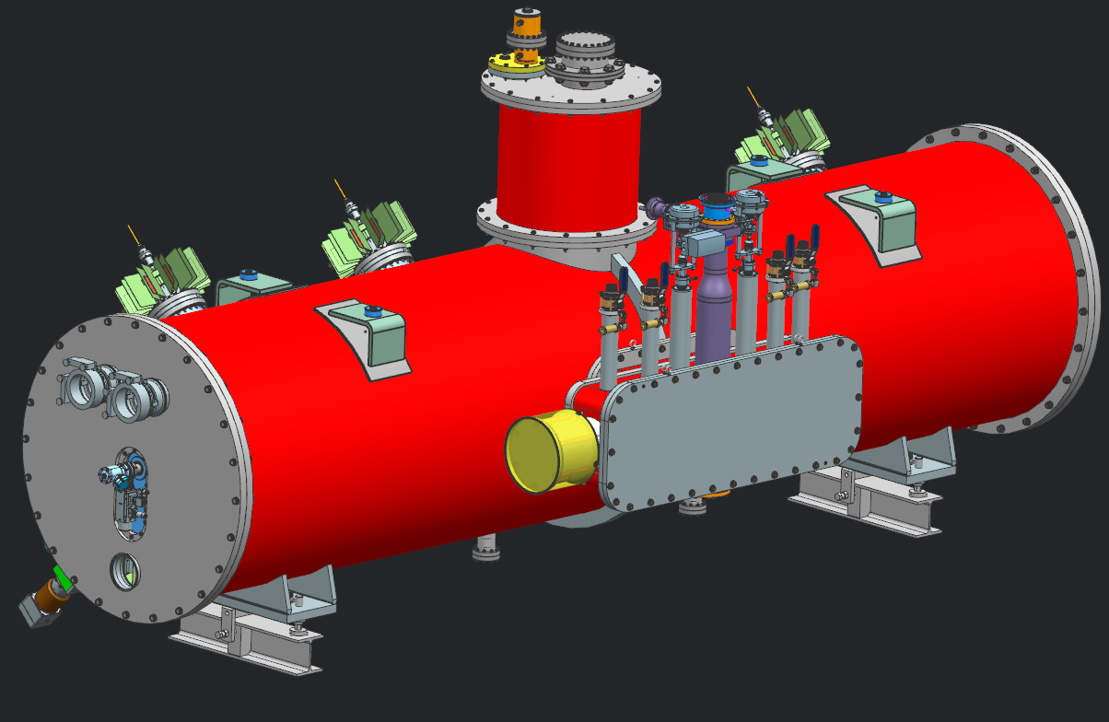
3. Cryomodule - Design strategy
SSR1 & HB650 cryomodules share the same design strategy, and our plan is to use it for SSR2 & LB650 cryomodules as well.
    Strong-back at room temperature
    Same support post
    Same cryogenic side port
    Similar Piping and Instrumentation Diagram
SSR1 Cryomodule
HB650 Cryomodule
  Minimize the design cost
  Use of similar tooling and procedures

Slide 11
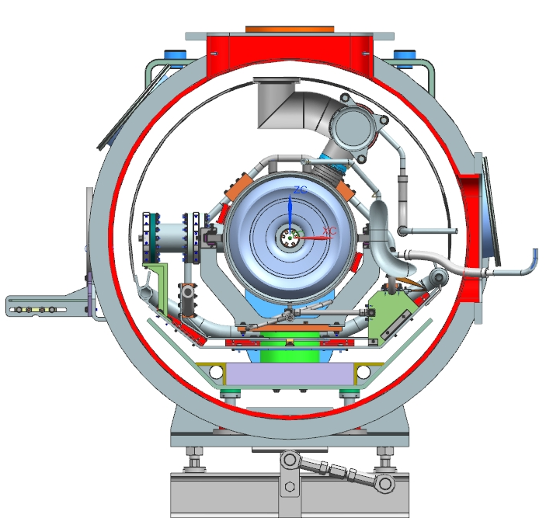
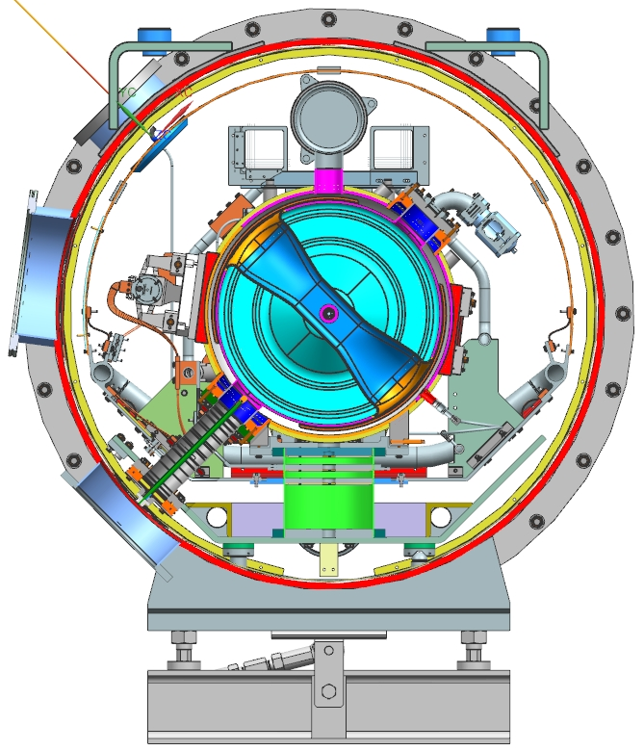
3. Cryomodule - Design strategy
3.1 Strong-back
SSR1, SSR2, LB650 & HB650 cryomodules are based on a strong-back at room temperature. Calculations have been done in order to warrant that the strong-back will be still warm after the cool down of the cryomodule.
SSR1 Cryomodule
T equilibrium : 286 K
ED0005286
HB650 Cryomodule
T equilibrium : 287 K
ED0003725

Slide 12
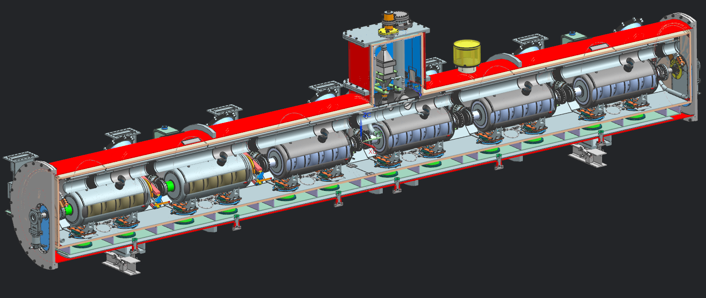
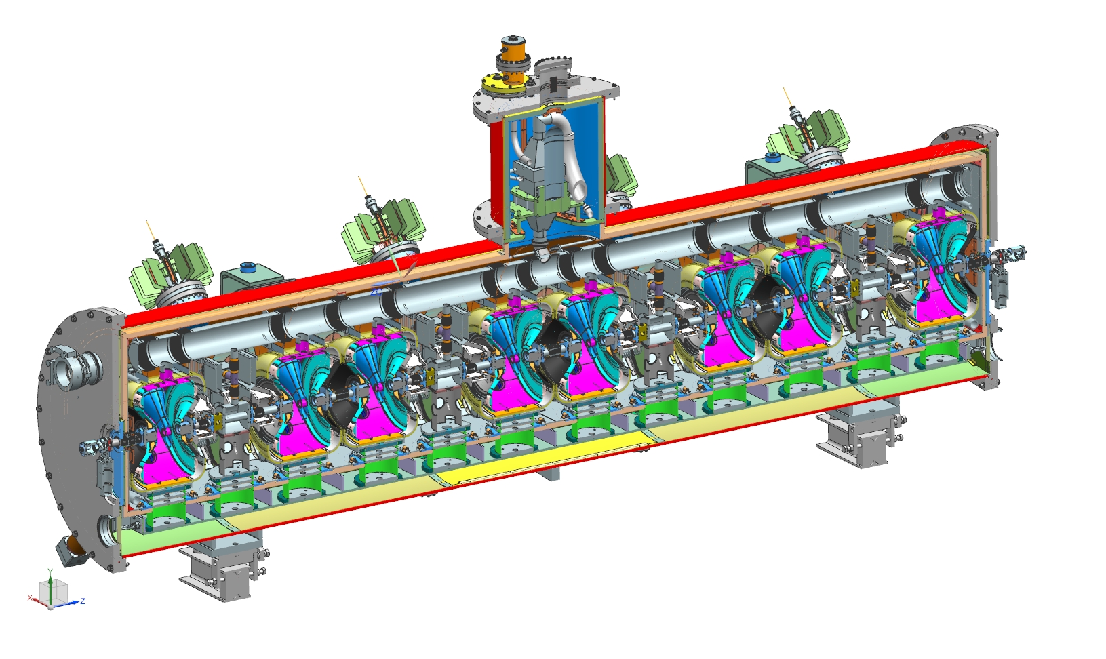
3. Cryomodule - Design strategy
3.2 Layout
Vacuum vessel : 1.5 m high compared to the beam axis
Thermal shield at 35-50 K
5 K line used as thermal intercept & to cool down the cavities & solenoids
5 Bayonets, 2 cryogenic valves & an heat exchanger
Cavities, tuners & couplers
A magnetic shield
    Around each cavity for the LB650 and HB650 cryomodules
    On the inner surface of the vacuum vessel for SRR1 and SSR2 cryomodules

Slide 13
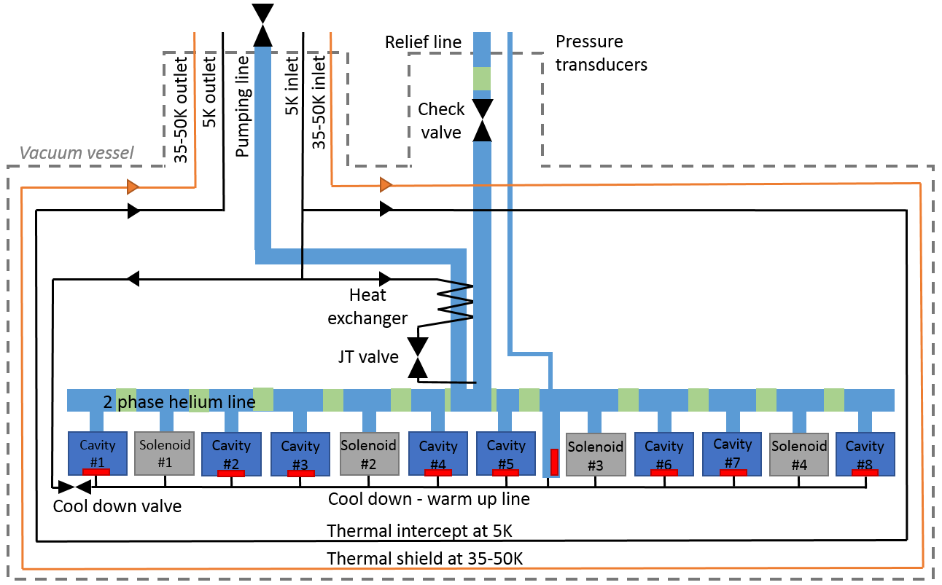
3. Cryomodule - Design strategy
3.2 Layout of the cryomodule
Piping and Instrumentation Diagram
F10082628
SSR1 Cryomodule

Slide 14
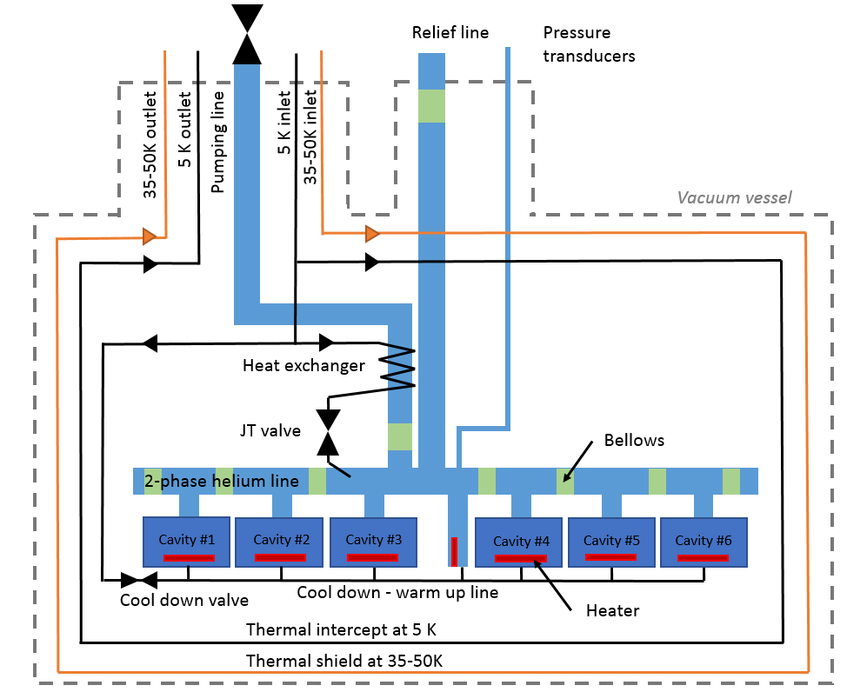
3. Cryomodule - Design strategy
3.2 Layout of the cryomodule
Piping and Instrumentation Diagram
F10101087
HB650 Cryomodule

Slide 15
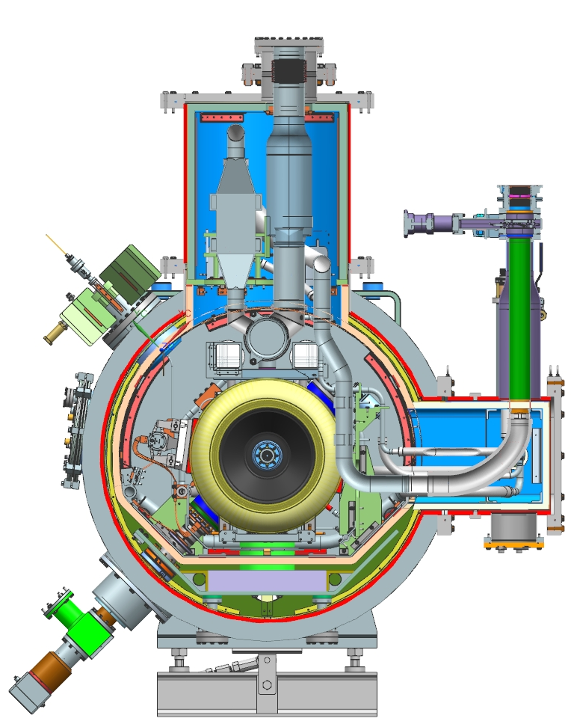
3. Cryomodule - Design strategy
3.3 Cryogenic lines
Pipe G - 2phase He pipe & Relief line
MAWP: 2.05 bar warm, 4.1 bar cold
Pipe B - Pumping line
MAWP: 2.05 bar warm, 4.1 bar cold
Pipe E & F - 35-50 K line
MAWP: 20 bar
Pipe A - 2 K supply
MAWP: 20 bar
Pipe C & D - 5 K line
MAWP: 20 bar
Pipe H - Cool down /
warm up line
MAWP: 20 bar
SSR1 Cryomodule

Slide 16
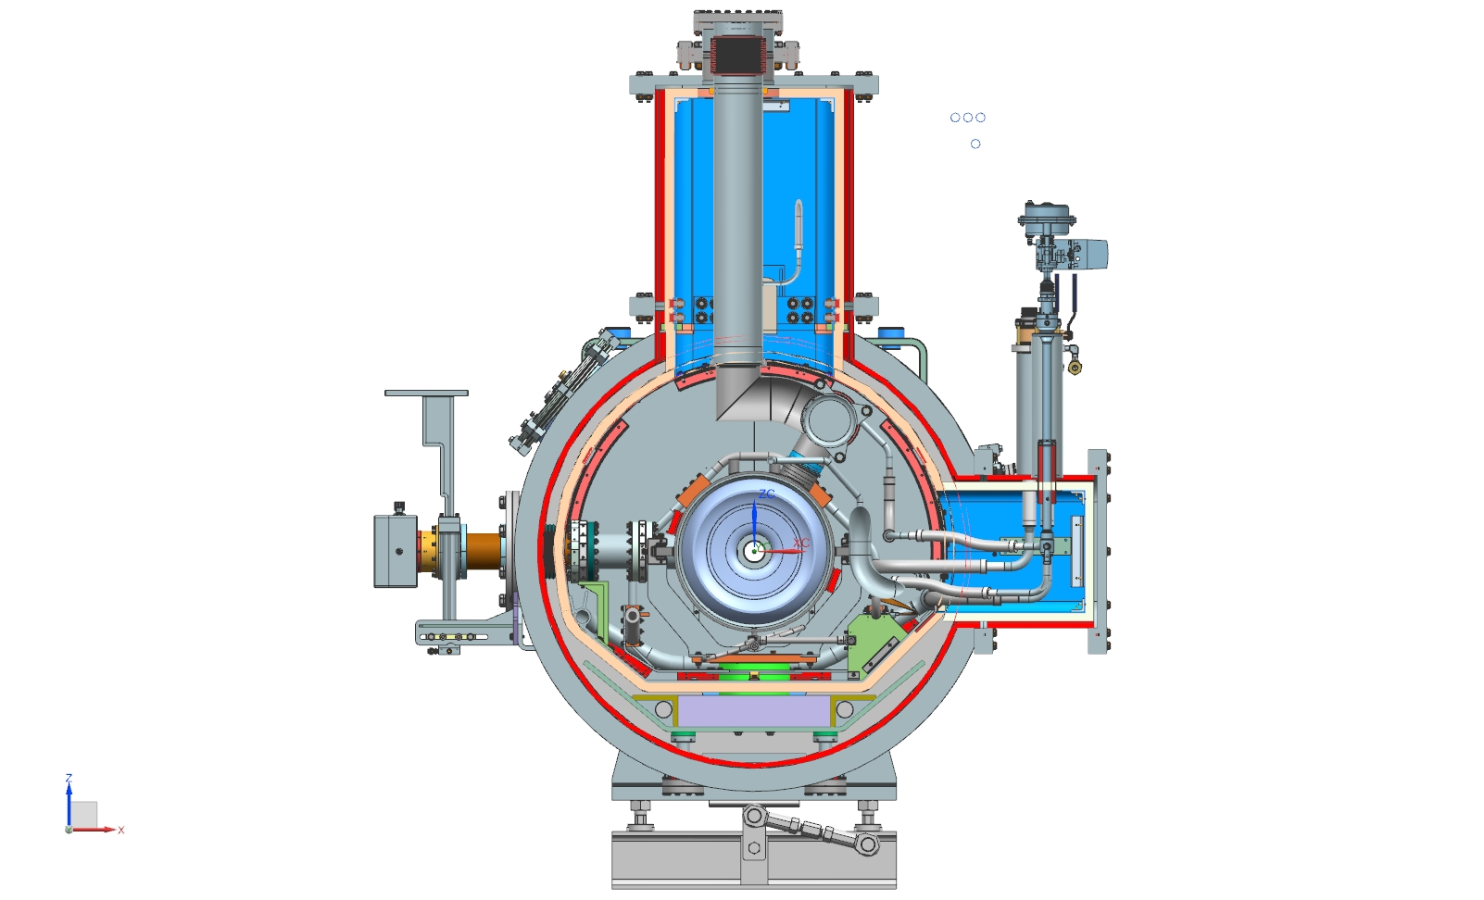
3. Cryomodule - Design strategy
3.3 Cryogenic lines
Pipe G - 2phase He pipe & Relief line
MAWP: 2.05 bar warm, 4.1 bar cold
Pipe B - Pumping line
MAWP: 2.05 bar warm, 4.1 bar cold
Pipe E & F - 35-50 K line
MAWP: 20 bar
Pipe A - 2 K supply
MAWP: 20 bar
Pipe C & D - 5 K line
MAWP: 20 bar
Pipe H - Cool down /
warm up line
MAWP: 20 bar
HB650 Cryomodule

Slide 17
3. Cryomodule - Design strategy
3.4 Pipe sizing
Calculations have been done in order to demonstrate that all the pipes of the cryomodule have been designed per venting requirements.
 | Needed diameter for the chimney of the solenoid | Needed diameter for the chimney of the dressed cavity | Needed diameter for the 2-phase helium pipe | Needed diameter for the relief line
Loss of insulating vacuum | 6.9 mm | 31.5 mm | 92.0 mm | 92.5 mm
Cavity vacuum loss | 2.3 mm | 32.3 mm | 91.6 mm | 91.6 mm
Magnet quench | 26.8 mm | - | 53. 5 mm | 53. 5 mm
 | Needed diameter for the chimney of the solenoid | Needed diameter for the chimney of the dressed cavity | Needed diameter for the 2-phase helium pipe | Needed diameter for the relief line
Loss of insulating vacuum | 6.9 mm | 31.5 mm | 92.0 mm | 92.5 mm
Cavity vacuum loss | 2.3 mm | 32.3 mm | 91.6 mm | 91.6 mm
Magnet quench | 26.8 mm | - | 53. 5 mm | 53. 5 mm
Considered diameter | 35 mm | 57 mm | 146.8 mm | 108.2 mm
SSR1 Cryomodule
The two-phase helium pipe has been oversized in order to increase the gas volume and therefore the pressure stability.

Slide 18
3. Cryomodule - Design strategy
3.5 Estimation of the heat loads
SSR1 Cryomodule
HB650 Cryomodule

Slide 19
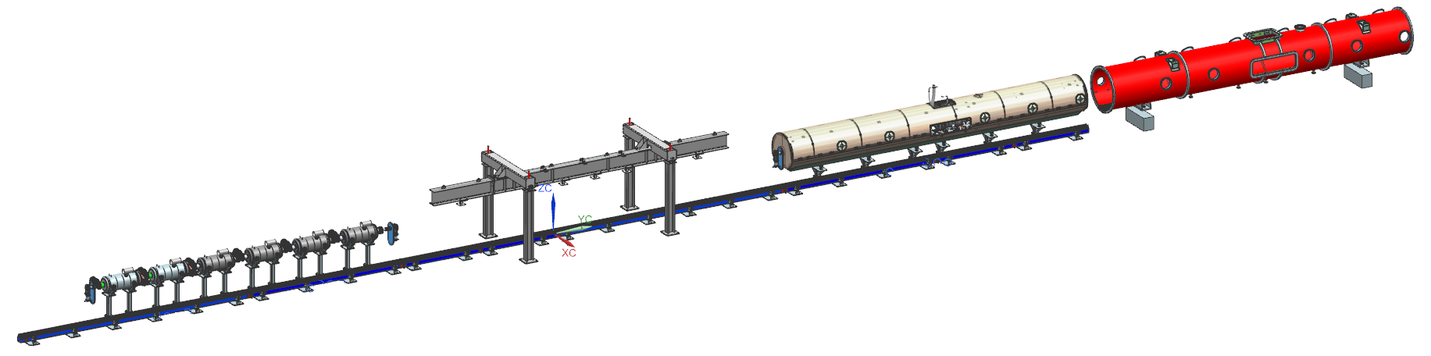
3. Cryomodule - Design strategy
3.6 Main workstations
Workstation 1: Assembly of the cavity string in the clean room
Workstation 2: Lifting of the string assembly
Welding of the cool-down / warm up line
Moving down the string assembly on the strong-back assembly
Workstation 3: Assembly of the cold-mass
Workstation 4: Insertion of the cold-mass in the vacuum vessel
Completion of the cryomodule

Slide 20
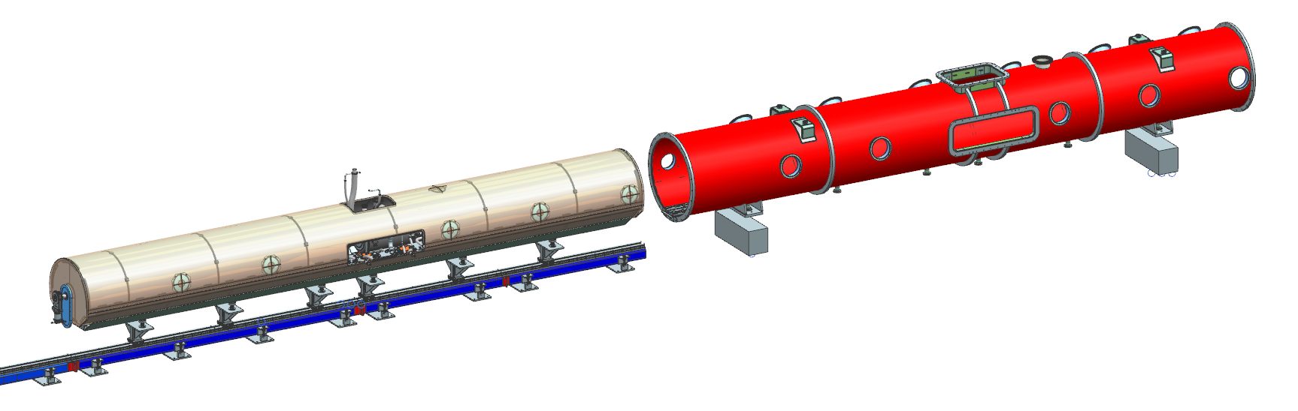
3. Cryomodule - Design strategy
3.7 Alignment strategy
1. Cavities will be measured in order to record their geometrical, electric and magnetic axis wrt fiducials placed on their top.
2. During the assembly of the beam line, inclinometers will be placed on each cavity to get a rough alignment and avoid stress on the bellows.
The key of the strong-back strategy is to support the strong-back in the same way on the insertion tooling and inside the vacuum vessel. Laser tracker will be used.

Slide 21
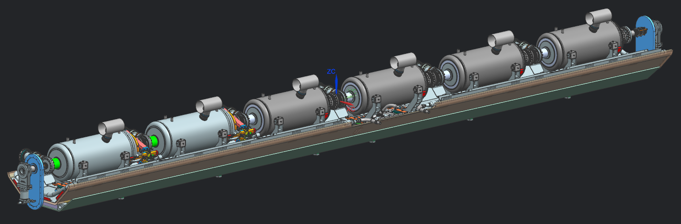
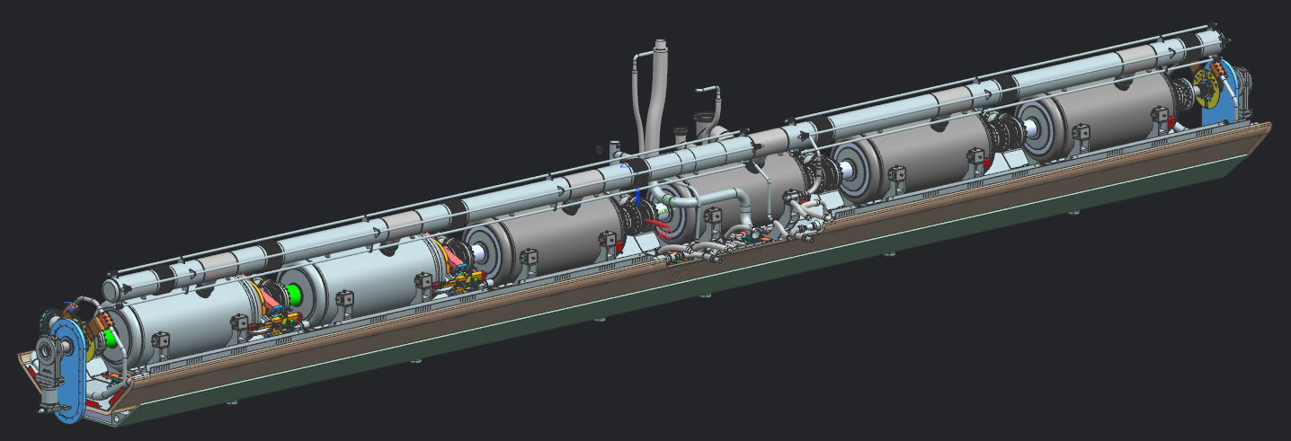
3. Cryomodule - Design strategy
3.7 Alignment strategy
1. Cavities will be measured in order to record their geometrical, electric and magnetic axis wrt fiducials placed on their top.
2. During the assembly of the beam line, inclinometers will be placed on each cavity to get a rough alignment and avoid stress on the bellows.
The key of the strong-back strategy is to support the strong-back in the same way on the insertion tooling and inside the vacuum vessel. Laser tracker will be used.
3. Once the beam line moved down on the strong-back, a rough alignment of the cavities will be done taking into account the shift due to the thermal contraction during the cool-down. Final alignment will be done after welding the two-phase helium pipe.

Slide 22
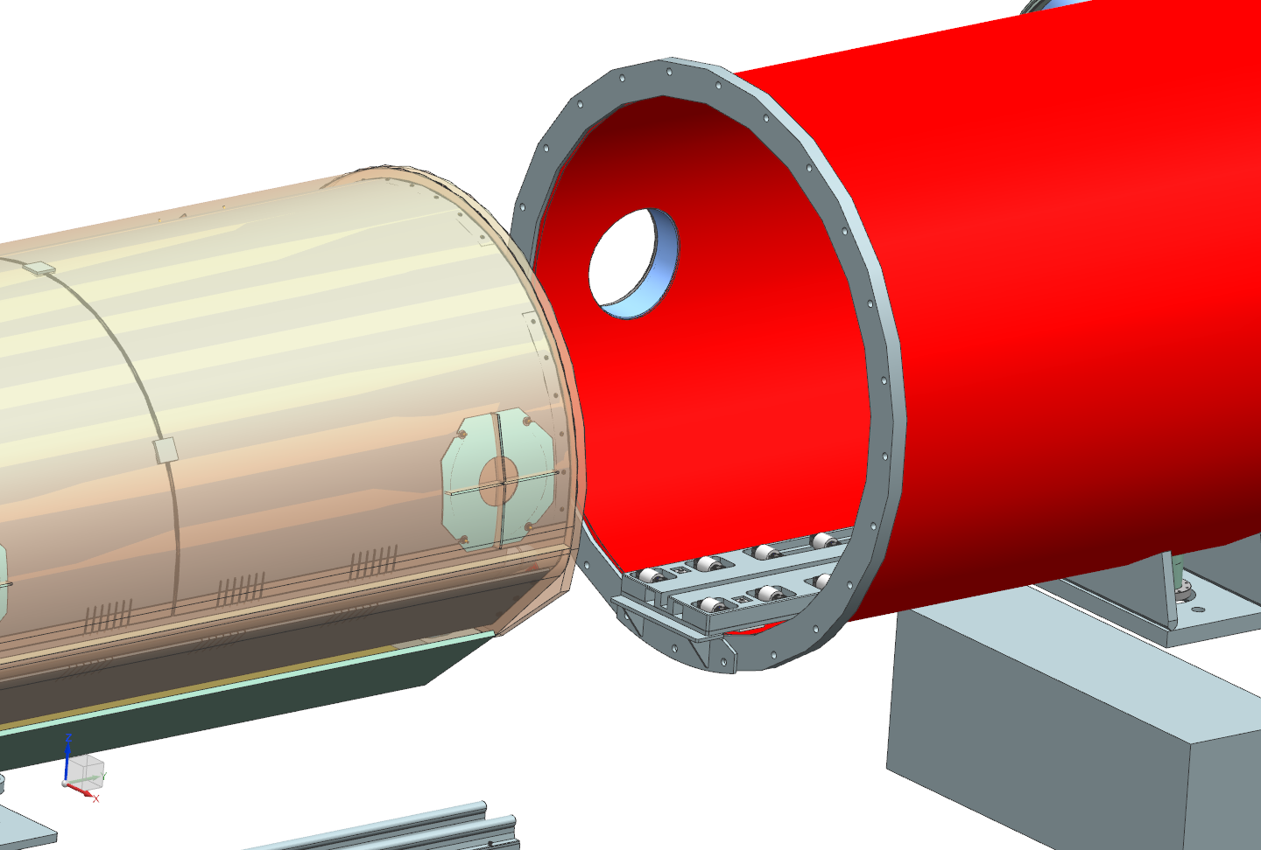
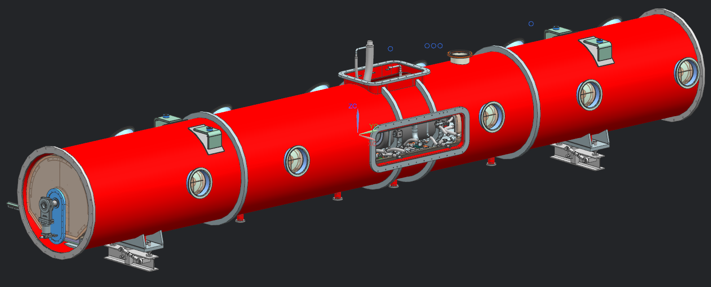
3. Cryomodule - Design strategy
3.7 Alignment strategy
4. The coldmass will be inserted in the vacuum vessel slightly using rollers. Then the coldmass will be screwed to the vacuum vessel support posts. Finally the alignment will be transferred to the vacuum vessel. (The insertion tooling is still under-designed).

Slide 23
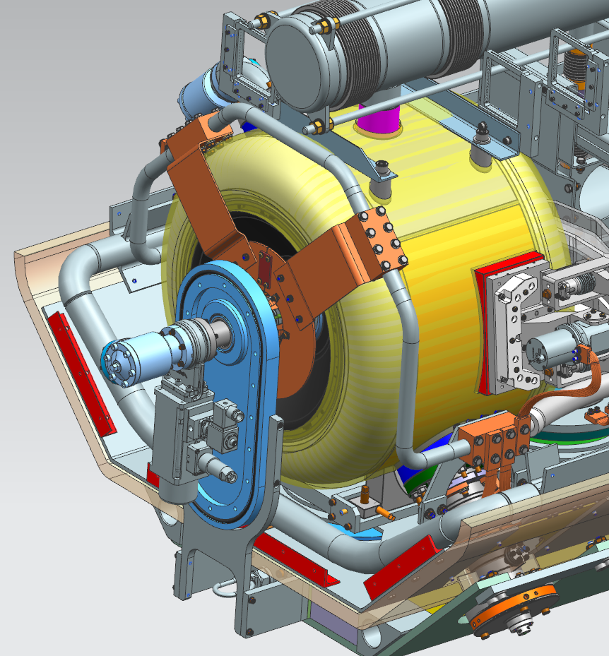
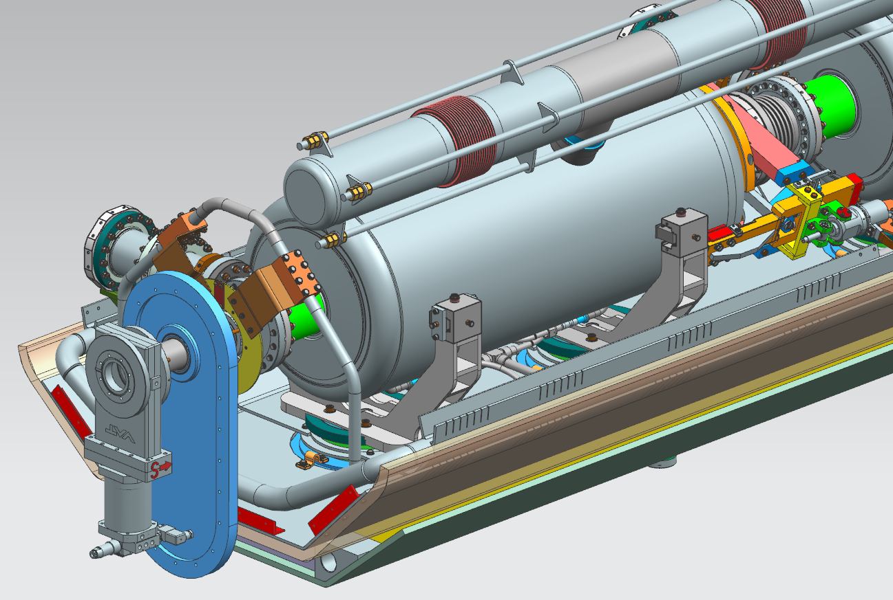
3. Cryomodule - Design strategy
3.7 Alignment strategy
Note that the way to align spoke and elliptical cavities will be different.

Slide 24
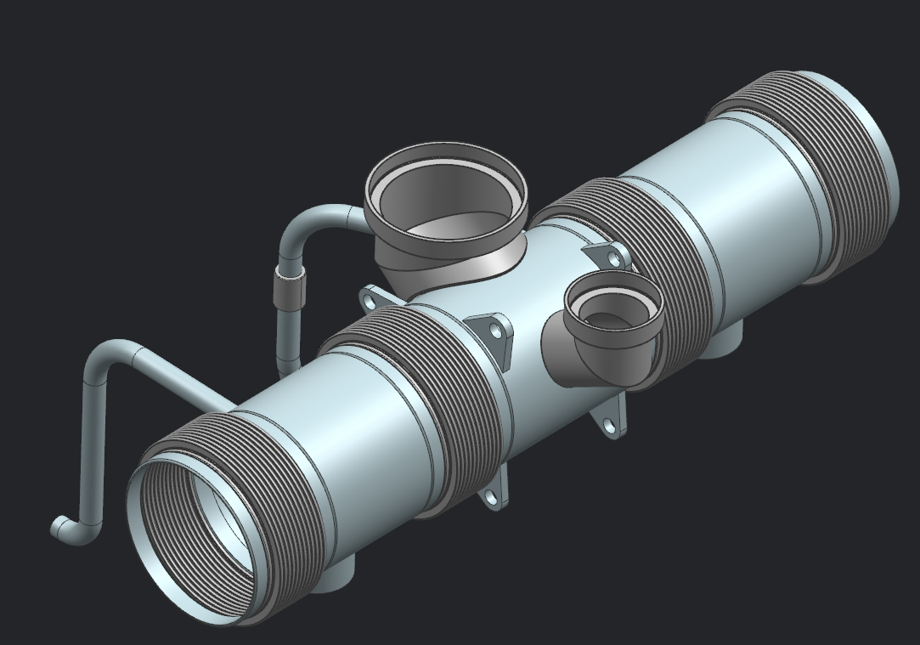
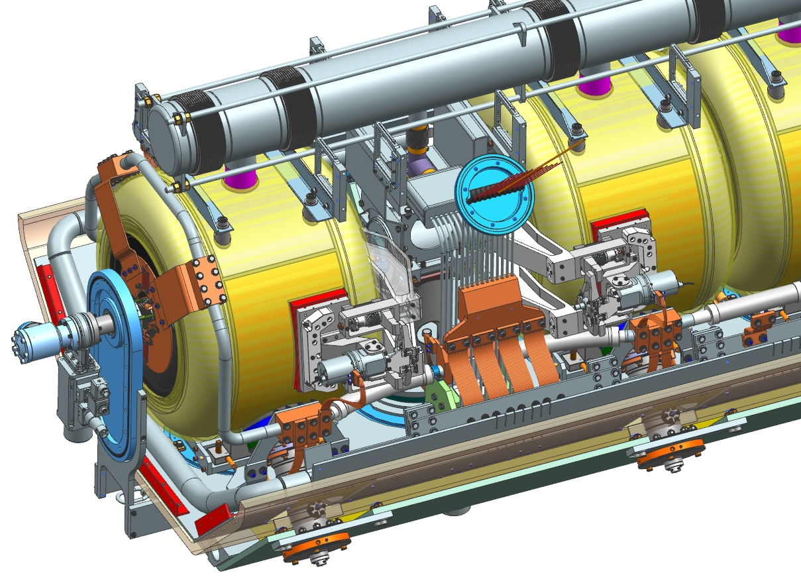
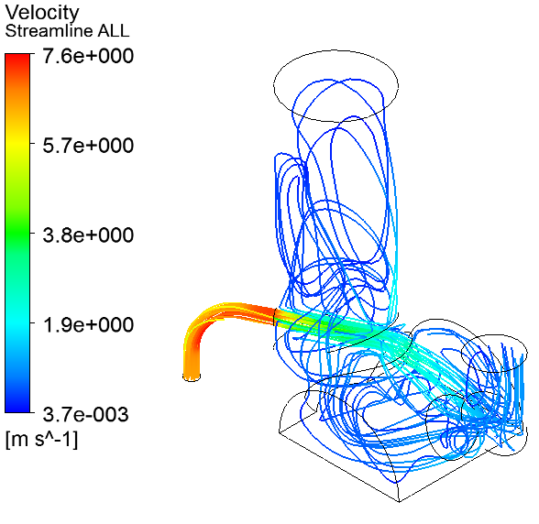
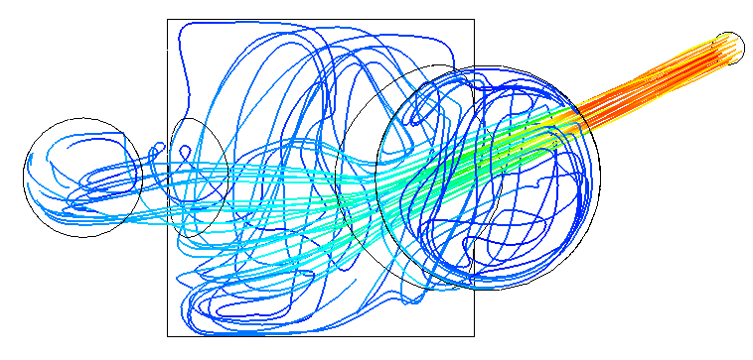
3. Cryomodule - Design strategy
3.8 LCLS II Experience
The design have been done in order to mitigate the thermal acoustic oscillations, helium bath instability, and structural vibrations.
Helium inlet at 2 K
SSR1 cryomodule is composed of more than 100 thermal straps,
Similar procedures will be used (torque, Loctite, washers, indium)
Interface with the JT valve
By courtesy of S. Cheban

Slide 25
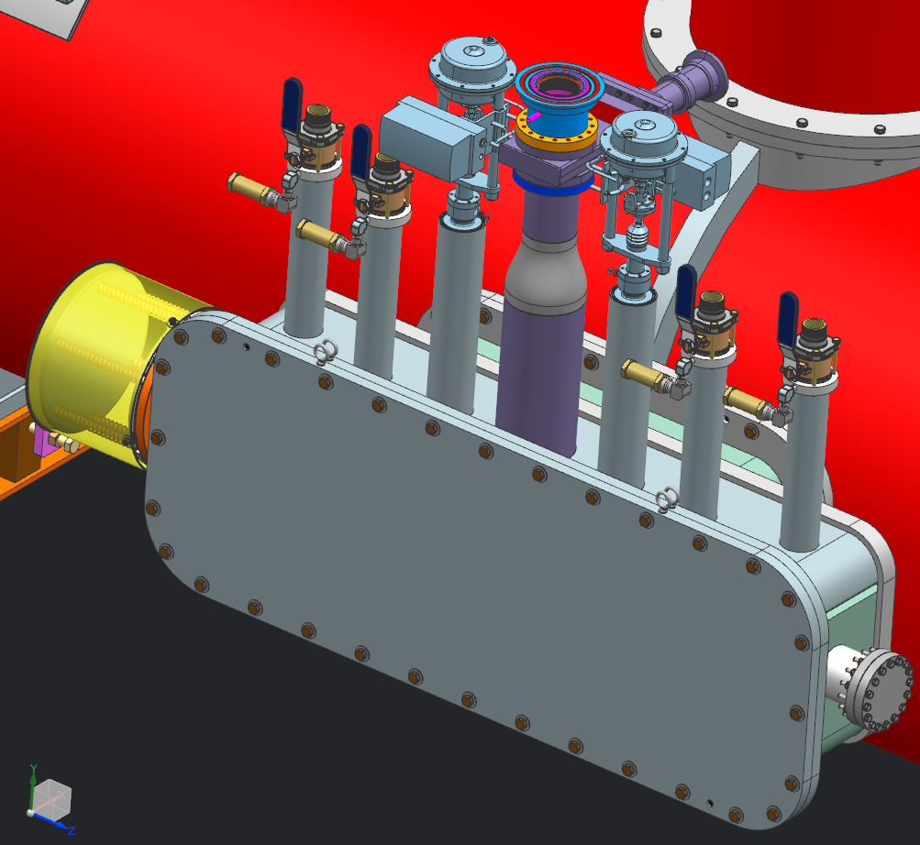
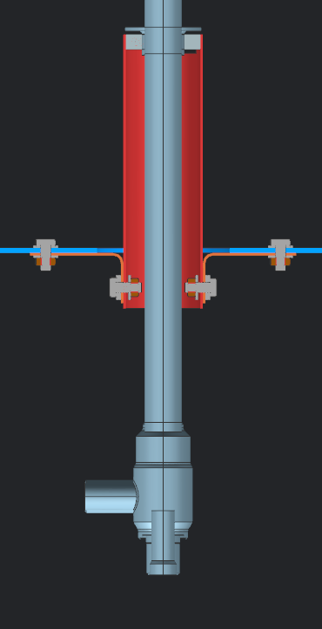
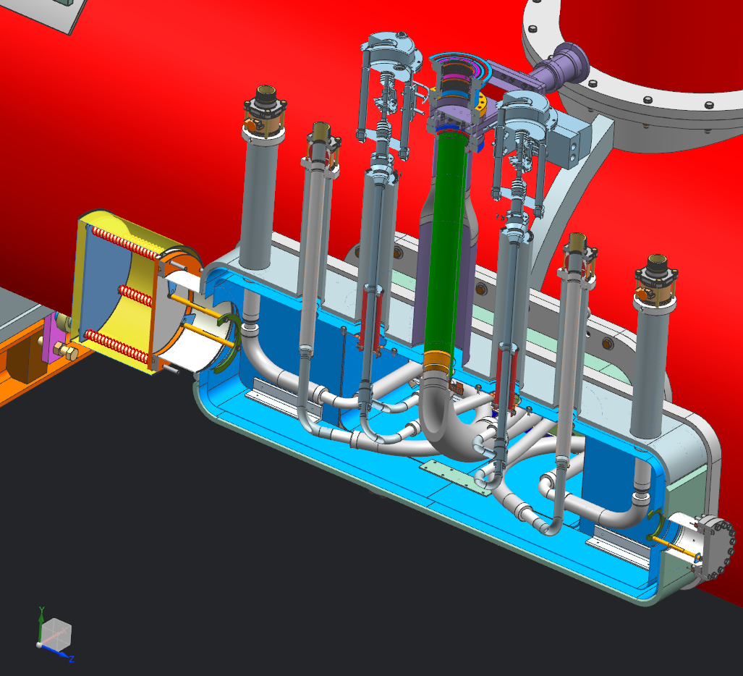
3. Cryomodule - Design strategy
3.8 LCLS II Experience
The cryogenic valves have been set up in the same way as LCLS II cryomodule:
Thermal intercepts
Helium guard with VCR fitting
Outlet
Inlet

Slide 26
3. Cryomodule - Design strategy
3.9 Design status
SSR1 Cryomodule
HB650 Cryomodule
Current leads: to be finalized
Insertion tooling: to be finalized
Vacuum vessel: calculations and engineering note need to be updated
Magnetic shield: Design and calculations need to be finalized
Assembly process: A complete procedure need to be done
Alignment strategy: A complete procedure need to be written
Coldmass design in progress
Insertion tooling to be done
Vacuum vessel: design, calculations and engineering note
Alignment strategy
…

Slide 27
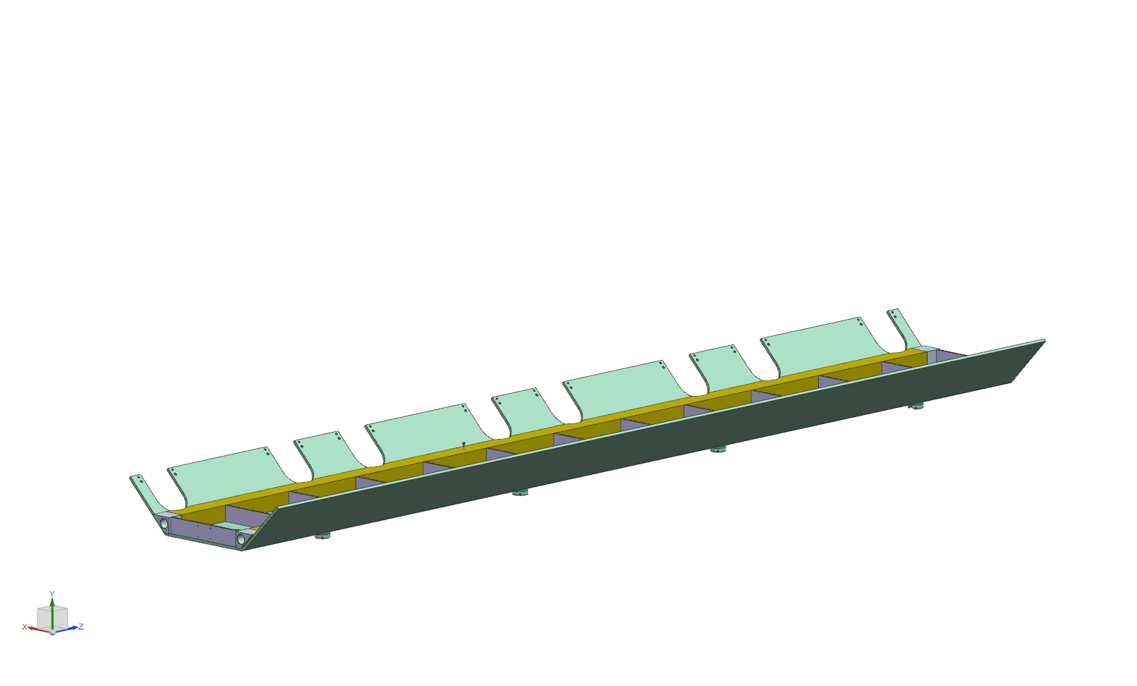
4. Assembly process - SSR1 cryomodule

Slide 28
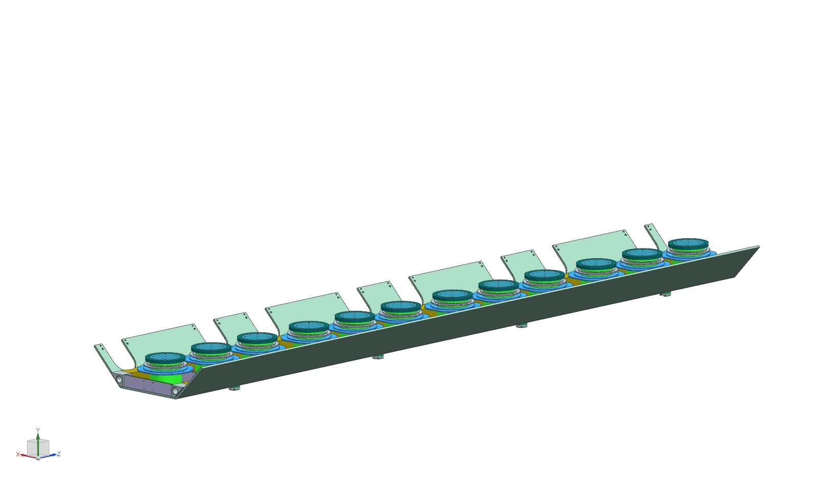
4. Assembly process - SSR1 cryomodule

Slide 29
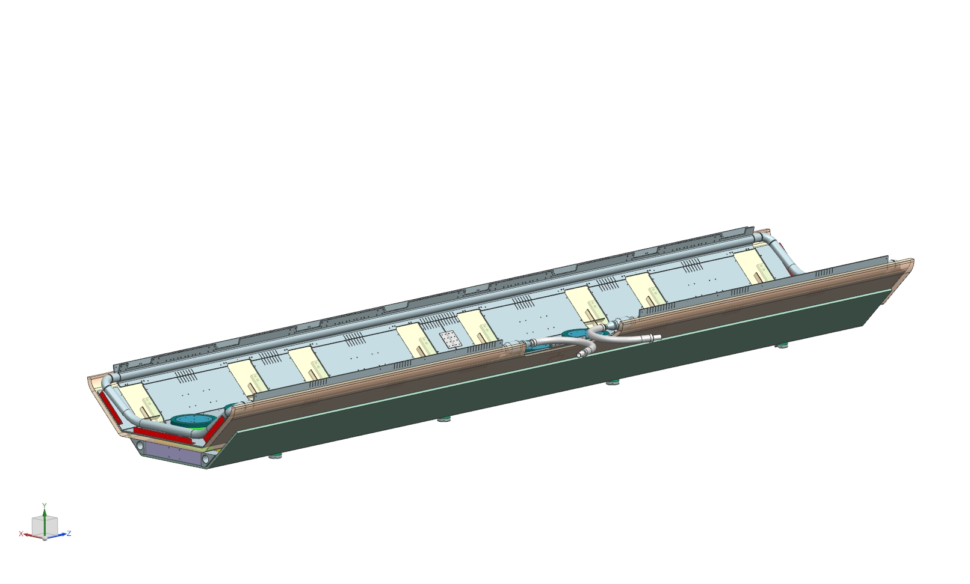
4. Assembly process - SSR1 cryomodule
A company will deliver the lower part of the thermal shield in a single piece.
A leak test and a pressure test will be done during the manufacturing.
Design pressure: 20 barg

Slide 30
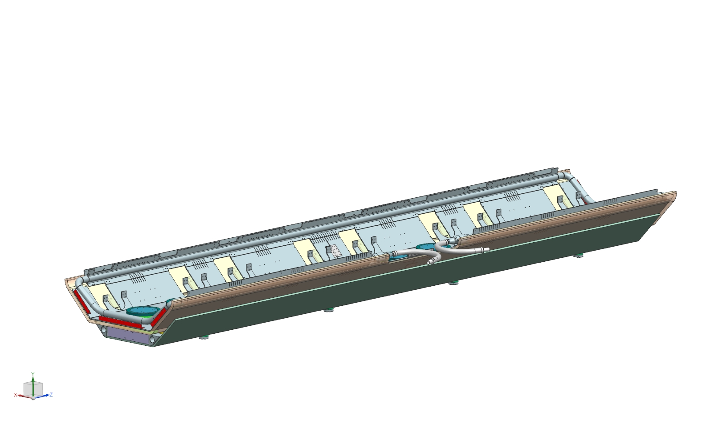
4. Assembly process - SSR1 cryomodule

Slide 31
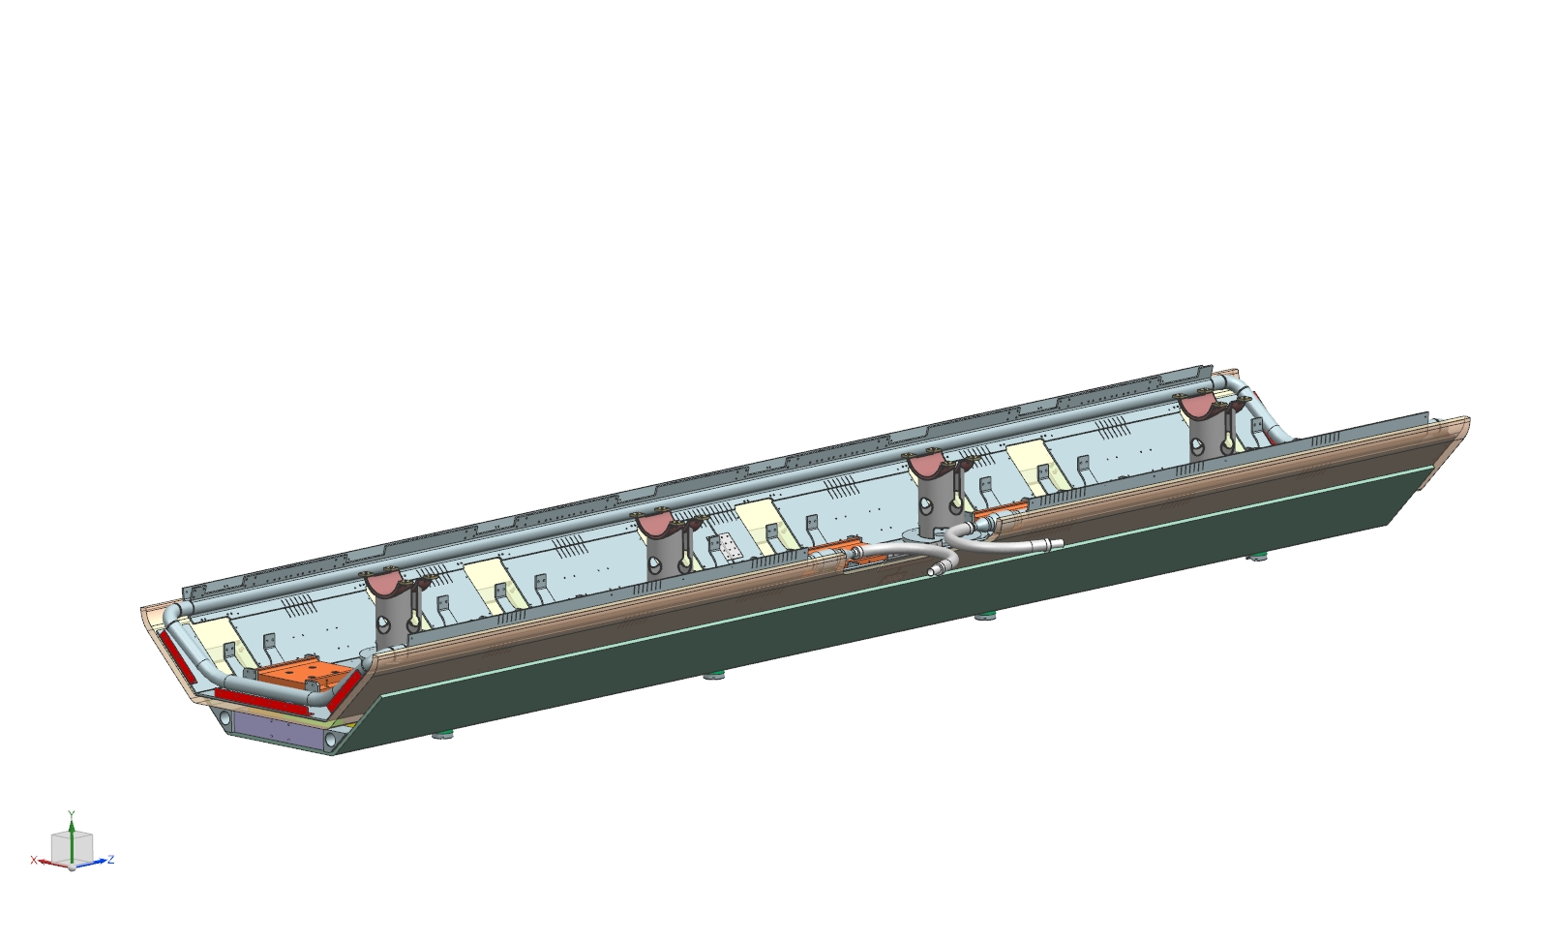
4. Assembly process - SSR1 cryomodule

Slide 32
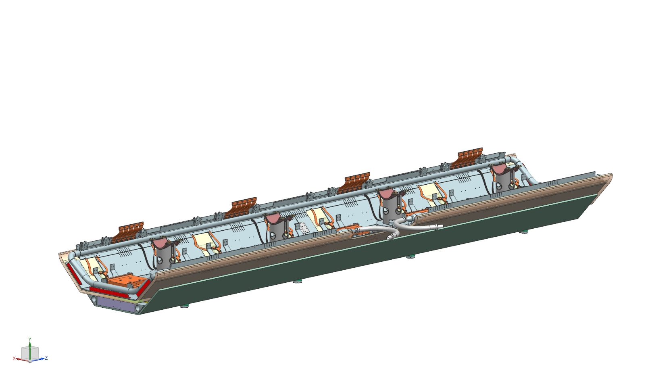
4. Assembly process - SSR1 cryomodule
The thermal straps will be set up on the lower thermal shield using Indium.

Slide 33
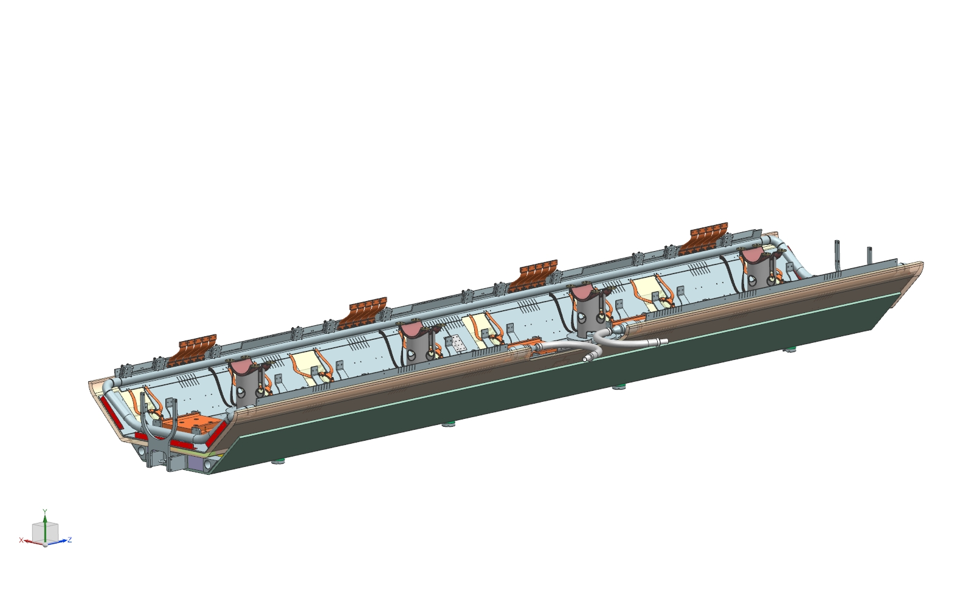
4. Assembly process - SSR1 cryomodule

Slide 34
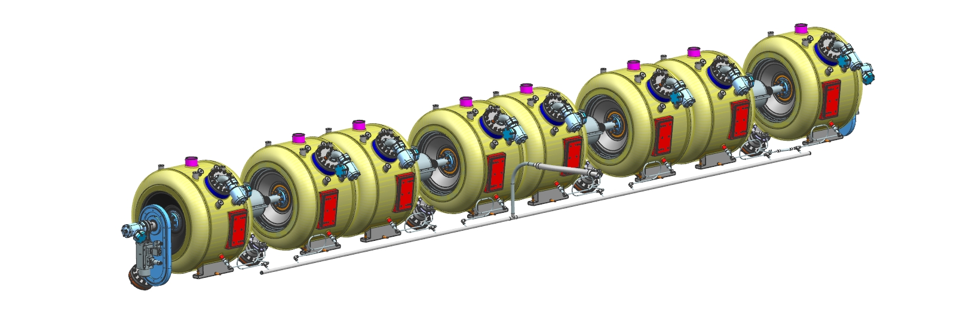
4. Assembly process - SSR1 cryomodule
A company will deliver the cool down line in a single piece.
A leak test and a pressure test will be done during the manufacturing.
Design pressure of the cool down line: 20 barg
The cool down line will be welded to the cavities at Fermilab.
Design pressure of the weld making the connection with the dressed cavities: 2.05 barg at warm, 4.1 barg at cold

Slide 35
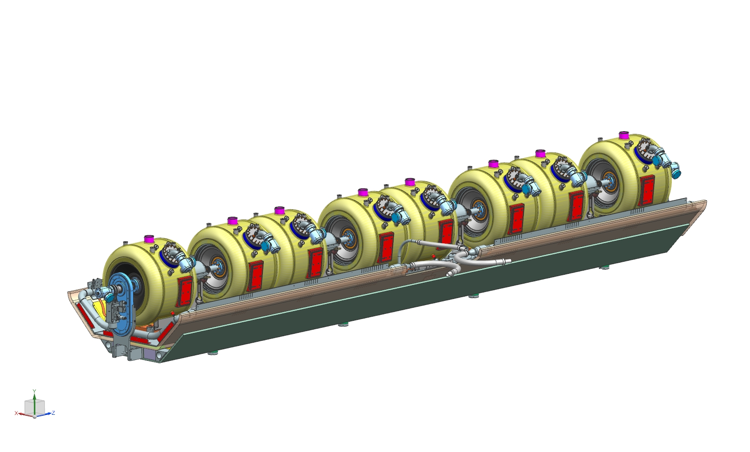
4. Assembly process - SSR1 cryomodule

Slide 36

4. Assembly process - SSR1 cryomodule
Rough alignment of the cavities and solenoids with regards to the strong-back taking into account the shift due to the thermal contraction during the cool-down.
RF measurements.

Slide 37
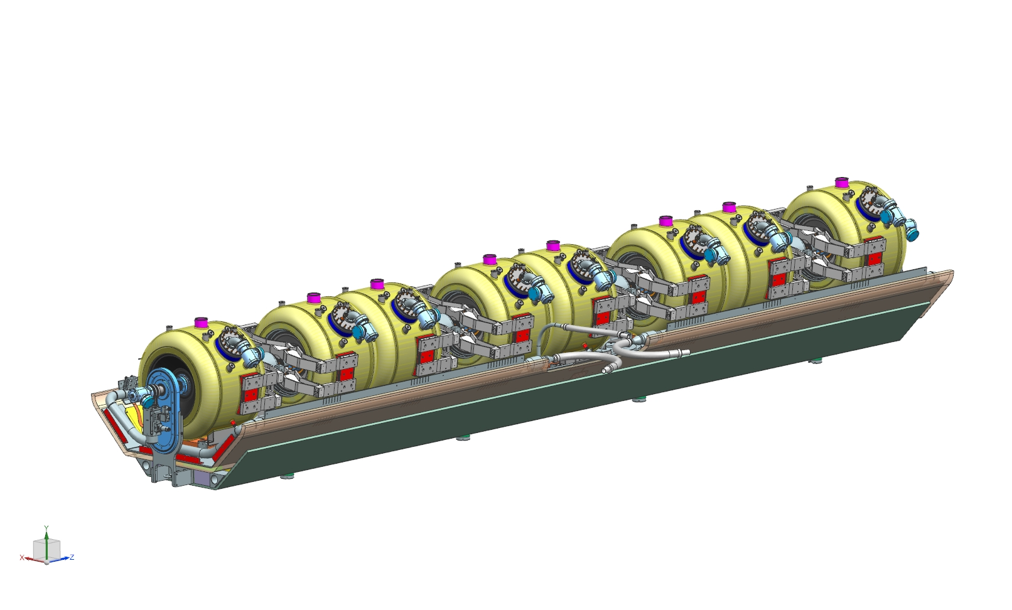
4. Assembly process - SSR1 cryomodule

Slide 38
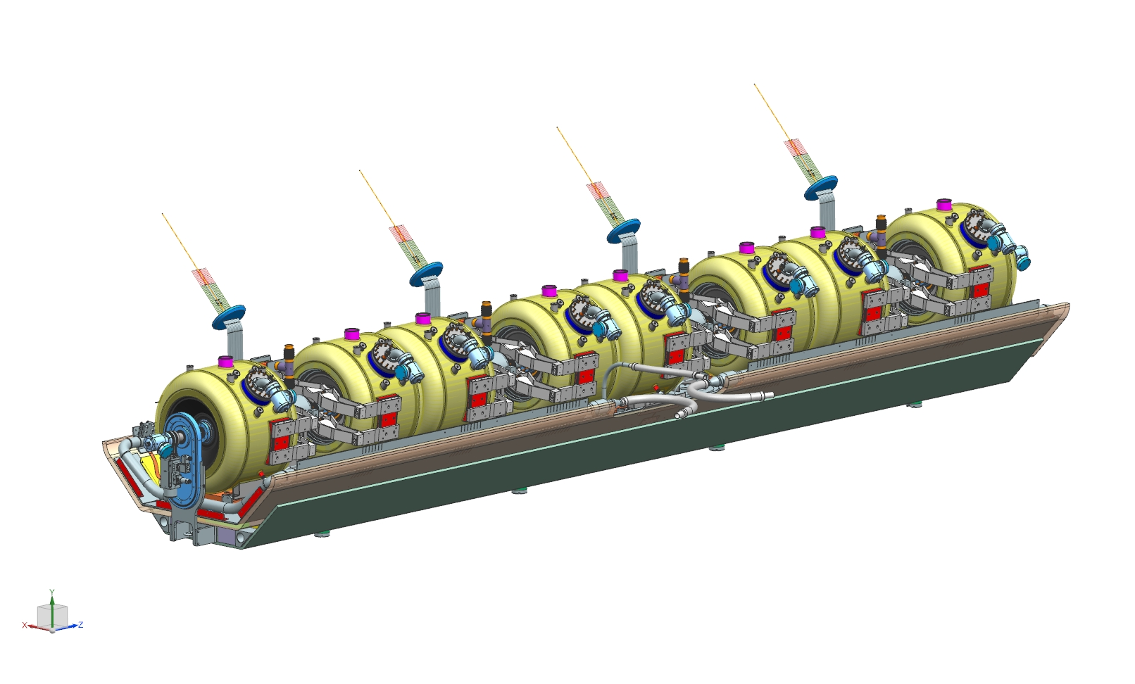
4. Assembly process - SSR1 cryomodule

Slide 39

4. Assembly process - SSR1 cryomodule

Slide 40
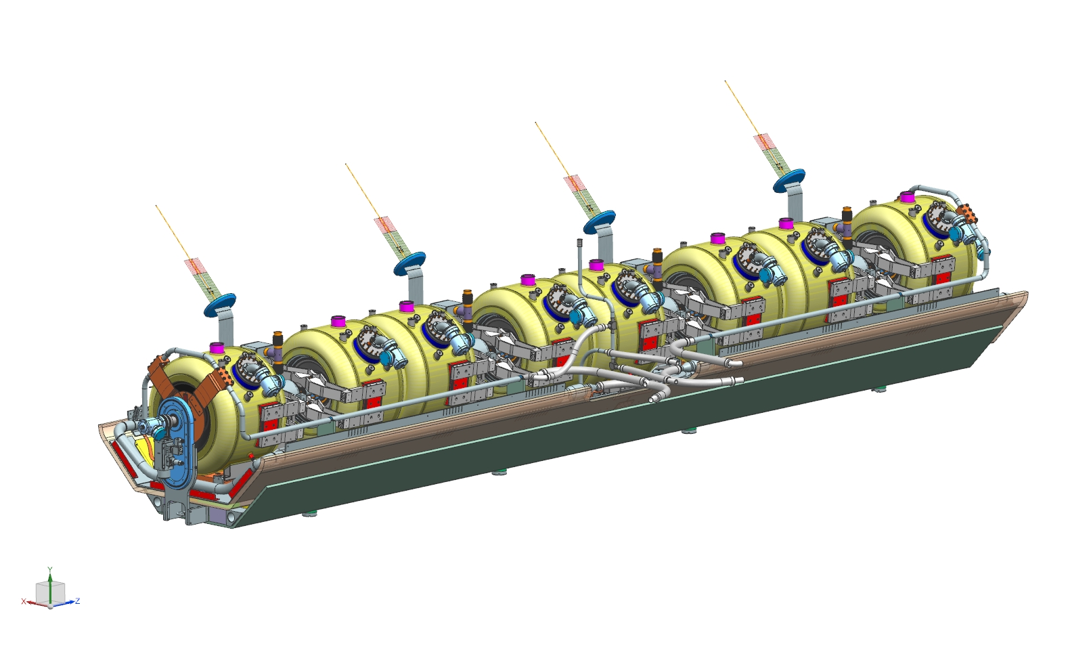
4. Assembly process - SSR1 cryomodule
The 5 K lines and 2K lines will be leak-tested by the manufacturer.

Slide 41
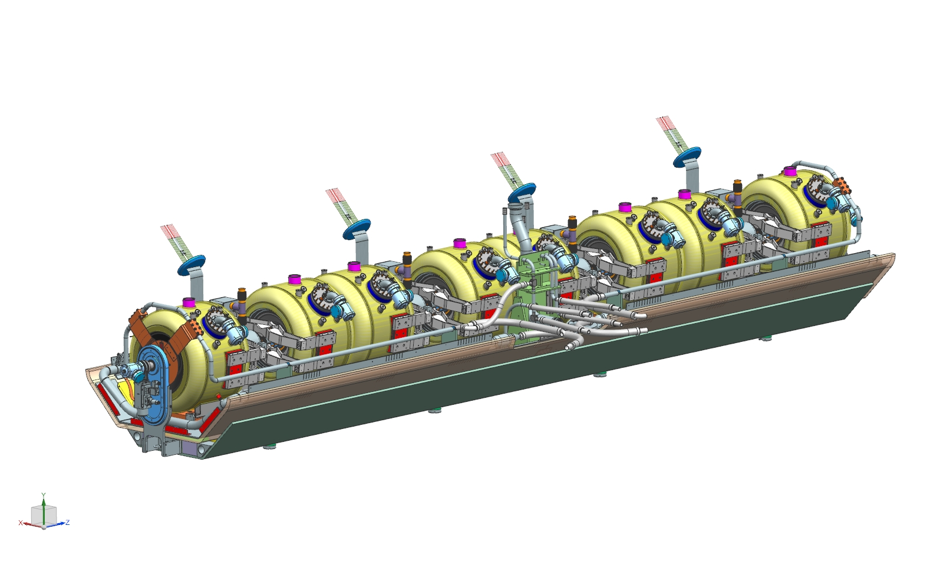
4. Assembly process - SSR1 cryomodule

Slide 42
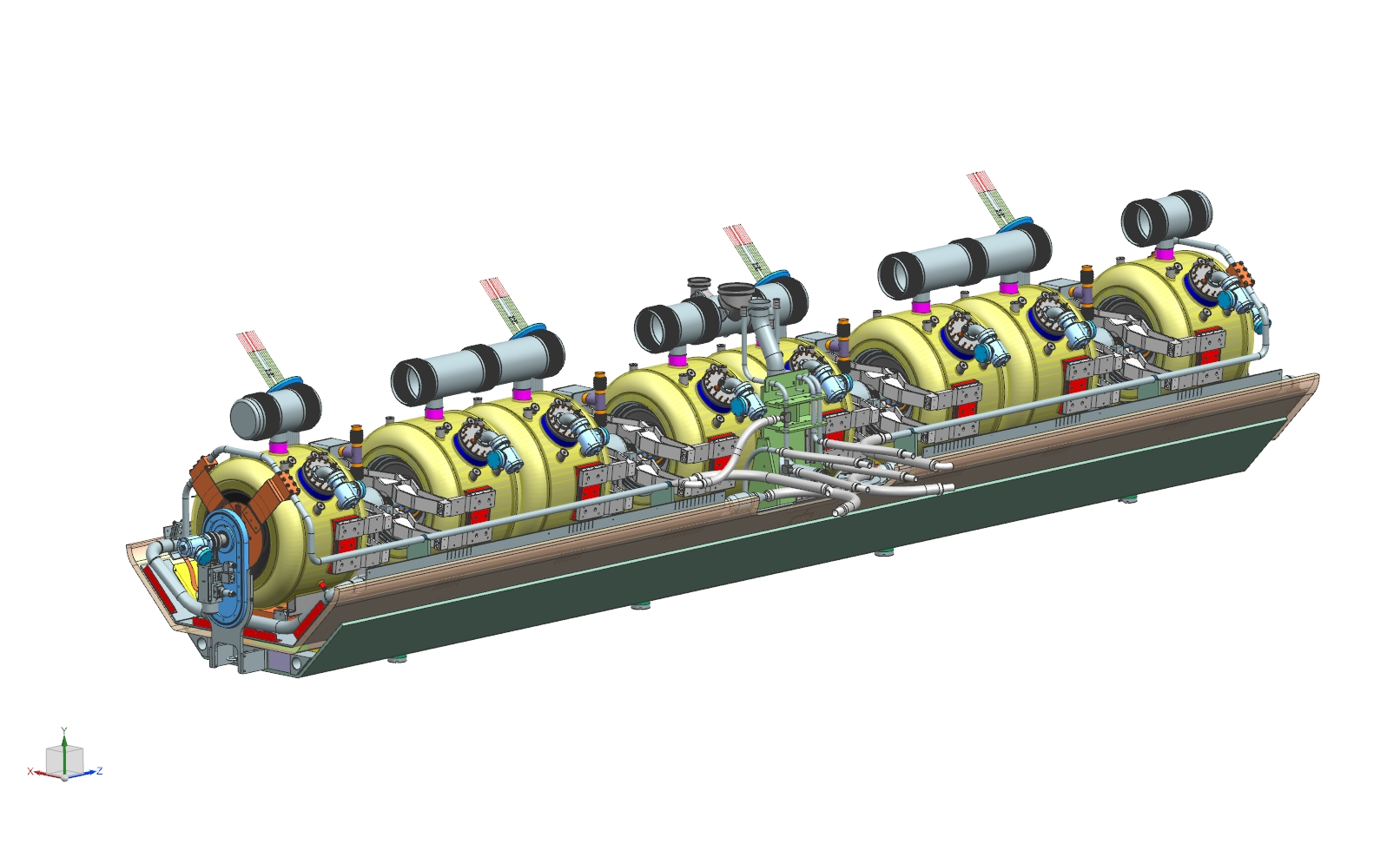
4. Assembly process - SSR1 cryomodule

Slide 43
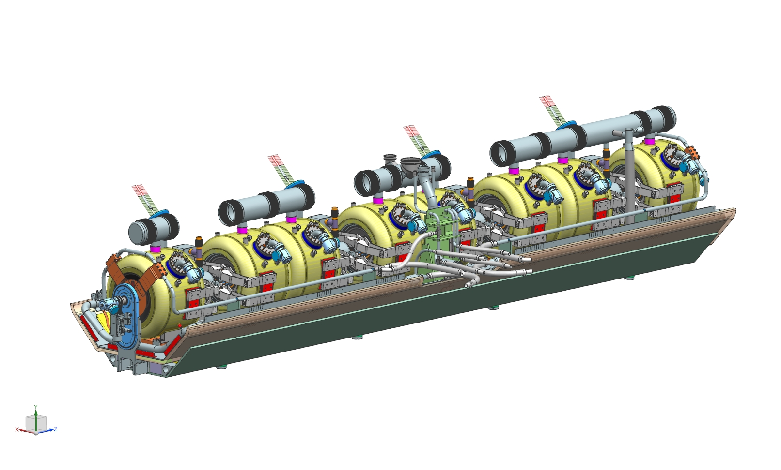
4. Assembly process - SSR1 cryomodule

Slide 44
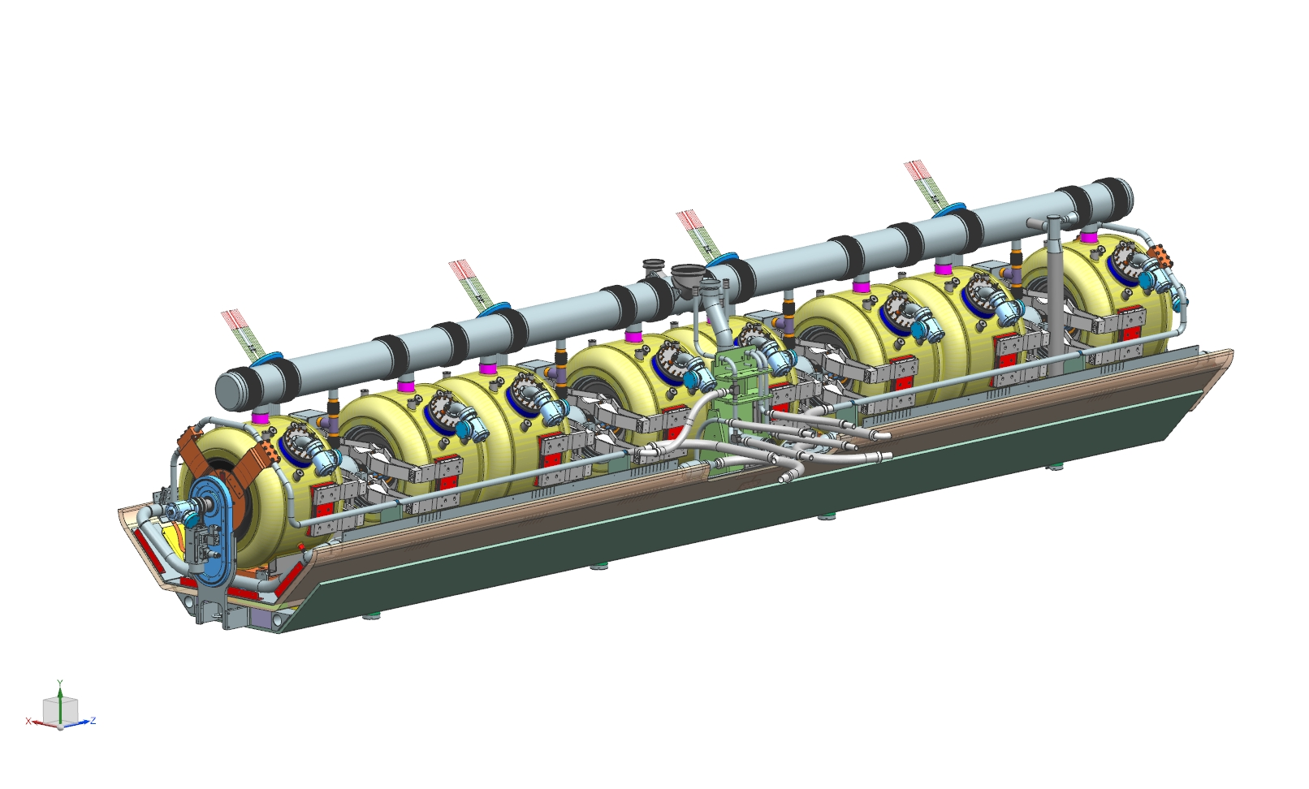
4. Assembly process - SSR1 cryomodule

Slide 45
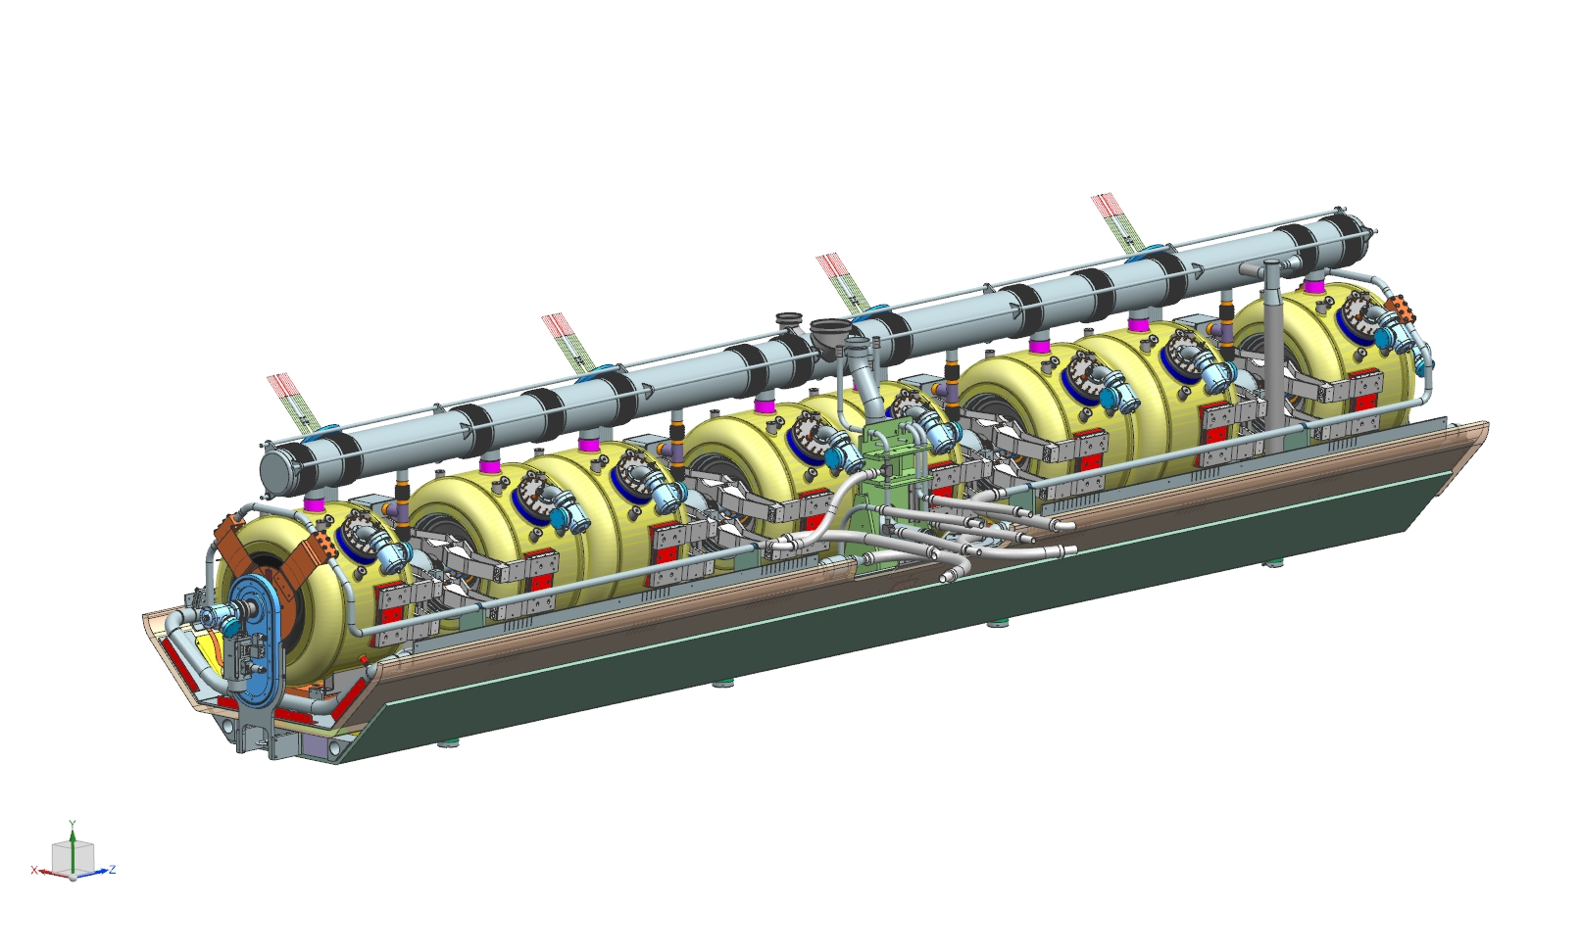
4. Assembly process - SSR1 cryomodule

Slide 46
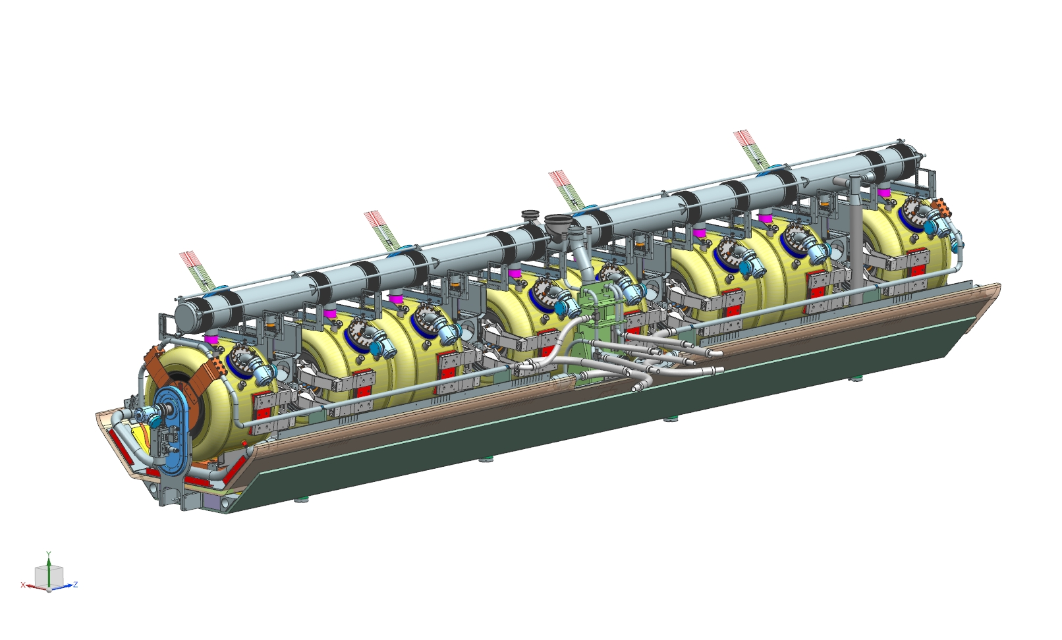
4. Assembly process - SSR1 cryomodule
Final alignment of the cavities and solenoids with regards to the strong-back taking into account the shift due to the thermal contraction during the cool-down.
RF measurements.

Slide 47
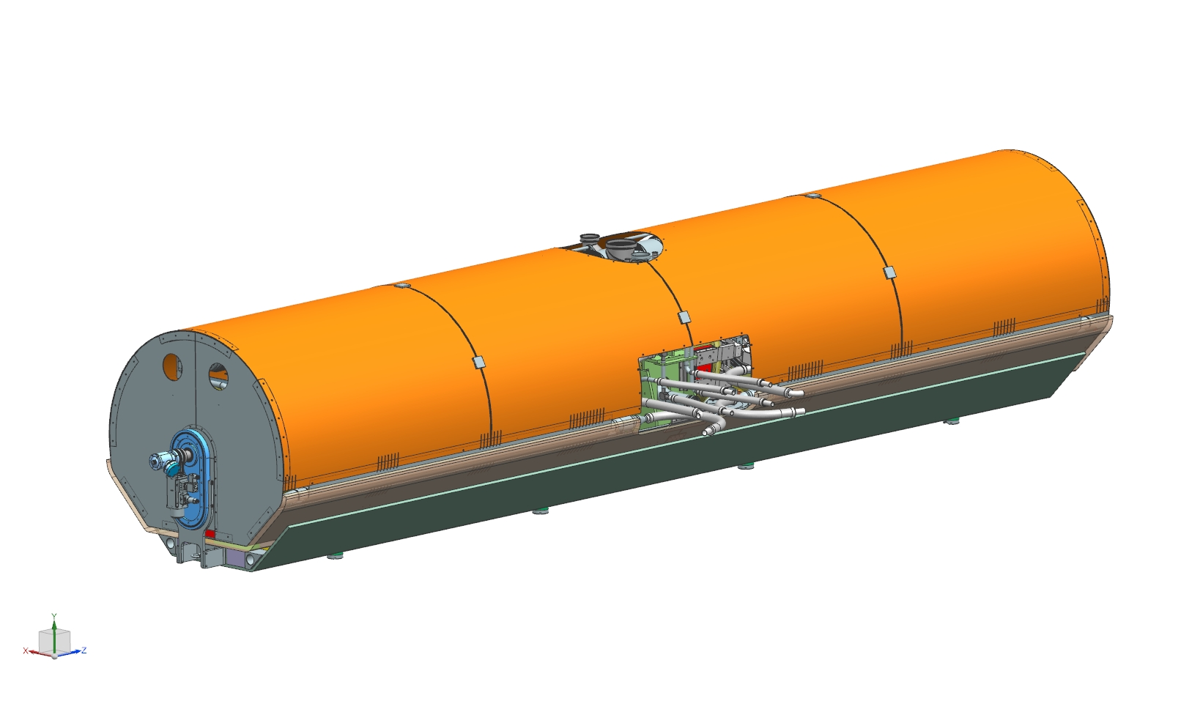
4. Assembly process - SSR1 cryomodule

Slide 48
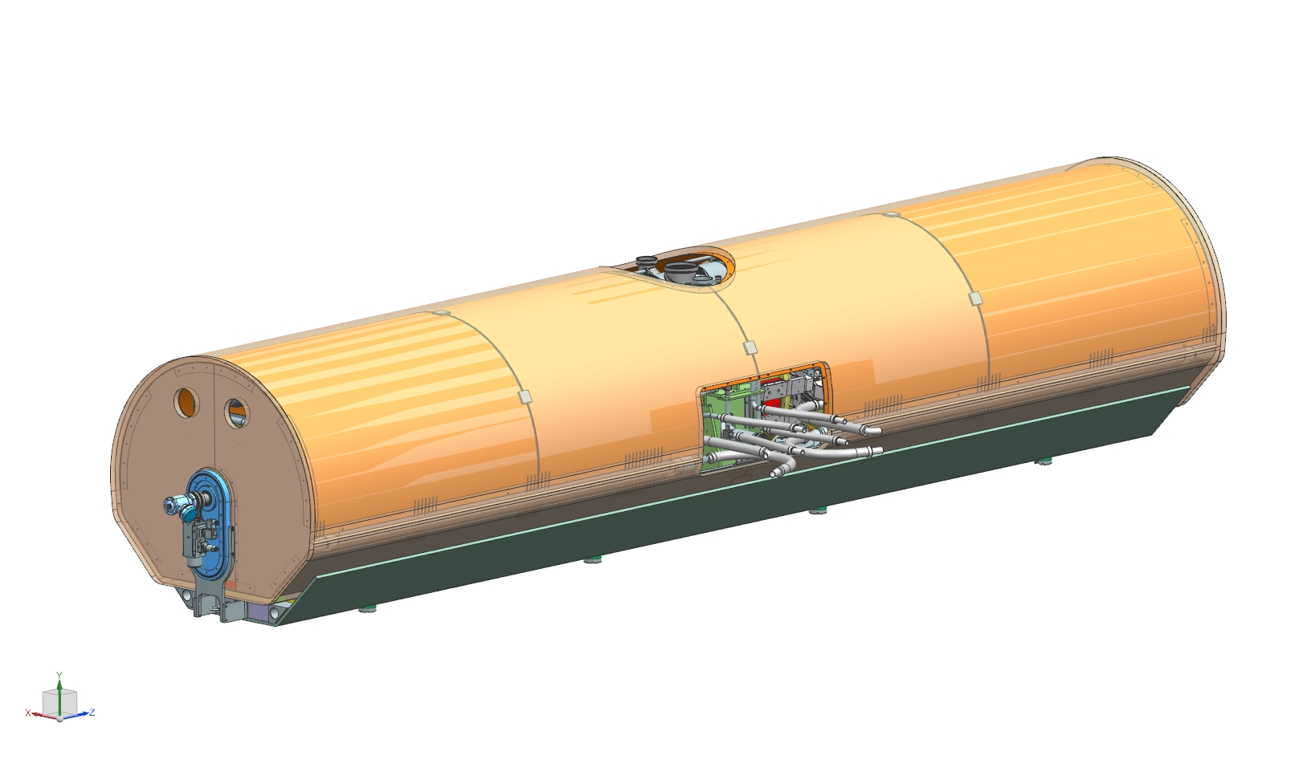
4. Assembly process - SSR1 cryomodule

Slide 49
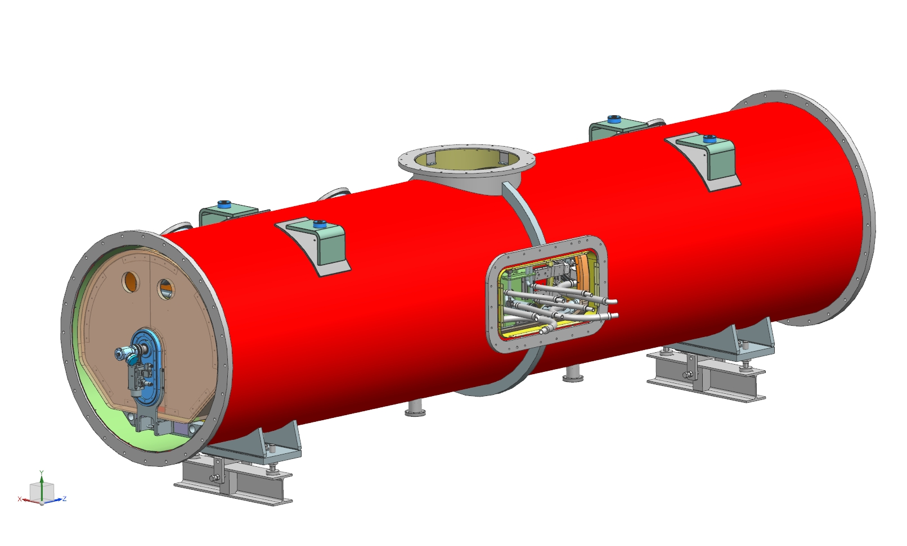
4. Assembly process - SSR1 cryomodule
Alignment of the coldmass with regards to the vacuum vessel taking into account the shift due to the thermal contraction during the cool-down.

Slide 50

4. Assembly process - SSR1 cryomodule

Slide 51

4. Assembly process - SSR1 cryomodule
RF measurements.

Slide 52

4. Assembly process - SSR1 cryomodule

Slide 53

4. Assembly process - SSR1 cryomodule

Slide 54

4. Assembly process - SSR1 cryomodule

Slide 55

4. Assembly process - SSR1 cryomodule

Slide 56

4. Assembly process - SSR1 cryomodule

Slide 57

4. Assembly process - SSR1 cryomodule
A pressure test of the 35-50 K line will be performed at 22 barg.

Slide 58

4. Assembly process - SSR1 cryomodule

Slide 59

4. Assembly process - SSR1 cryomodule

Slide 60

4. Assembly process - SSR1 cryomodule

Slide 61

4. Assembly process - SSR1 cryomodule

Slide 62

4. Assembly process - SSR1 cryomodule

Slide 63

4. Assembly process - SSR1 cryomodule
A pressure test of the 5 K line will be performed at 22 barg.
The cryogenic valves will be closed.
Radiographic tests will be needed on two welds between the CD valve and cool down line.

Slide 64

4. Assembly process - SSR1 cryomodule

Slide 65

4. Assembly process - SSR1 cryomodule

Slide 66

4. Assembly process - SSR1 cryomodule

Slide 67

4. Assembly process - SSR1 cryomodule

Slide 68

4. Assembly process - SSR1 cryomodule

Slide 69

4. Assembly process - SSR1 cryomodule

Slide 70

4. Assembly process - SSR1 cryomodule
A leak test of the two phase helium pipe volume will be done.

Slide 71

4. Assembly process - SSR1 cryomodule

Slide 72

4. Assembly process - SSR1 cryomodule

Slide 73

4. Assembly process - SSR1 cryomodule

Slide 74

4. Assembly process - SSR1 cryomodule
The connection between the support of the beam pipe end and the strong-back will be removed thanks to an opening in the vacuum vessel.
The vacuum vessel will be under vacuum while a pressure test of the two phase helium pipe volume will be done at 1.27 barg. The cryogenic pipes and cavities will see a pressure of 2.27 barg. RF measurements will be done.

Slide 75
4. Assembly process - SSR1 cryomodule
After completion, the cryomodule will be transported to the test station at PIP2IT, and then in PIP-II tunnel. The transport being done at Fermilab, the risk is limited.
So far, no calculations or analysis has been done concerning the transport of PIP II cryomodule.

Slide 76
5. Conclusion
This first SSR1 cryomodule will validate our design strategy and also the cryogenic design. This cryomodule is unique, the strong-back, the alignment process, the current leads, and of the course the cavities with the couplers and tuners.
Many analysis have been done and need to be confirmed by manufacturing and by testing this 1st cryomodule.
Then, we could think about improvements, and production.
by supporting the coldmass thanks to a strong-back at room temperature.
and also the cryogenic design: heat loads, vibrations,

