Slide 1
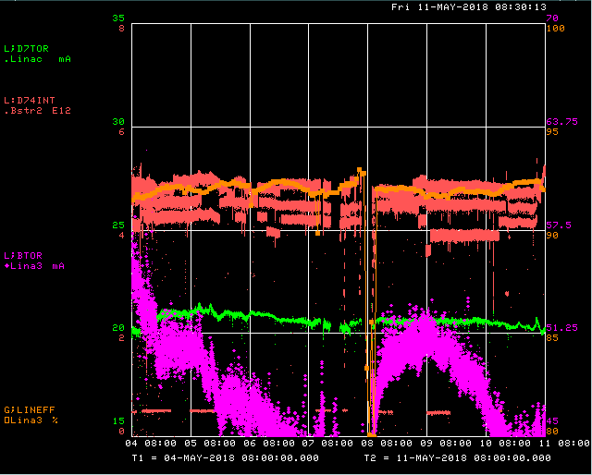
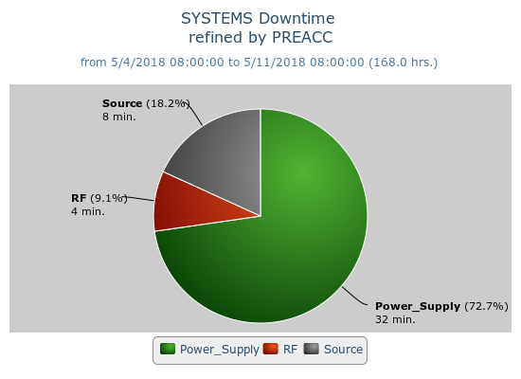
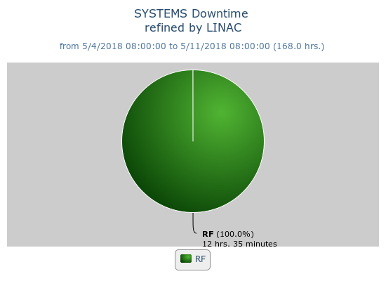
Preacc/Linac Weekly Performance
Monday – KRF5 Slow Start Controller failure
Tuesday – KRF5 recovery, Replaced LRF1 Quad D/A

Slide 2
Current Conditions/Plans
Source B – 45 mA
Linac input – 22 mA
Linac output – 20 mA, ~5E12 p/pulse
Downtime/Studies requests:
5 min. to access Source B HV cabinet
15 min. 5 Hz beam to Linac dump for BBM toroid study

