Slide 1
Muon Campus Status
Jim Morgan
Weekly Status
May 11, 2018

Slide 2
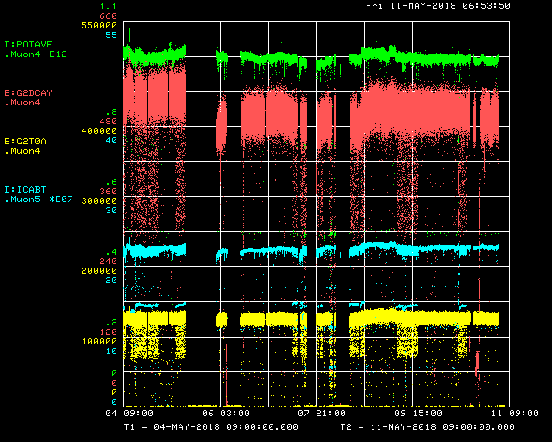
Beam to g-2 this week
Beam from Recycler
g-2 kicker
Decay Positrons
KRF5
Trolley Run/MI Access
g-2 Kicker
KRF5/Trolley Run
g-2 Kicker
Trolley Run/Slow dump/Trolley Runv
Delivery Ring
g-2 T0 Detector

Slide 3
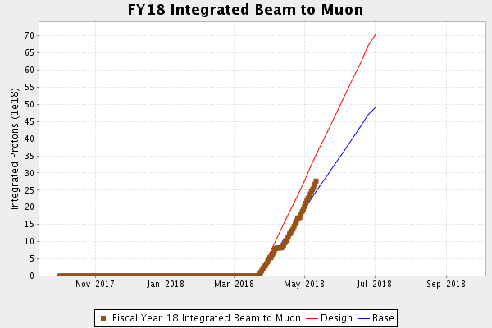
Protons on Target

Slide 4
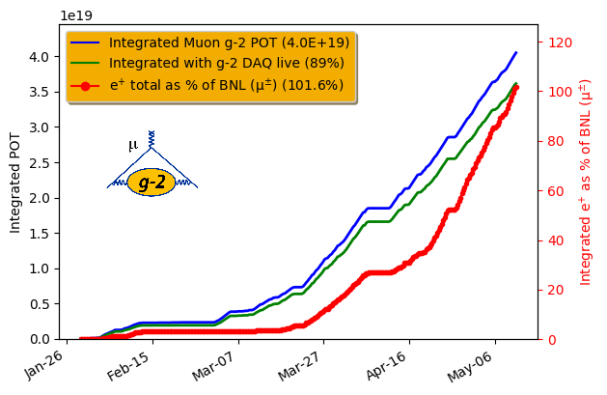
G-2 Experiment summary
Surpassed BNL!

Slide 5
In the past week
Decent up time and muon delivery this week
Gathered data to pinpoint source of poor transmission on cycle(s) after SY120
Nuisance EKIK trips on a Thyratron prefire indication
Added to permit loop to make sure it’s noticed
I:HVF11 has significant 180 Hz ripple
Appears to be source of varying positions on 8 transfers
Noisy dump water flow interlock jumpered
Redundant pressure and temperature interlocks still active
Switched M1 trims from ramped to DC operation
Limited upstairs work planned during today’s MI access

Slide 6
Sharing P1 and P2 Lines with SY120
P1 and P2 Lines are shared between g-2 and SY120
Can’t run both concurrently
SY120 operates at 120 GeV, g-2 beam to target is 8 GeV
Two “switch” magnets powered for g-2, not powered for SY120
V703 is at the junction of the RR to P1 stub and the P1 Line from MI
F17B3 is at the junction of the P2 Line and M1 to g-2 and P3 to Switchyard
The R:V703 and I:F17B3 power supplies can’t ramp up fast enough to allow all possible cycles to be sent to g-2
Three cycles are lost after SY120 cycle
Beginning of SY120 spill can be affected by decaying tail of R:V703 and I:F17B3
MI SY120 cycles is 5.5 seconds, NuMI/g-2 cycles 1.4 seconds
Expected to lose 4 cycles when SY120 runs (4/43 = 9.3%)
Currently go from 43 to 36 events in TLG when SY120 runs (7/43 = 16.3%)

Slide 7
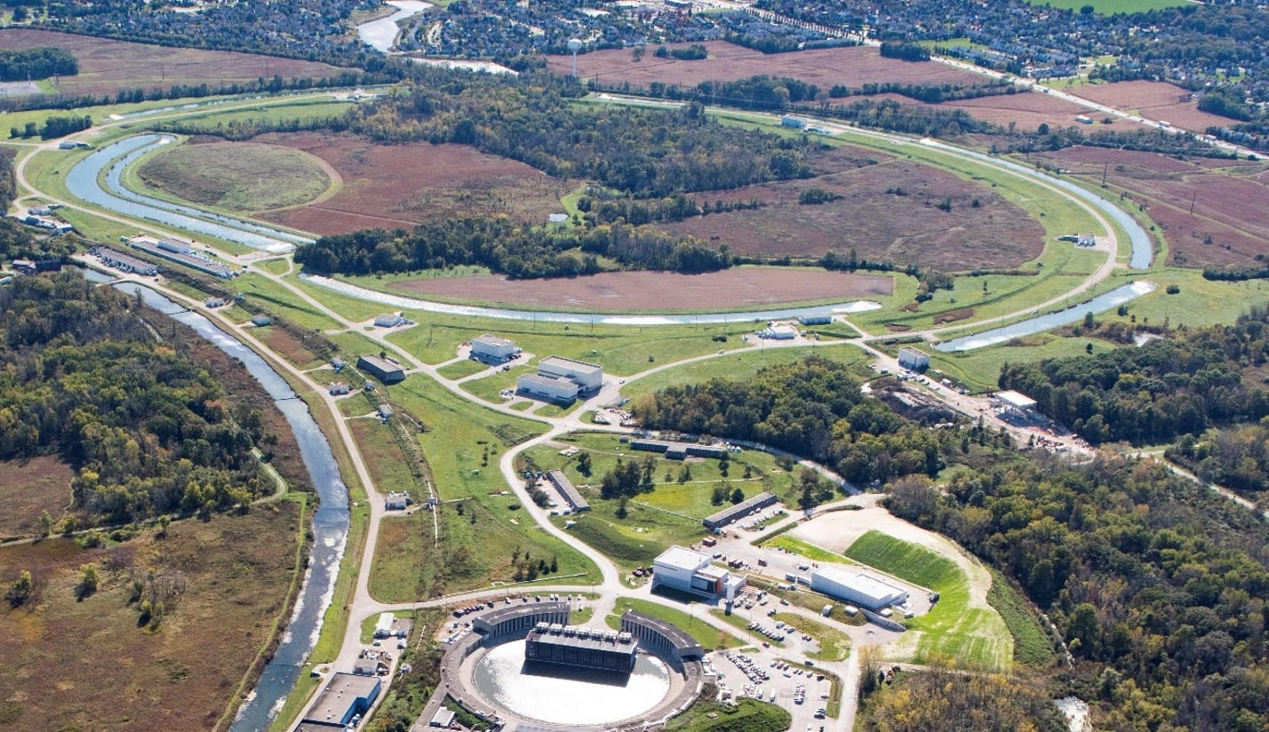
Beam Path to Muon and Switchyard
V703
Recycler
F17B3
P1, P2, M1
M2
AP0
target
hall
Delivery Ring
M3
AP50
M4
AP30
AP10
P3
M5
Mu2e
MC-1
(g-2)

Slide 8
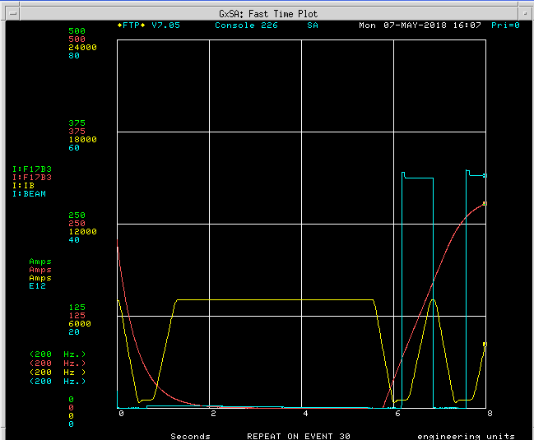
SY120 Effect
I:F17B3, bends beam
From P2 into M1
16 bunch operation March 22
SY120 cycle
Spill to Switchyard

Slide 9
Unexpected SY120 Effect
There is also a loss of yield on (mainly) the first g-2 cycle after SY120 cycle
First g-2 cycle is down about 50%, next several have minor loss of flux
Beam measurements seem to exonerate everything
BPM’s look the same, wires show the same positions and beam widths
Wires in (secondary) M2/M3 Lines show lower intensity and shifted horizontal position, Ion Chambers show lower intensity
Creating gap in TLG of the same size as SY120 event doesn’t change Target Station performance
Have a study plan that explores the event spacing with and without SY120 more thoroughly

Slide 10
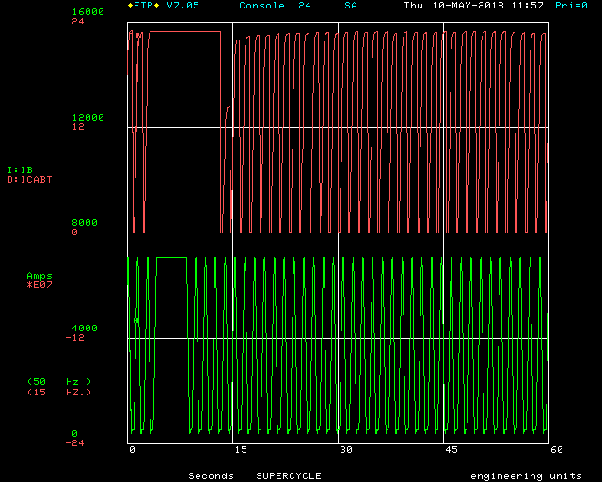
SY120 Effects
Beam in Delivery Ring
SY120
Main Injector ramp

