Slide 1
Main Injector/Recycler
D. Capista
Friday Operations Meeting
11 May 2018

Slide 2
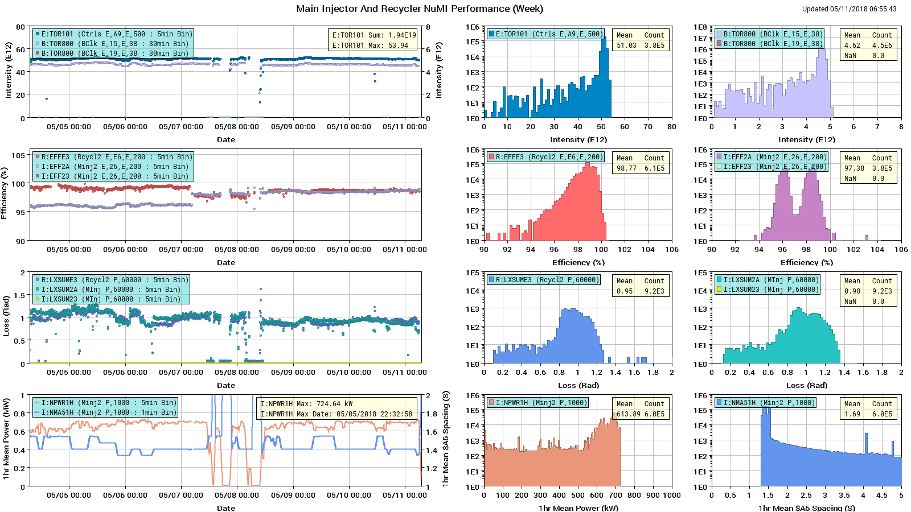
NuMI Performance

Slide 3
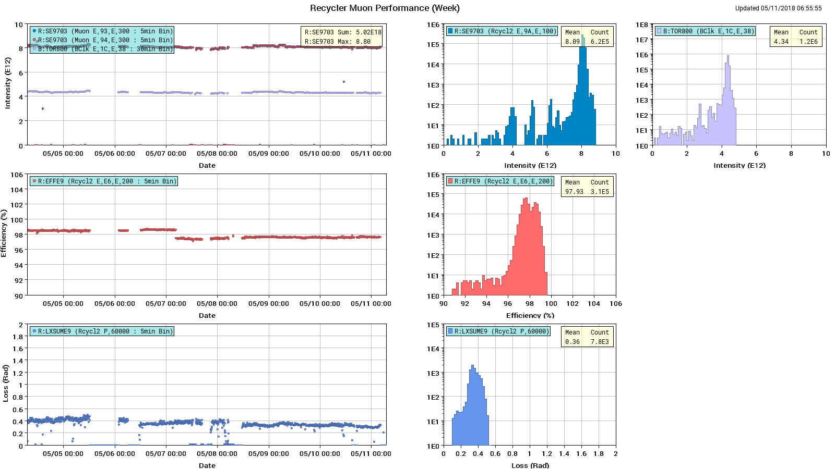
Muon Performance

Slide 4
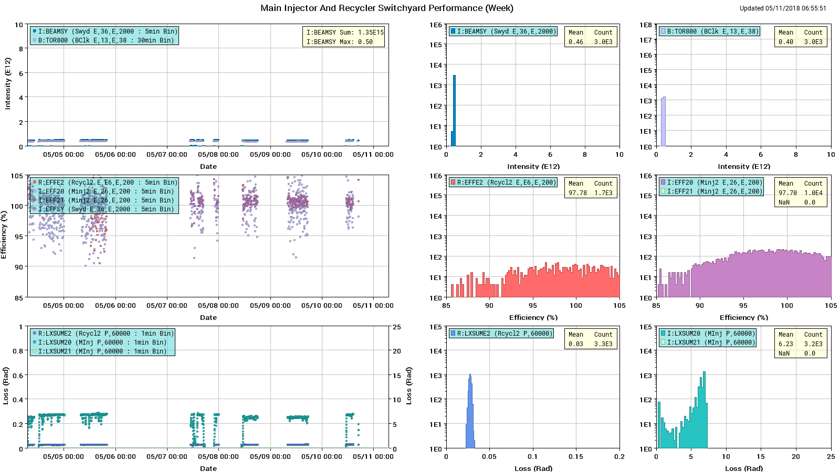
SY Performance

Slide 5
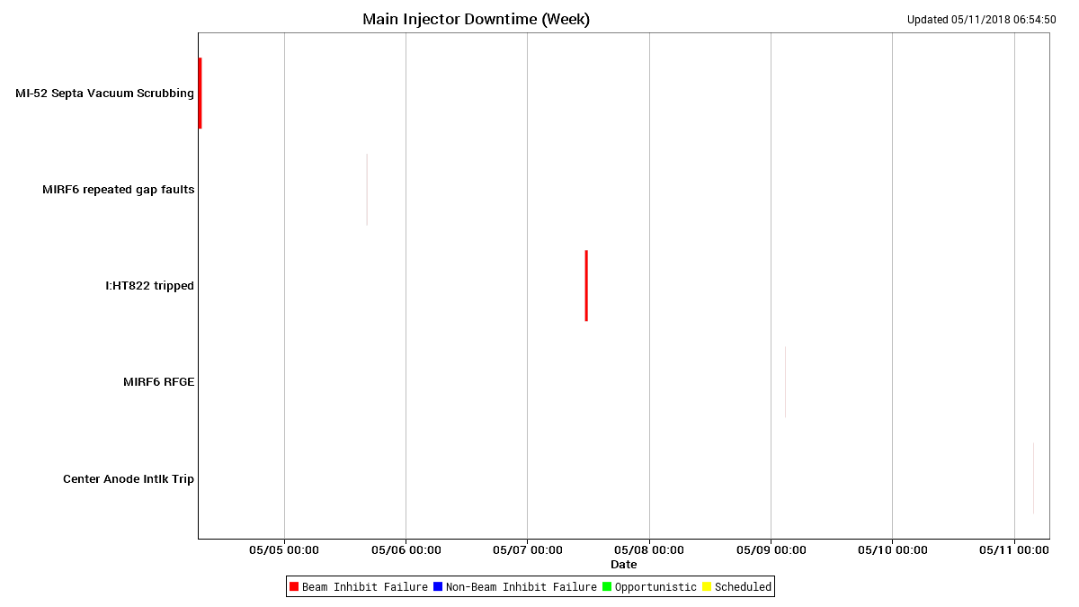
Downtime MI

Slide 6
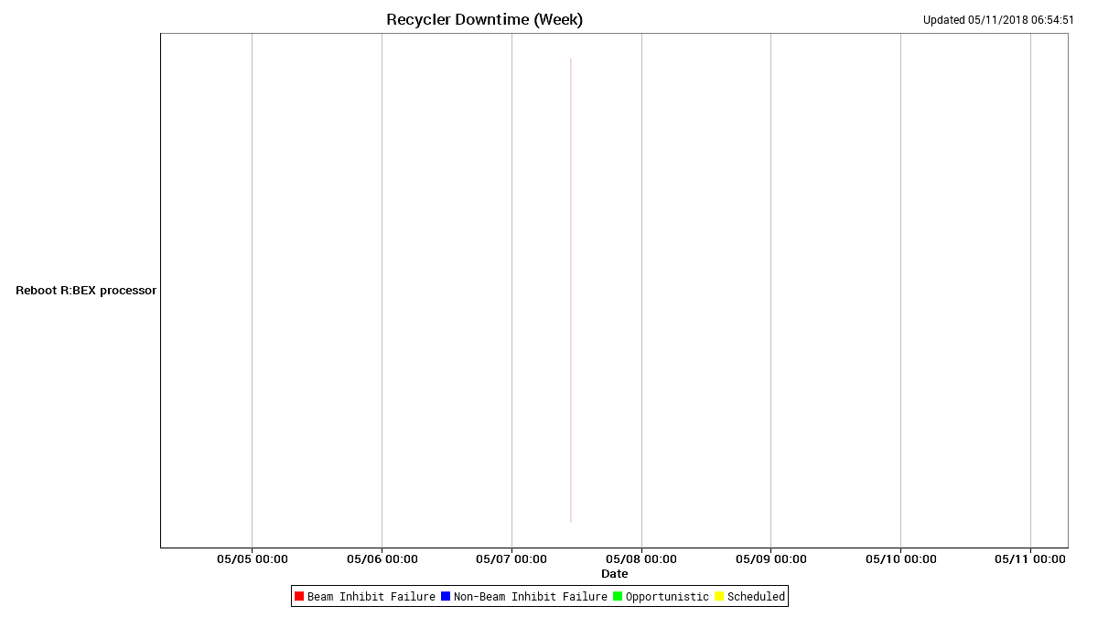
Downtime RR

Slide 7
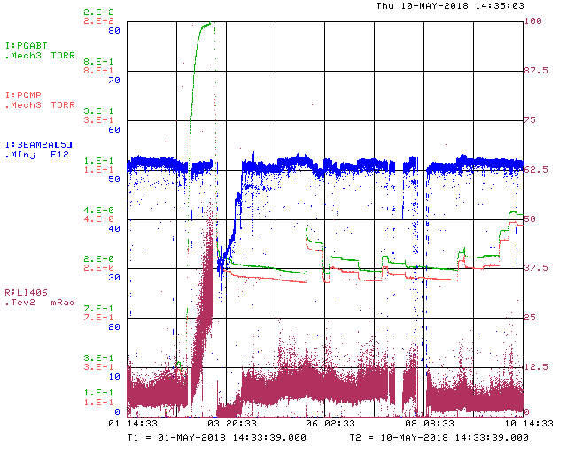
Abort Line Vacuum and Losses

Slide 8
Next Week
Studies
  1.2 sec fast ramp.
  MI TBT lattice measurement
    8-GeV.
    Use $2B ramped 1.67 second cycle.
  RR TBT lattice measurement
Vacuum issues
  MI52 septa
    Need more RGA data
  Abort line vacuum

