Slide 1
Accelerator Status Report
Friday 5/11/2018

Slide 2
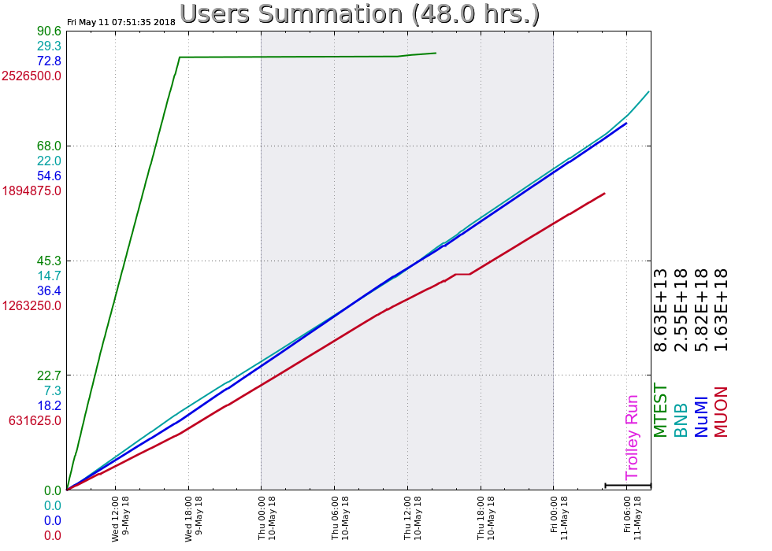
Wednesday
Booster bi-modal losses (different than before, intermittent, ongoing)
Thursday
MI abort line vacuum degrades
Friday
MI access for abort line vacuum
Your Shift Plot
could be here!
Ask me how!
Friday Update

