Slide 1
72 Hour Weekend Summary
Donovan Tooke
Monday 09:00 Meeting
May 14, 2018

Slide 2
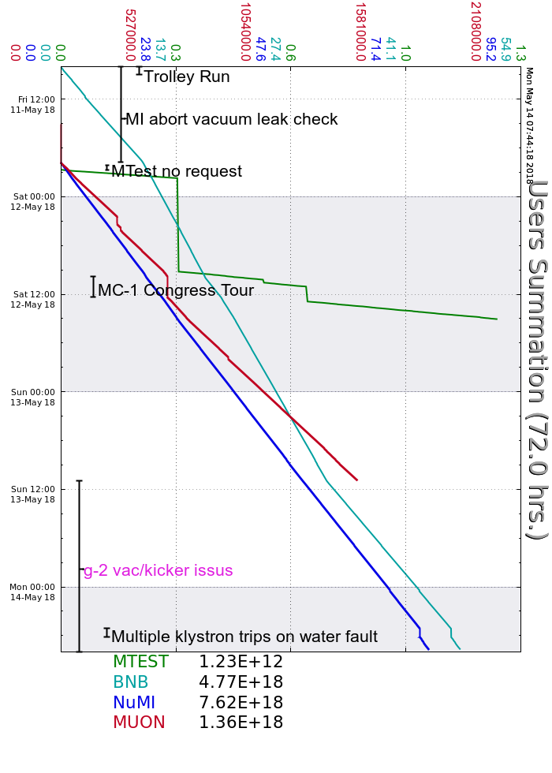
Friday
MI20-62 access for MI abort vac leak repair
Beam to BNB during access
Leak not found. Add’l RP to overpower leak.
Beam to NuMI, g-2, SY about (19:45)
Saturday
D:KPS3E thyratron delay fire issues
Inc Reservoir current 0.1 Amps
MC-1 Open access (congress tour)
BNB Indian Rd Chipmunk ms pls (storm)
P2 line vac burst
MI internal recirc mode (CUB valves clsd)
1 incident of Booster bi-modal
Sunday
MC-1 open access. G-2 vac/kicker issues
NuMI target pressure He bottles replaced
Kly Cooling Skid #1 trip (upstairs)
06:30 Lightning Strike glitch Safety System

Slide 3
Current Conditions
Beam to NuMI (1.333s ramp)
722.3 kWatts
50.3 E12
Beam to BNB
7.84 E16 p/hr
5 Hz
g-2 vac/kicker issues

