Slide 1
Accelerator Division Status
Duane Newhart
All Experimenters’ Meeting/Lab Status Meeting
21 May 2018

Slide 2
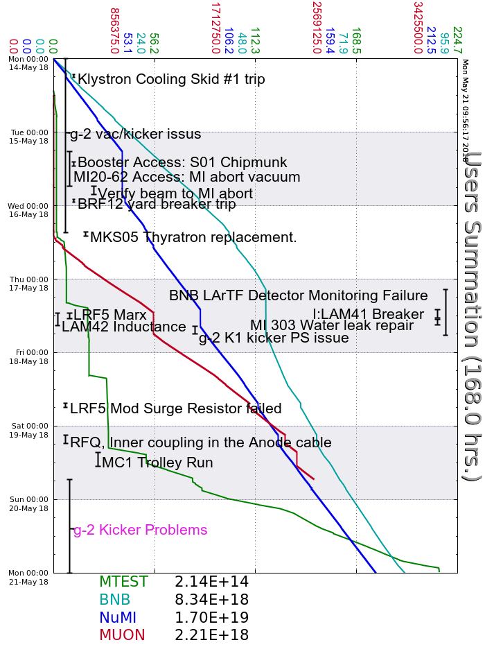
Accelerator Operations Summary
From: May 14, 2018 (0000 hours)
To: May 21, 2018 (0000 hours)
Calendar Week # 20
NuMI Weekly Integrated Intensity 1.70 E19 protons
Beam Hours To NuMI 136.2 hours
BNB Weekly Integrated Intensity 7.81 E18 protons
Beam Hours To BNB 139.5 hours
Muon Weekly Integrated Intensity 2.21 E18 protons
Beam Hours To Muon 102.5 hours
MTest Weekly Integrated Intensity 2.14 E14 protons
Beam Hours To MTest 27.8 hours
MCenter Weekly Integrated Intensity 0.00 E12 protons
Beam Hours To MCenter 0.0 hours

Slide 3
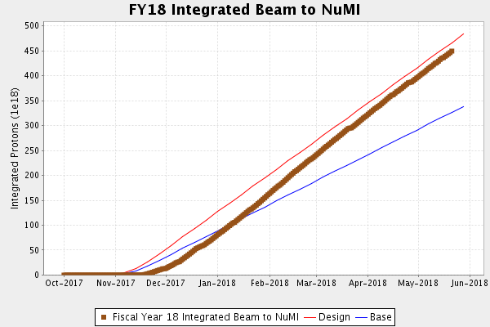
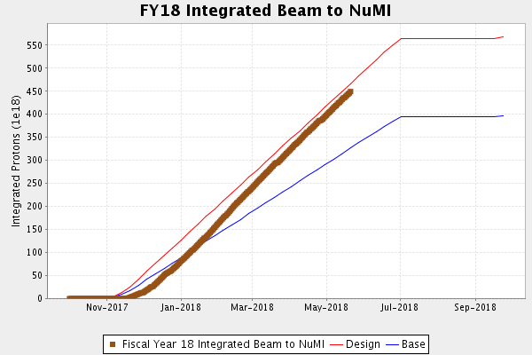
NuMI Operation

Slide 4
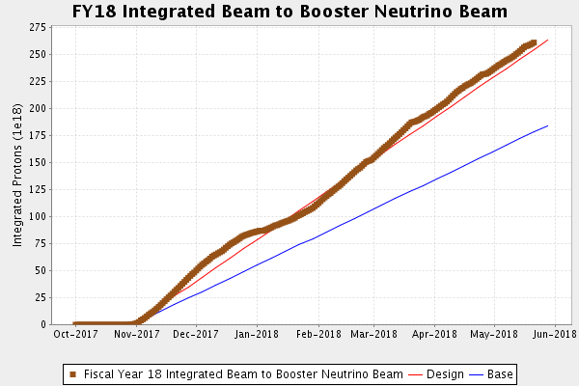
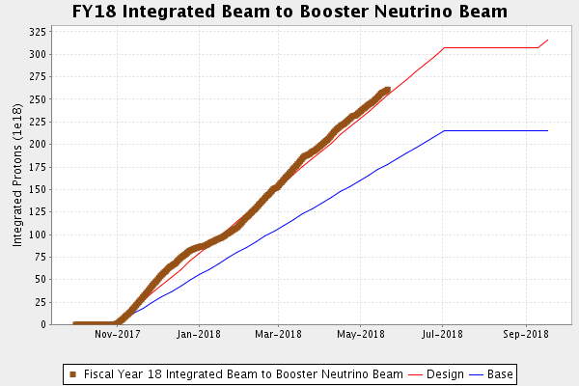
BNB Operation

Slide 5
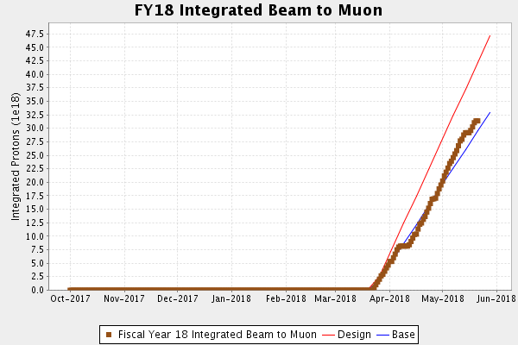
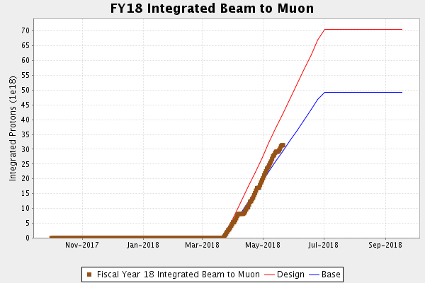
Muon Operation

Slide 6
Complex Status
LINAC
  Klystron RF cooling skid controller repair
  LRF5 Marx connected
    Mod Surge resistor failed/replaced
Booster
  Tuning continues
  Fighting a bi-model loss pattern
MI/RR
  Tuning continues
  MI40 abort vacuum
    Leak found and epoxied
  LAM41 breaker inspection/repair
  LAM42 inductance measurement
NuMI
  Monitoring NuMI target (TA-02) helium leak
Booster Neutrino Beamline (BNB)
  Sump discharge line break
    Off much of Thursday
Switchyard
  Meson Test operating
Muon Campus
  G-2 not taking beam
    Kicker issues developed over the weekend
General
  Items on the horizon
    MI40 abort line spool-piece
    TLG reboot

Slide 7
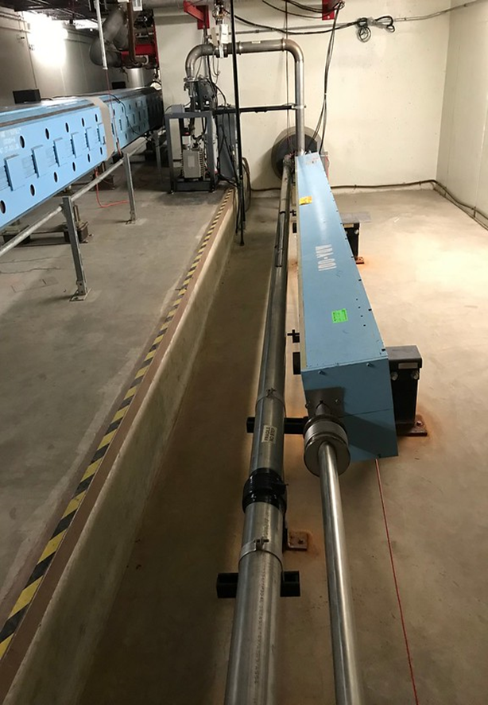
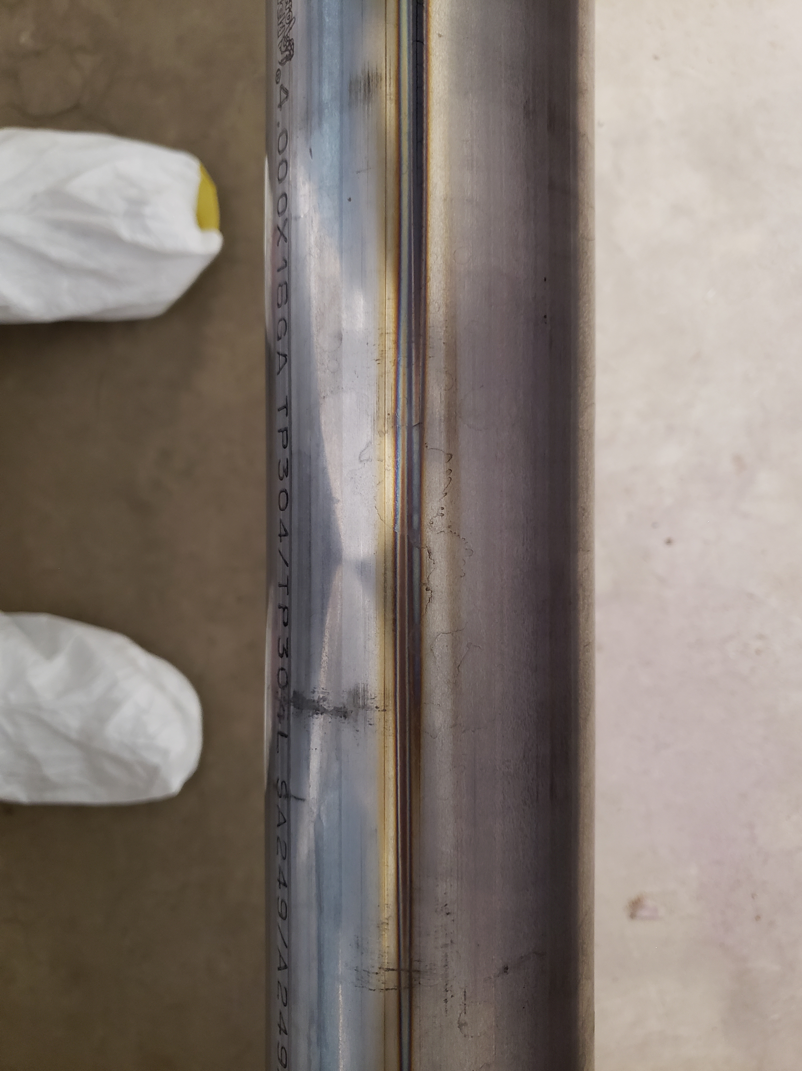
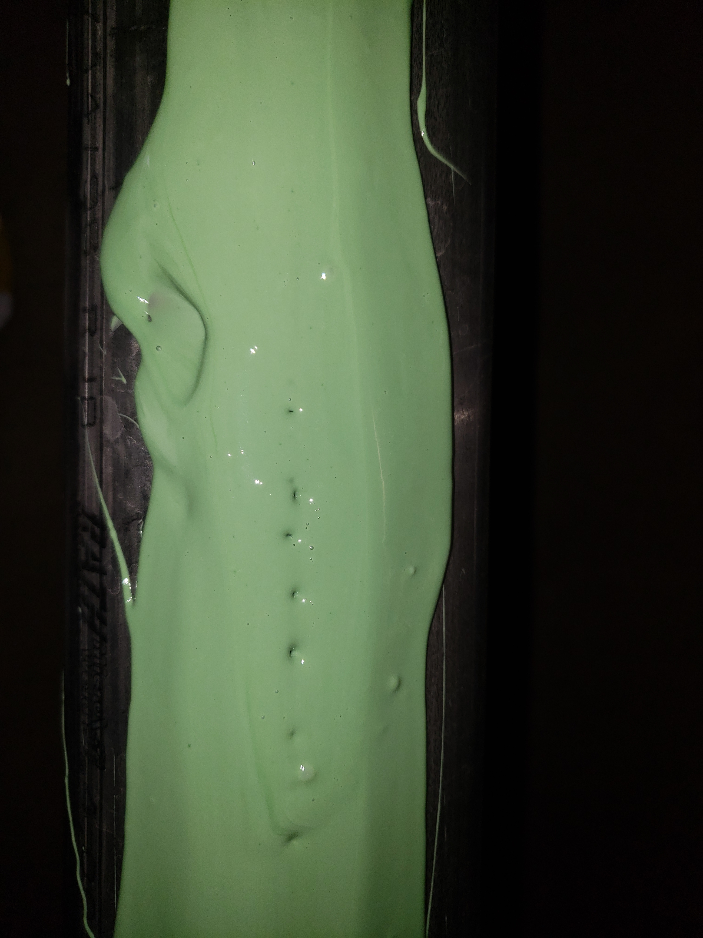
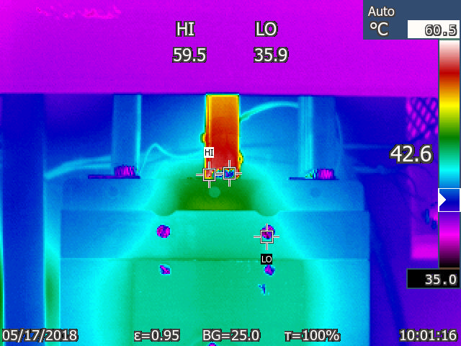
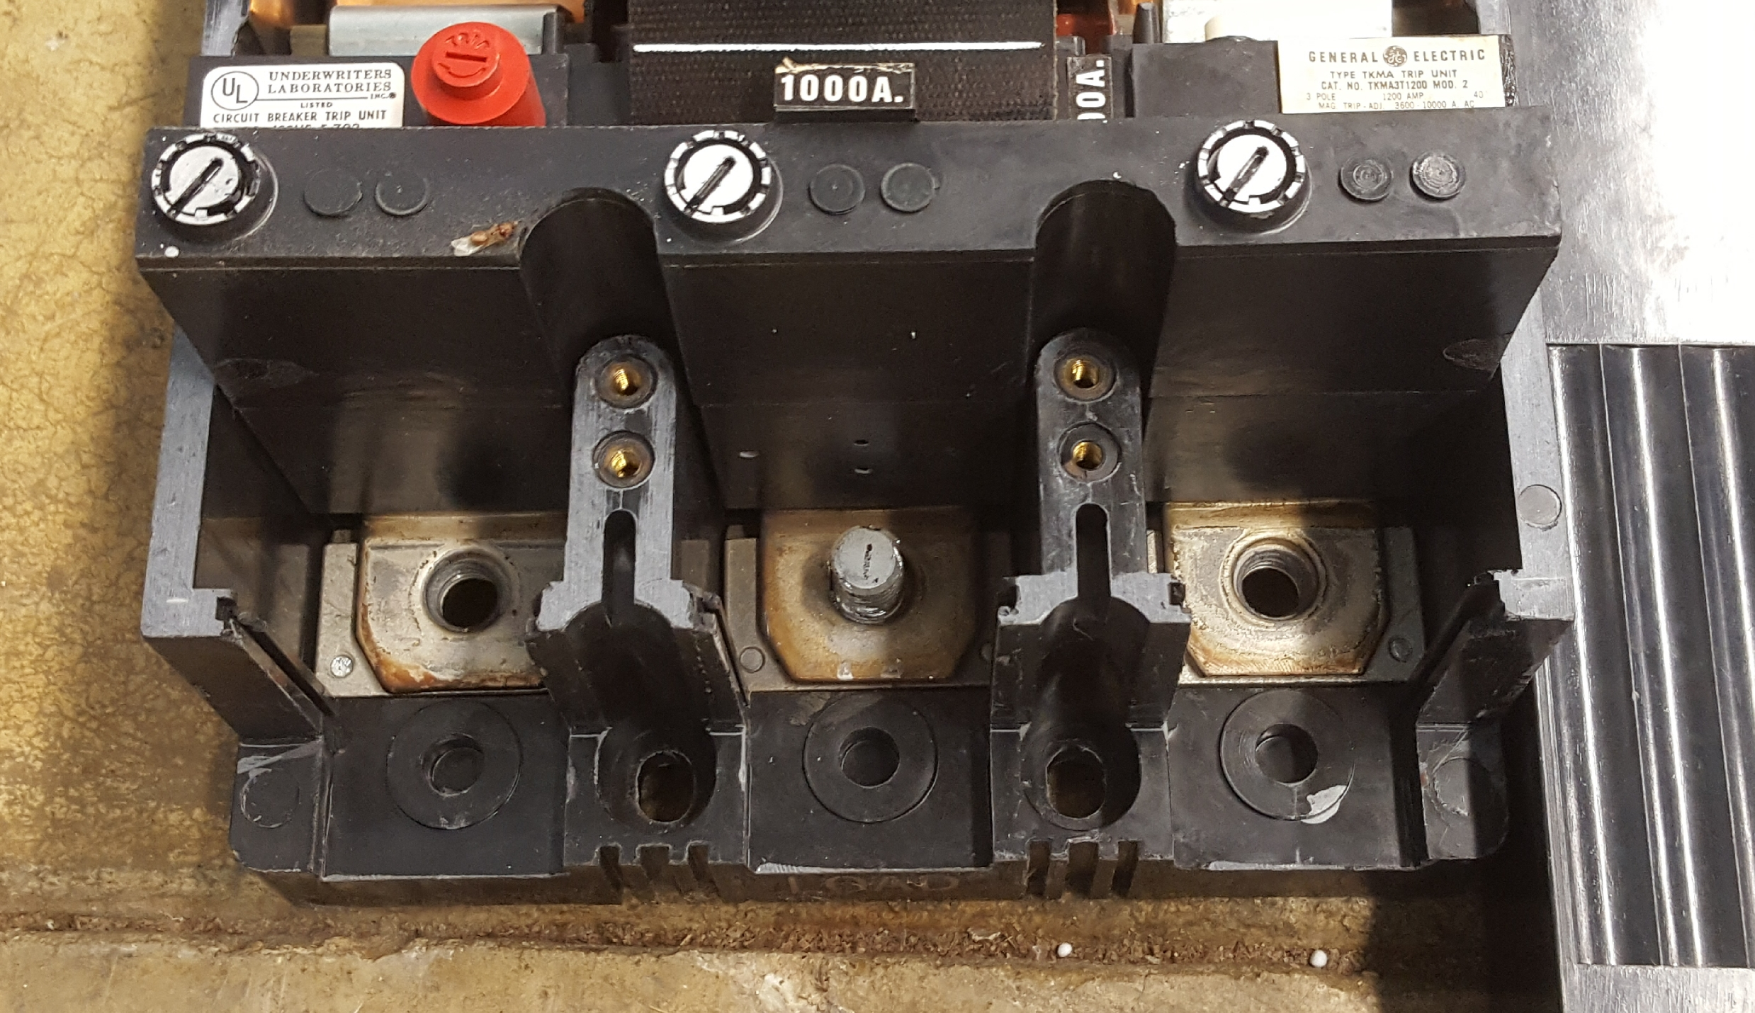
Complex Status
LINAC
  Klystron RF cooling skid controller repair
  LRF5 Marx connected
    Mod Surge resistor failed/replaced
Booster
  Tuning continues
  Fighting a bi-model loss pattern
MI/RR
  Tuning continues
  MI40 abort vacuum
    Leak found and epoxied
  LAM41 breaker inspection/repair
  LAM42 inductance measurement
NuMI
  Monitoring NuMI target (TA-02) helium leak

Slide 9
Complex Status
Booster Neutrino Beamline (BNB)
  Sump discharge line break
    Off much of Thursday
Switchyard
  Meson Test operating
Muon Campus
  G-2 not taking beam
    Kicker issues developed over the weekend
General
  Items on the horizon
    MI40 abort line spool-piece
    TLG reboot

Slide 10
PIP-II Injector Test & FAST/IOTA Status
PIP-II Injector Test
  Studies
    10mS pulse length
      5mA @ 20 Hz
      2.1 kW through the MEBT
      Working on stability
    High power beam studies scheduled through May 25th.
    Cryogenic Transfer Line (CTL) installation begins after studies.
FAST/IOTA
IOTA dipole LCW leak repaired
Transformer PMs scheduled for June 1st
  Lab B, E & F included
Bakeout of the injection lambertson continues
Cryo plant cooldown is scheduled to begin on June 15th. Beam operations are schedule to begin in July.

Slide 11
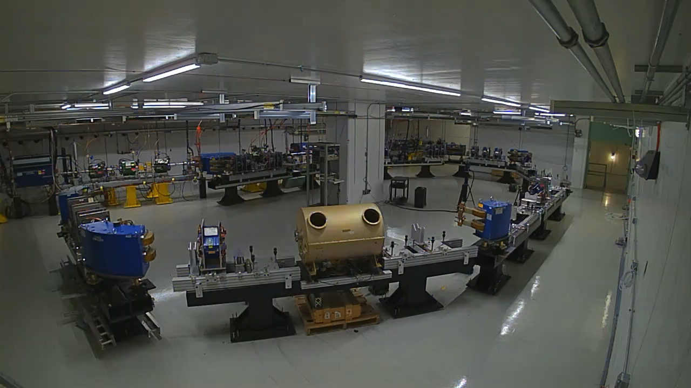

Slide 12
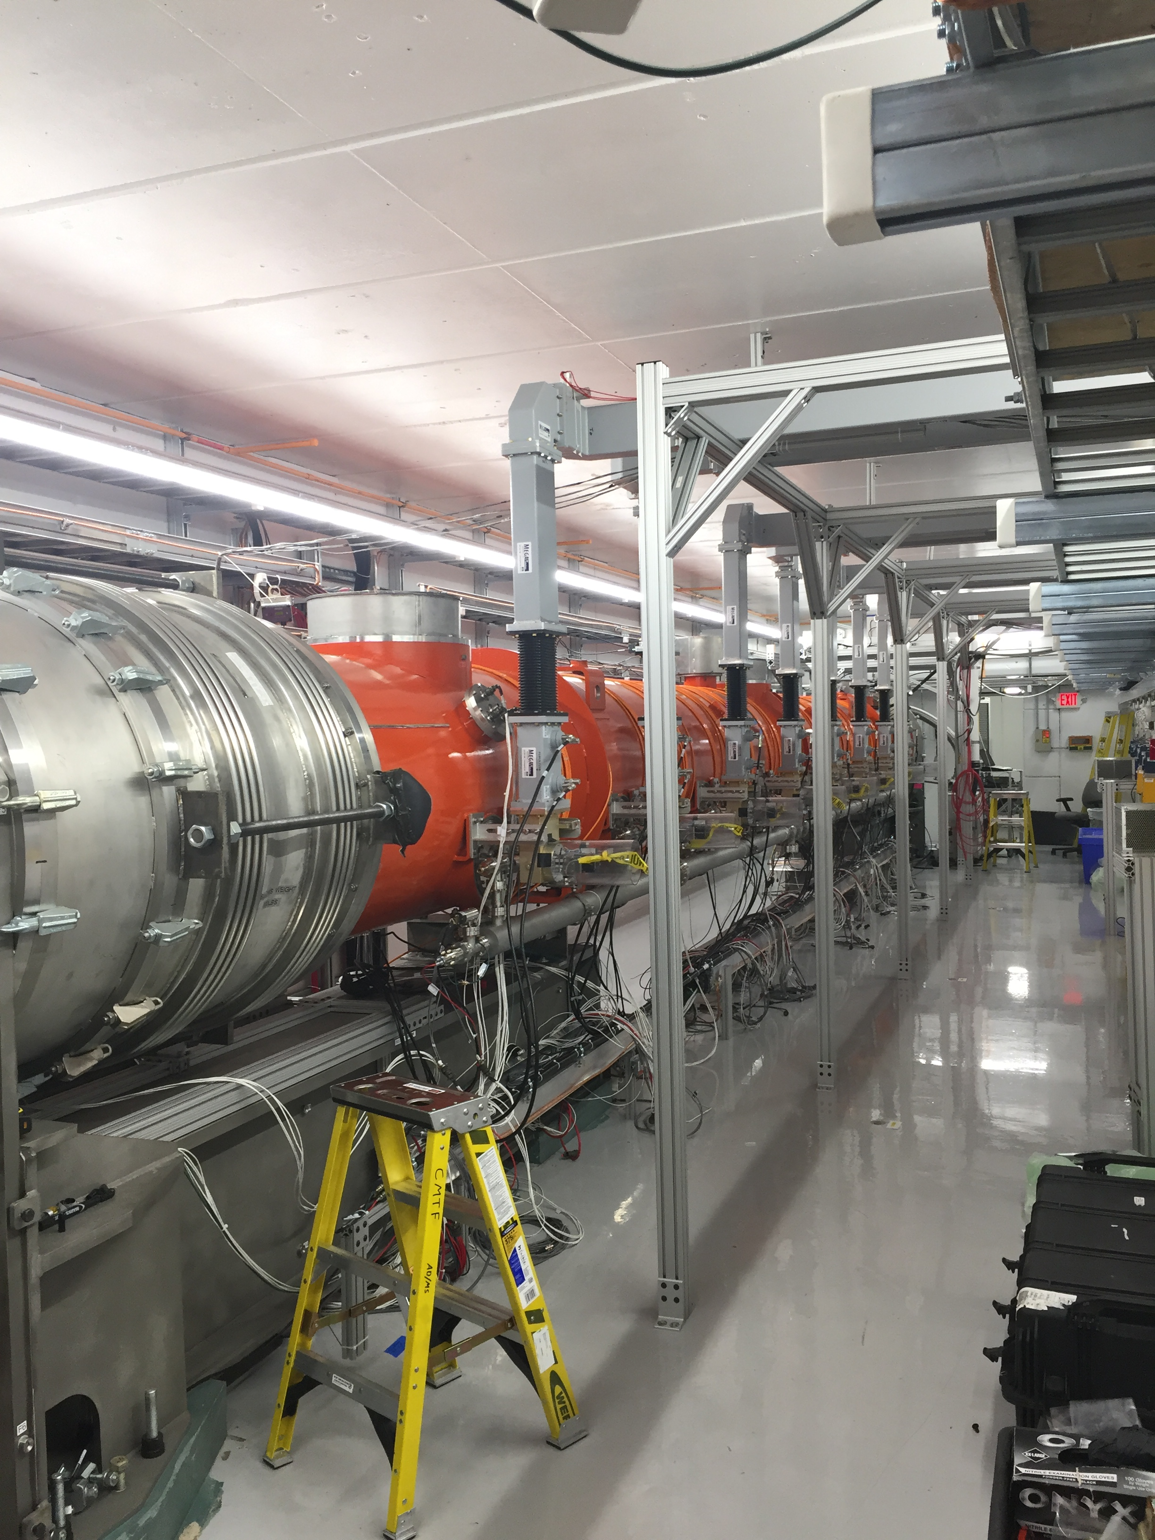
CMTS1 Status
LCLSII Cryomodule F1.3-09
  Module performed well
  Warmed Up
  Prepping for removal
Cryo plant repairs
  System began turn on last week
LCLSII Cryomodule F1.3-08
  Testing in June

Slide 13
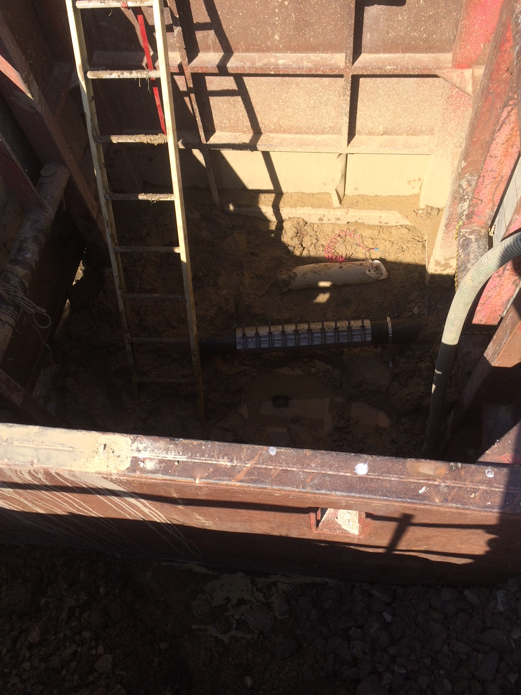
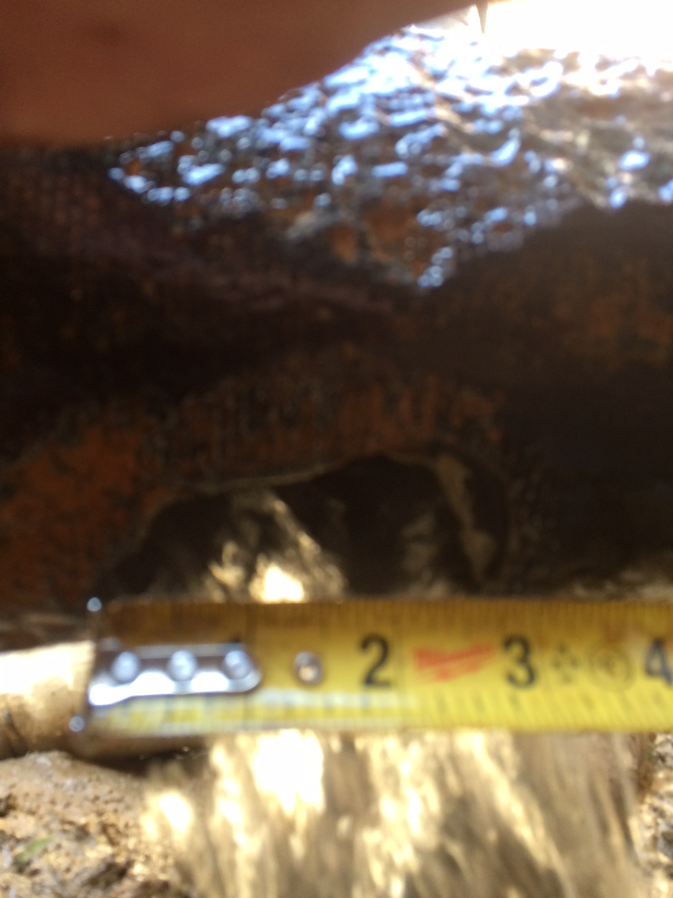
MI-8 Domestic Water Repair
Pipe looks a little rough
  3” hole
Repair clamp
Anode bag

Slide 14
Schedules and Links
Schedule can be accessed from the Operations Department Home Page
  Schedules -> Operations Schedule
Direct link to schedule
  http://www-ad.fnal.gov/ops/schedule.html

