Slide 1
NuMI Underground Report
Cindy Joe
AD 9:00 Meeting
May 18, 2018

Slide 2
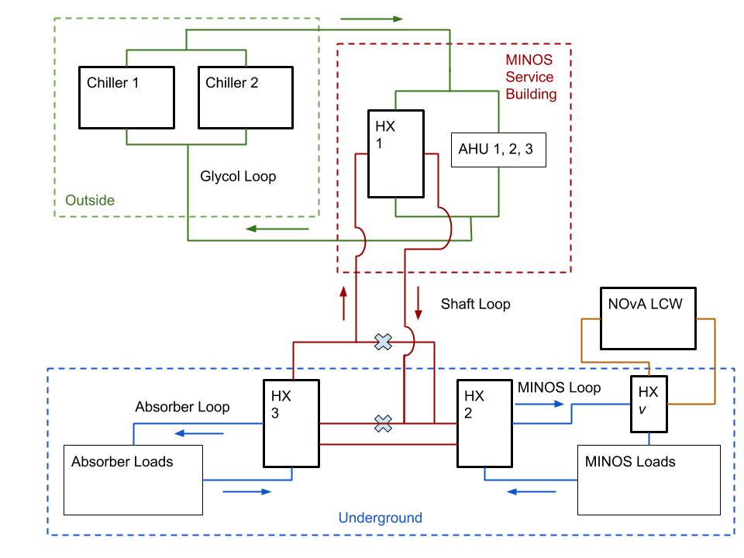
Chiller Cleaning, Temperature Problems (NOvA)

Slide 3
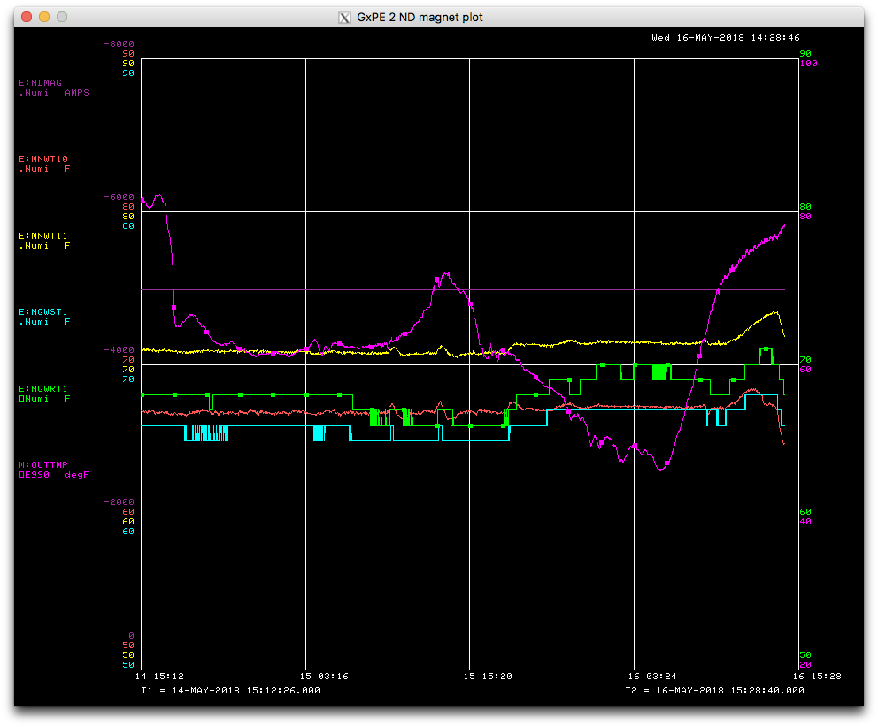
Chiller Cleaning, Temperature Problems (NOvA)
But we’re good now

Slide 4
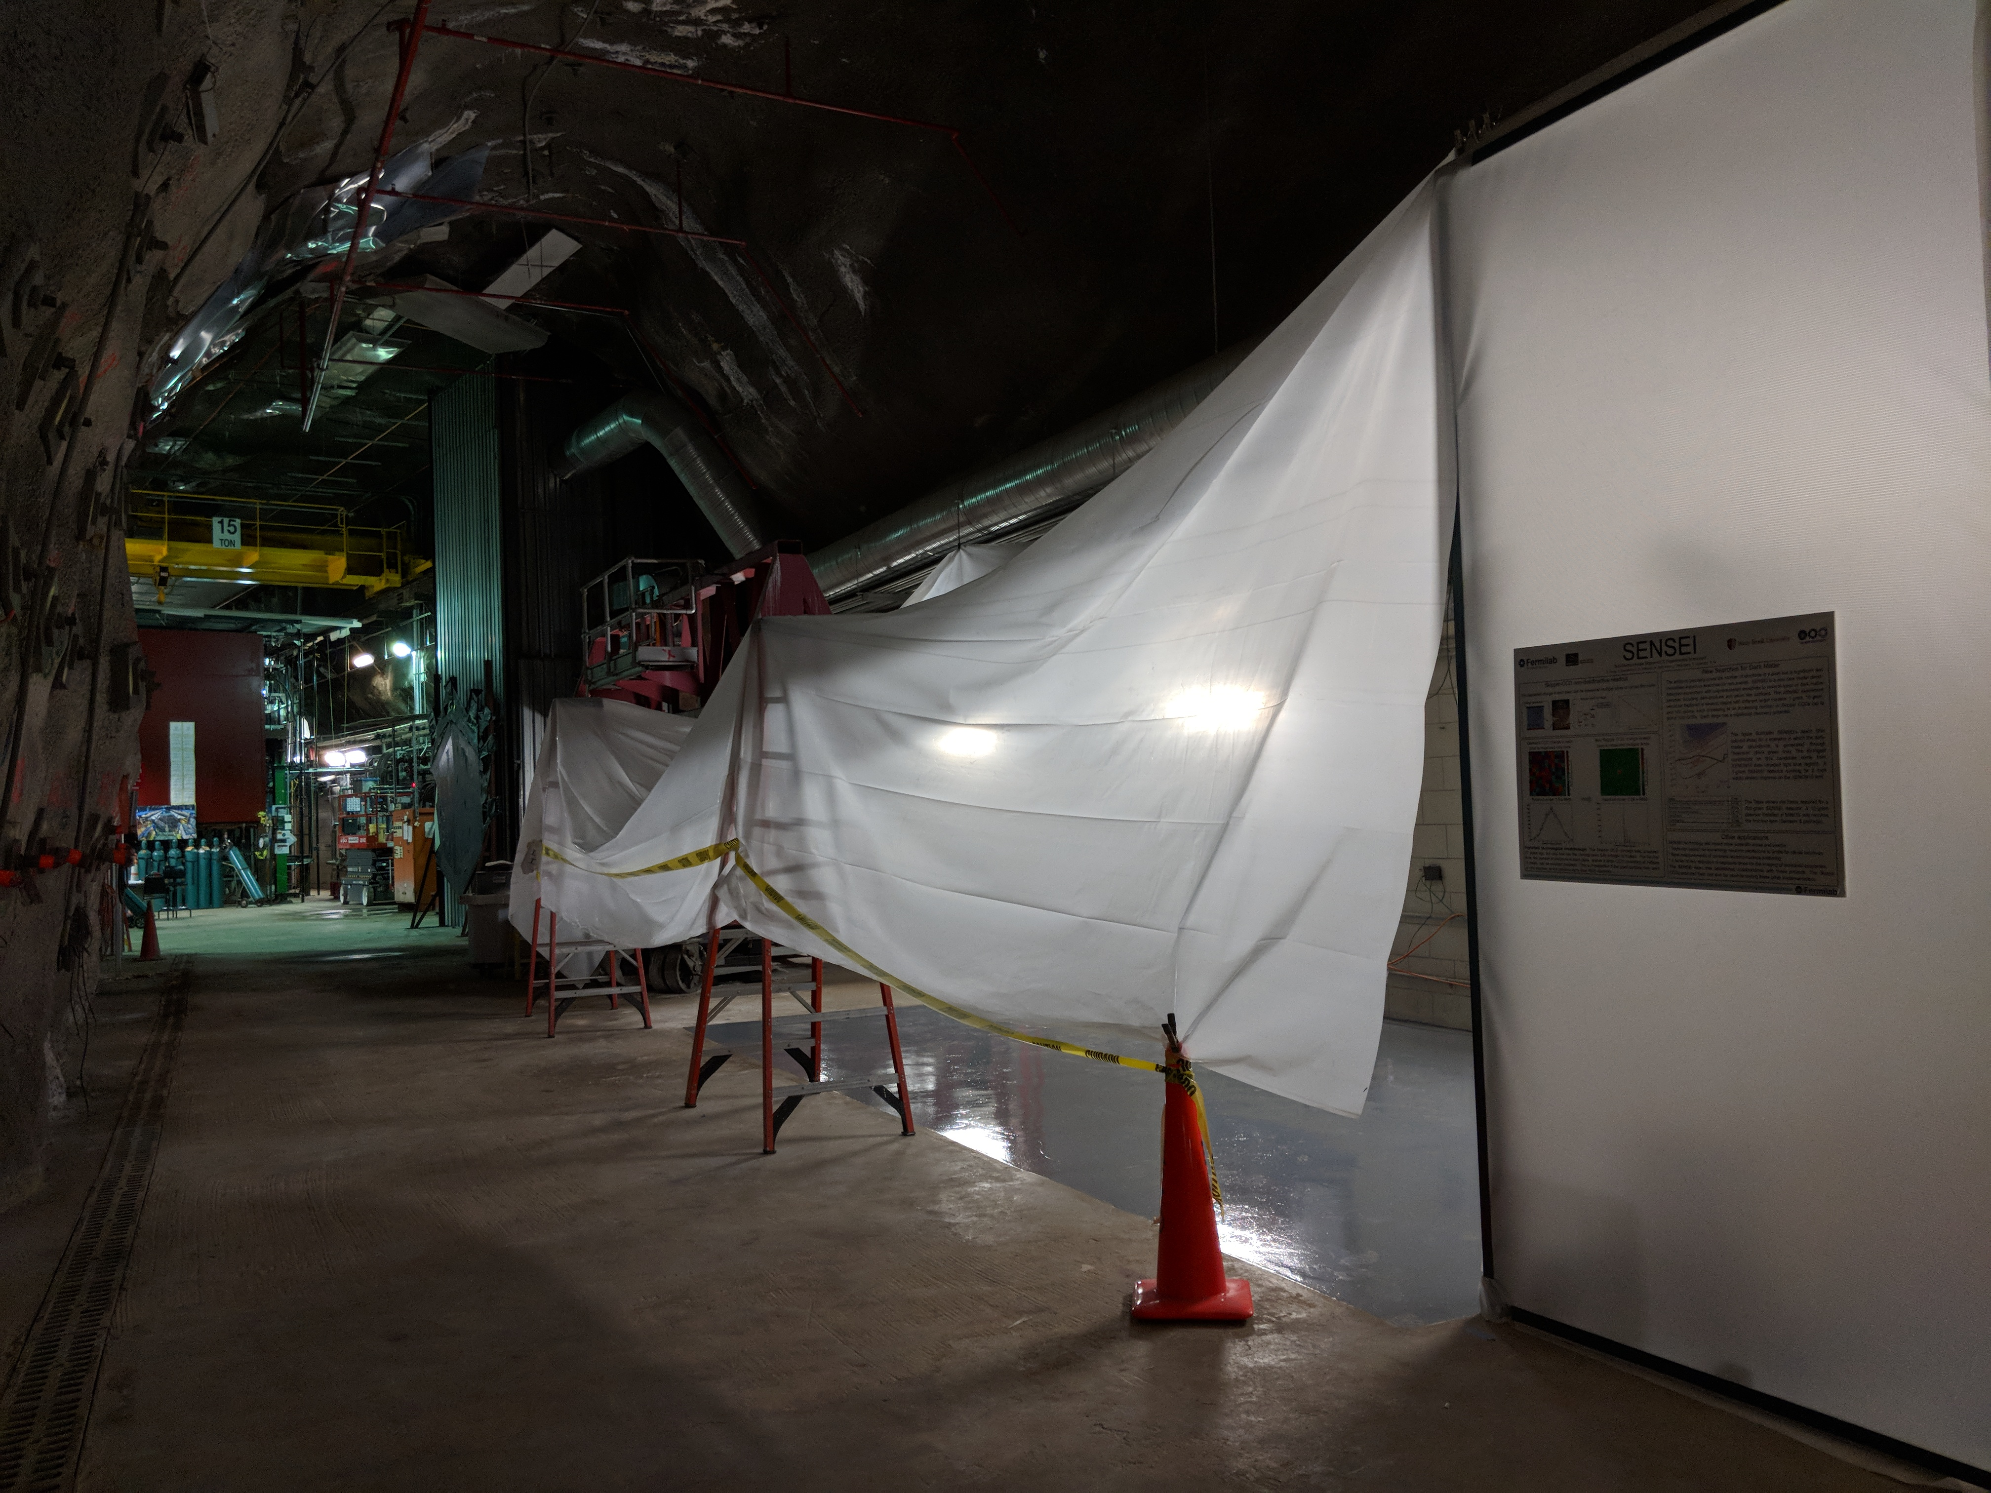
NEXUS Cleanroom Floor

Slide 5
Magnetometer Measurements in the Shaft
Good luck, Steve and Phil

Slide 6
And a Congressional Visit

