Slide 1
Friday 9:00
2018-05-18

Slide 2
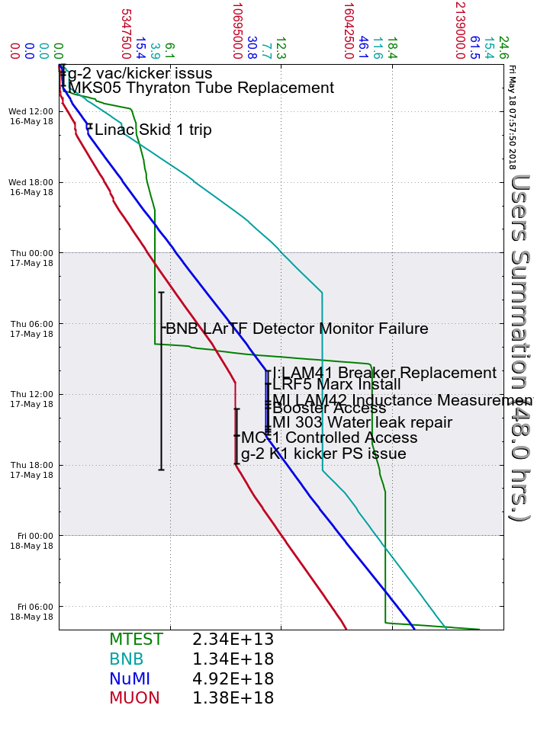
Wednesday
Established beam to g-2
Had issues switching back to 3GeV
MKS05 Investigation
Linac Klystron Skid #1 trip, replaced temperature sensor
I:LAM41 excessive 60Hz trips
Thursday
MicroBooNE Detector issues
I:LAM41 breaker replacement
MI Access to measure abort Lambertson inductances
Found & repaired water leak at 303
LRF5 Marx Install
Booster access to investigate MKS05
MS2 Cooling tower repairs and PLC updates
g-2 Kicker issues
NuMI beam by 15:30, g-2 by 17:56, MTest by 18:45
Booster bimodal losses
Current Conditions
Beam to NuMI, BNB, MTest and Muon
MI abort tune-up

