Slide 1
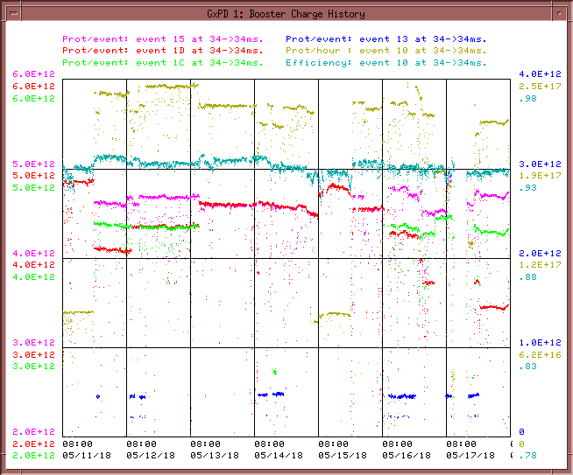
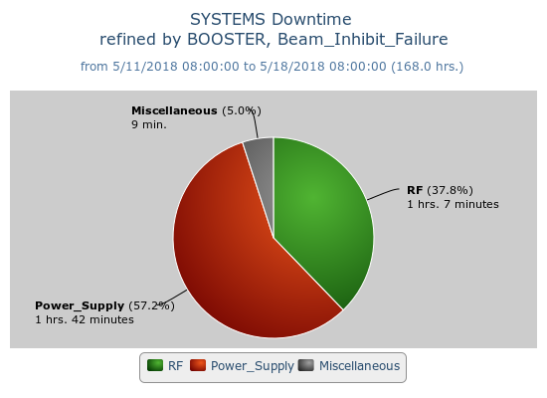
Booster Operations 5/11/18 – 5/18/18
F
T
F
F
Sa
Su
M
F
F
F
W
F
Sa
W
F
F
F
F
F
F
F
Sa
Su
Su
M
Tu
F
F
F
M
M
Su
M
Th
F
M
W
W
W
Th
Sa
W
F
F
Sa
Tu
F
Sa
F
F
Sa
Su
M
F
M
F
Sa
Su
M
Sa
Su
M
Tu
Th
Su
Su
Sa
Su
F
Sa
M
F
Sa
F
W
Su
W
F
M
W
Th
F
Sa
M
F
Sa
Su
W
Th
F
F
Su
W
F
Sa
Su
M
Tu
Sa
M
Su
M
M
W
Th
F
M
F
Su
M
W
Sa
Su
u
F
Sa
Th
Sa
M
W
F
Sa
Su
W
F
Su
M
BRF12 Yard Breaker
Capture/Transition Issues
Access to replace BRF16 Cavity
MKS05 Kicker
BRF8 Cable Fault
DOGL3 Flow Switch
MKS06 Cable Termi
Collimator Studies
Downtime:
~3hr.
MKS05 Thyratron swap (prefires)
BRF12 Yard breaker trip
MKS05 Thyratron Change
Scheduled shutdown
Scheduled shutdown
Studies this week:
New BPM Checkout with Pings
This week:
Currently $15 ~4.74E12 93%, $1C ~4.32E12 93%, $1D ~3.65 E12 94%, $13 ~4.6E11 91%.
Looked into extraction losses starting earlier Monday morning (traced to kicker), also looking at bimodal loss related to GMPS possibly.
Opportunistic access Tuesday, BRF20 DS gap monitor replaced. Tunnel tour. Short 1 chipmonk replaced due to 3 trips on failsafe voltage.
Wednesday Replaced MKS05 Thyratron but then Tracked down pre-fire problem with MKS05 causing extraction loss. Bad trigger driver channel was seeing noise spikes.
Opportunistic access Thursday, inspected 5-1 GMPS girder for loose connections that might contribute to intermittent regulation problem we have been chasing down. Retimed extraction kickers for new trigger driver card during Marx work.

