Slide 1
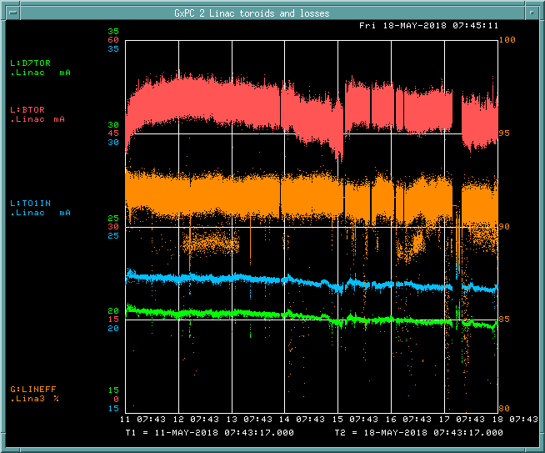
PREACC/LINAC Weekly Performance (May 11 – May 18, 2018)
BTOR: 48.8mA
TO1IN: 22.1 mA
D7TOR: 20.2 mA
LINAC efficiency:
90.9%

Slide 2
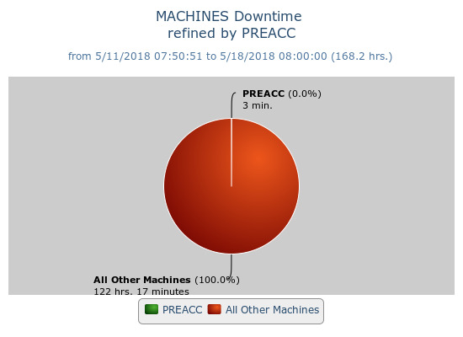
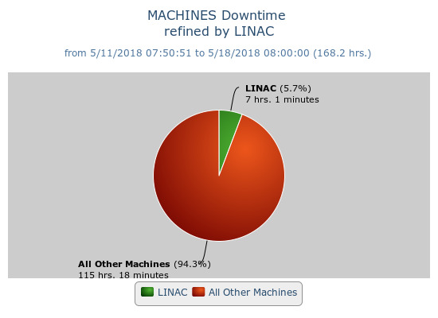
Beam inhibit downtime PREACC: (3min)
LINAC: (7 hr 1min)
Issues
Klystron skid #1 tripped at over temperature. (May 14 & 16)
→ Replaced temperature monitor on supply.
Switched to Marx modulator on LRF5 (May 17)

