Slide 1
Muon Campus Status
Jim Morgan
Weekly Status
May 18, 2018

Slide 2
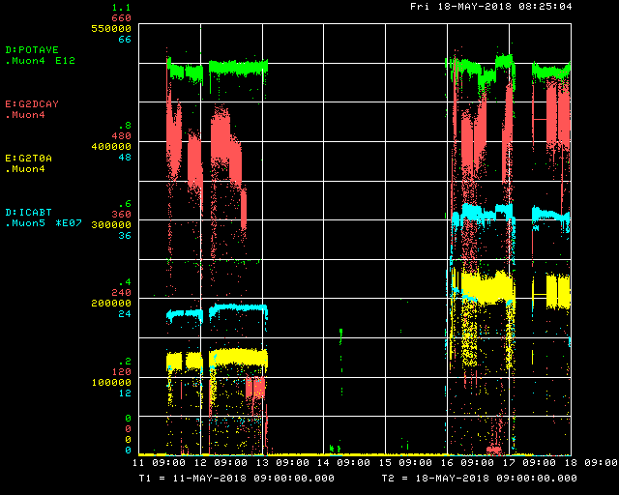
Beam to g-2 this week
Beam from Recycler
g-2 Kicker repair and recovery
Decay Positrons
g-2 quad problems
g-2 kicker problems
Congressional Tour
I:LAM41 & MI access
MI Abort Vacuum
Trolley Run
Trolley Run
MI Abort Vacuum
g-2 kicker
Delivery Ring
g-2 kicker problems
Momentum Scrapers
retracted
Accelerator
Studies
g-2 T0 Detector

Slide 3
In the past week
Down three days due to g-2 kicker repair
Accelerator studies on Monday
RR to Target dispersion measurements
Development of 3.1 GeV to 8 GeV mode changes
Second day of studies planned, but MI abort vacuum access occurred
Work on EKIK due to thyratron prefire trips
Thyratron pre-trigger circuit modified
All kickers added to permit loop to inhibit beam when they trip
I:HVF11 has significant 180 Hz ripple
Still trying to get experts significant time to troubleshoot
Some vacuum issues in Delivery Ring
BV209 has worsening leak each time it’s cycled
Working on getting more g-2 parameters into ACNET

Slide 4
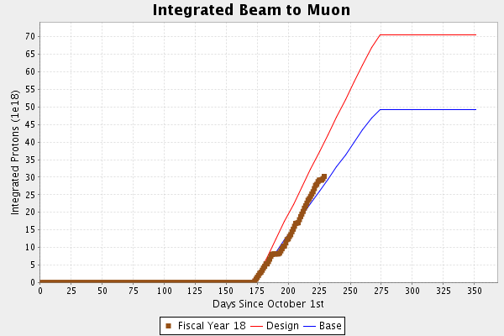
Protons on Target

Slide 5
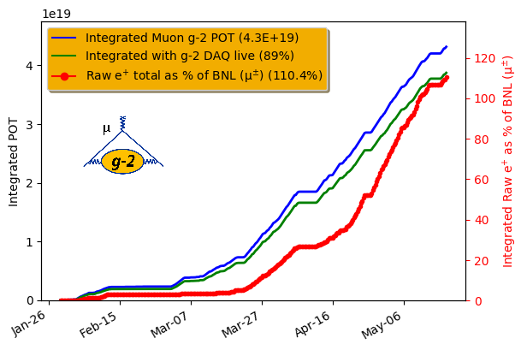
G-2 Experiment summary
101.6% Last Friday

Slide 6
Plan
Primary short-term goal is to concentrate on maximizing g-2 data taking with existing rate of muon delivery
Accelerator studies will be parasitic or coordinated with experiment downtime
Maximize up-time, accesses only for repairs
Parasitic studies
Understanding and mitigating lower efficiency cycles after SY120 (improved)
Improving yield from Target Station (without turning up lithium lens)
General tuning to maintain or improve current muon delivery
More destructive studies
Dispersion measurement in primary beamlines (Done)
Software improvements for mode changing between 3.1 GeV and 8 GeV
Delivery Ring 8 GeV proton tune measurement
“Straight-through” muon storage studies to quantify Delivery Ring efficiency
Beam intensity to end of M5 with 1, 2, 3 & 4 turns in the Delivery Ring
3 turn proton removal

Slide 7
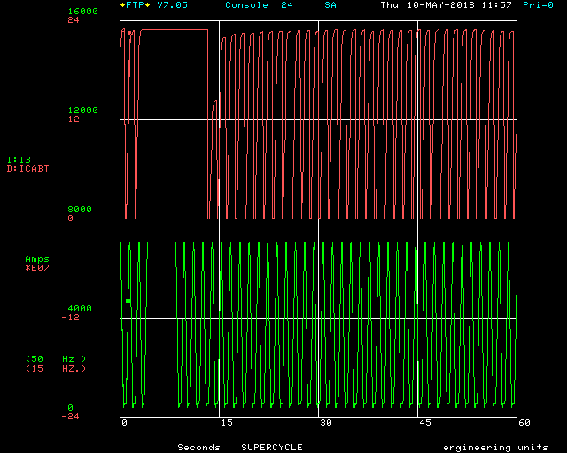
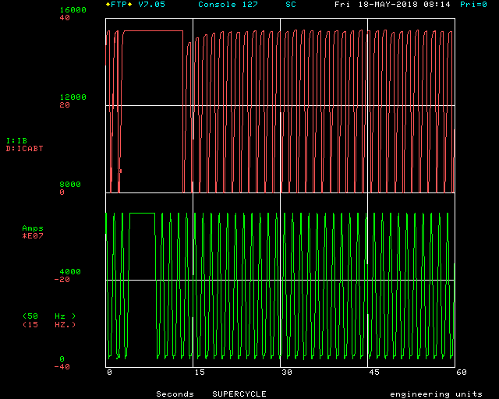
SY120 Effect before and after M:HT107A ramp fixed
SY120
SY120

