Slide 1
Main Injector/Recycler
D. Capista
Friday Operations Meeting
18 May 2018

Slide 2
NuMI Performance

Slide 3
Muon Performance

Slide 4
SY Performance

Slide 5
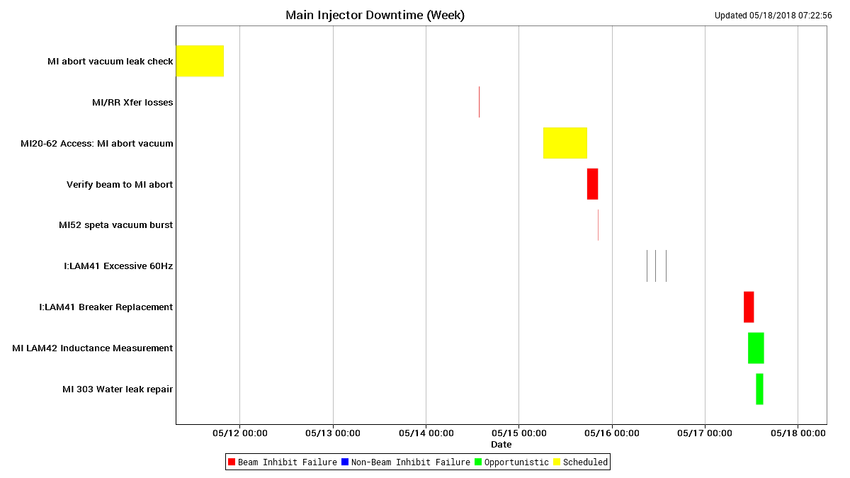
Downtime MI

Slide 6
Downtime RR

Slide 7
Abort Vacuum and Losses

Slide 8
Abort Vacuum and Losses

Slide 9
Abort Vacuum and Losses

Slide 10
Abort Vacuum and Losses

Slide 11
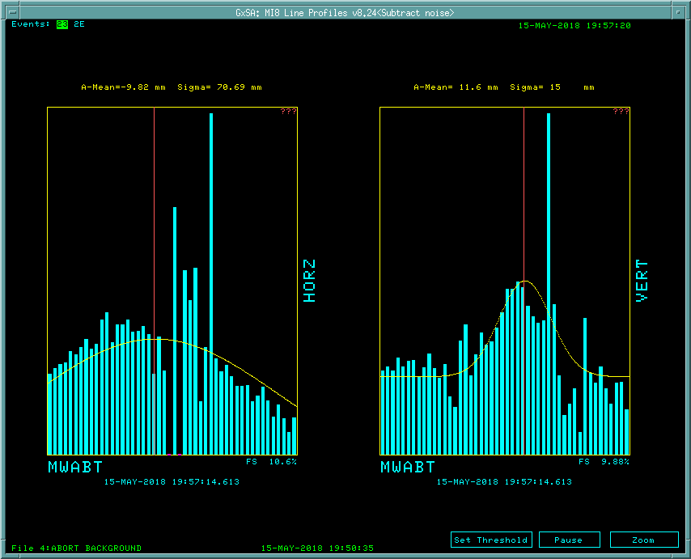
Abort Vacuum and Losses
After 100A increase
On LAM42 (abort Lambertson)
120 Gev Abort As found

Slide 12
Abort Times and Frequency

Slide 13
Next Week
Studies
1.2 sec fast ramp.
MI TBT lattice measurement
8-GeV.
Use $2B ramped 1.67 second cycle.
RR TBT lattice measurement
MI abort vs. energy
Vacuum issues
MI52 septa
Mostly good, a few vacuum spikes
Abort line vacuum
Need to replace beam pipe

